Slide 1
Supplemental Material – Original Blots
Relevant areas for cropped blots in the main and Extended Data figures are shown with a dashed box.

Slide 2
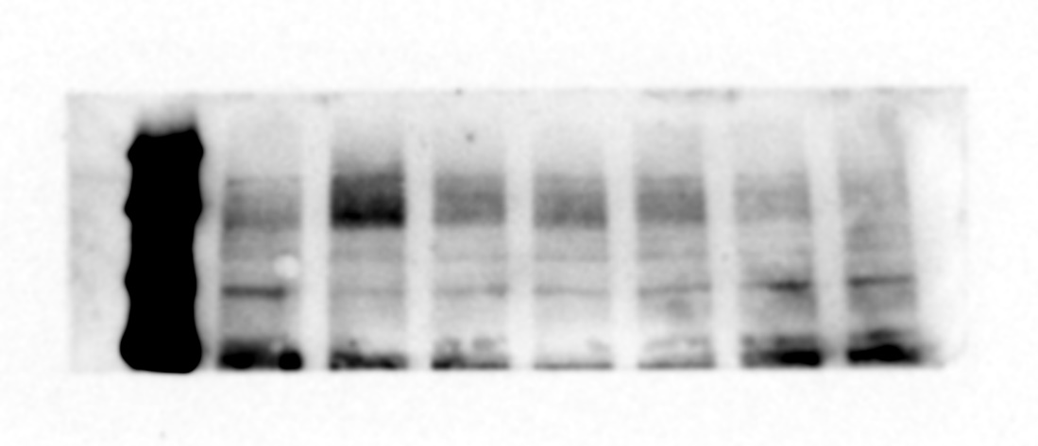
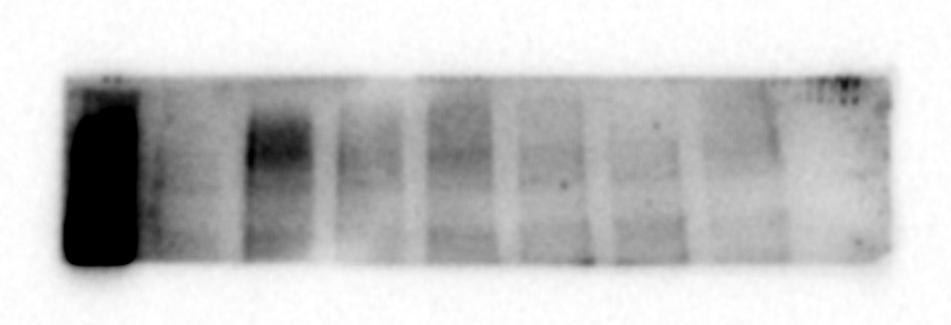
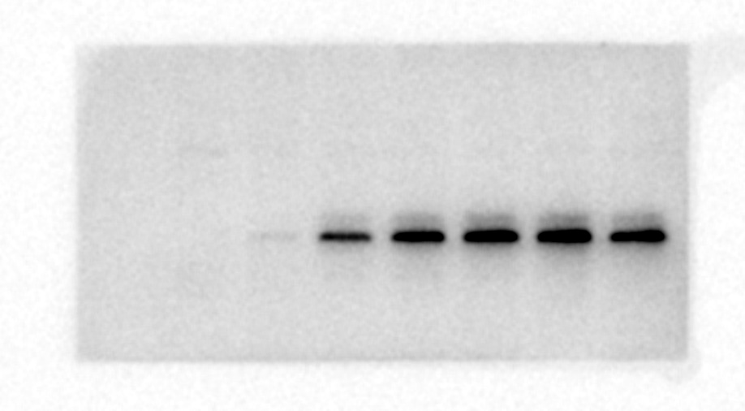
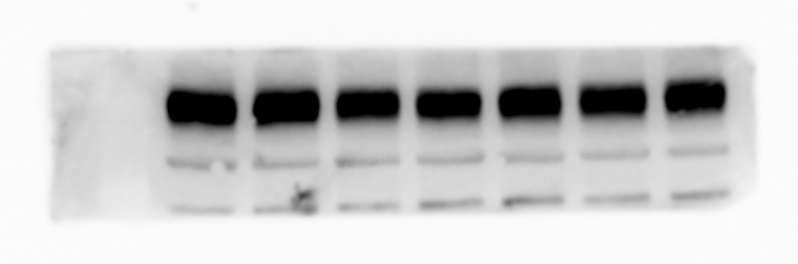
Supplemental Material to Fig 1 (original blots)
PARP1 and PARylation are dynamic in (A) C2C12 and (B) LHCN-M2
A
B
140
140
PAR
100
PAR
120
70
140
140
PARP1
100
PARP1
35
35
MYOG
MYOG
50
Tubulin
50
Tubulin

Slide 3
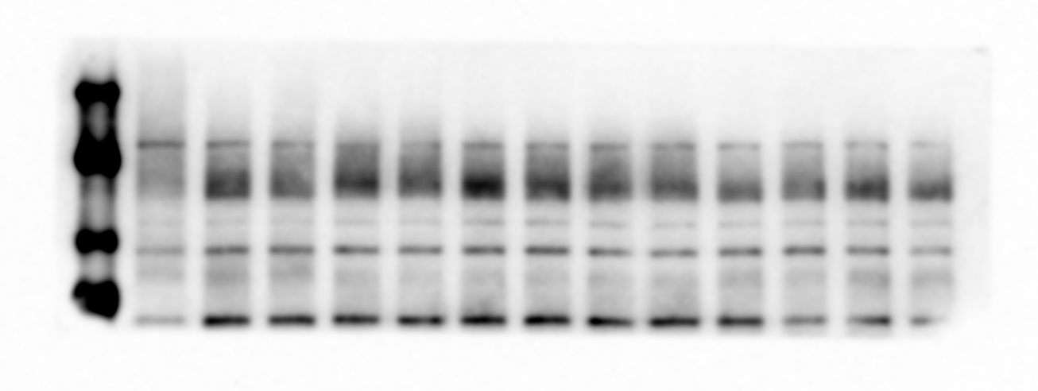
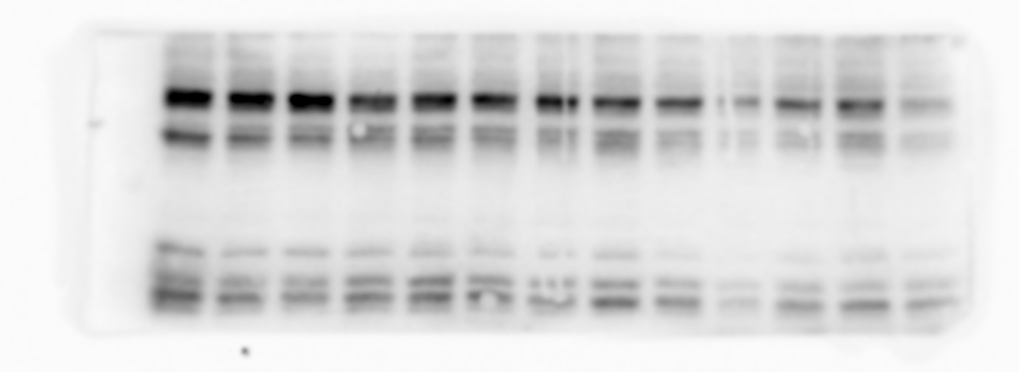
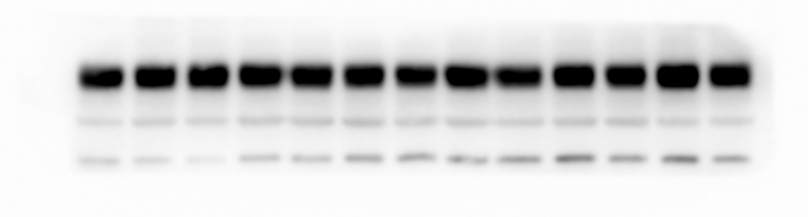
Supplemental Material to Fig 2a (original blots)
PARP1 and PARylation are metabolically sensitive
(A) NR treatment
140
PAR
100
70
140
100
PARP1
50
MYOD
35
50
Tubulin

Slide 4
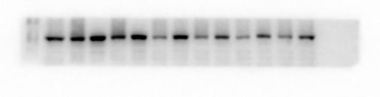
Supplemental Material to Fig 2b (original blots)
PARP1 and PARylation are metabolically sensitive
(B) FK866 treatment
140
PAR
100
70
140
100
PARP1
50
TNNT1
35
50
Tubulin

Slide 5
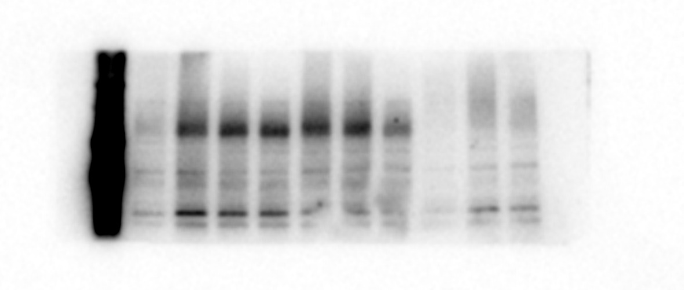
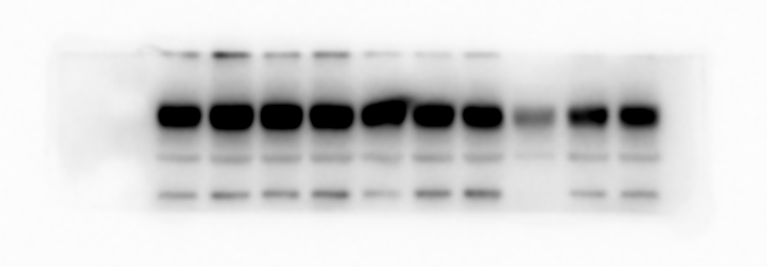
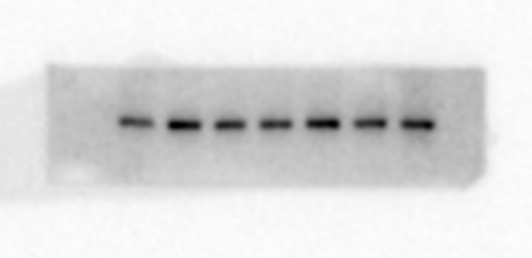
Supplemental Material to Fig 2c (original blots)
PARP1 and PARylation are metabolically sensitive
(C) Glucose deprivation
140
100
PAR
70
140
100
PARP1
50
Tubulin
100
HKII ^
^ HKII was only blotted on day 0 , day 1 and day 3 glucose deprived lysates. This is because cell death was observed on glucose deprived lysates by day 6 of myogenesis and was hence omitted from HKII blotting.

Slide 6
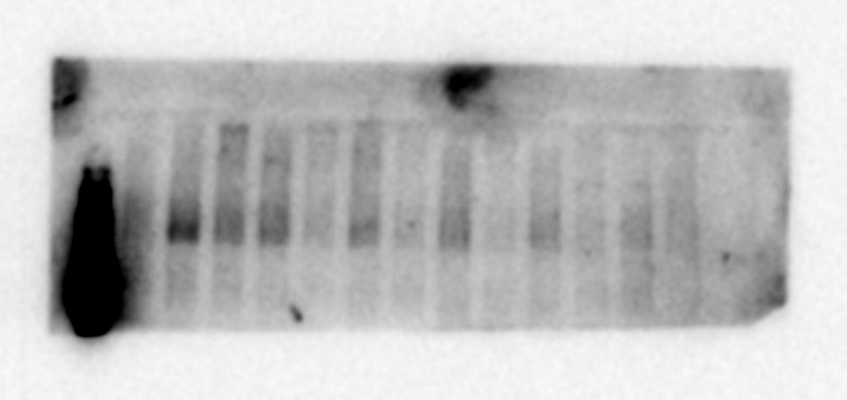
Supplemental Material to Fig 2d (original blots)
PARP1 and PARylation are metabolically sensitive
(D) Dexamethasone treatment
140
PAR
100
70
140
100
PARP1
35
Myogenin
50
Tubulin

Slide 7
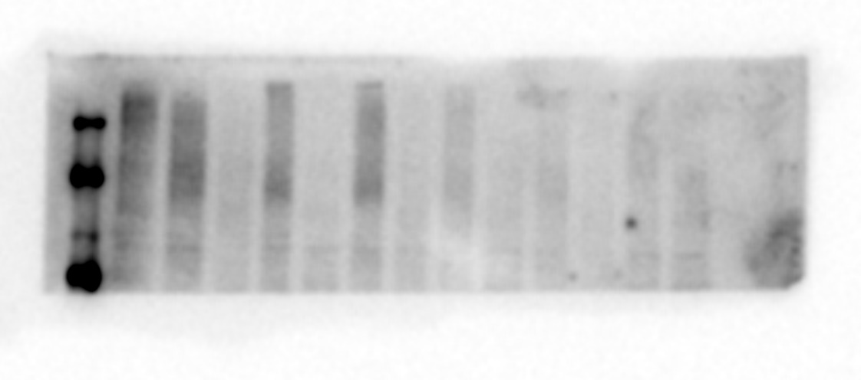
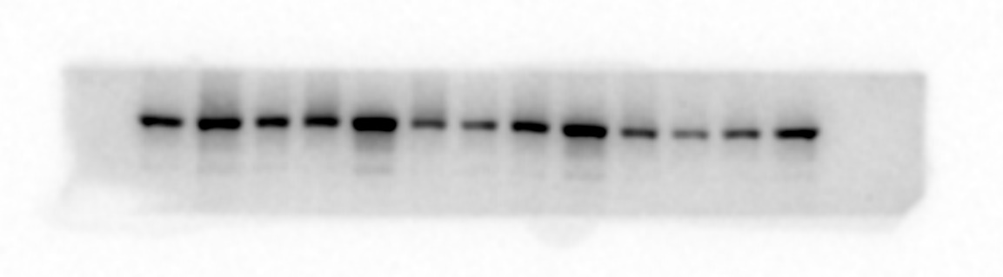
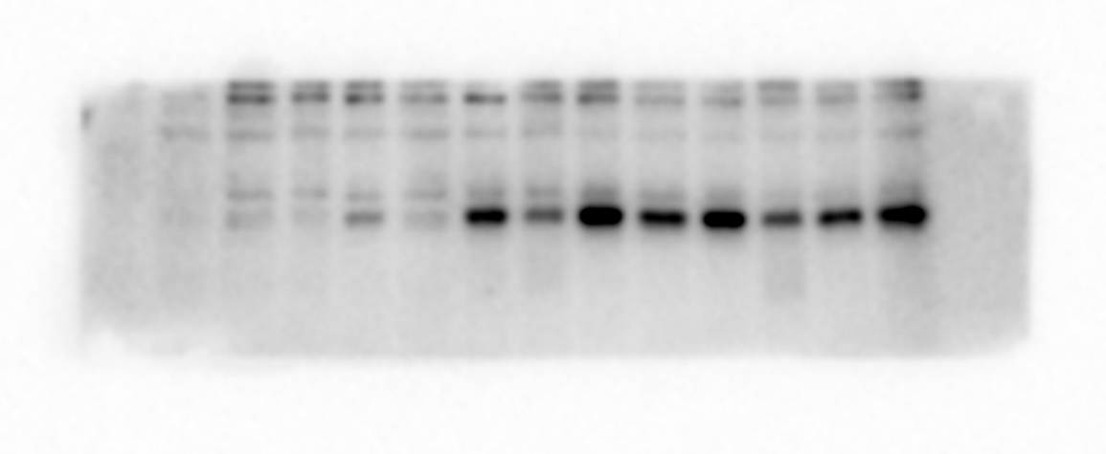
Supplemental Material to Fig 2e (original blots)
PARP1 and PARylation are metabolically sensitive
(E) Synergistic r/s between PARP inhibition and Dex treatment
140
PAR
100
70
140
100
PARP1
35
Myogenin
50
Tubulin

Slide 8
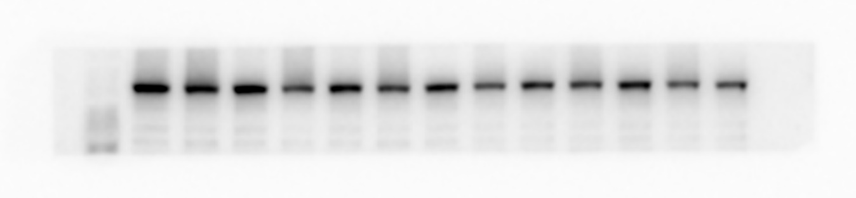
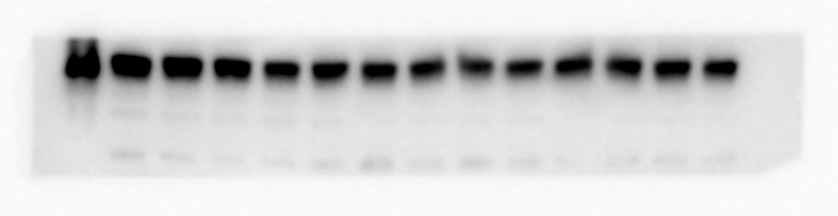
Supplemental Material to Fig 3a (original blots)
Modulation of PARylation during myogenesis.
PJ34 inhibition during differentiation (A) C2C12
140
PAR
100
70
140
100
PARP1
25
Troponin-1
50
Tubulin

Slide 9
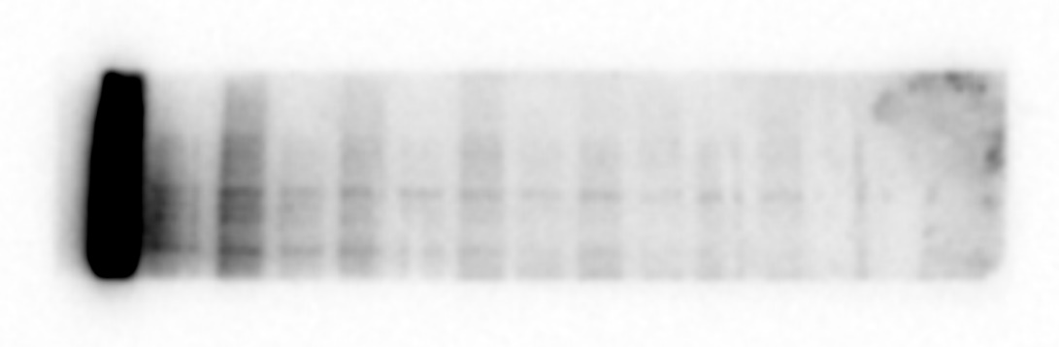
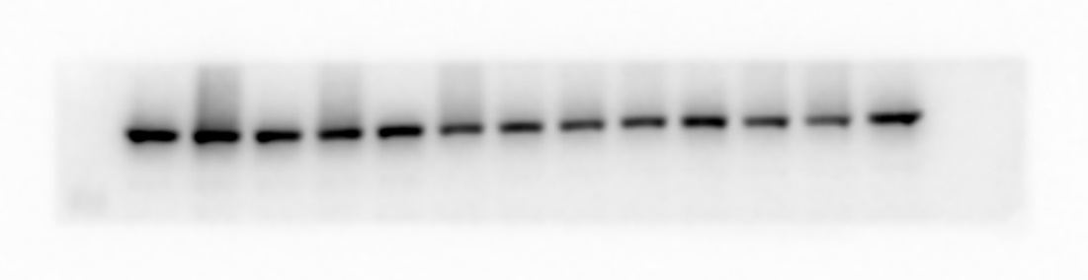
Supplemental Material to Fig 3b (original blots)
Modulation of PARylation during myogenesis.
PJ34 inhibition during differentiation (B) LHCN-M2
140
100
PAR
70
140
100
PARP1
25
Troponin-1
50
Tubulin

Slide 10
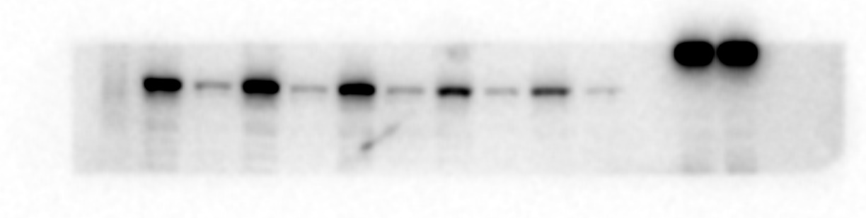
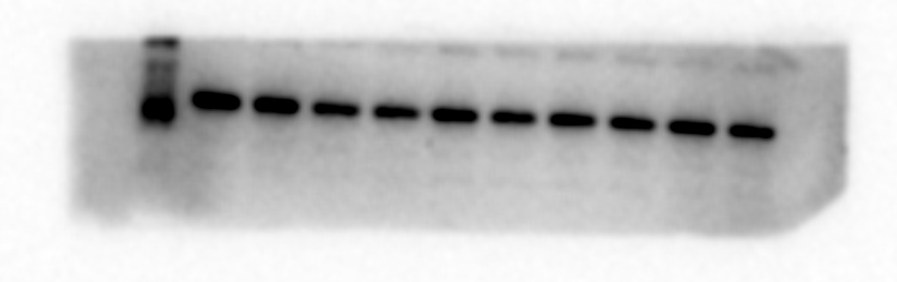
Supplemental Material to Fig 6 (original blots)
siPARP1
140
100
PARP1
50
Tubulin

