Slide 1
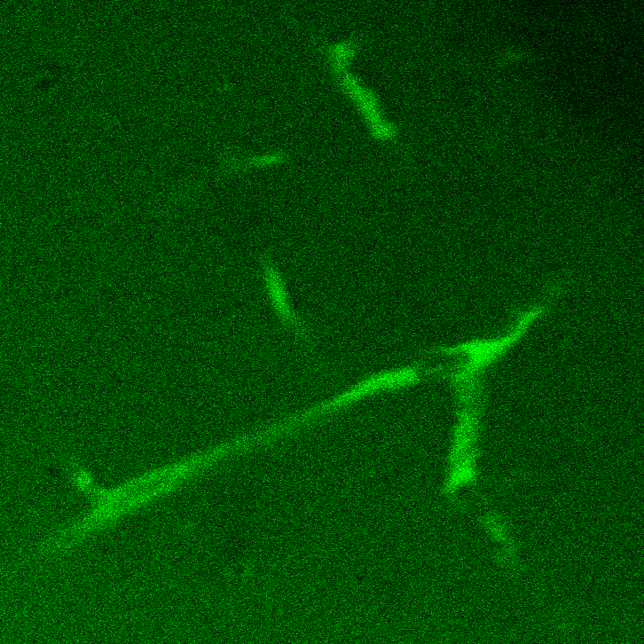
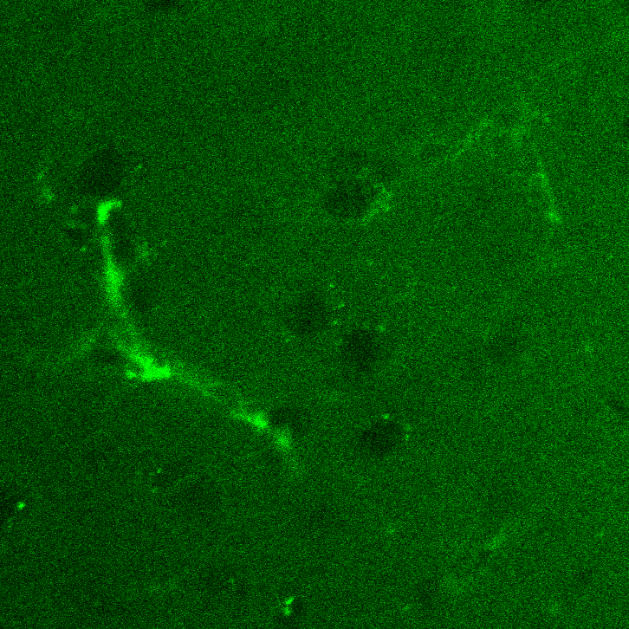
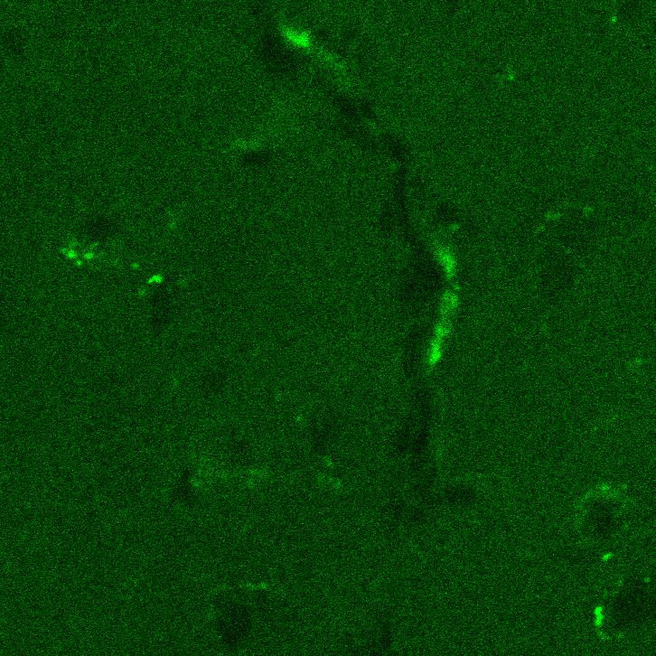
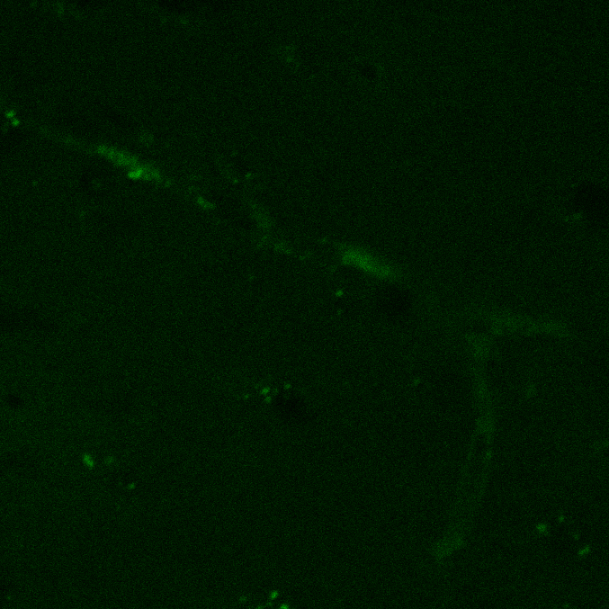
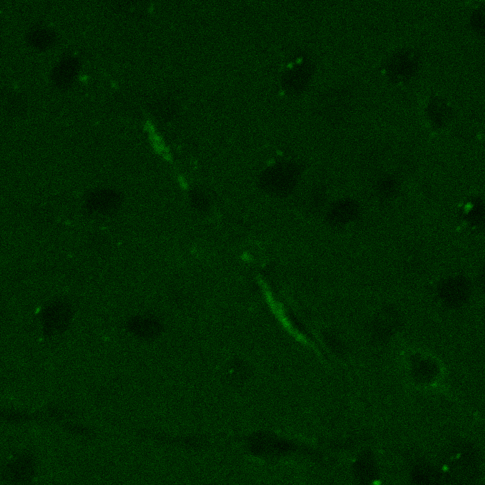
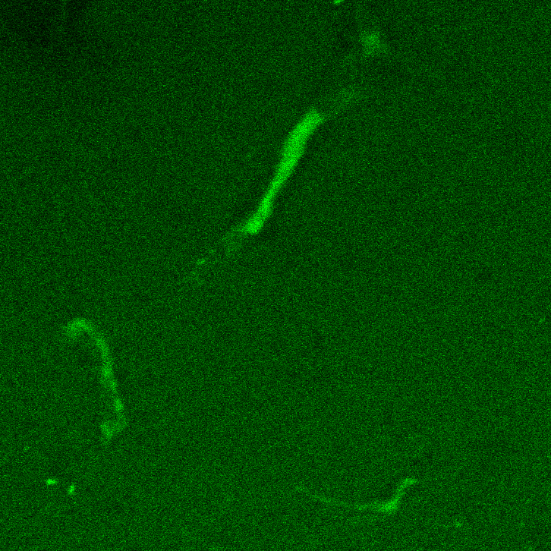
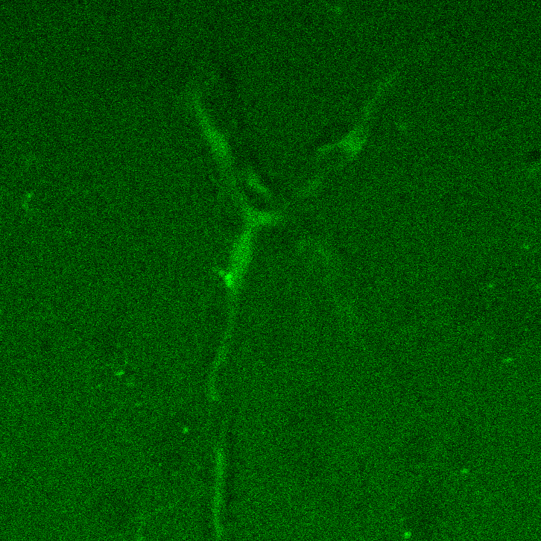
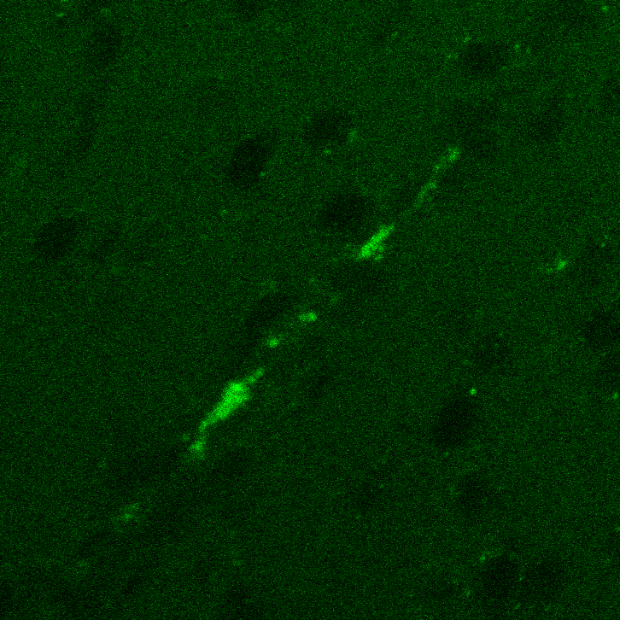
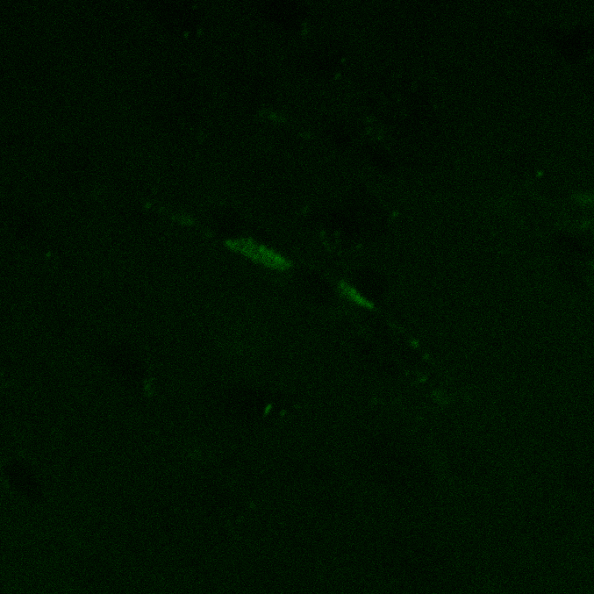
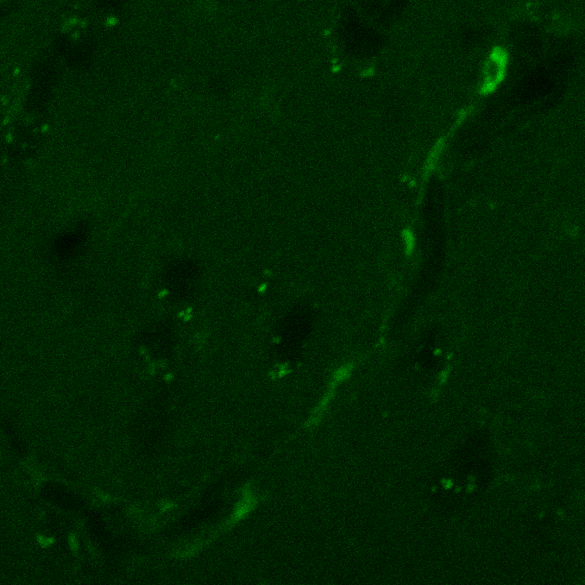
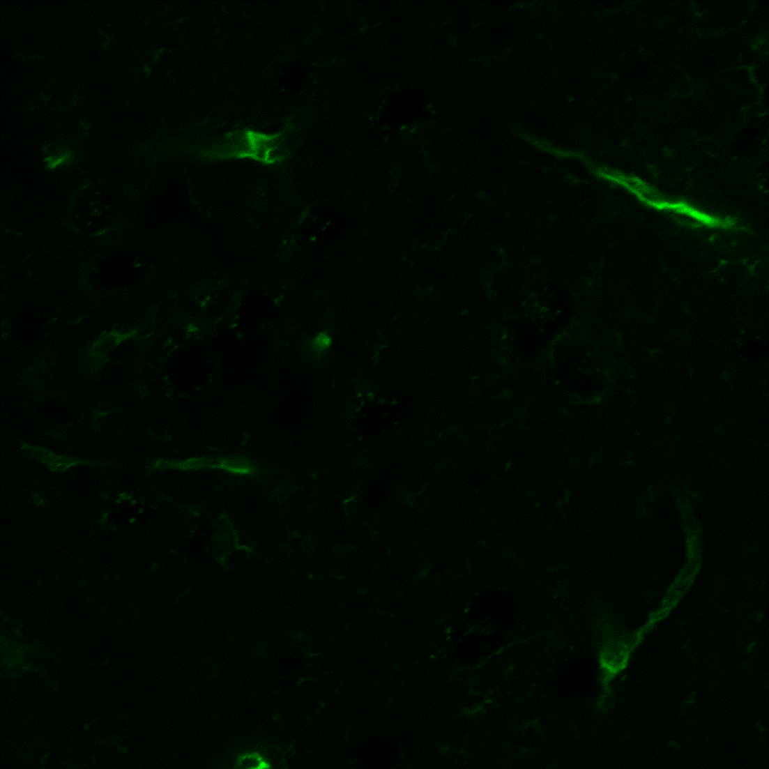
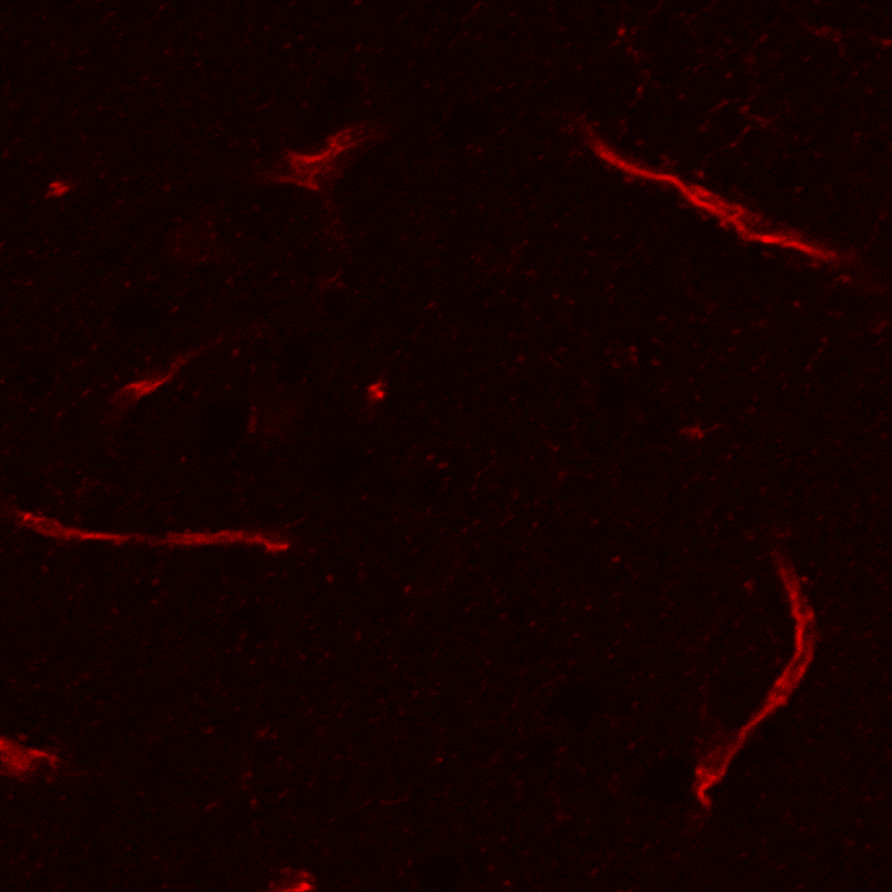
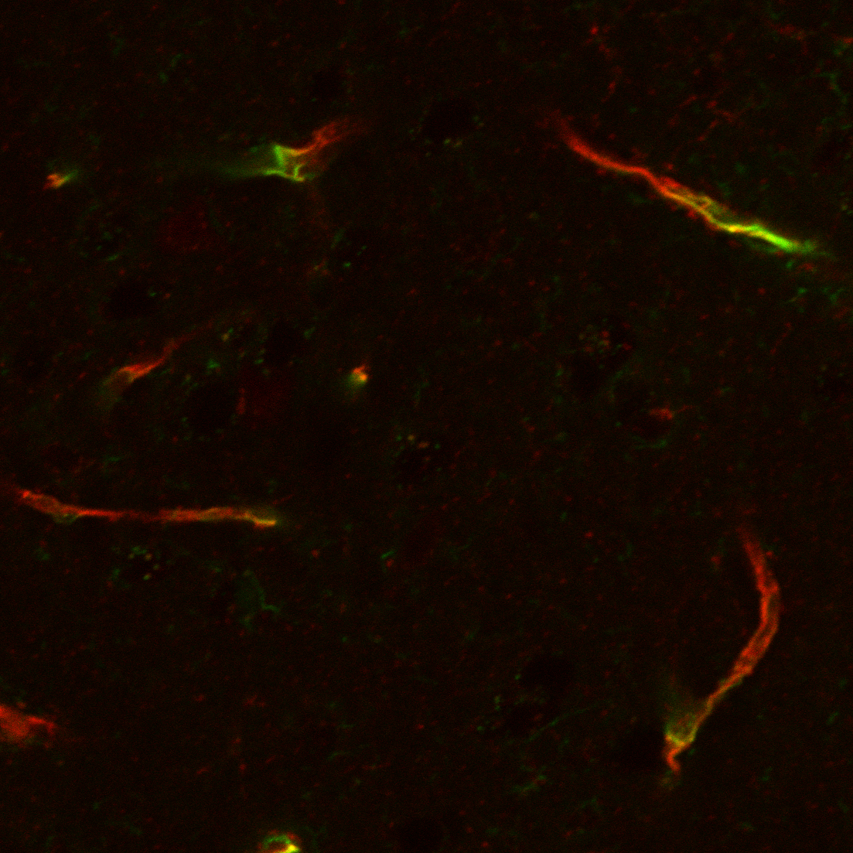
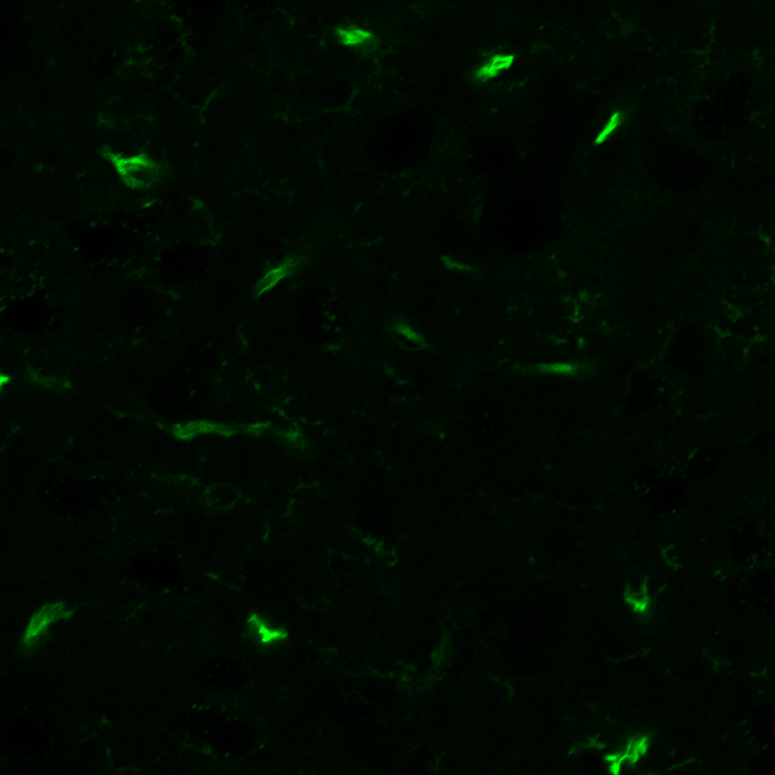
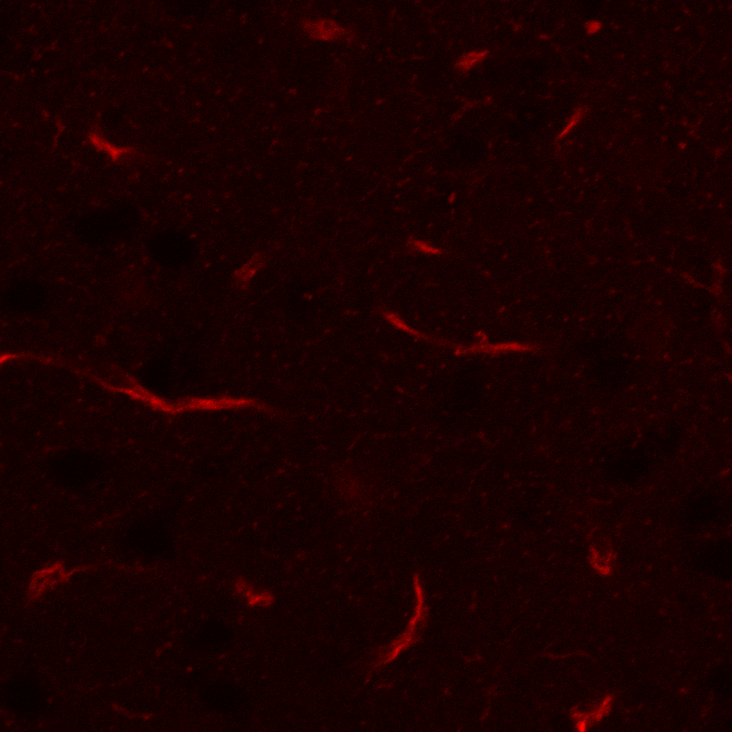
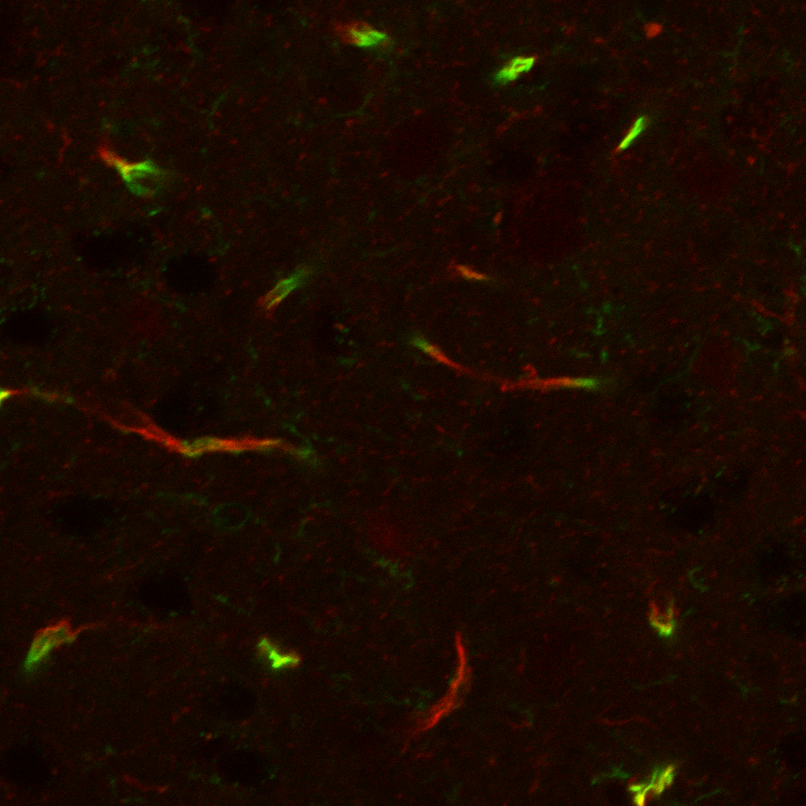
A
3 min
1 h
3 h
C
3 min
3 h
WT
WT
KO
KO
B
n.s.
n.s.
D
n.s.
n.s.
1.0
1.0
Relative intensity to WT-3min
n.s.
Relative intensity to WT
0.5
0.5
0.0
WT
KO
WT
KO
WT
KO
0.0
WT
KO
WT
KO
3 min
1 h
3 h
3 min
3 h
E
LEL
Biotin
Merge
F
n.s.
WT
1.0
Relative intensity to WT
0.5
KO
0.0
WT
KO
Supplemental Figure S1. Sugiyama et al.

Slide 2
Supplemental Figure S1. Extravascular leakage of fluorescein, FD-4, and FD-10 under physiological conditions.
Under physiological conditions, the leakage rate of fluorescein (A and B), FD-4 (C and D), and sulfo-biotin (E and F) is similar between wild-type mice and occludin-deficient mice according to unpaired t tests. The relative intensities are quantified and are shown in boxes and whiskers with maximum and minimum in B, D, and F. *P<0.05. Scale bar=100 µm. n=4 each.
FD-10 and FD-4: fluorescein isothiocyanate-dextran with average molecular weights of 4,000 and 10,000, respectively.

Slide 3
Supplementary Table S1. Primer sequences used in this study.
Name of gene | Sequence (5’→3’)
 | Forward | Reverse
Claudin-5 | TAACCTGAAAGGGCAGCTGGAGAAAC | AGGTCCAGGCTAAGTCCTTTGGTTCAGTAG
Occludin | GGACCCTGACCACTATGAAACAGACTAC | ATAGGTGGATATTCCCTGACCCAGTC
Tricellulin | GATCTTCCTGTTTGTCACCATG | TCGATGACAACGACGGGTC
ZO-1 | AGCTCATAGTTCAACACAGCCTCCAG | TTCTTCCACAGCTGAAGGACTCACAG
β-actin | GGCTACAGCTTCACCACCAC | GAGTACTTGGCGTCAGGAGG

