Slide 1
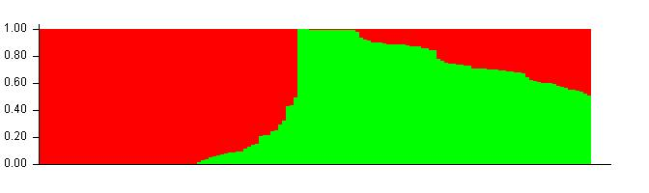
Additional file 3
a
b
Gp1
Gp2
Additional file 3 Population structure of 143 wheat landrace accessions in Southern Autumn-Sown Spring Wheat Zone of China
(a) The population structure of 143 accessions with Bayesian clustering analysis. Two colors stand for 2 different compositions. The Subgroup 1 (Gp1) mainly showed as red color. The Subgroup 2 (Gp2) mainly showed as green color;
(b) Estimated the distance of hierarchical clustering for the accessions using Fast Ward grouping algorithm and heat map showing the kinship and phylogenetic Relations.

