Slide 1
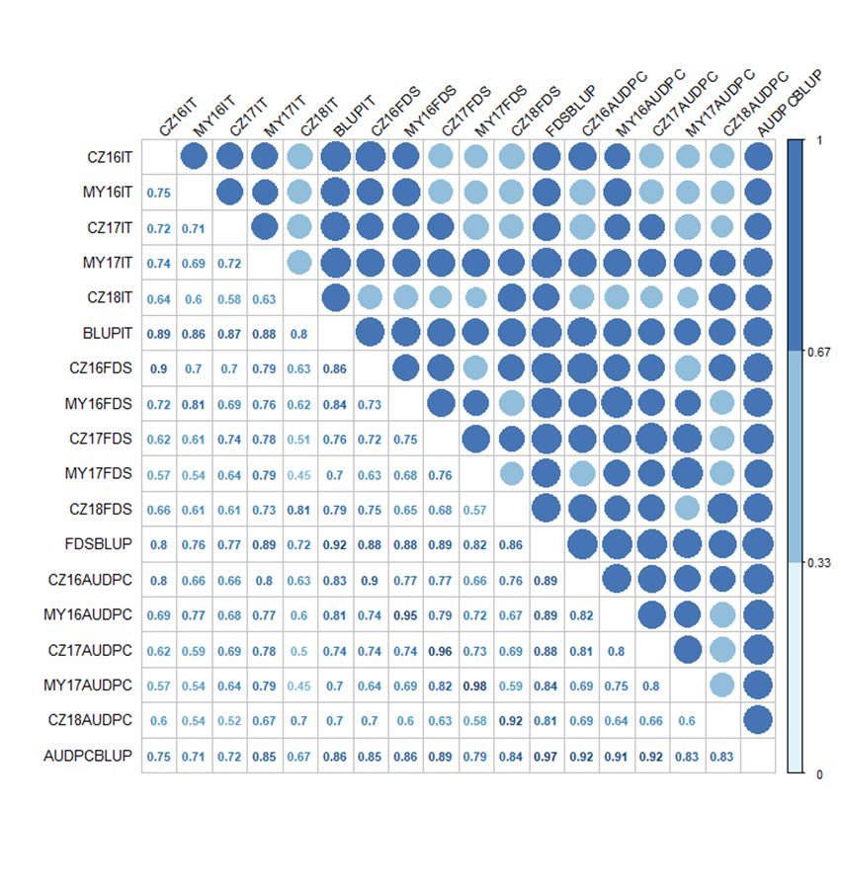
Additional file 2
Additional file 2 Pearson correlation coefficients for infection type (IT), final disease severity (FDS) and the area under disease progress curve (AUDPC) against stripe rust evaluated among five environments during 2016 to 2018. Different environments were all correlated, Significant at P < 0.01

