Slide 1
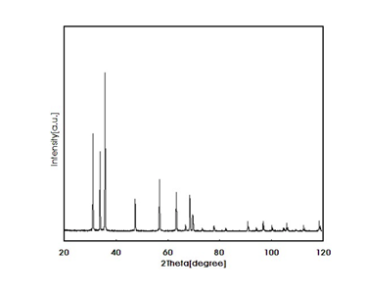
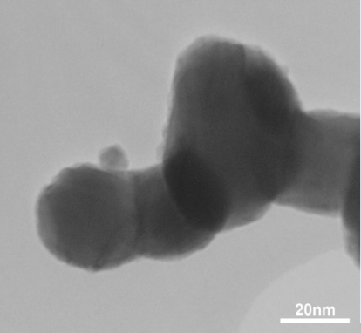

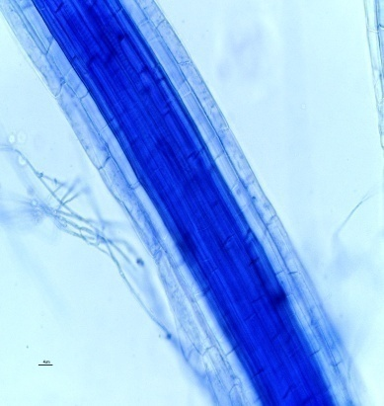


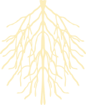
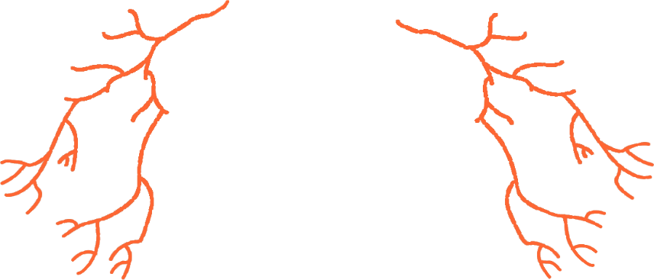


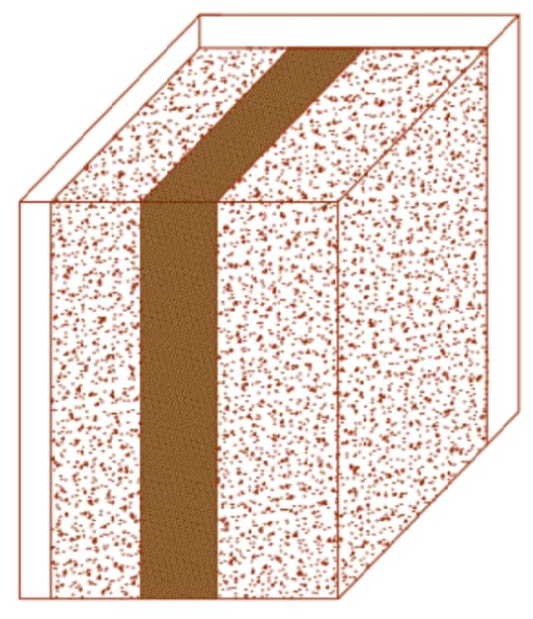


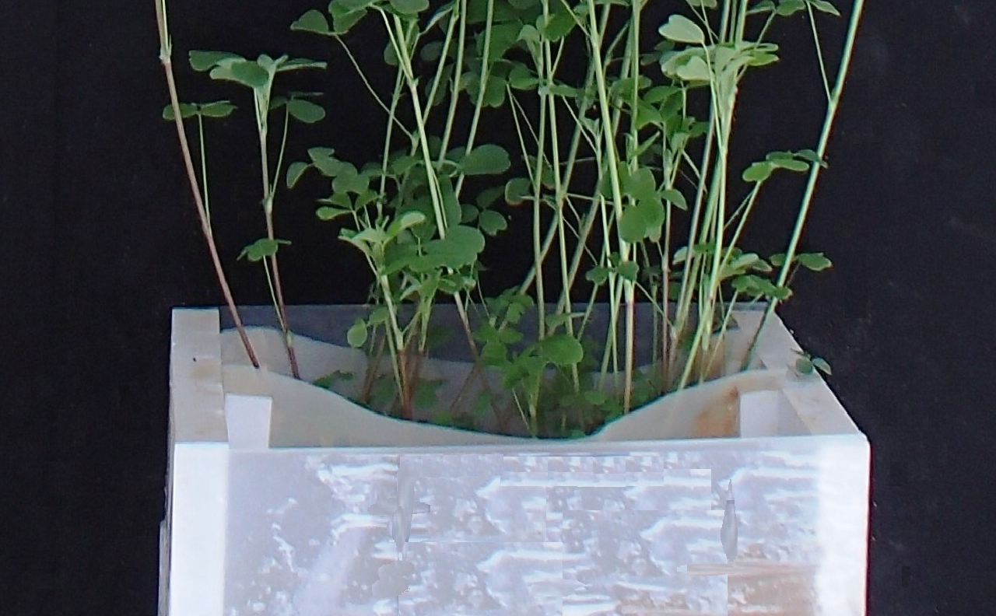

Intensity (a.u.)
20 nm
ZnO
ZnO
2theta (degree)
Zinc oxide Nanoparticles (ZnO-NPs)
ZnO
ZnO
S. indica-Colonized Roots
H⁺
H⁺
H⁺
Bulk Soil
ZnO-NPs
Rhizosphere Soil
Bulk Soil
Rhizosphere Soil

