Slide 1
m
m
m
m
m
Figure S1: A transmission electron micrograph montage of MUG Lucifer cells

Slide 2
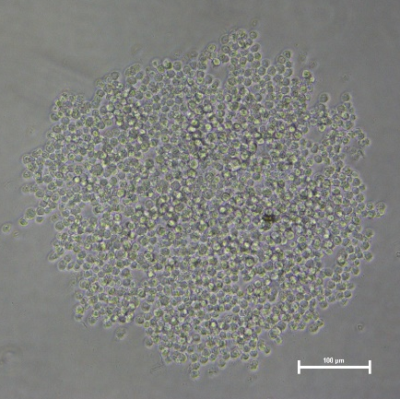
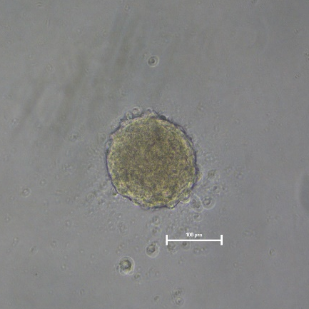
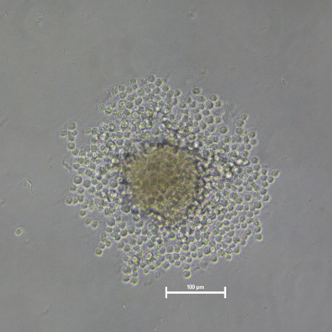
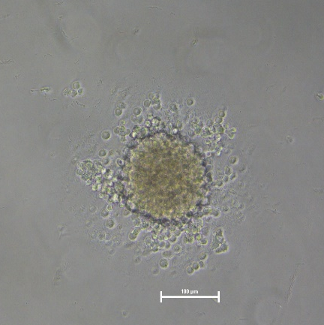
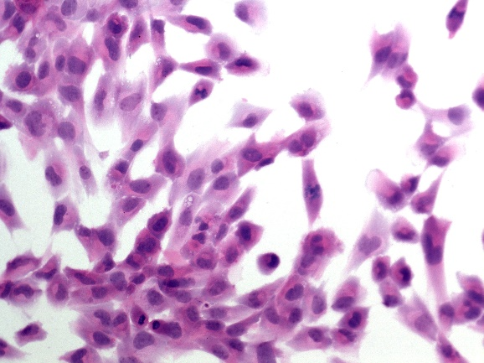
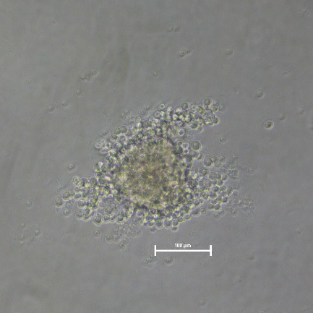
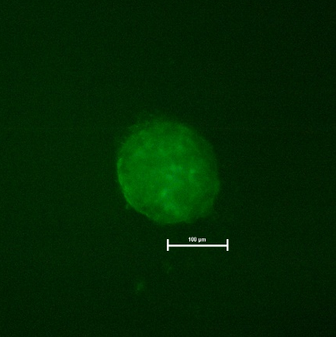
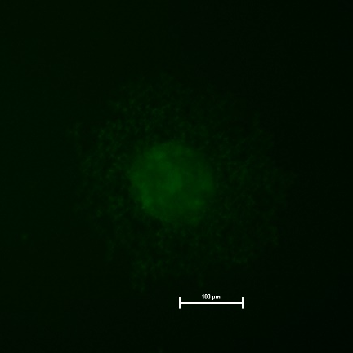
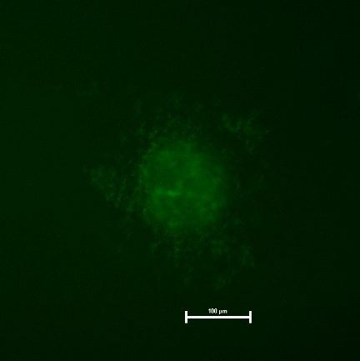
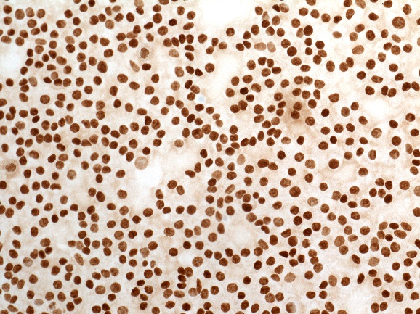
A
C
E
G
I
B
D
F
H
J
Figure S2: spheroids of MUG Lucifer cells

Slide 3
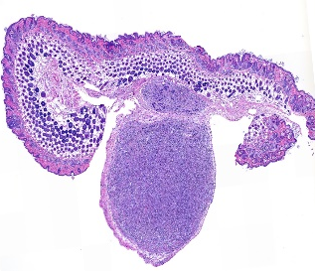
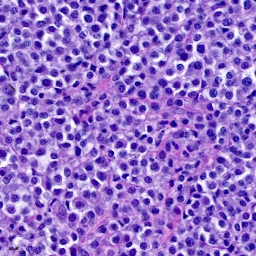
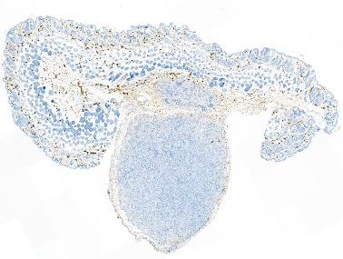
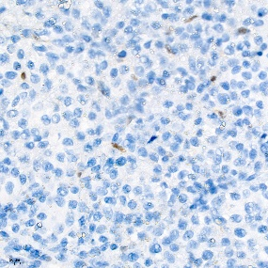
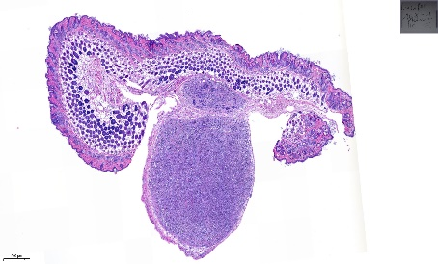

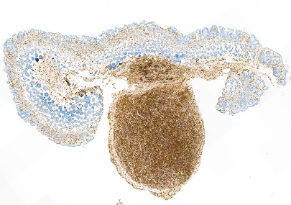
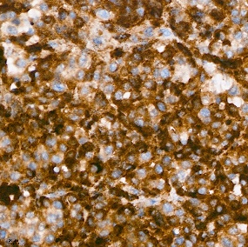
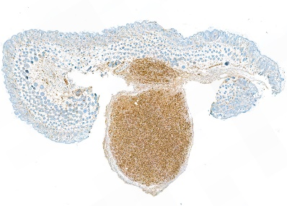
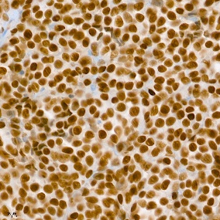

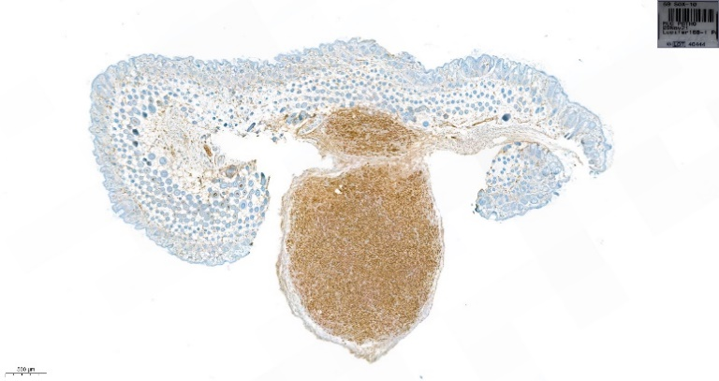
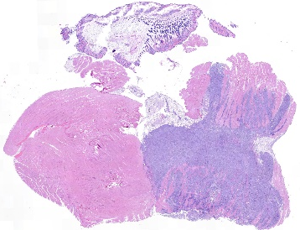
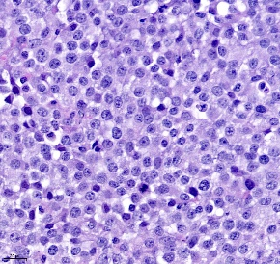
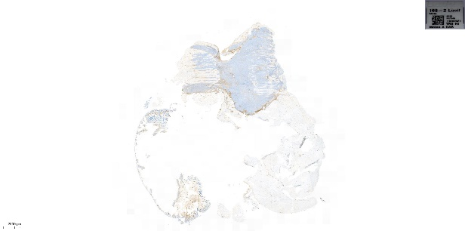
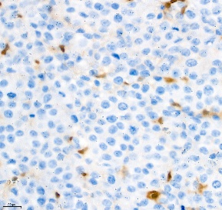

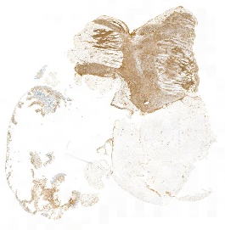
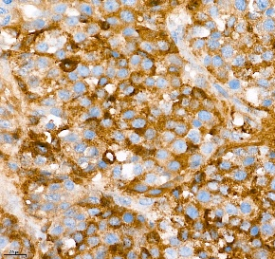
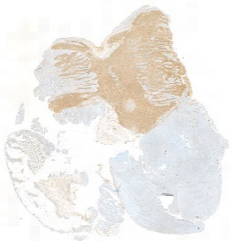
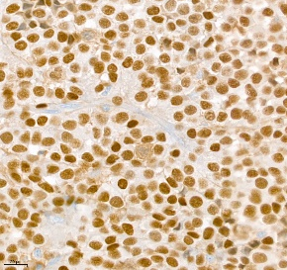


MUG Lucifer prim
MelanA
HE
HMB45
SOX10
MUG Lucifer met
HE
MelanA
HMB45
SOX10
Figure S3: HE, MelanA, HMB45 and SOX10 staining of MUG Lucifer prim and MUG Lucifer met xenografts

Slide 4
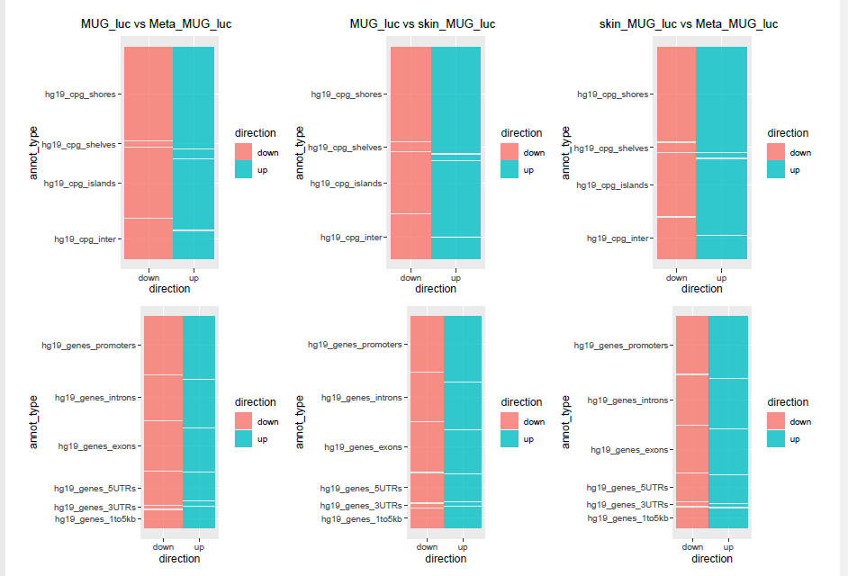
Figure S4: Location of DMPs with respect to CpG Island and gene annotations

Slide 5
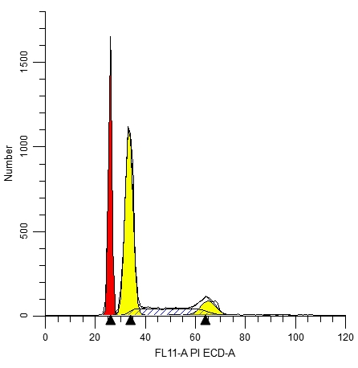
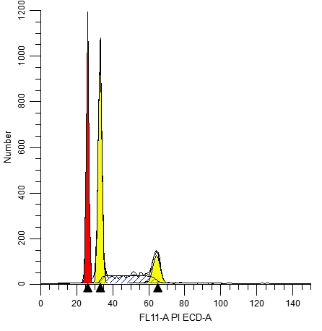
MUG Lucifer prim
MUG Lucifer met
Figure S5: Cell cycle histograms of MUG Lucifer prim and MUG Lucifer met spiked with PBMNCs.

Slide 6
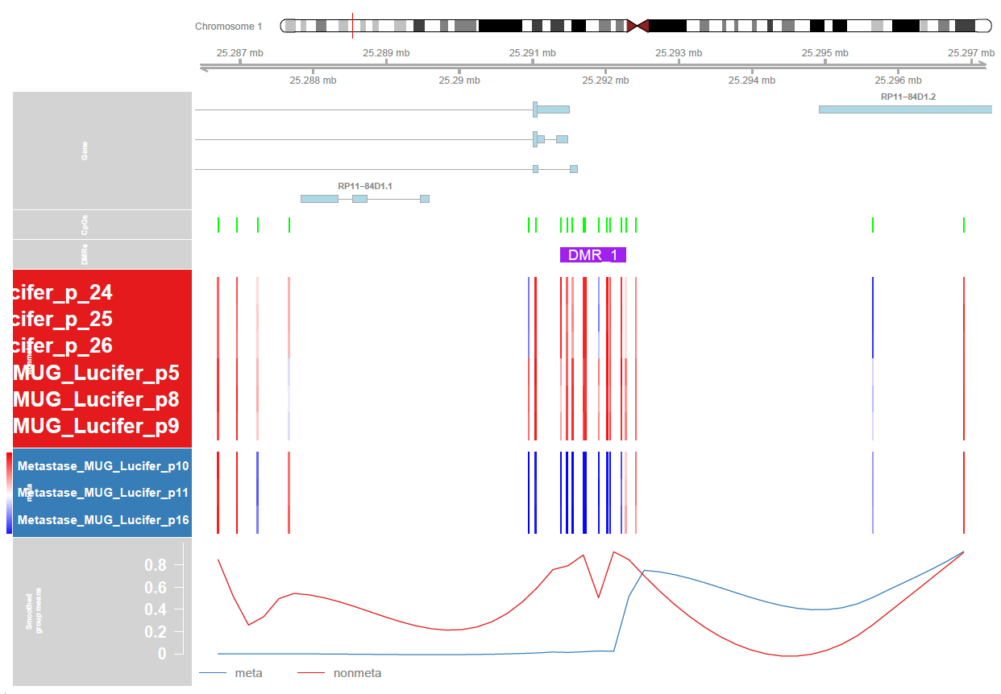
Figure S6: Locations on chromosomes and in relation to genes and CpG islands of 36 regions (DMRs)

Slide 7
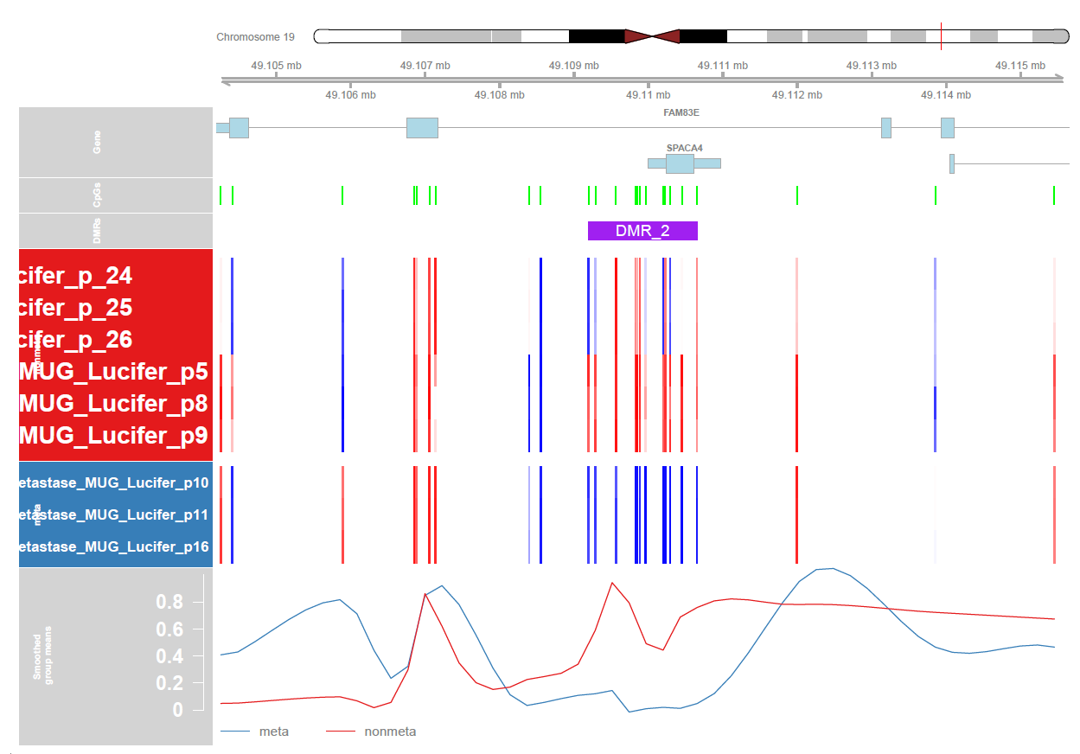
Figure S7: Locations on chromosomes and in relation to genes and CpG islands of 36 regions (DMRs)

Slide 8
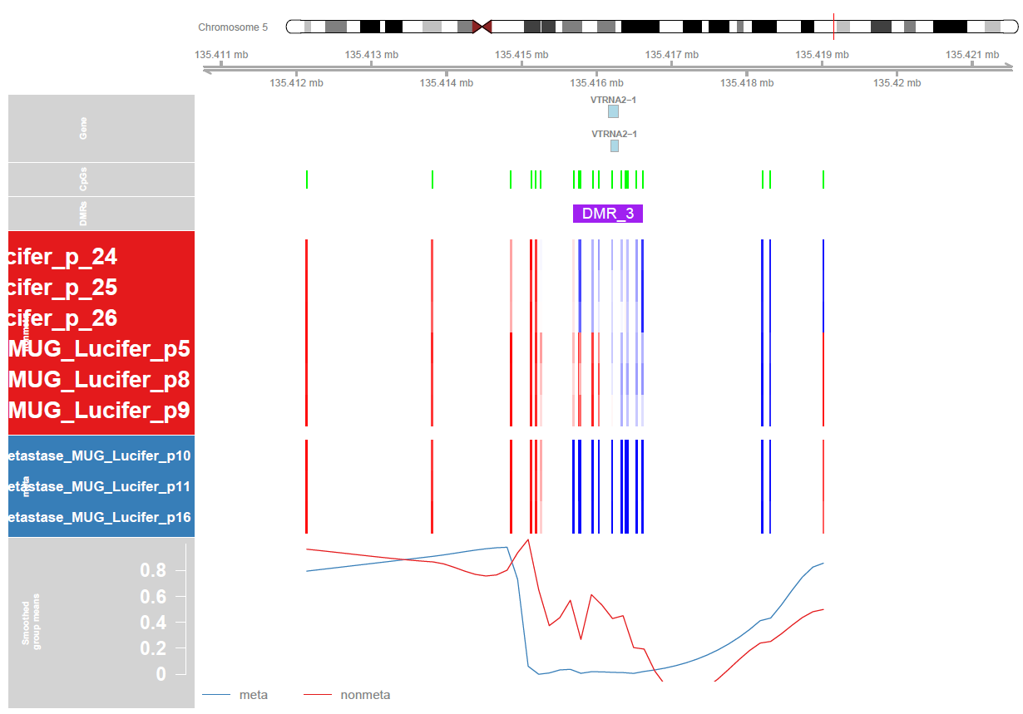
Figure S8: Locations on chromosomes and in relation to genes and CpG islands of 36 regions (DMRs)

Slide 9
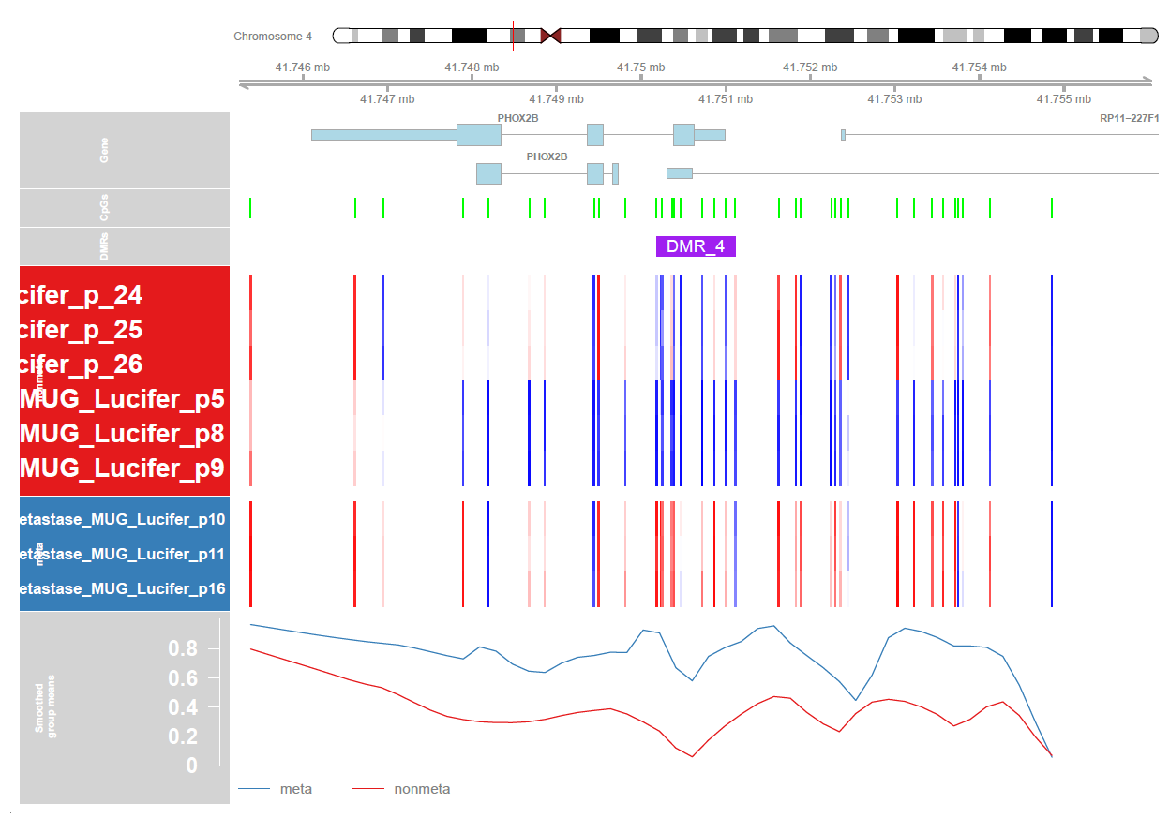
Figure S9: Locations on chromosomes and in relation to genes and CpG islands of 36 regions (DMRs)

Slide 10
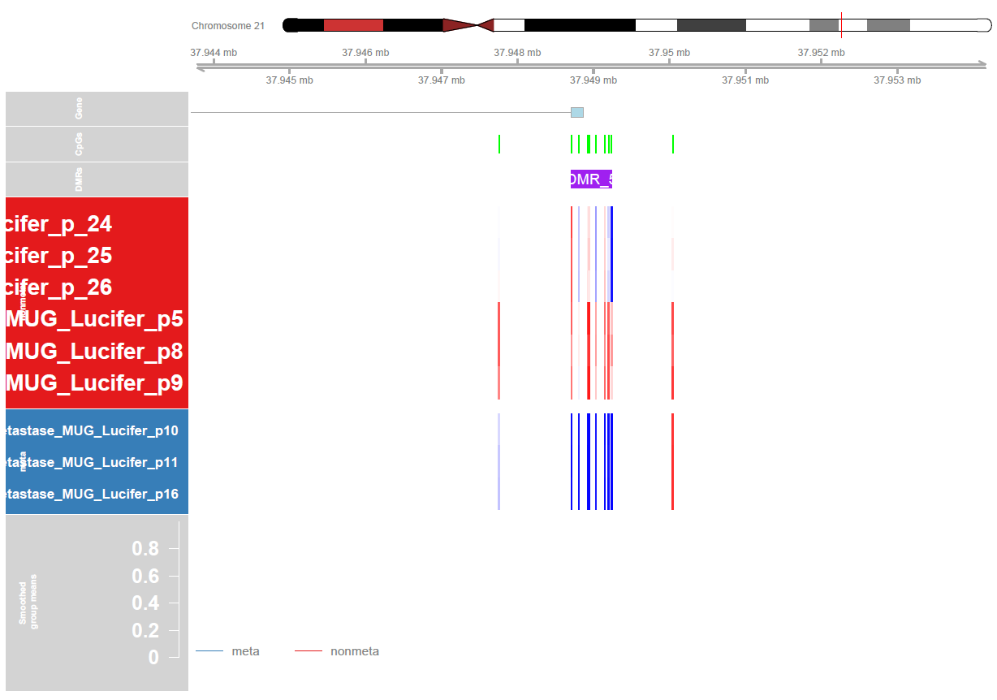
Figure S10: Locations on chromosomes and in relation to genes and CpG islands of 36 regions (DMRs)

Slide 11
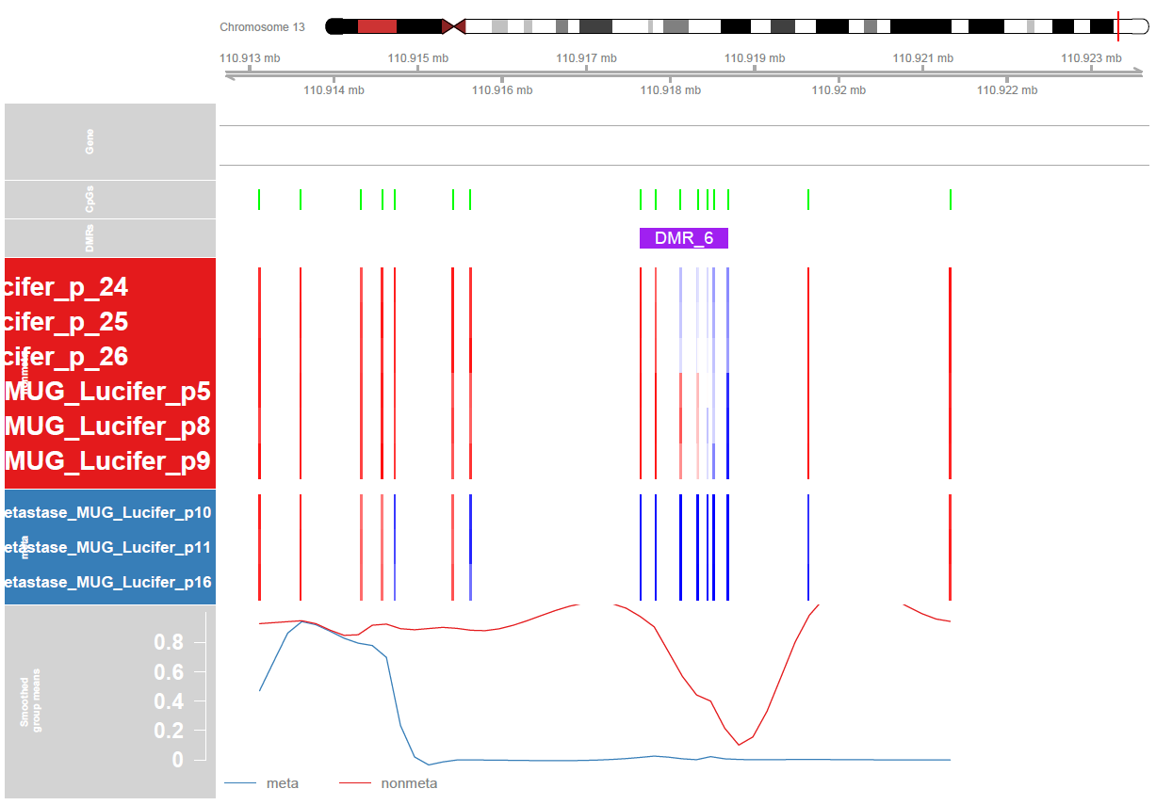
Figure S11: Locations on chromosomes and in relation to genes and CpG islands of 36 regions (DMRs)

Slide 12
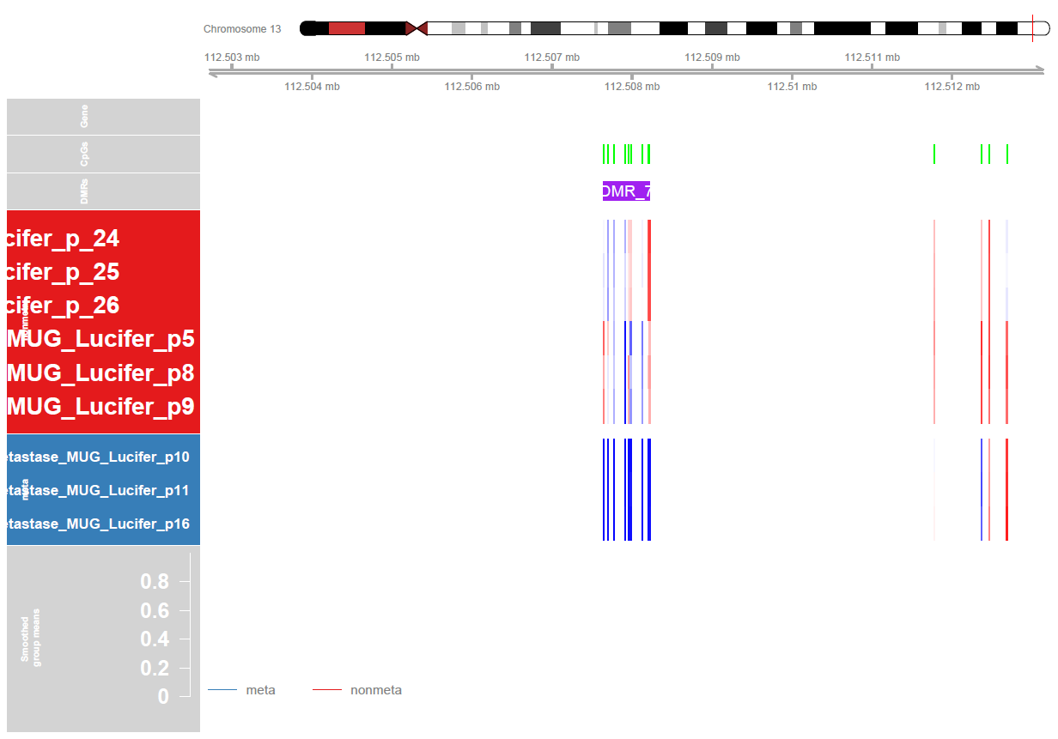
Figure S12: Locations on chromosomes and in relation to genes and CpG islands of 36 regions (DMRs)

Slide 13
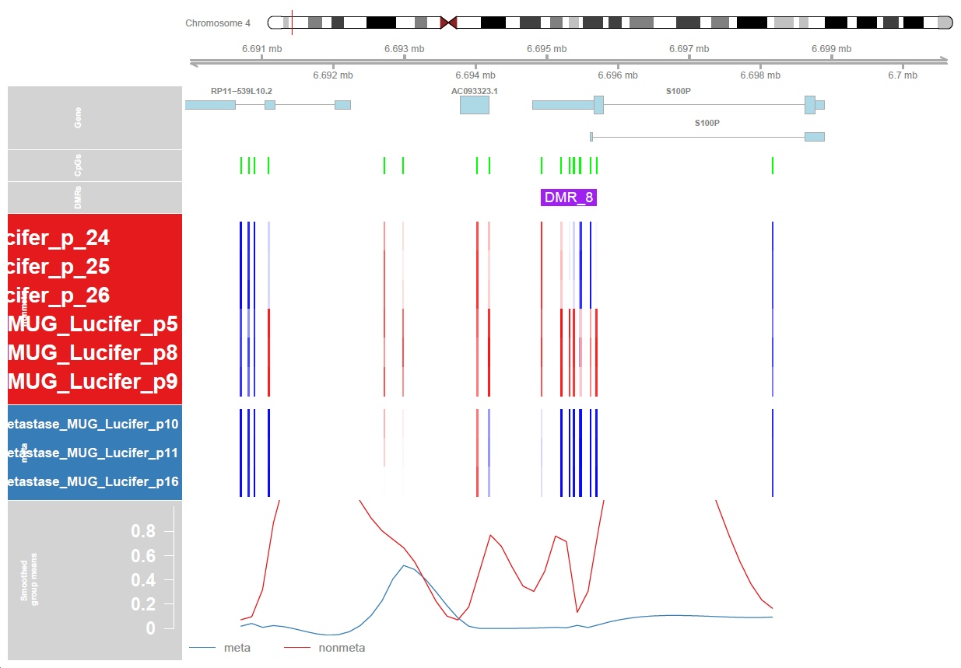
Figure S13: Locations on chromosomes and in relation to genes and CpG islands of 36 regions (DMRs)

Slide 14
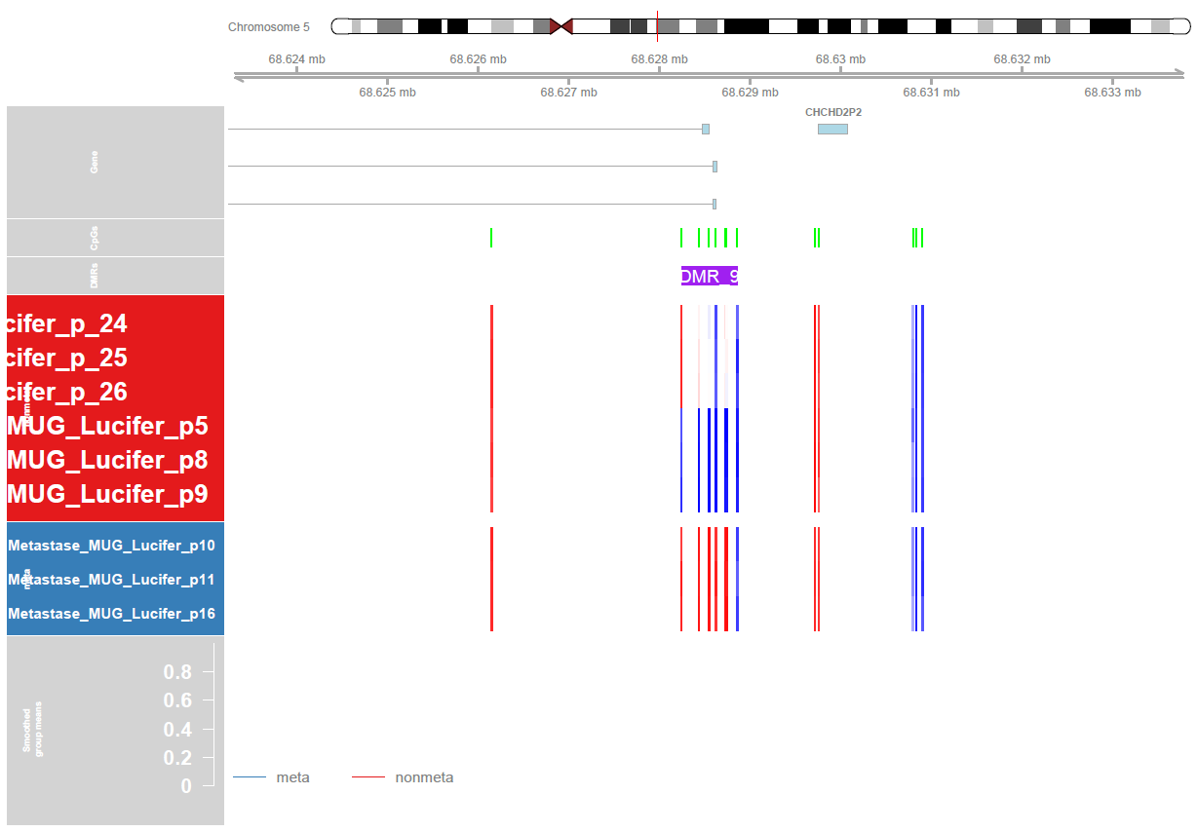
Figure S14: Locations on chromosomes and in relation to genes and CpG islands of 36 regions (DMRs)

Slide 15
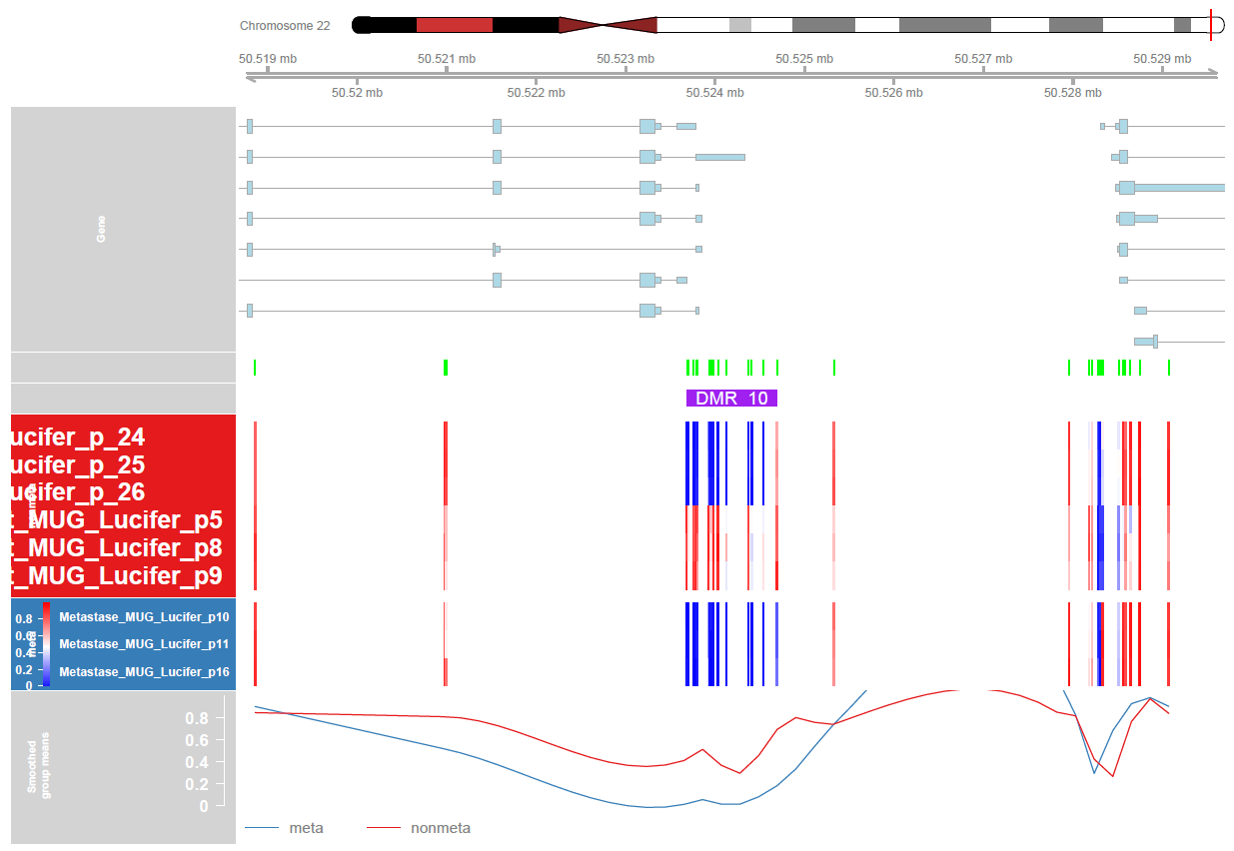
Figure S15: Locations on chromosomes and in relation to genes and CpG islands of 36 regions (DMRs)

Slide 16
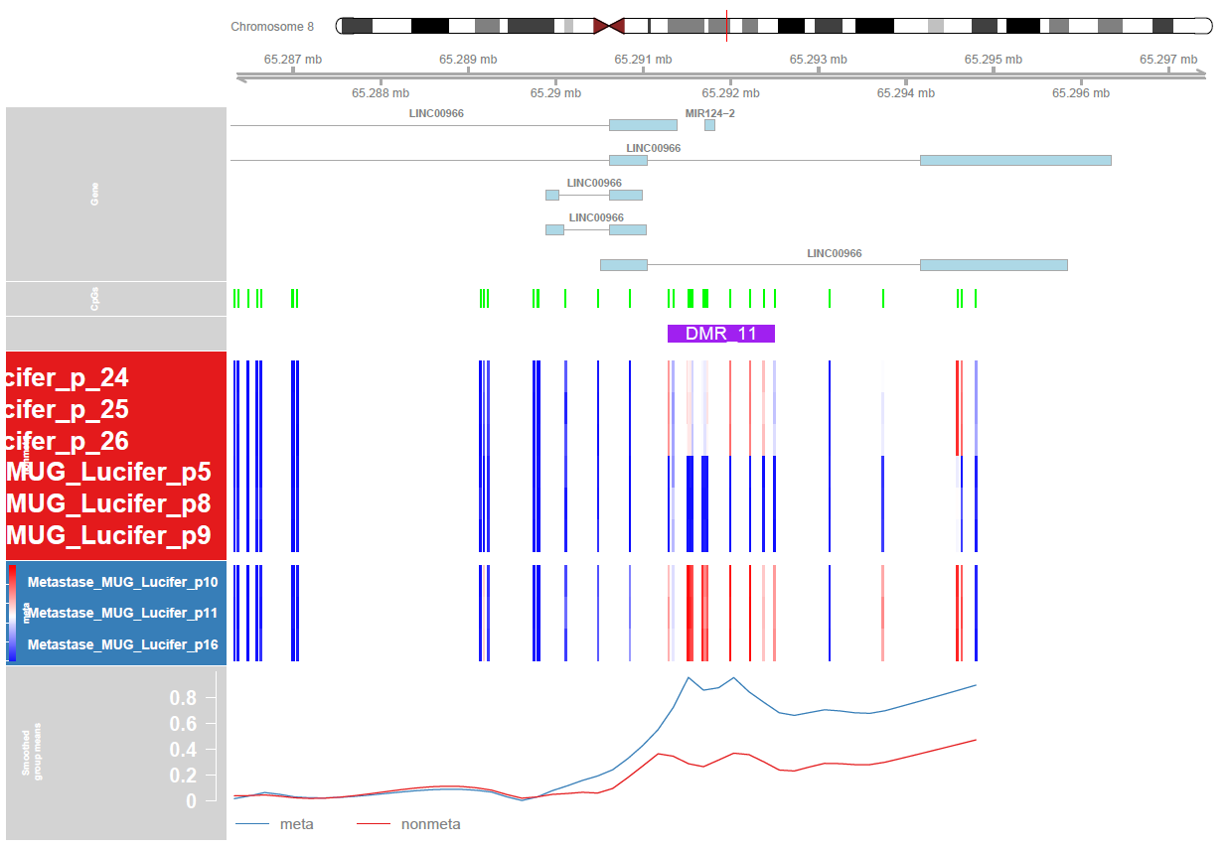
Figure S16: Locations on chromosomes and in relation to genes and CpG islands of 36 regions (DMRs)

Slide 17
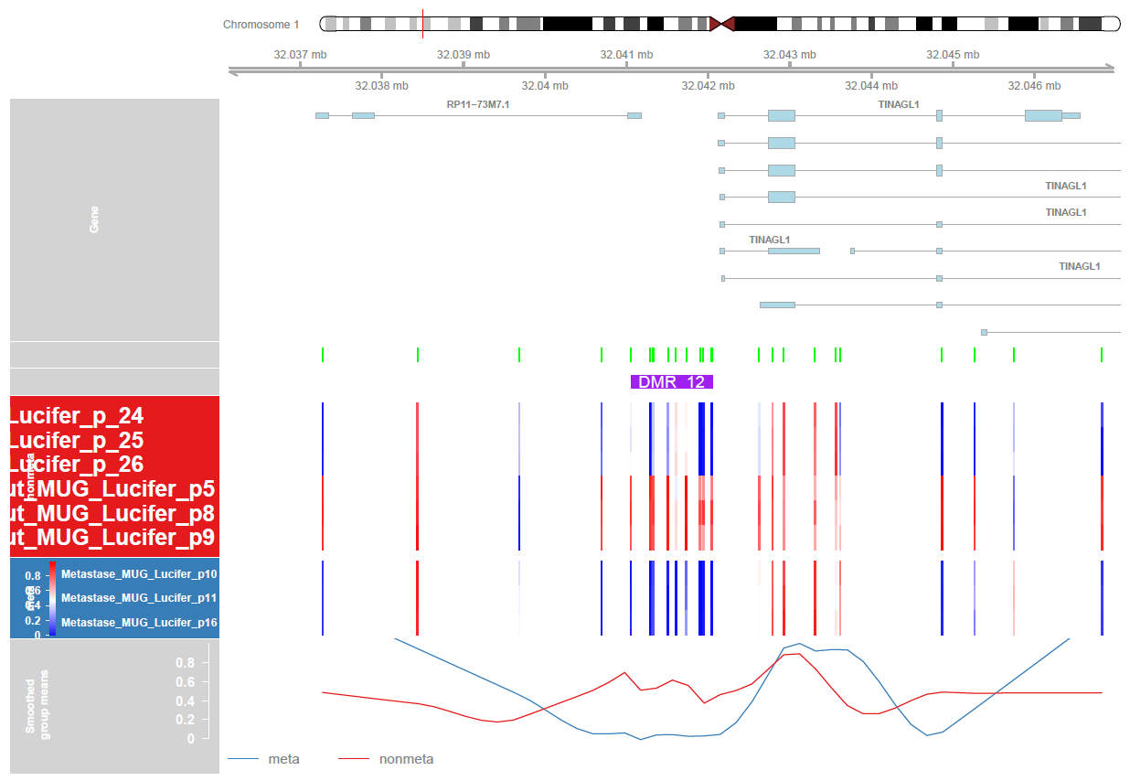
Figure S17: Locations on chromosomes and in relation to genes and CpG islands of 36 regions (DMRs)

Slide 18
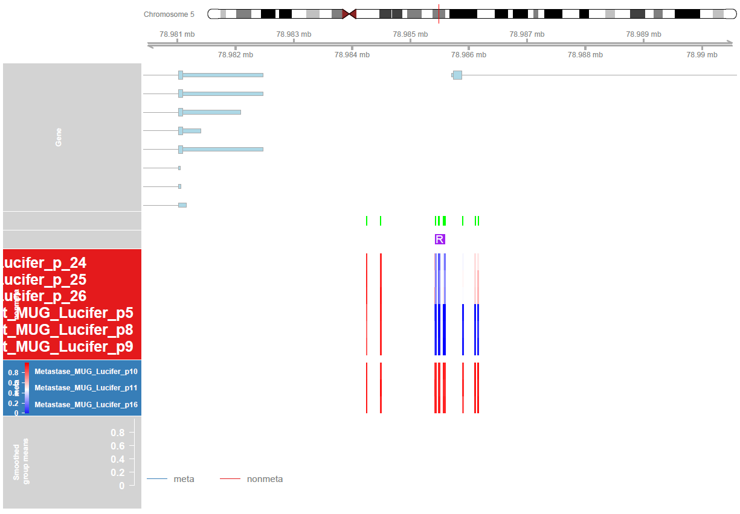
Figure S18: Locations on chromosomes and in relation to genes and CpG islands of 36 regions (DMRs)

Slide 19
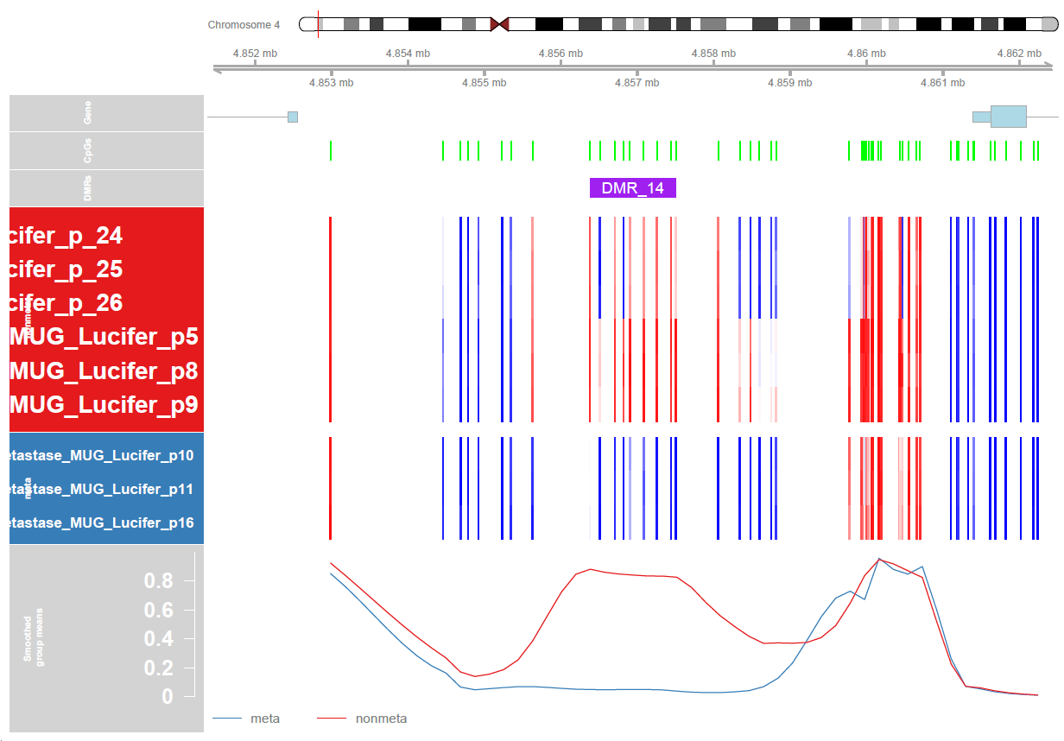
Figure S19: Locations on chromosomes and in relation to genes and CpG islands of 36 regions (DMRs)

Slide 20
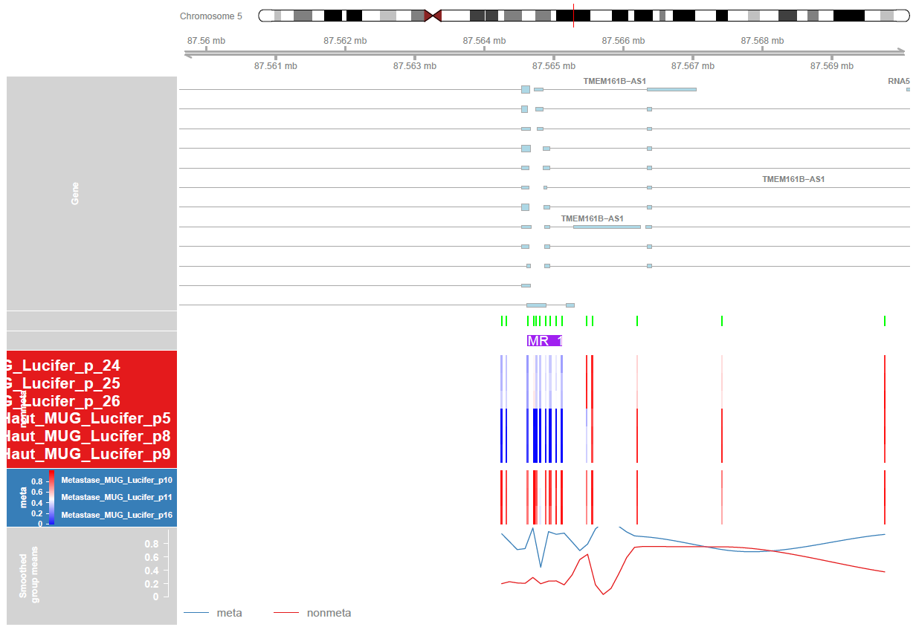
Figure S20: Locations on chromosomes and in relation to genes and CpG islands of 36 regions (DMRs)

Slide 21
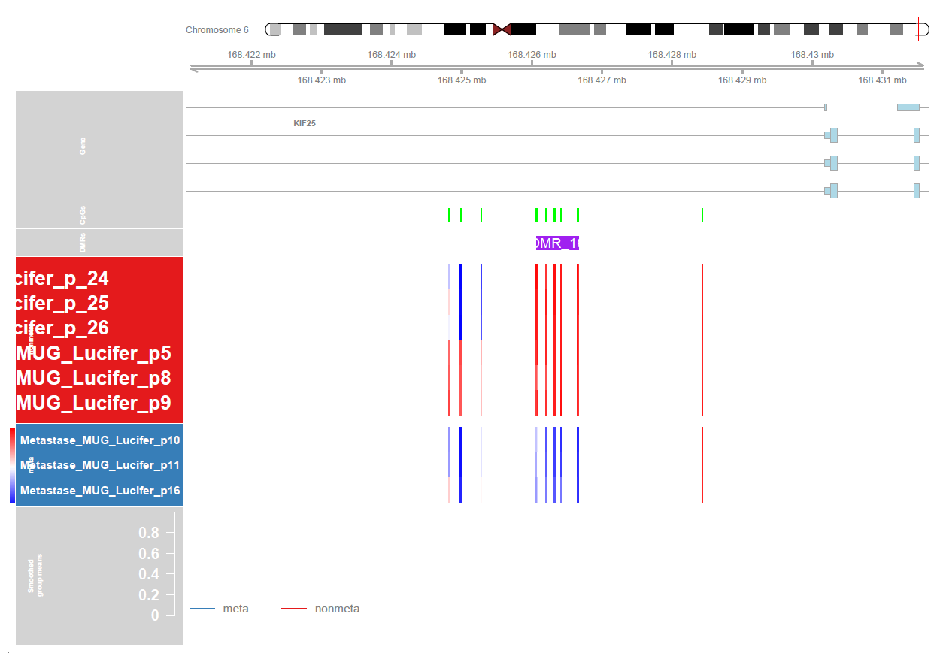
Figure S21: Locations on chromosomes and in relation to genes and CpG islands of 36 regions (DMRs)

Slide 22
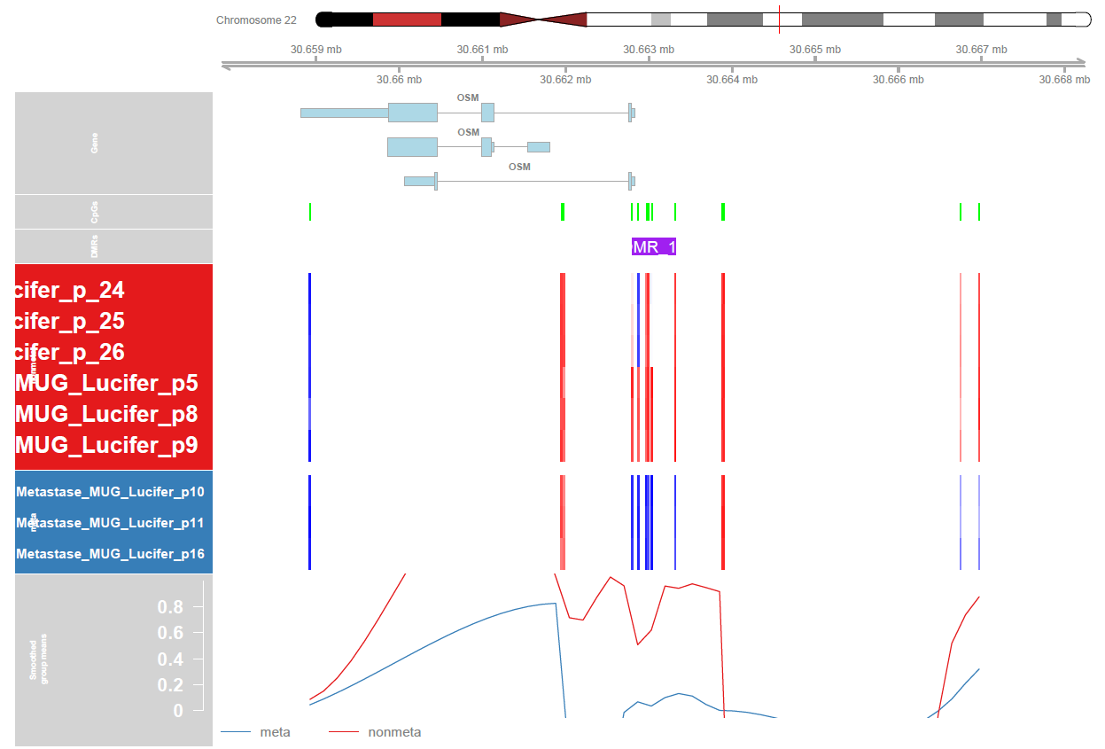
Figure S22: Locations on chromosomes and in relation to genes and CpG islands of 36 regions (DMRs)

Slide 23
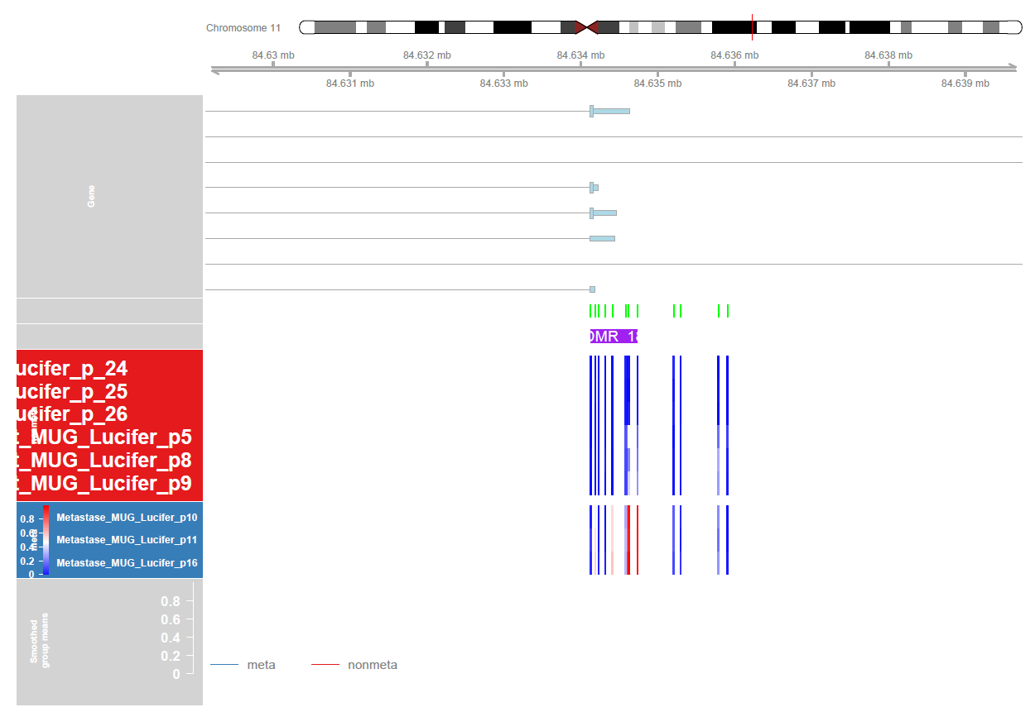
Figure S23: Locations on chromosomes and in relation to genes and CpG islands of 36 regions (DMRs)

Slide 24
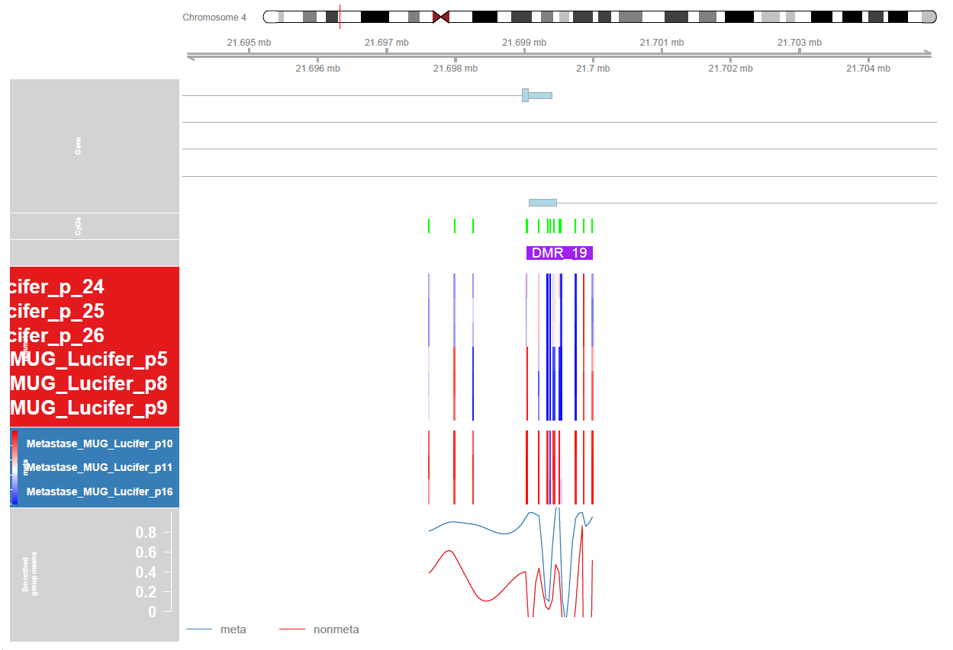
Figure S24: Locations on chromosomes and in relation to genes and CpG islands of 36 regions (DMRs)

Slide 25

Figure S25: Locations on chromosomes and in relation to genes and CpG islands of 36 regions (DMRs)

Slide 26

Figure S26: Locations on chromosomes and in relation to genes and CpG islands of 36 regions (DMRs)

Slide 27

Figure S27: Locations on chromosomes and in relation to genes and CpG islands of 36 regions (DMRs)

Slide 28

Figure S28: Locations on chromosomes and in relation to genes and CpG islands of 36 regions (DMRs)

Slide 29

Figure S29: Locations on chromosomes and in relation to genes and CpG islands of 36 regions (DMRs)

Slide 30

Figure S30: Locations on chromosomes and in relation to genes and CpG islands of 36 regions (DMRs)

Slide 31

Figure S31: Locations on chromosomes and in relation to genes and CpG islands of 36 regions (DMRs)

Slide 32

Figure S32: Locations on chromosomes and in relation to genes and CpG islands of 36 regions (DMRs)

Slide 33

Figure S33: Locations on chromosomes and in relation to genes and CpG islands of 36 regions (DMRs)

Slide 34

Figure S34: Locations on chromosomes and in relation to genes and CpG islands of 36 regions (DMRs)

Slide 35

Figure S35: Locations on chromosomes and in relation to genes and CpG islands of 36 regions (DMRs)

Slide 36

Figure S36: Locations on chromosomes and in relation to genes and CpG islands of 36 regions (DMRs)

Slide 37

Figure S37: Locations on chromosomes and in relation to genes and CpG islands of 36 regions (DMRs)

Slide 38

Figure S38: Locations on chromosomes and in relation to genes and CpG islands of 36 regions (DMRs)

Slide 39

Figure S39: Locations on chromosomes and in relation to genes and CpG islands of 36 regions (DMRs)

Slide 40

Figure S40: Locations on chromosomes and in relation to genes and CpG islands of 36 regions (DMRs)

Slide 41

Figure S41: Locations on chromosomes and in relation to genes and CpG islands of 36 regions (DMRs)

