Slide 1
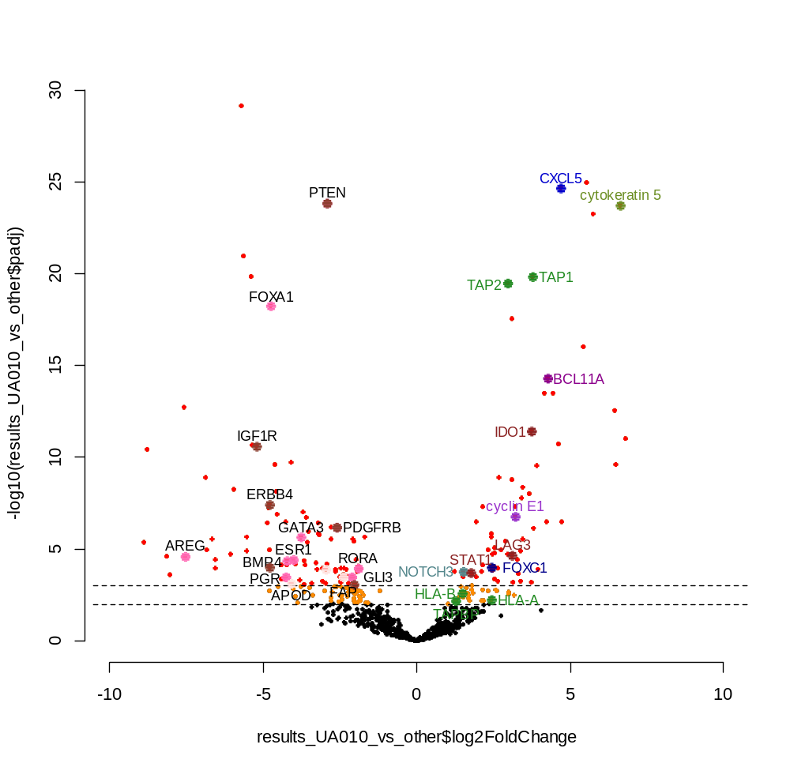
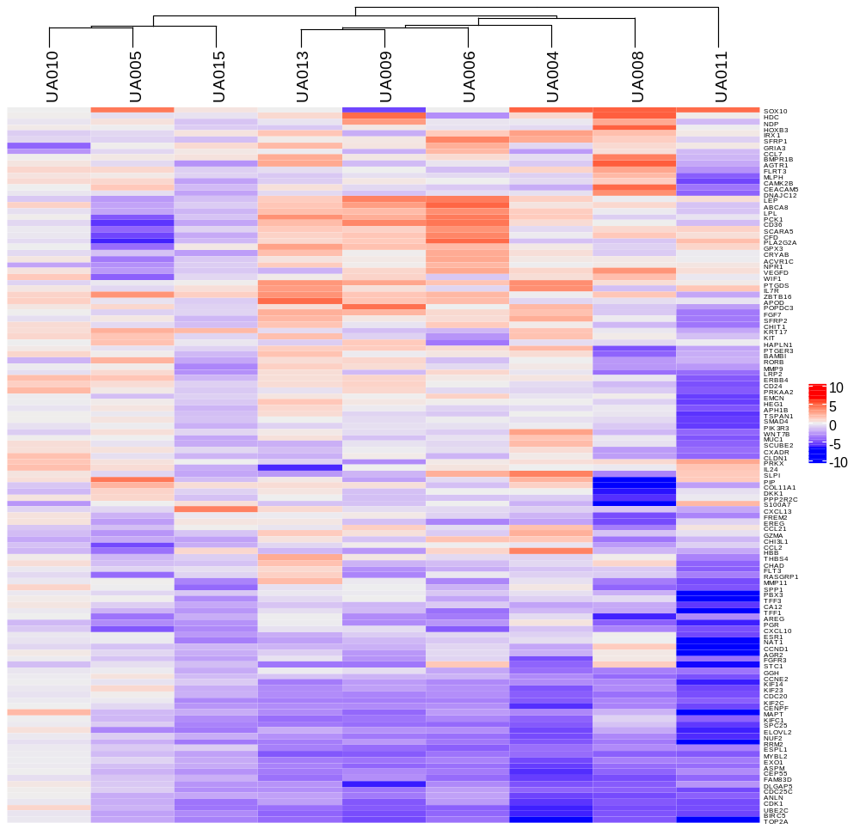

Supplementary Figure 5
A
B
Basal
Basal
LumA - LumA
LumB LumB
LumB - LumA
-log10(p-adjusted)
Log2 fold change (post/pretreatment)
p <0.001
Underexpressed in UA010
Overexpressed in UA010
Log2 fold change

