Slide 1
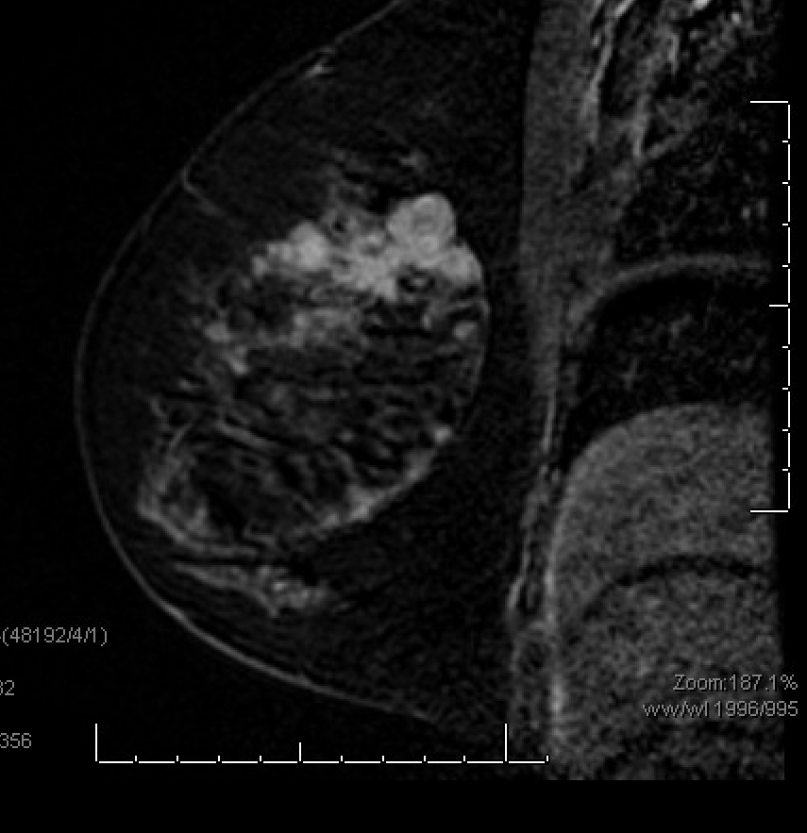
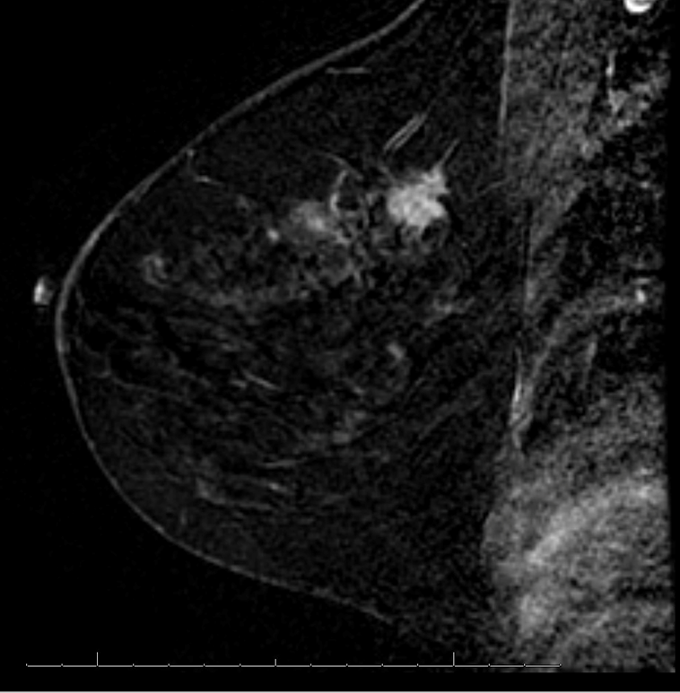
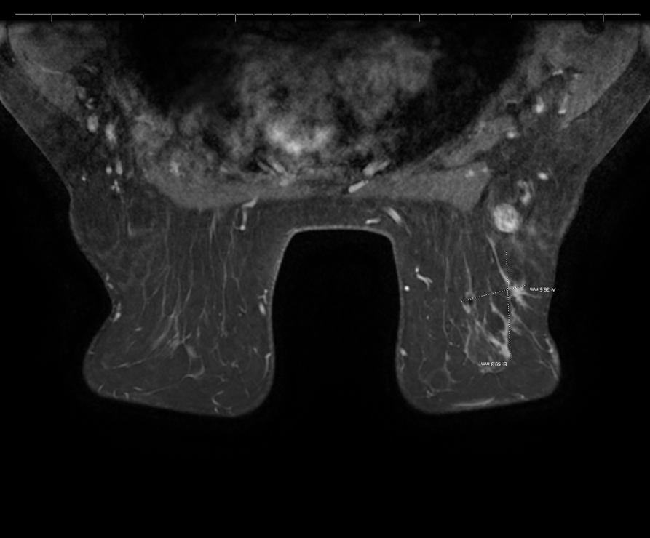
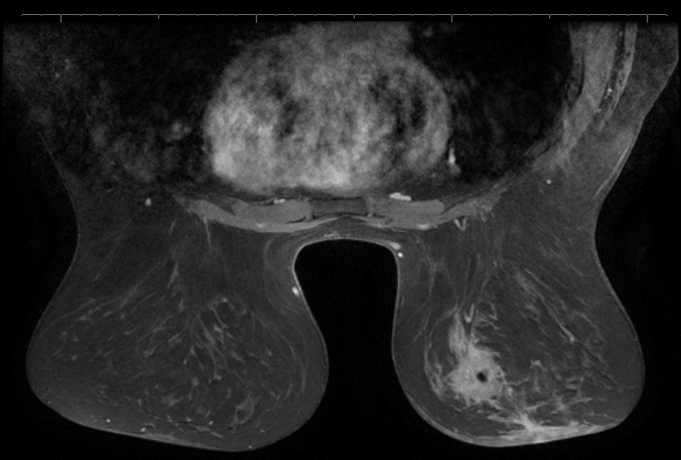
Supplementary Figure 2
pre-treatment
Cycle 4 day 1
pre-treatment
Cycle 4 day 1
pre-treatment
Cycle 4 day 1

