Slide 1
Figure 1-A
Young Old
HtrA2
Actin
HtrA2/Actin 1 0.49
HtrA2
Actin
Figure 1-A Representative western blot showing HtrA2 expression in oocytes from young and old mice.
The HtrA2 proteins were marked with red. The relative amount of HtrA2 in old mice was estimated based on the level of actin, which was used as control. The Actin were marked with black.

Slide 2
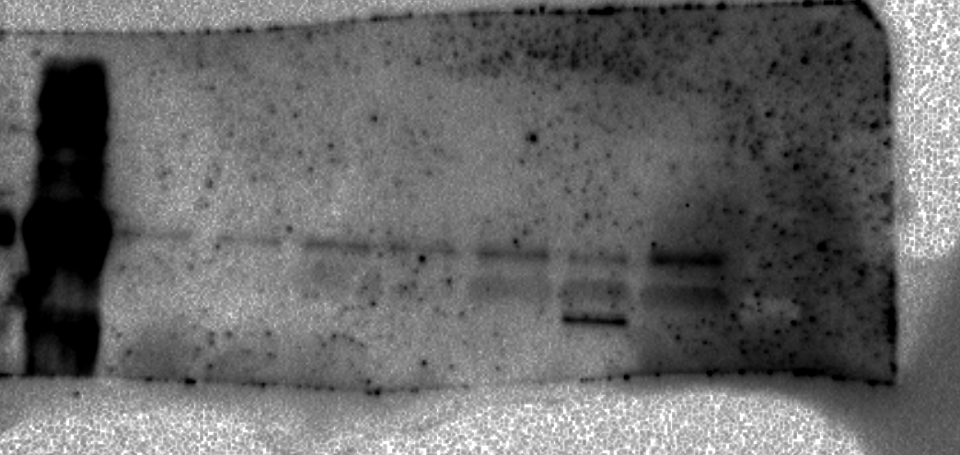
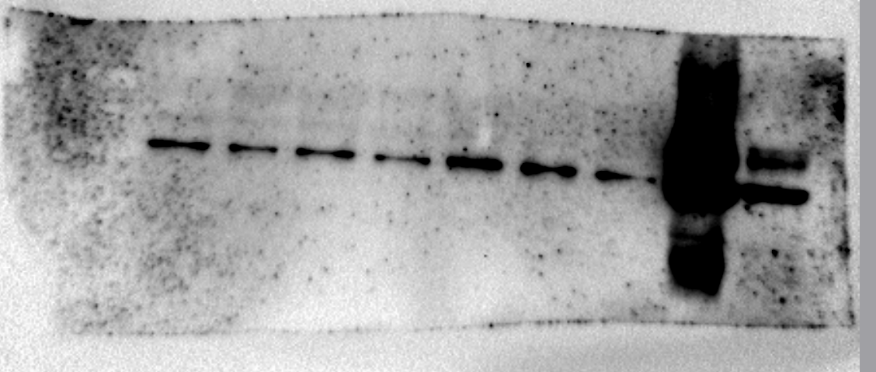

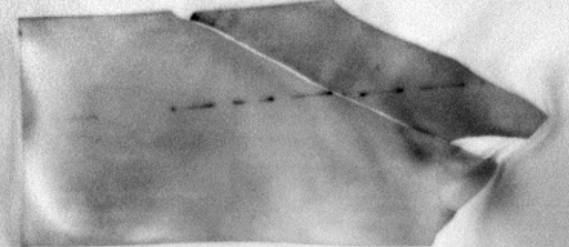
Figure 1-C
Control
siRNA-1
siRNA-2
HtrA2
Actin
HtrA2/Actin 1 0.41 0.46
Gapdh
HtrA2/Gapdh 1 0.40 0.43
Actin
HtrA2
Gapdh
Figure 1-C Western blotting verification of endogenous HtrA2 knockdown
The HtrA2 proteins were marked with red. The relative amount of HtrA2 in HtrA2-KD oocytes was estimated based on the level of actin and gapdh. The actin and gapdh were marked with black and blue respecially.

Slide 3
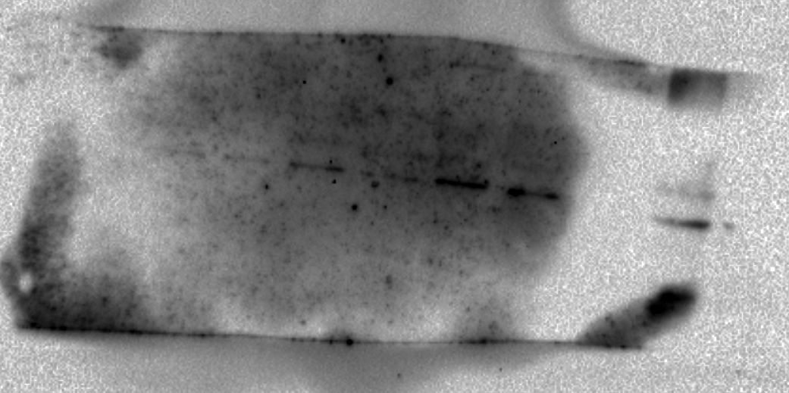
Figure 5-C
Control
siRNA-1
Ac-Tubulin
Actin
HtrA2/Actin 1 2.37
Gapdh
HtrA2/Gapdh 1 2.66
Actin
Ac-Tubulin
Gapdh
Figure 5-C Representative western blots showing the expression of acetylated tubulin in oocytes from control and HtrA2-KD mice
The HtrA2 proteins were marked with red.The relative amount of HtrA2 was estimated based on the level of actin and gapdh. The actin and gapdh were marked with black and blue respecially.

Slide 4
Figure 6-B
HtrA2
Overexpression
Exogenous
Endogenous
Control
Exogenous
Endogenous
Htra2 Antibody
Actin
Actin
Figure 6-B Western blot analysis confirming successful overexpression of exogenous HtrA2 using with an anti-HtrA2 antibody
The exogenous and endogenous HtrA2 proteins were show in one blot and marked with red. The Actin were marked with black.

