Slide 1
Table s1 The performances of commercial cells
 | This study | Company T | Company T | Company T | Company T | Company T | Company C | Company C | Company C
type | laminate | laminate | laminate | laminate | laminate | laminate | laminate | laminate | laminate
Voltage(V) | 1.2 | 3.2 | 3.2 | 3.2 | 4.2 | 4.2 | 2.5 | 2.5 | 2.5
Number of series | 1 | 2 | 2 | 2 | 2 | 2 | 1 | 1 | 1
Capacitance value [F] | 1.6 | 0.005 | 0.01 | 0.015 | 0.35 | 0.5 | 0.17 | 1.04 | 1.8
Length [mm] | 47 | 27 | 27 | 27 | 20 | 20 | 20 | 28.5 | 39
Width [mm] | 43 | 17 | 17 | 17 | 15 | 15 | 18 | 17 | 17
Height (mm) | 1.5 | 0.4 | 0.4 | 0.4 | 2.1 | 2.6 | 1.7 | 1.7 | 1.7

Slide 2
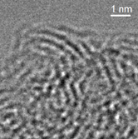
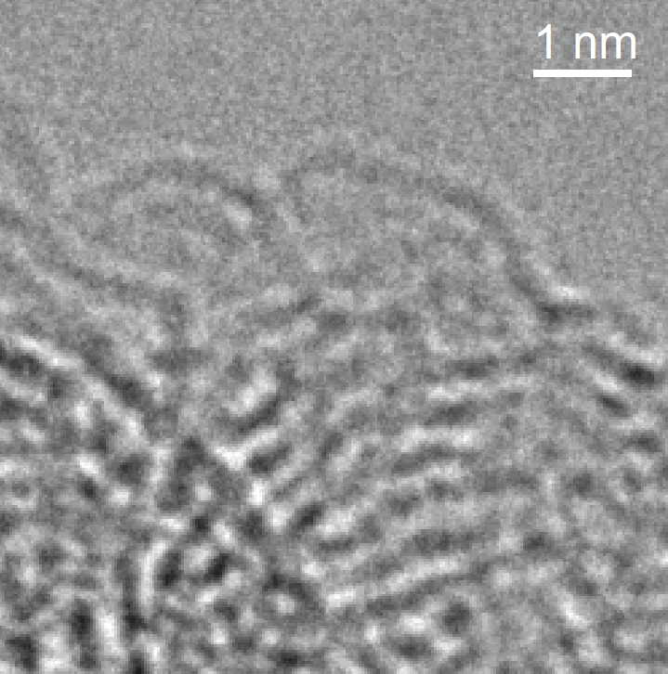
Sample A
Sample H
The comparisons of TEM image and EELS spectrum for the sample “A” and the sample “H”.

