Slide 1
Supplementary information for
A novel personal ventilation strategy to circumvent aerosol transmission
Tomoaki Yoshida*¹, Eiji Shibata², Natsuki Ishida³, Tomoya Nakatani³
¹Dept. of Biology, Fujita Health University School of Medicine, ²Aichi Medical University Health Service, ³Seto Health Check Center
*Corresponding author: Tomoaki Yoshida, MD PhD, Dept. of Biology Fujita Health University School of Medicine,
1-98 Dengakugakubo Kutsukake Toyoake 4701192 Aichi Japan (tomo-y@fujita-hu.ac.jp)

Slide 2
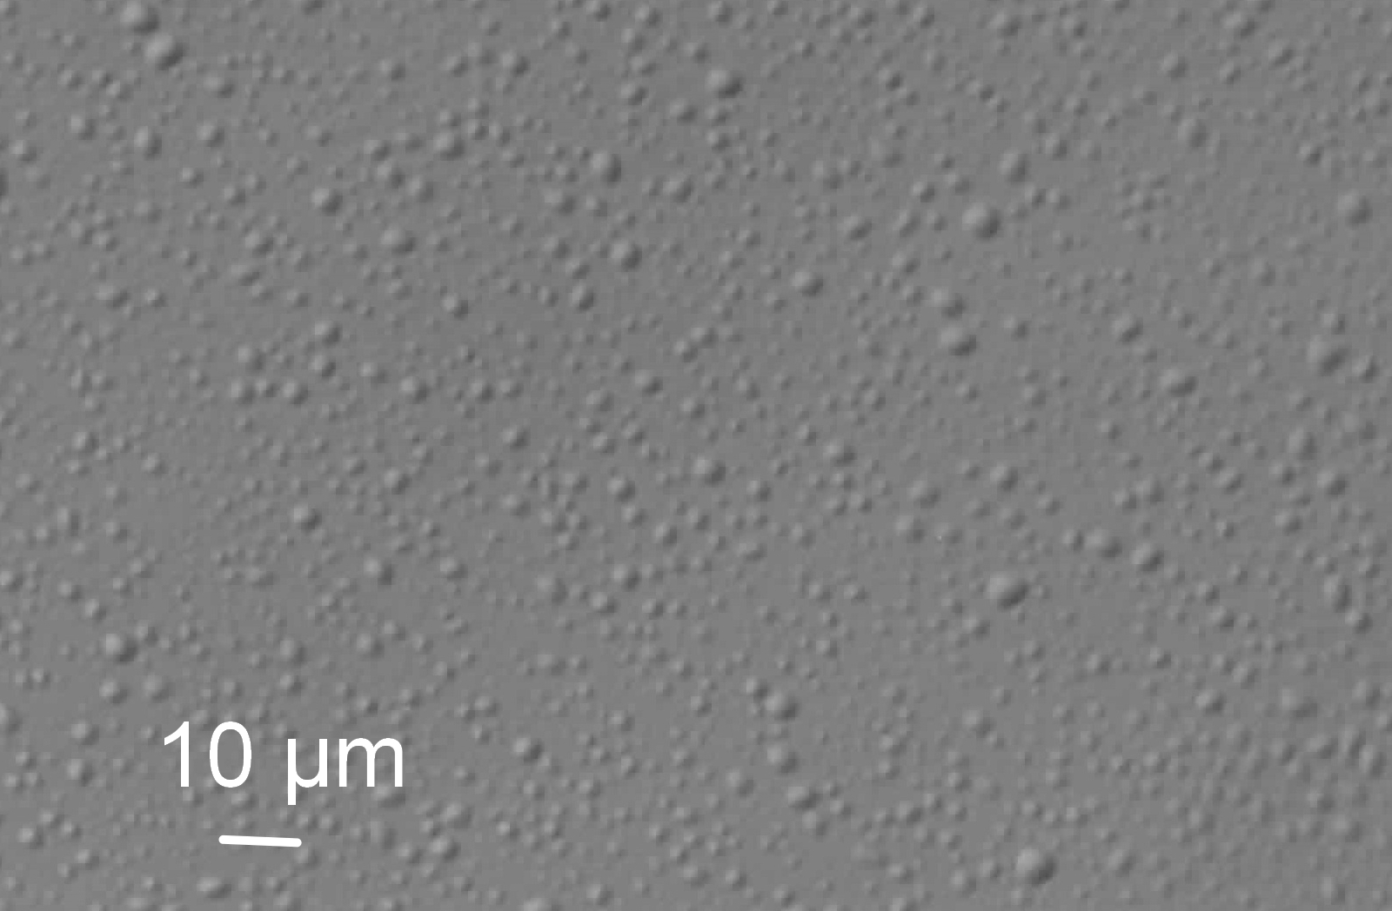
Supplementary Figure S1:
Microscopic view of droplets used

Slide 3
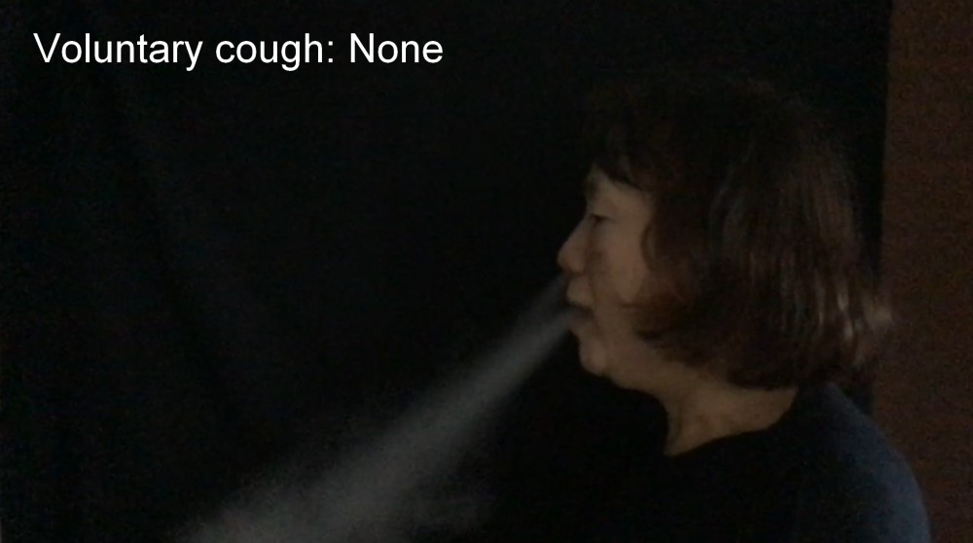
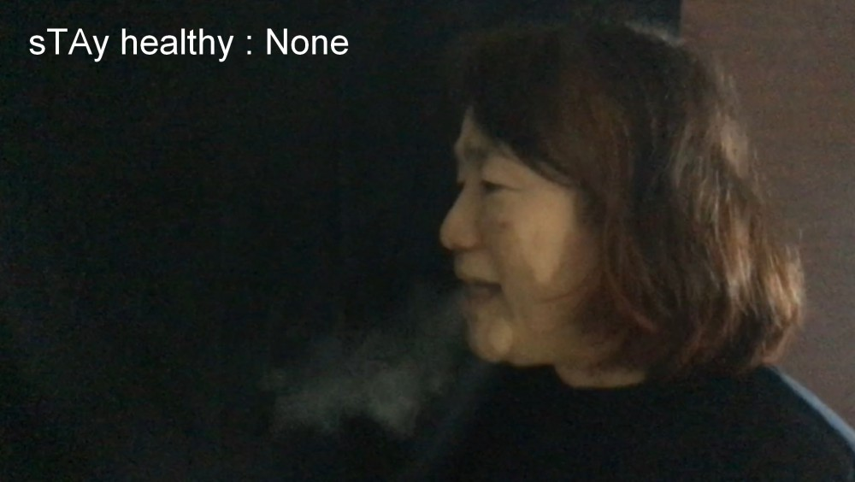
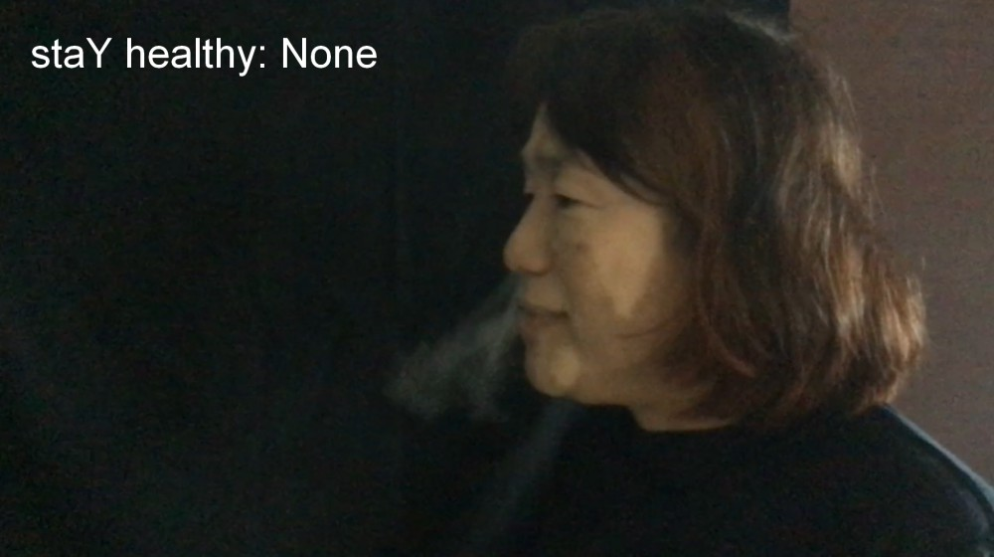
Supplementary Figure S2: Still pictures of innate smoke videos

Slide 4
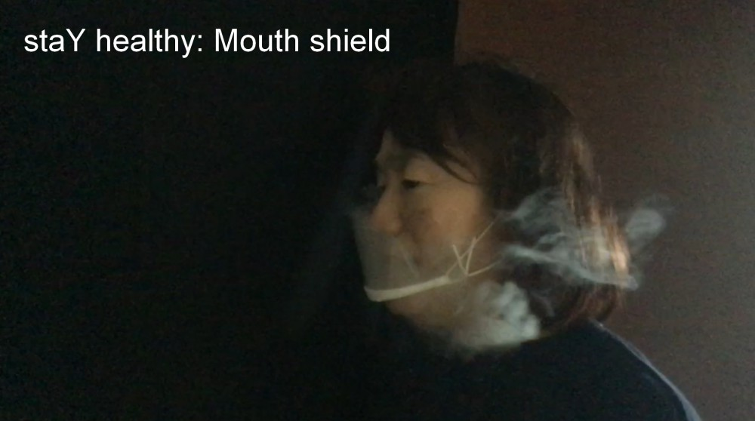
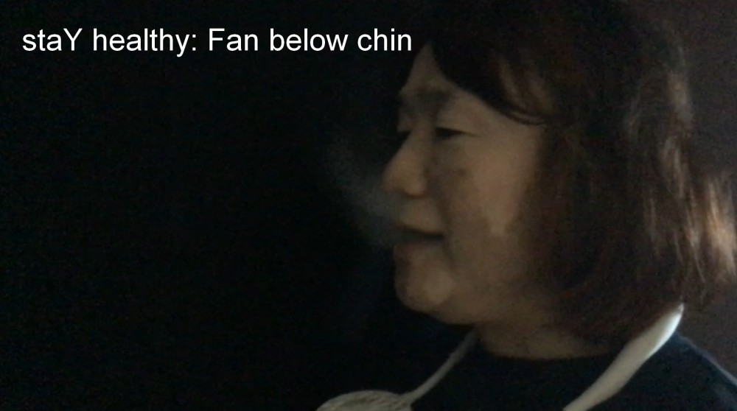
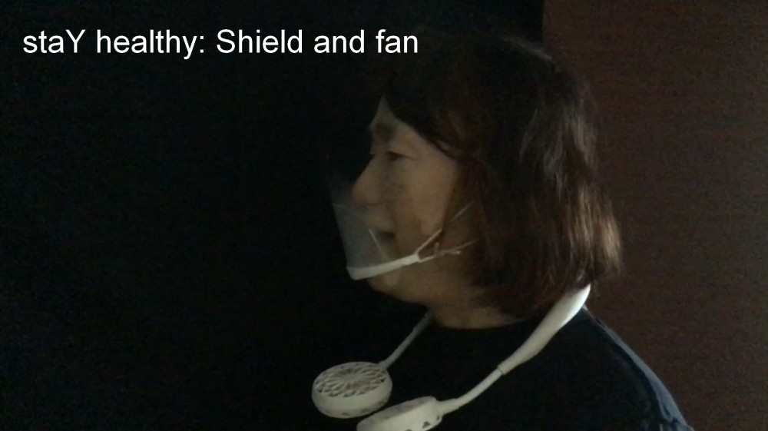
Supplementary Figure S3:
Still pictures of smoke videos with safety devices

Slide 5
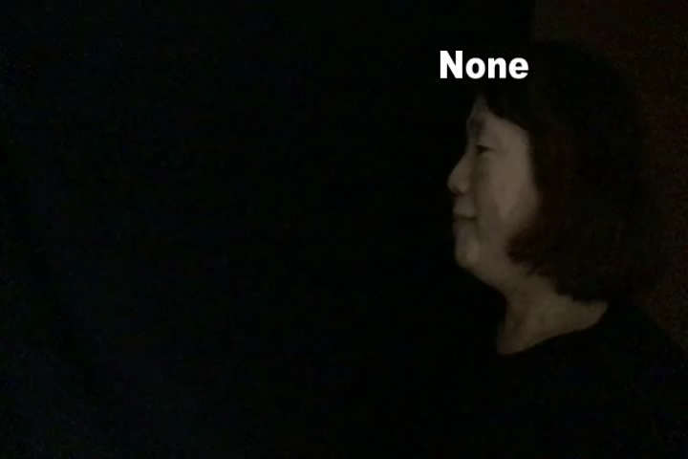
Supplementary video

