Slide 1
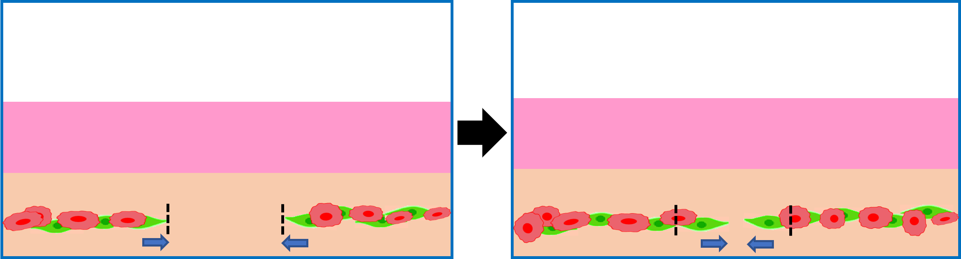


Supplemental Figure 1
Medium
Medium
Collagen gel
Collagen gel
Cancer Cells
CAFs

Slide 2
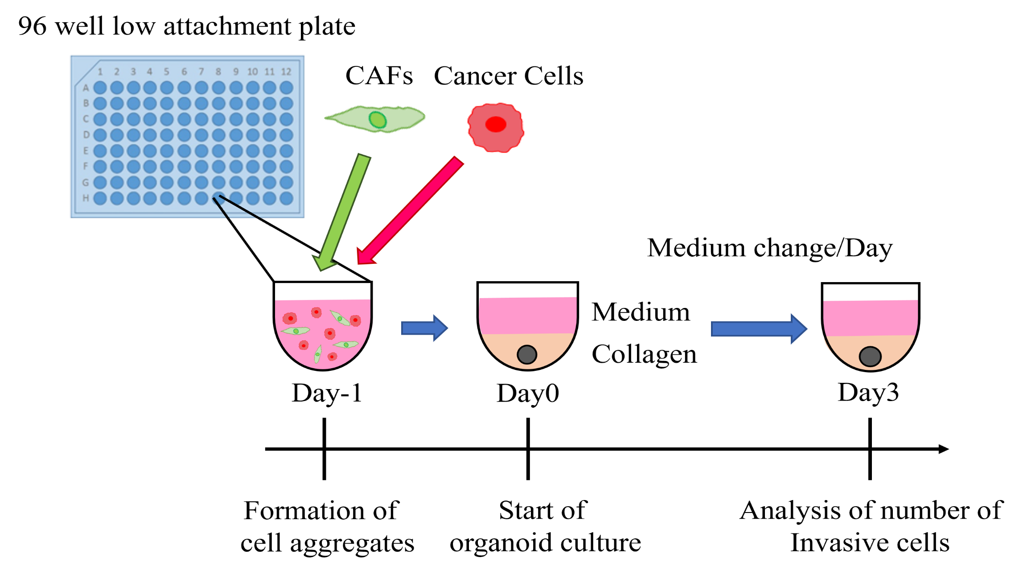
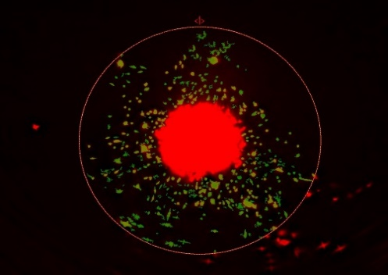
Supplementary Figure 2
A
B

Slide 3
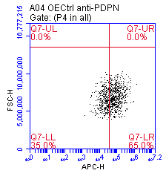
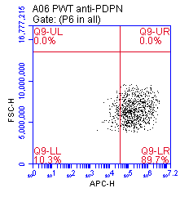
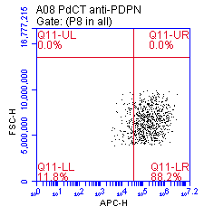
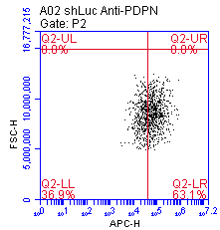
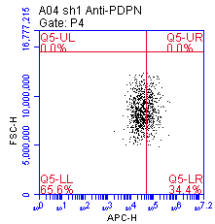
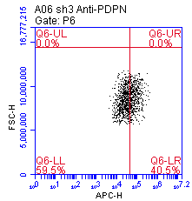
Supplementary Figure 3
A
CAFs-Ctrl
CAFs-PDPN-WT
CAFs-PDPN-Del.IC
B
CAFs-shLuc
CAFs-shPDPN1
CAFs-shPDPN3
C
CAFs-Ctrl
CAFs-PDPN-WT
CAFs-PDPN-Del.IC
D
CAFs-shLuc
CAFs-shPDPN1
CAFs-shPDPN3

Slide 4
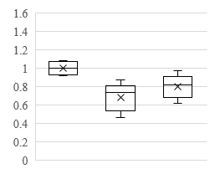
Supplementary Figure 4
A
CAFs-shLuc
CAFs-shPDPN1
CAFs-shPDPN3
Day0
Day3
B
**
*
Invasion Index of CAFs
shLuc
shPDPN1
shPDPN3

Slide 5
Supplementary Figure 5
Target gene/GAPDH*100
Target gene/GAPDH*100

