Slide 1
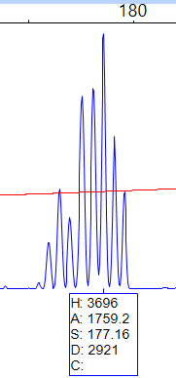
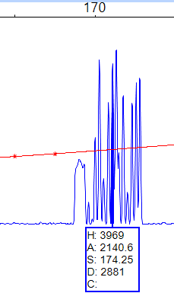
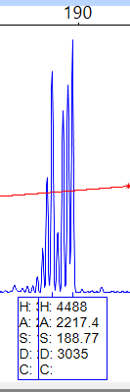
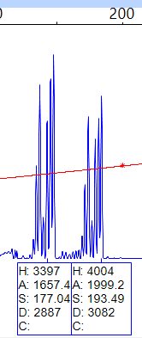
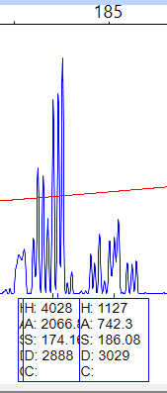
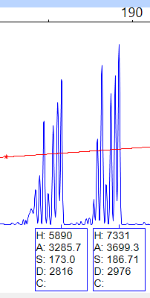
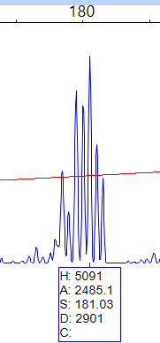
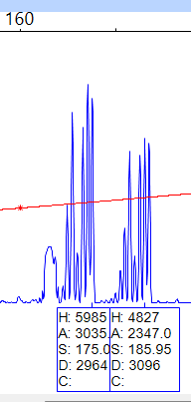
1
2
3
4
5
6
7
8
ESM_Fig.3 BC2 1-8
Notes:
BC2

Slide 2
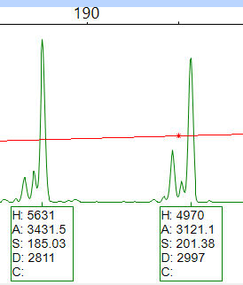
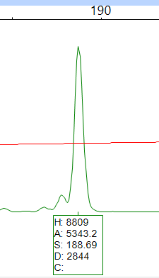
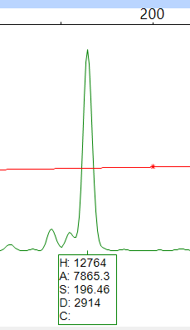
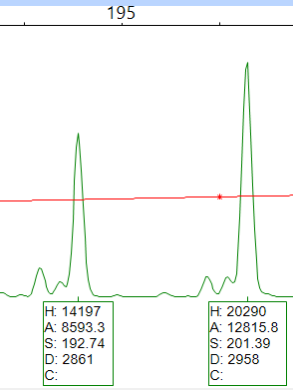
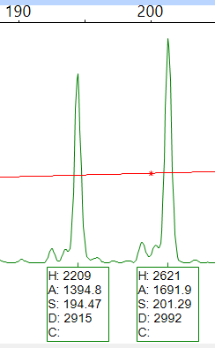
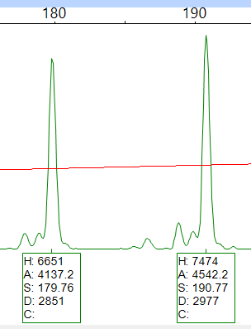
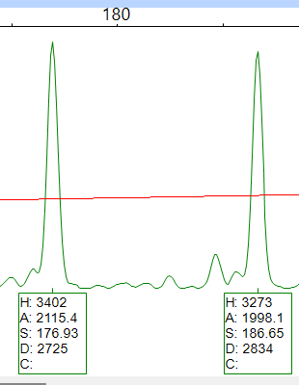
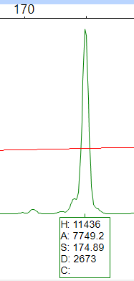
1
2
3
4
5
6
7
8
ESM_Fig.3 BC7 1-8
Notes:
BC7

Slide 3
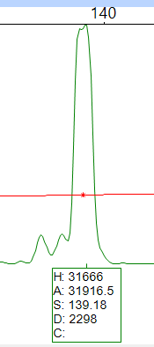
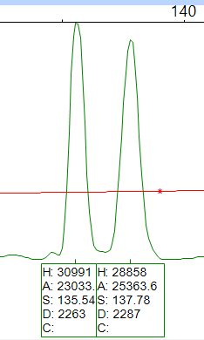
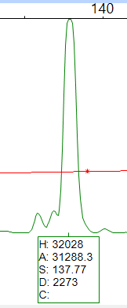
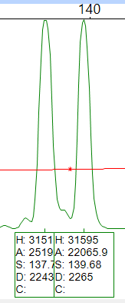
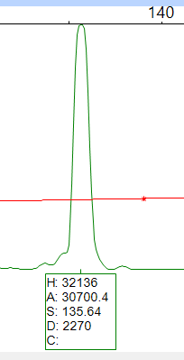
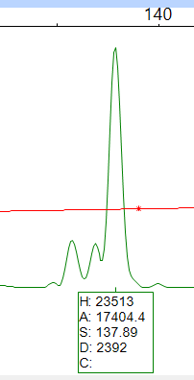
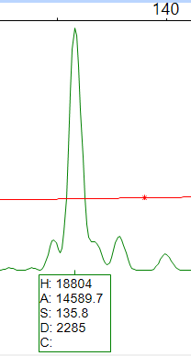
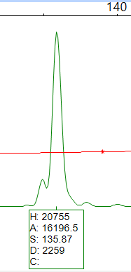
1
2
3
4
5
6
7
8
ESM_Fig.3 BC8 1-8
Notes:
BC8

Slide 4
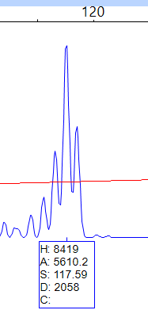
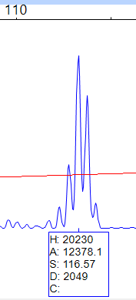
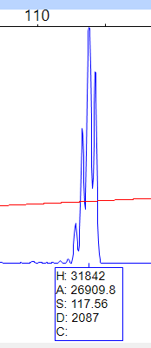
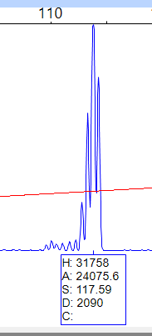
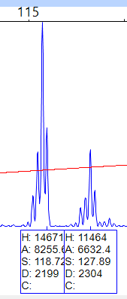
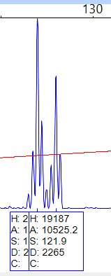
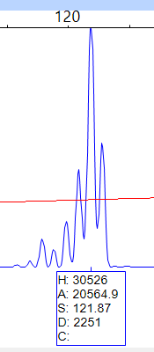
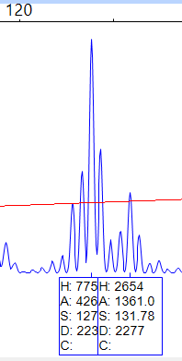
1
2
3
4
5
6
7
8
ESM_Fig.3 BC17 1-8
Notes:
BC17

Slide 5
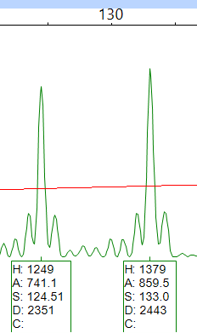
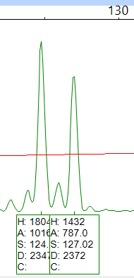
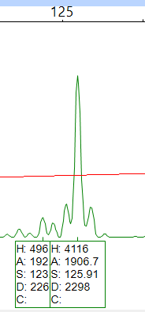
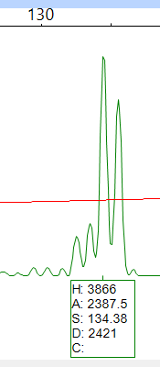
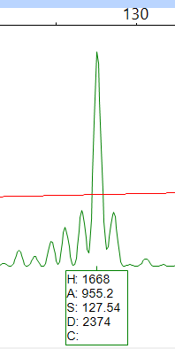
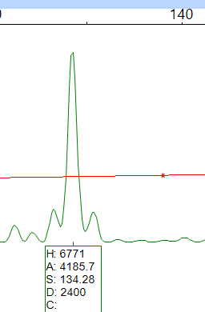
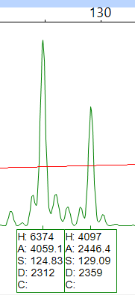
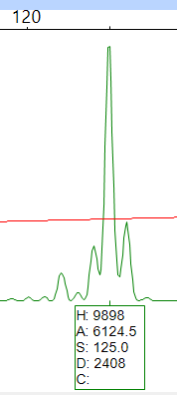
1
2
3
4
5
6
7
8
ESM_Fig.3 BC23 1-8
Notes:
BC23

Slide 6
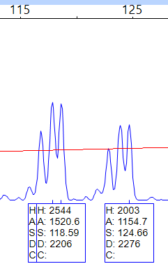
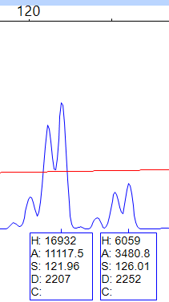
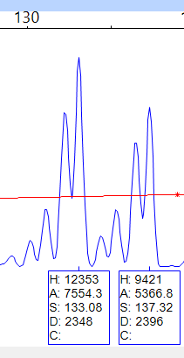
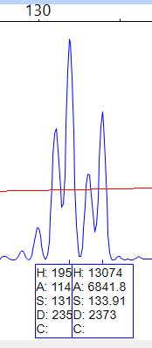
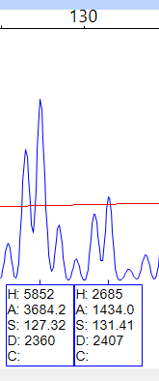
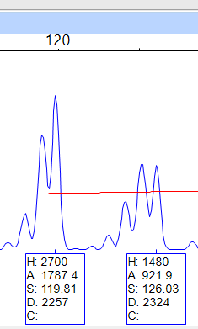
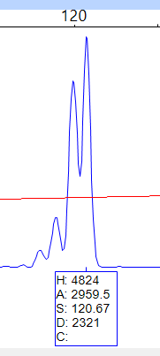
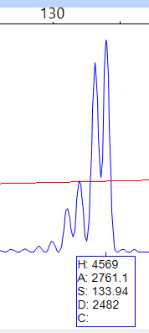
1
2
3
4
7
5
8
6
ESM_Fig.3 BC2 6 1-8
Notes:
BC26

Slide 7
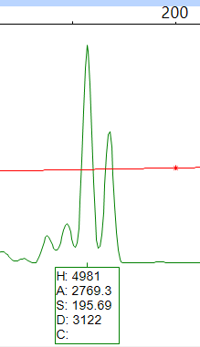
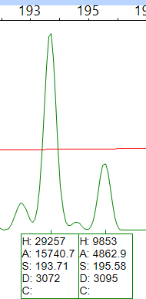






1
2
3
4
5
6
7
8
ESM_Fig.3 BC29 1-8
Notes:
BC29

Slide 8








1
2
3
4
5
6
8
7
ESM_Fig.3 BC33 1-8
Notes:
BC33

Slide 9








3
4
1
2
5
6
7
8
ESM_Fig.3 BC38 1-8
Notes:
BC38

Slide 10








1
2
3
4
5
6
7
8
ESM_Fig.3 BC50 1-8
Notes:
BC50

Slide 11








1
2
3
4
7
8
5
6
ESM_Fig.3 BC53 1-8
Notes:
BC53

Slide 12








1
2
3
4
5
6
7
8
ESM_Fig.3 BC58 1-8
Notes:
BC58

Slide 13








1
2
3
4
5
6
7
8
ESM_Fig.3 BC67 1-8
Notes:
BC67

Slide 14








1
2
3
4
5
6
7
8
ESM_Fig.3 BC71 1-8
Notes:
BC71

Slide 15








1
2
3
4
6
7
8
5
ESM_Fig.3 BC73 1-8
Notes:
BC73

Slide 16








1
2
3
4
5
6
7
8
ESM_Fig.3. BC74 1-8
Notes:
BC74

Slide 17








1
2
3
4
5
6
7
8
ESM_Fig.3. BC84 1-8
Notes:
BC84

Slide 18








2
3
4
1
5
6
7
8
ESM_Fig.3. BC87 1-8
ESM Fig.3Electropherogram of capillary sequencing showing the validation of 18 SSR markers with eight accessions of B. ciliata
Notes:
BC87

