Slide 1
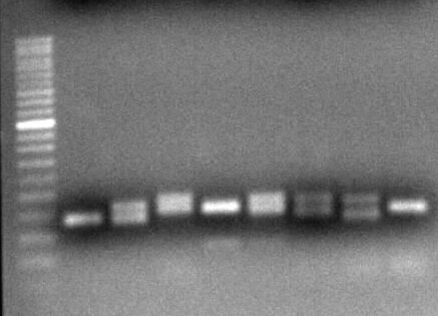
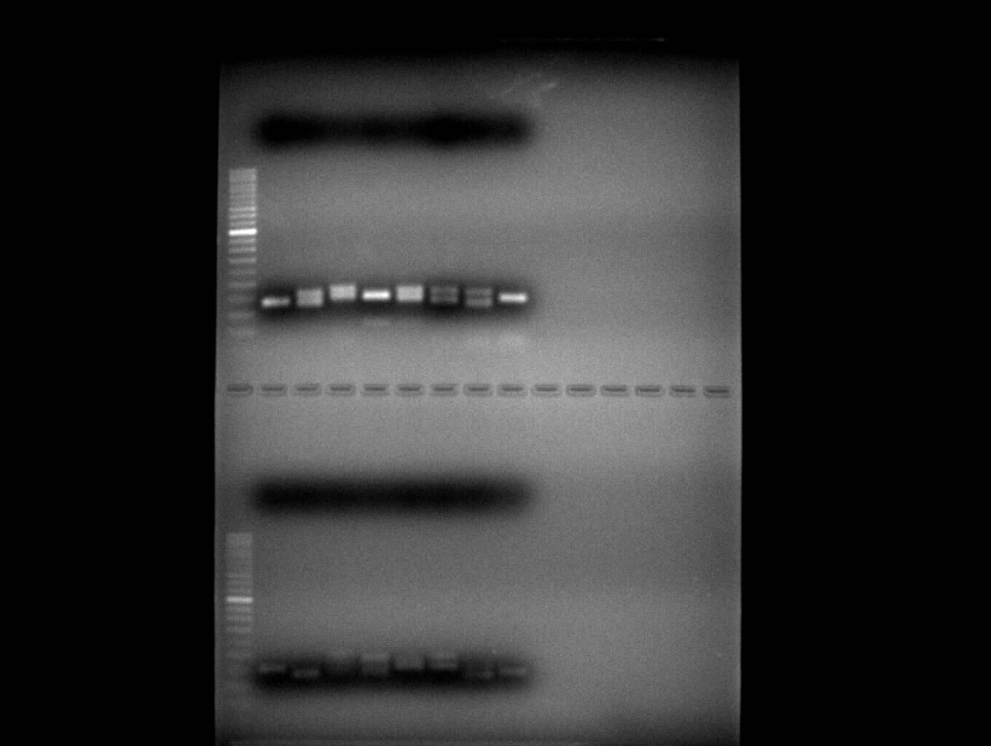
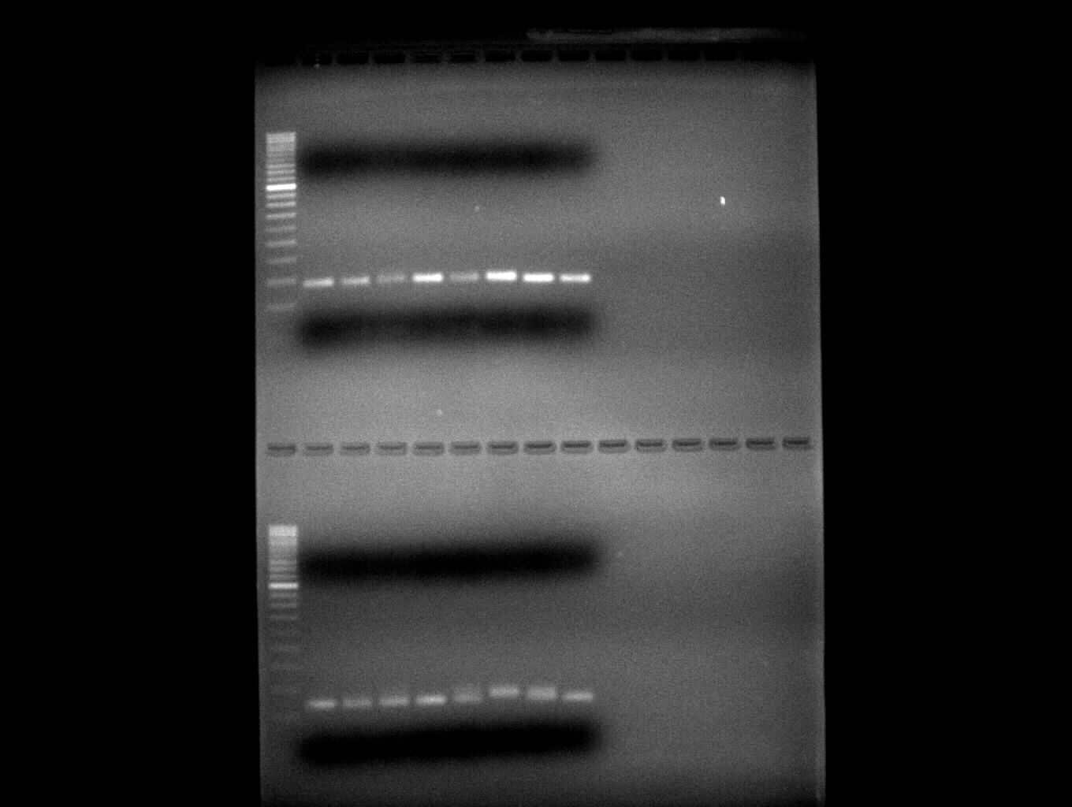
M 1 2 3 4 5 6 7 8 1 2 3 4 5 6 7 8
a
b
L
500
450
350
300
250
200
150
100
150
100
50
c
d
L
500
450
350
300
250
200
150
100
150
100
50
ESM_Fig. 2.(a) BC2 (b) BC7 (c) BC8 (d) BC17

Slide 2
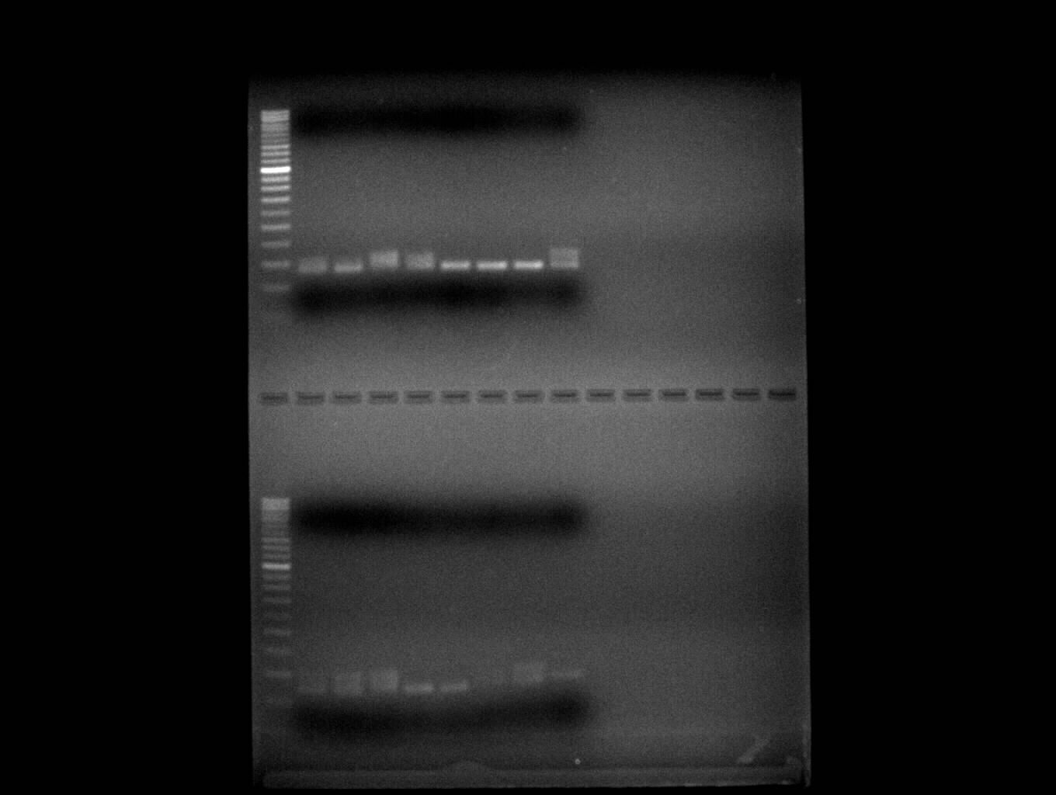
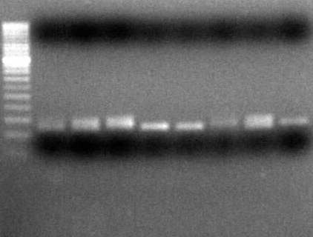
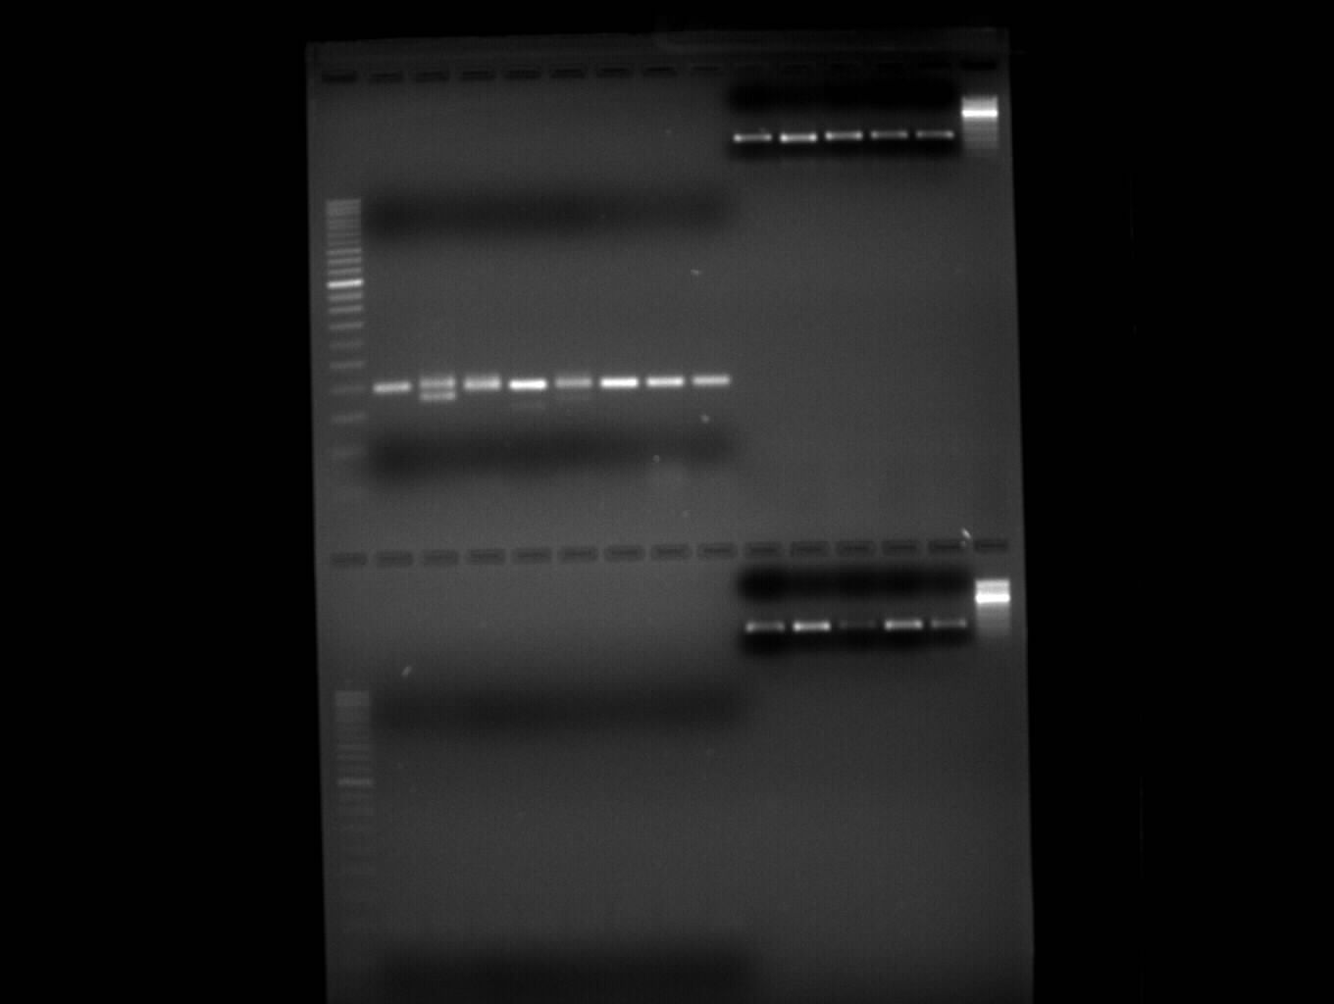
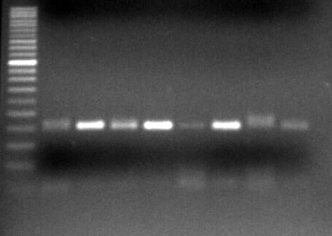
M 1 2 3 4 5 6 7 8 1 2 3 4 5 6 7 8
e
f
L
500
450
350
300
250
200
150
100
150
100
50
g
h
L
500
450
350
300
250
200
150
100
150
100
50
ESM_Fig. 2. (e) BC23 (f) BC26 (g) BC 29 (h) BC 33

Slide 3
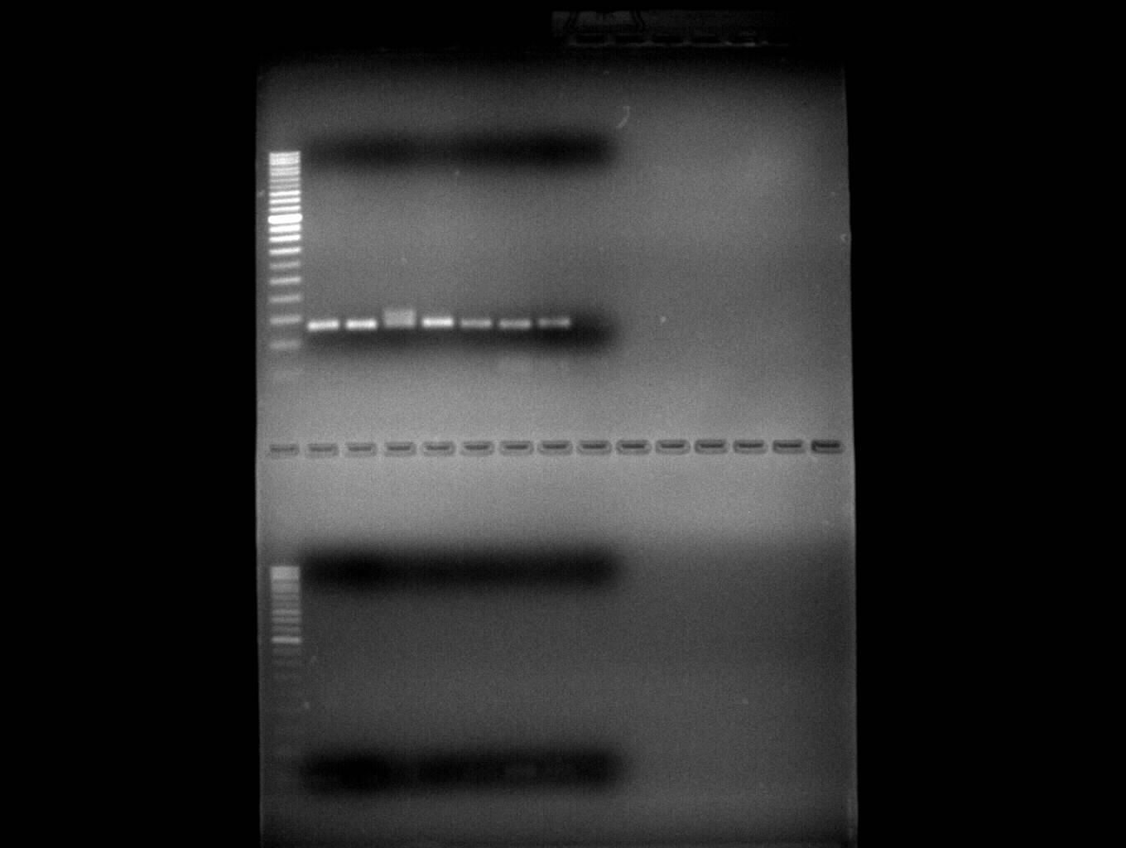
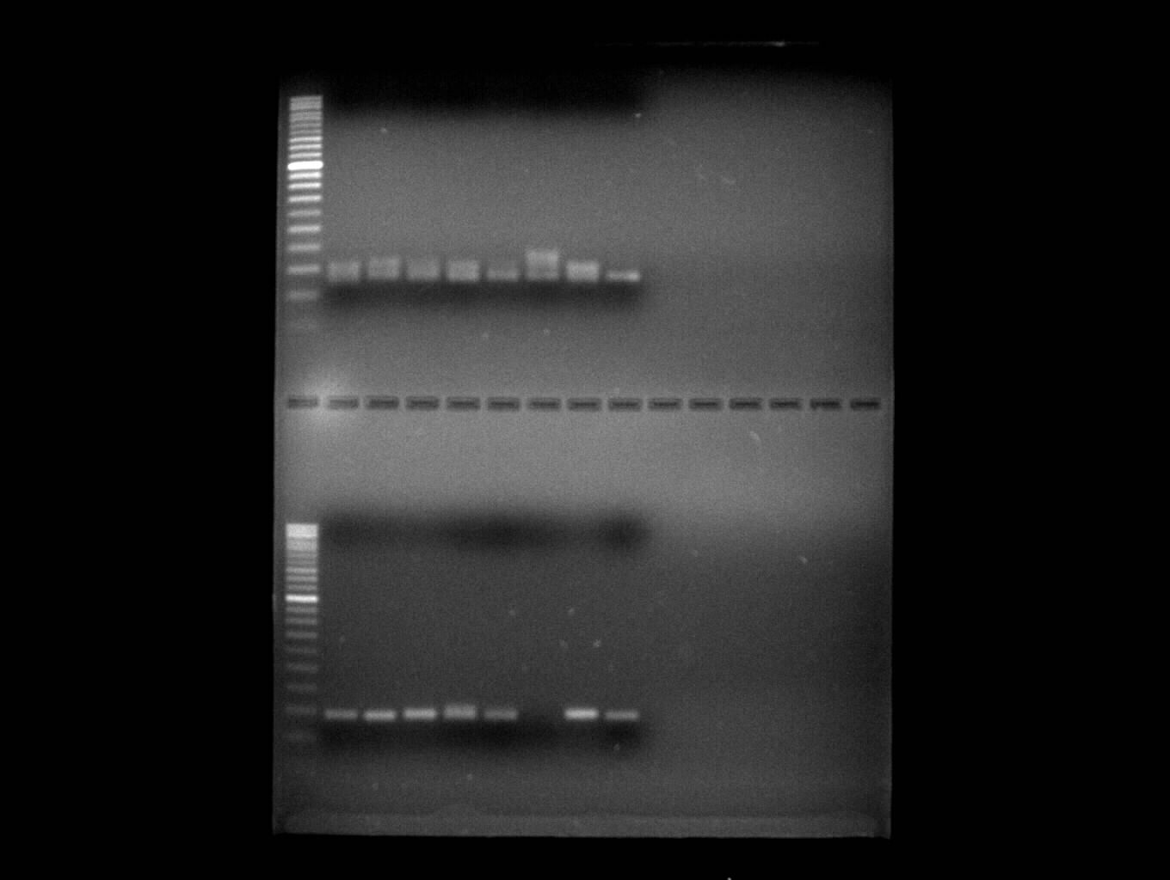
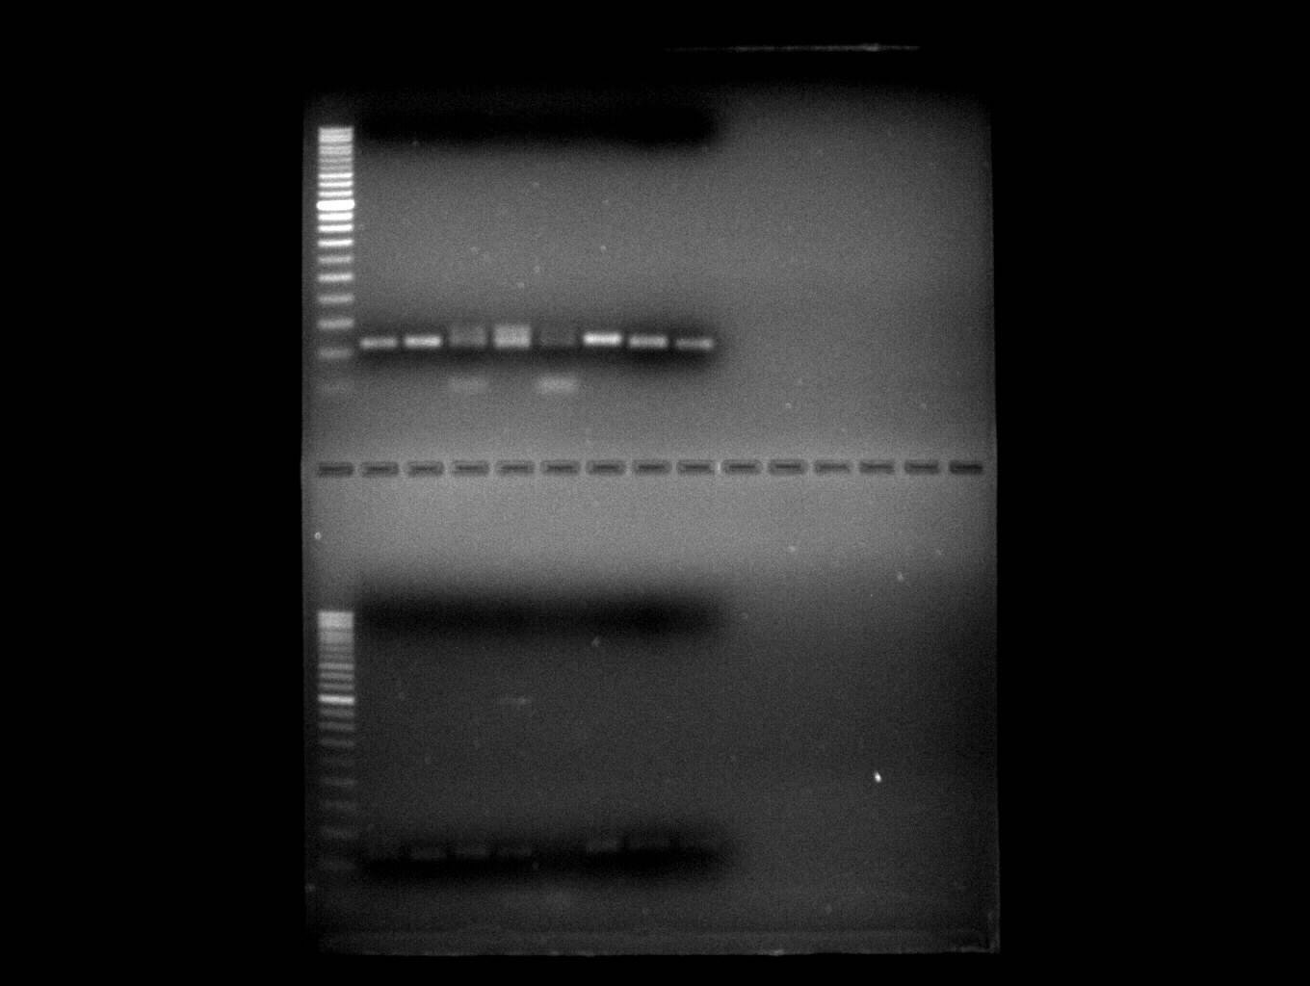
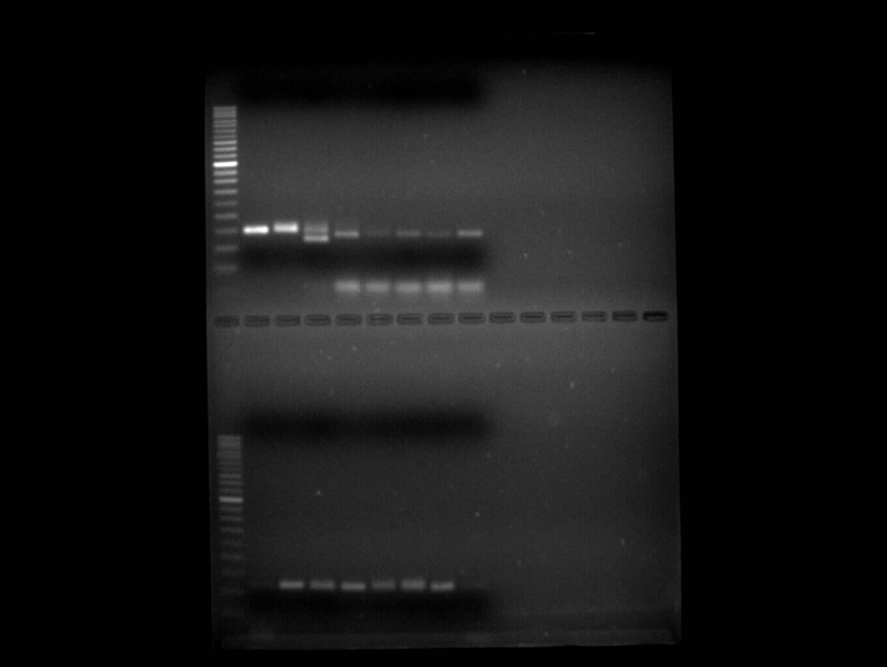
M 1 2 3 4 5 6 7 8 1 2 3 4 5 6 7 8
i
j
L
500
450
350
300
250
200
150
100
150
100
50
k
l
l
L
500
450
350
300
250
200
150
100
150
100
50
ESM_Fig. 2.(i) BC38 (j) BC50 (k) BC 53 (l) BC 58

Slide 4
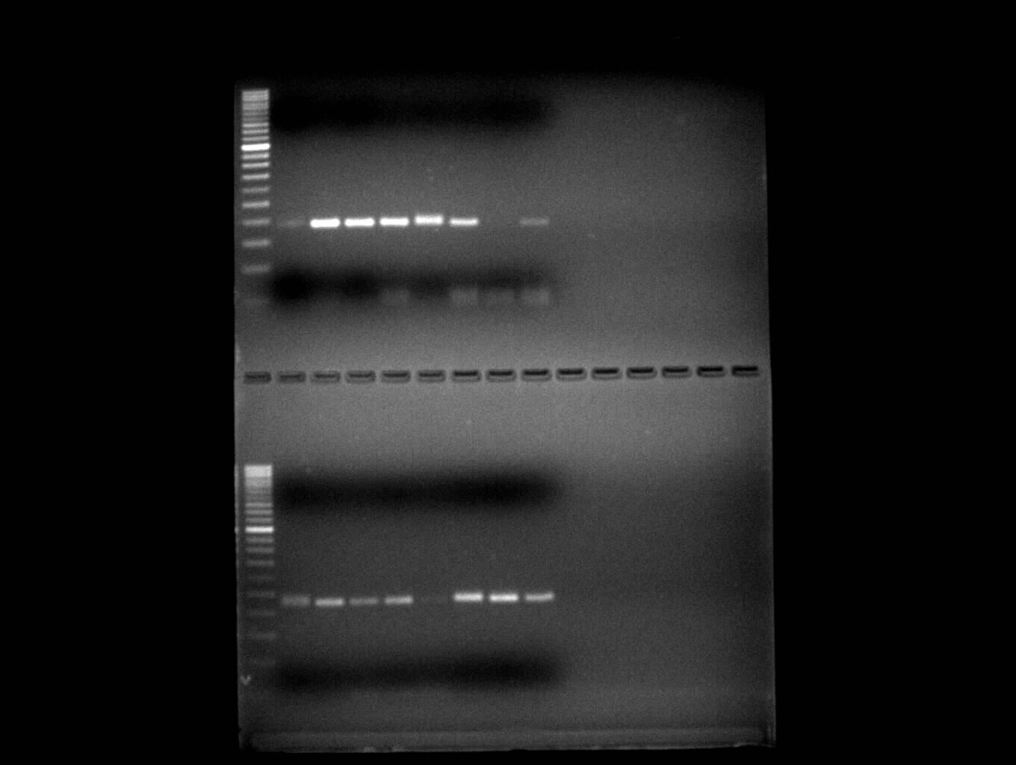
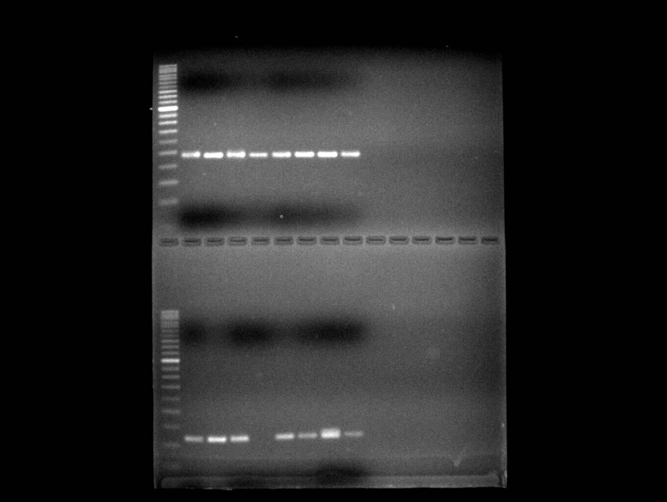
M 1 2 3 4 5 6 7 8 1 2 3 4 5 6 7 8
m
n
L
500
450
350
300
250
200
150
100
150
100
50
o
p
p
L
500
450
350
300
250
200
150
100
150
100
50
ESM_Fig. 2. (m) BC 67 (n) BC71 (o) BC 73 (p) BC 74

Slide 5
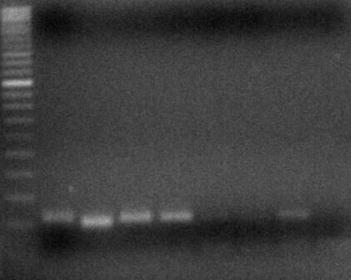
M 1 2 3 4 5 6 7 8 1 2 3 4 5 6 7 8
q
r
L
500
450
350
300
250
200
150
100
150
100
50
ESM_Fig. 2.(q) BC 84 (r) BC87
ESM Fig. 2 Gel profiles showing the validation of 18 SSR markers with eight accessions of B. ciliata

