Slide 1
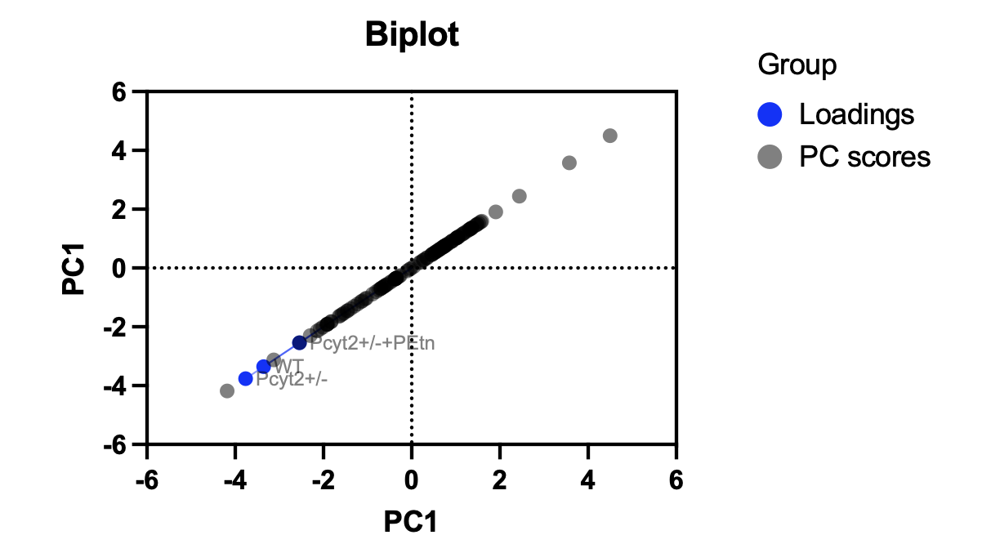
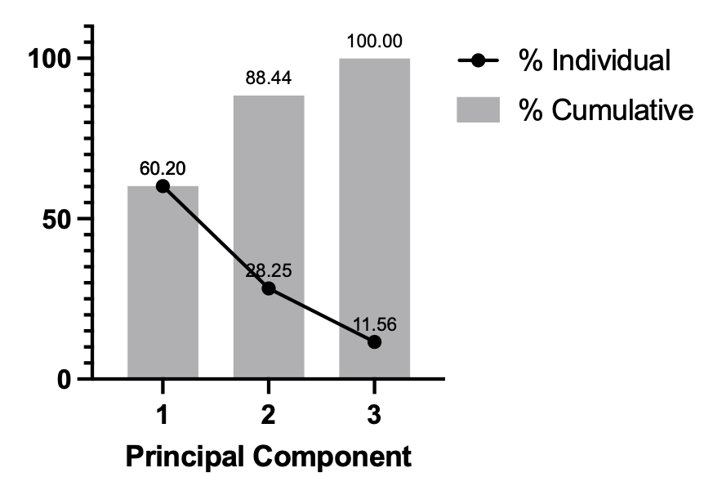
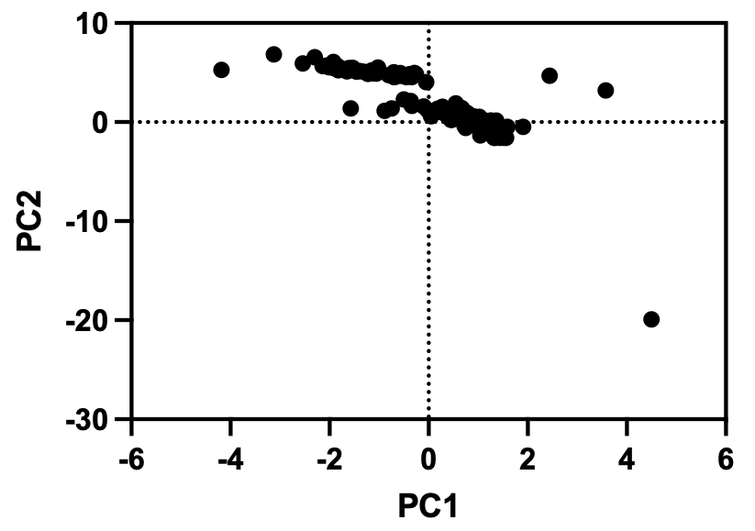
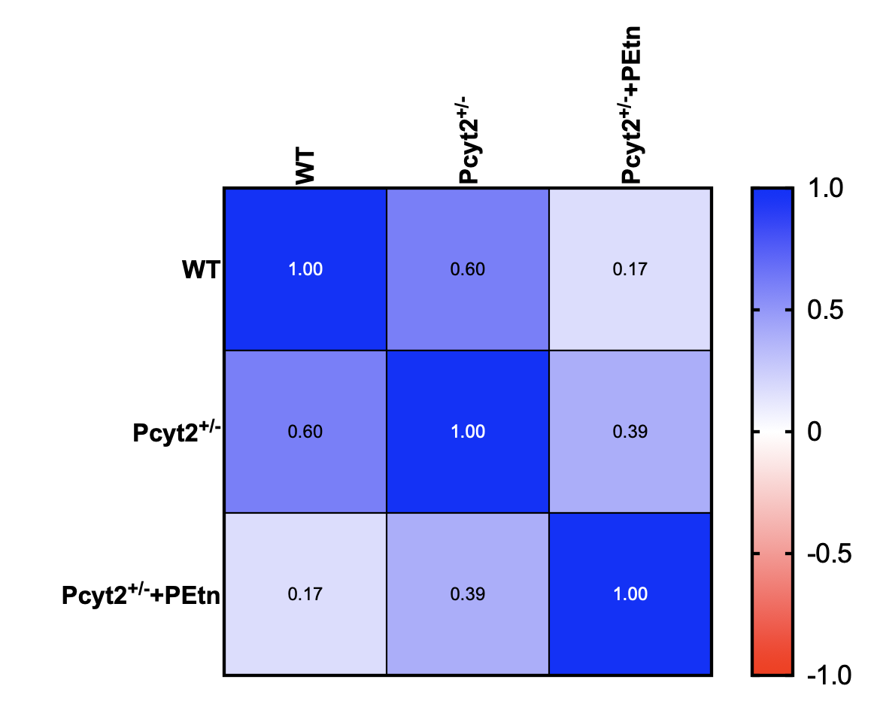
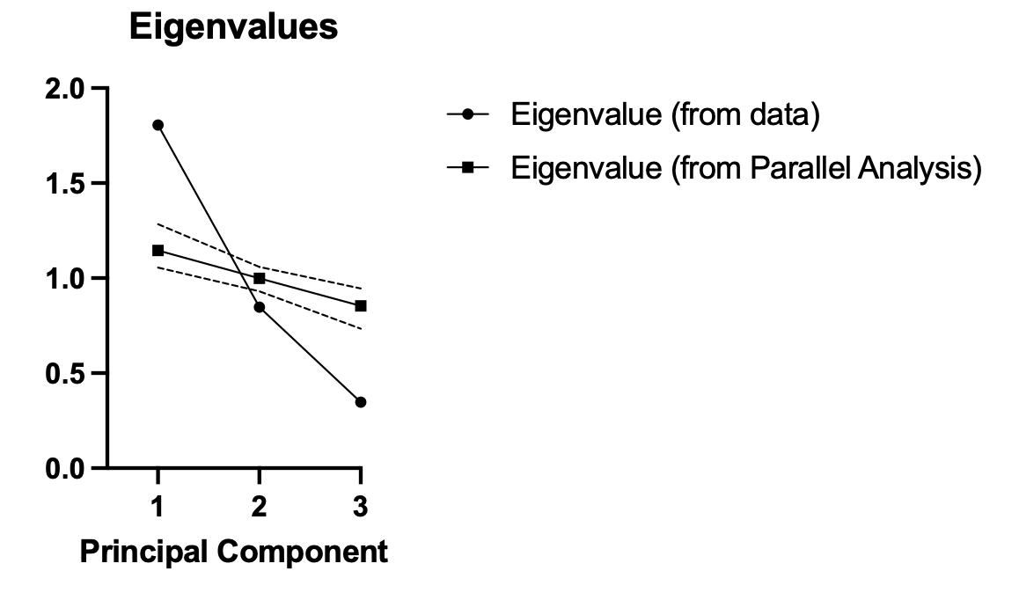
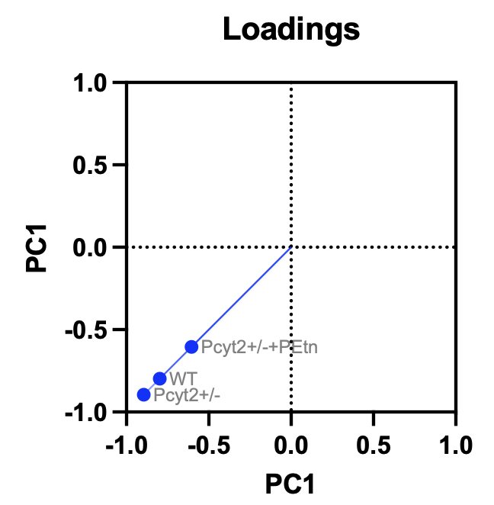
Figure S1. PCA analysis of overlapping DMGs between Pcyt2^{+/-} and Pcyt2^{+/-} +PEtn
(A)
(B)
(C)
(D)
(E)
(F)
Pcyt2 ^{+/+}
Pcyt2 ^{+/+}

Slide 2
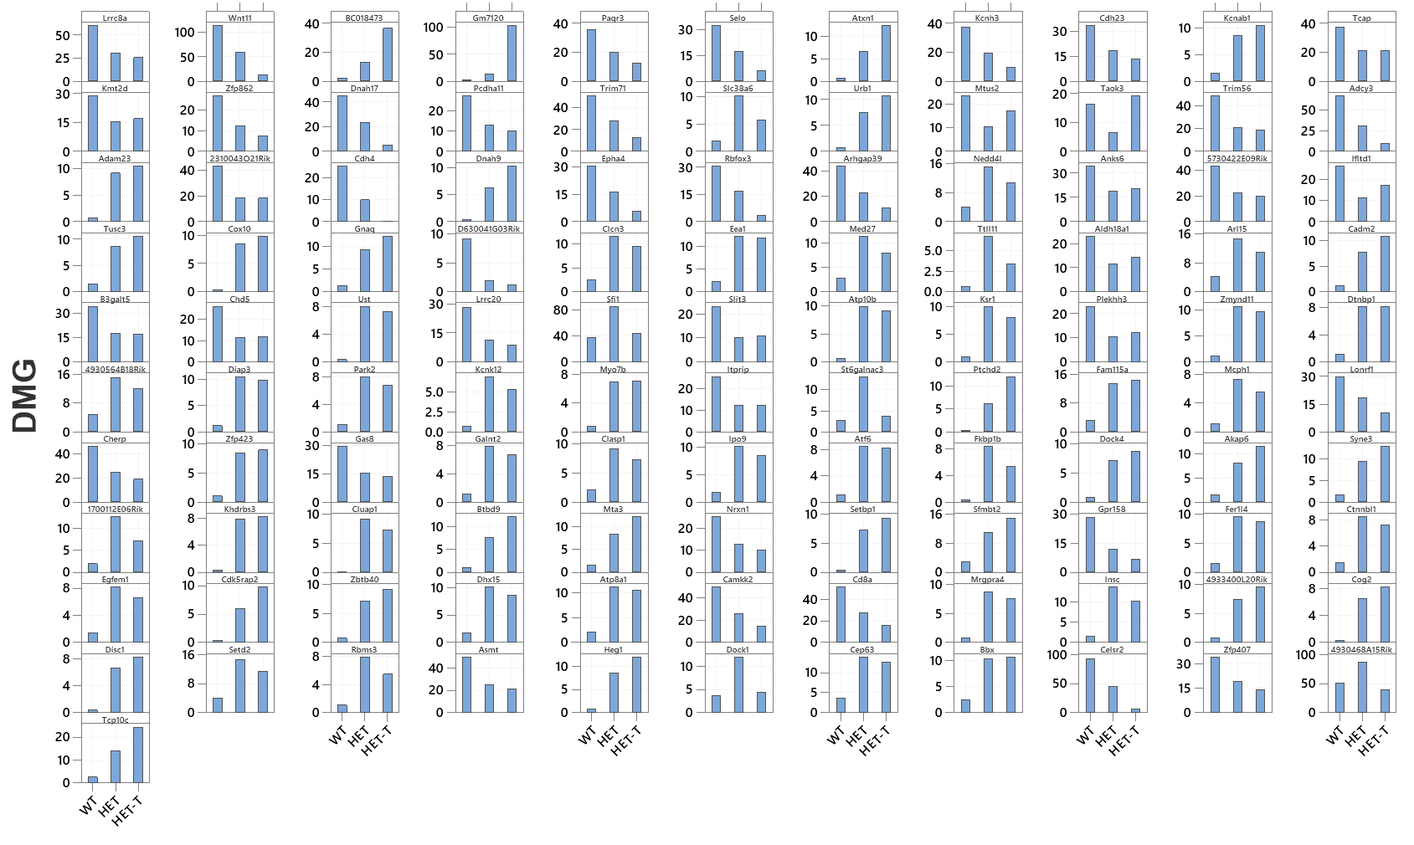
Figure S2. Histogram of overlapping DMGs between Pcyt2^{+/-} and Pcyt2^{+/-} +PEtn
Pcyt2^{+/-}
Pcyt2^{+/-}
Pcyt2^{+/-} +PEtn
Pcyt2^{+/-} +PEtn
Pcyt2^{+/-}
Pcyt2^{+/-} +PEtn
Pcyt2^{+/-}
Pcyt2^{+/-} +PEtn
Pcyt2^{+/-}
WT
WT
WT
WT
Pcyt2^{+/-} +PEtn
WT
(A)
WT
WT
WT
WT
WT
Pcyt2^{+/-}
Pcyt2^{+/-} +PEtn
Pcyt2^{+/-}
Pcyt2^{+/-}
Pcyt2^{+/-} +PEtn
Pcyt2^{+/-} +PEtn
Pcyt2^{+/-}
Pcyt2^{+/-}
Pcyt2^{+/-} +PEtn
Pcyt2^{+/-} +PEtn
WT
Pcyt2^{+/-}
Pcyt2^{+/-} +PEtn

Slide 3
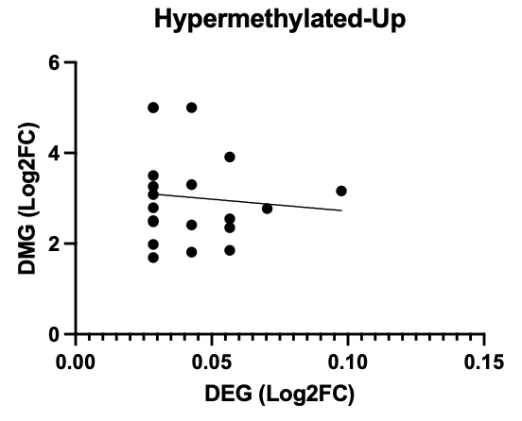
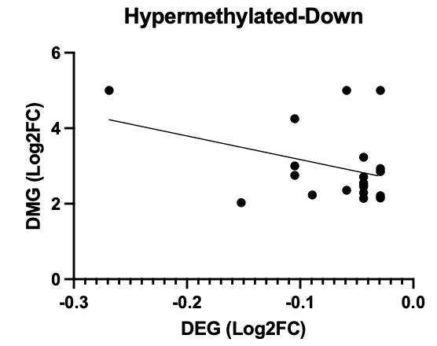
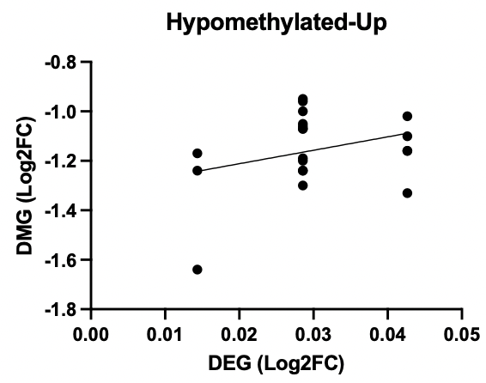
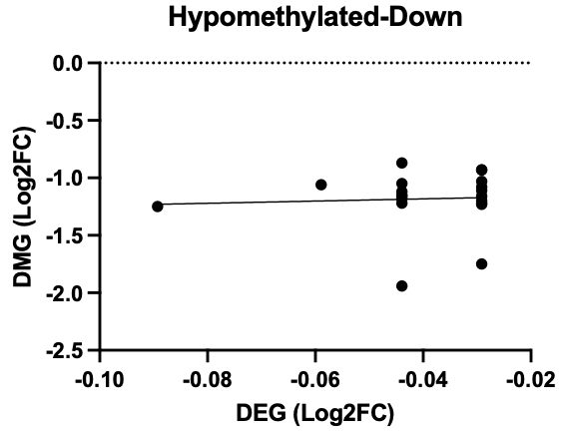
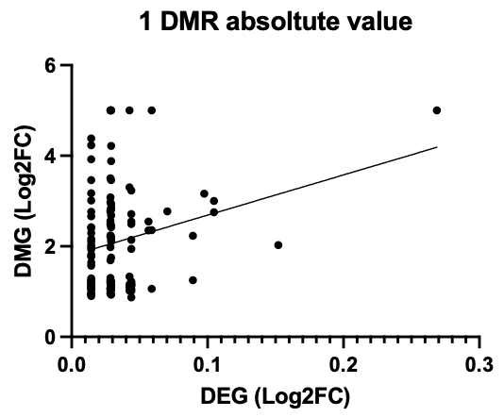
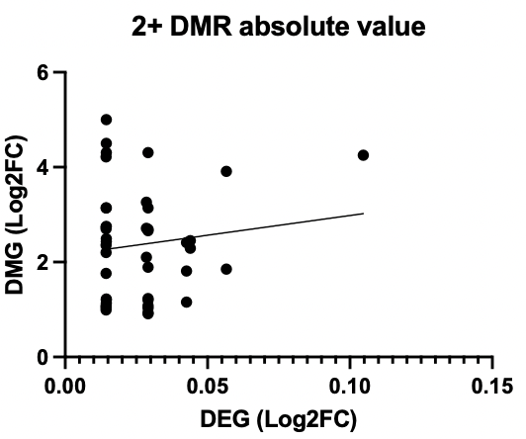
Fig. S3 Correlation plots of Pcyt2^{+/-} DMG /DEGs
(A)
(B)
(C)
(D)
R=0.008873
R=0.1311
R=0.09724
R=0.003117
(E)
(F)
R=0.05712
R=0.01575

Slide 4
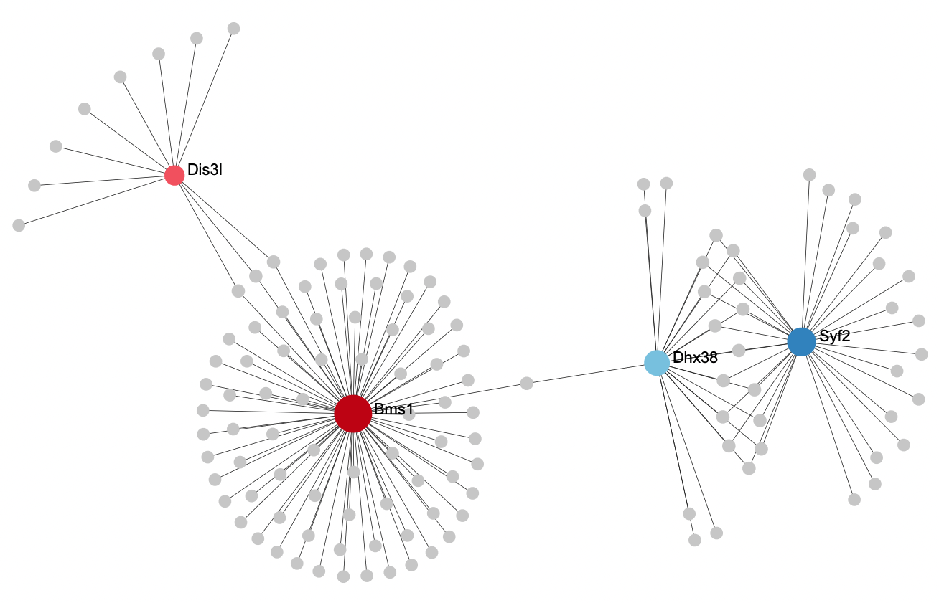
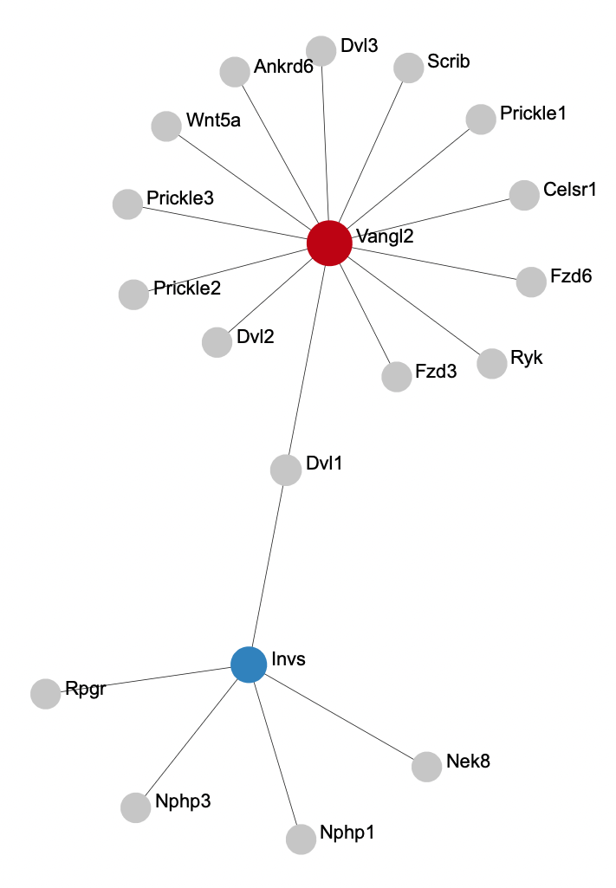
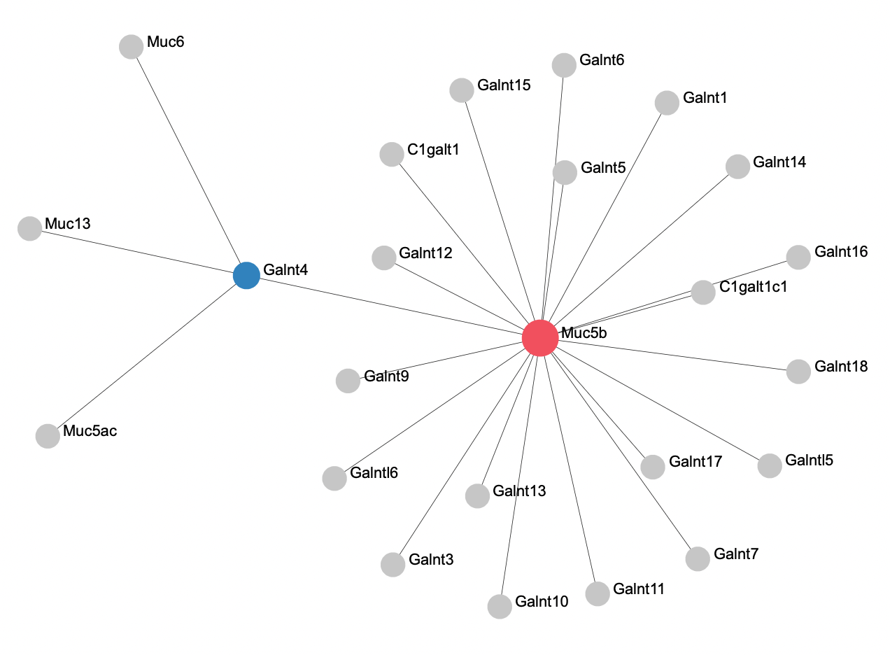
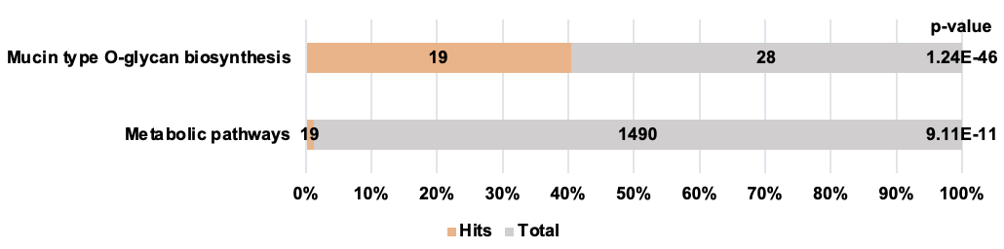
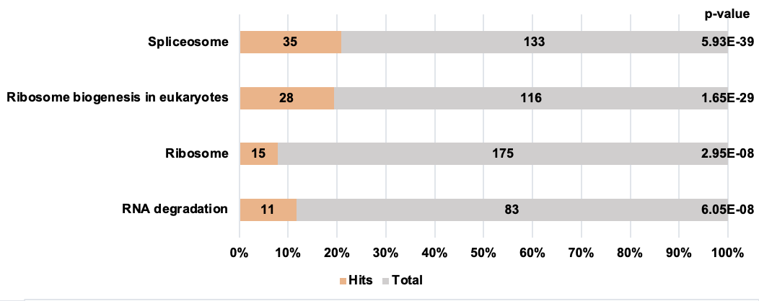
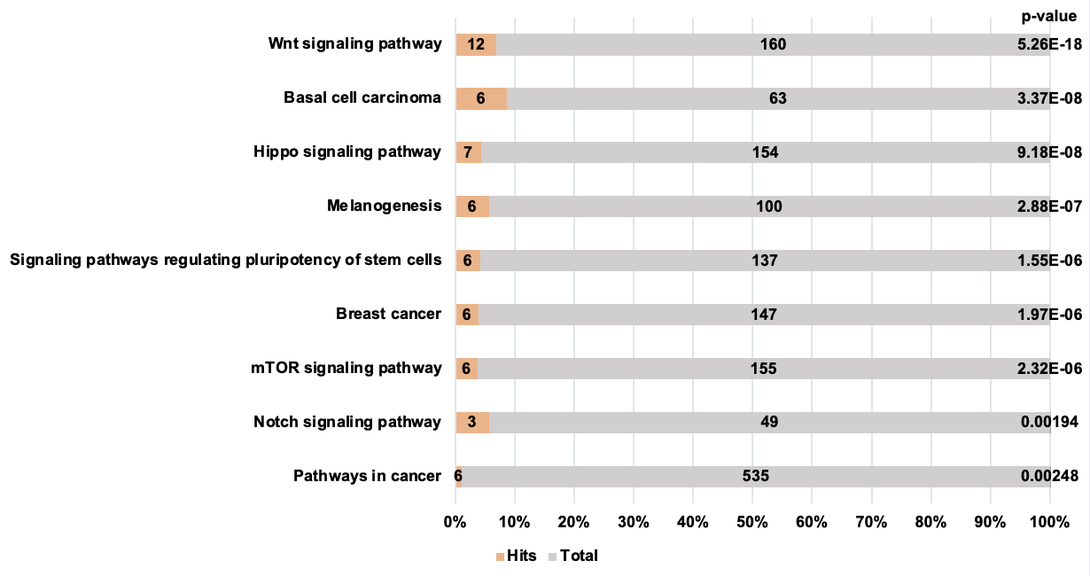
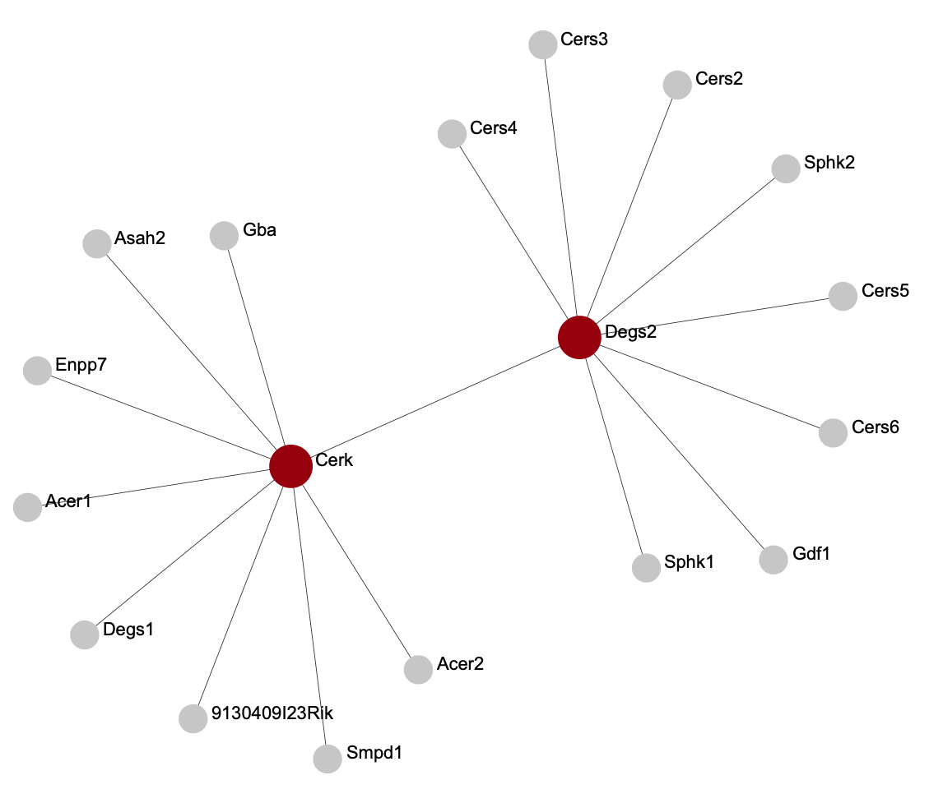
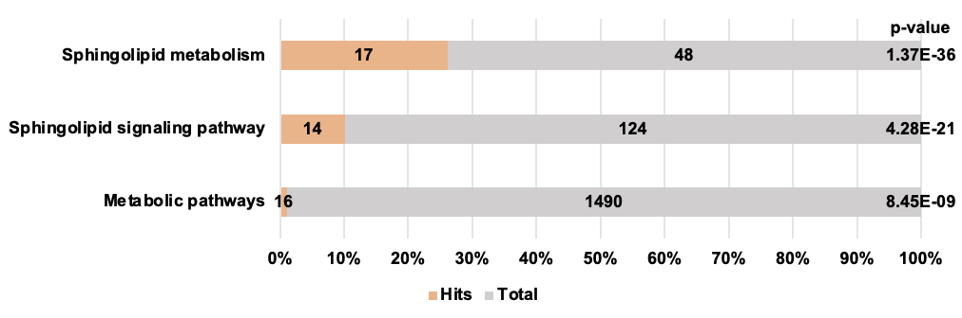
Fig. S4 smaller subnetwork of protein-protein interaction in DMG/DEGs
(A)
(B)
(C)
(D)

