Slide 1
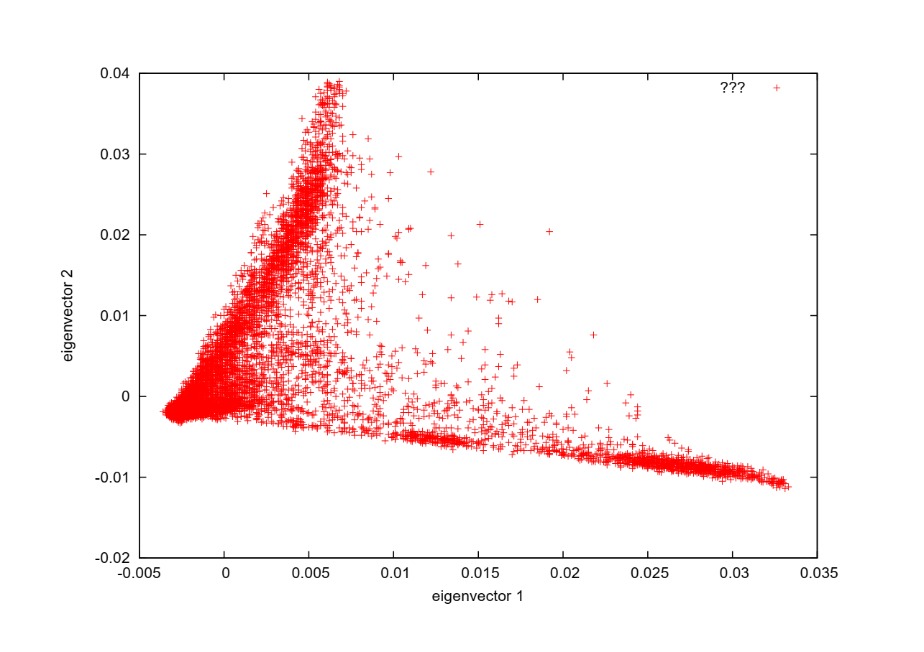
Supplementary Figure 1. Principal component analysis of the genotyping data.

