Slide 1
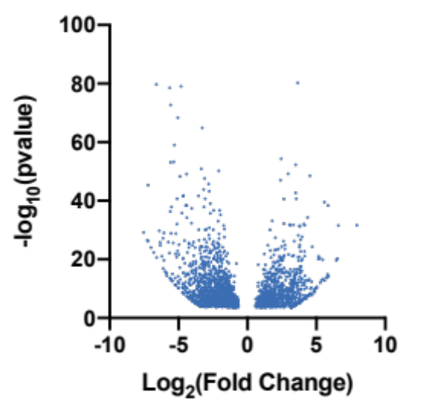

T-ALL vs. CD4 (top upregulated)
T-ALL vs. CD8 (top upregulated)
Gene | Fold Change | P-value
Rag1 | 244.67 | 2.31E-32
Endou | 96.53 | 3.44E-32
Syt13 | 92.16 | 6.30E-21
Arpp21 | 87.98 | 1.89E-20
Uaca | 59.20 | 5.29E-15
Dntt | 57.53 | 3.93E-39
Gm525 | 56.49 | 1.21E-15
Pdgfrb | 55.66 | 1.20E-14
Gfra1 | 53.90 | 2.19E-14
Slc4a1 | 48.27 | 1.66E-13
Gzma | 48.14 | 3.31E-40
Arsi | 44.94 | 5.03E-14
Ccdc18 | 43.82 | 1.12E-20
Hba-a2 | 41.27 | 1.19E-13
Nt5dc2 | 39.12 | 9.53E-13
Notch3 | 38.37 | 4.32E-21
Smo | 35.71 | 1.02E-21
Zfp704 | 35.48 | 7.13E-21
Vash1 | 32.60 | 2.75E-11
H2-T3 | 31.85 | 8.79E-11
Ptcra | 31.15 | 6.91E-11
Aqp11 | 28.85 | 1.60E-10
Hba-a2 | 28.68 | 1.72E-09
Rag2 | 28.64 | 6.57E-10
Heyl | 28.02 | 9.68E-10
Hbb-bs | 25.98 | 1.46E-08
Ptpn14 | 25.83 | 4.75E-25
Col27a1 | 25.04 | 4.07E-13
Ccne2 | 24.76 | 4.24E-11
Spta1 | 24.38 | 4.37E-09
Aqp1 | 23.96 | 1.18E-10
Gypa | 23.36 | 1.27E-08
Hemgn | 23.10 | 4.95E-09
Tmem151b | 22.42 | 1.54E-08
Gene | Fold Change | P-value
Rag1 | 258.50 | 7.97E-32
Endou | 99.45 | 6.31E-32
Syt13 | 96.57 | 1.42E-20
Arpp21 | 92.14 | 4.19E-20
Dntt | 68.69 | 3.10E-38
Uaca | 62.88 | 6.52E-15
Gm525 | 59.26 | 1.94E-15
Gfra1 | 57.11 | 2.72E-14
Chdh | 51.79 | 5.13E-24
Slc4a1 | 51.10 | 2.03E-13
Pdgfrb | 46.59 | 6.57E-14
Notch3 | 45.60 | 1.18E-20
Ccdc18 | 45.04 | 1.53E-20
Smo | 42.55 | 4.75E-21
Zfp704 | 42.25 | 2.31E-20
Hba-a2 | 41.50 | 2.97E-12
Gzma | 41.17 | 4.94E-42
Arsi | 35.31 | 6.36E-14
Vash1 | 34.13 | 3.62E-11
H2-T3 | 33.50 | 1.05E-10
Bmp7 | 33.20 | 4.01E-11
Ptcra | 32.63 | 8.85E-11
Ngp | 32.59 | 1.45E-15
Rag2 | 30.21 | 7.32E-10
Aqp11 | 30.15 | 2.06E-10
Heyl | 29.57 | 1.06E-09
Hbb-bs | 28.52 | 4.40E-09
Camp | 27.09 | 3.21E-09
Hba-a2 | 26.31 | 1.66E-08
Il17rb | 26.19 | 2.04E-11
Ccne2 | 25.64 | 5.18E-11
Spta1 | 25.61 | 4.94E-09
Ptprf | 25.37 | 2.03E-17
Aqp1 | 24.84 | 1.42E-10
T-ALL vs. CD4
T-ALL vs. CD8
Supplementary Fig. 1: Differentially expressed genes in T-ALL cells vs. CD4 and CD8 splenic T-cells: Volcano plots and top-upregulated genes comparing T-ALL infiltrated spleens to either CD4+ or CD8+ T-cells isolated from non-tumor bearing mice.

Slide 2
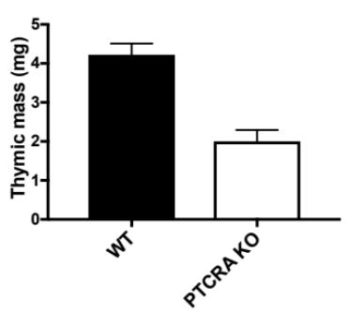
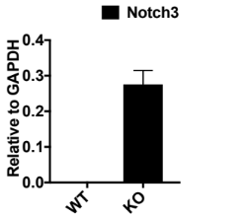
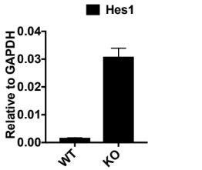
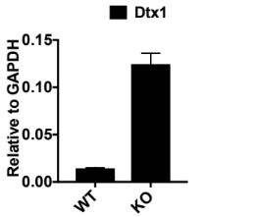
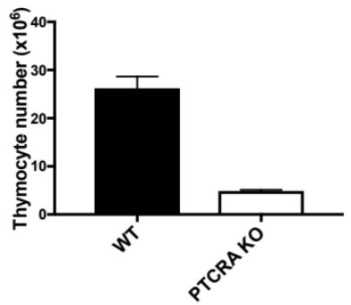
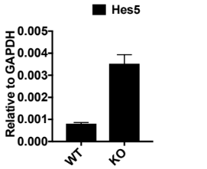
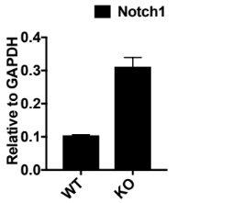
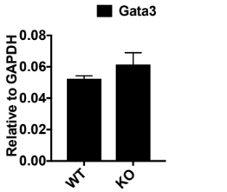
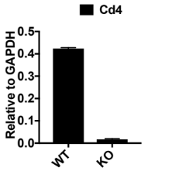
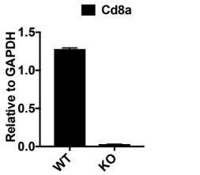
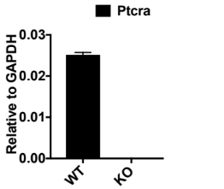
A
B
WT
PTCRA KO
D
4+/-2
90+/- 4
3+/-2
3+/- 1
WT
PTCRA KO
2+/-2
2+/-1
91+/-5
2+/-1
CD4
CD8
C
WT
PTCRA KO
WT
PTCRA KO
DN1
9+/-3
DN2
4+/- 1
DN1
10+/-2
DN2
6+/- 2
DN4
39+/-4
DN3
49+/-6
DN4
11+/-3
DN3
75+/-1
CD44
CD25
Supplementary Fig. 2: Ptcra KO results in thymic hypoplasia and arrest of thymocytes at the DN3 checkpoint. (A) Thymi derived from Ptcra KO animals are markedly reduced in size, mass and cellularity. n=4, error bars indicate s.d. (B, C) Immunoprofiling reveals that Ptcra KO thymi are largely devoid of DP cells and that most thymocytes are arrested at the DN3 stage. n=5 +/- s.d. (D) Consistent with their immunophenotyped, gene expression analysis reveals strong upregulation of DN3-associated genes and downregulation of DP markers in Ptcra KO thymus. n=5, error bars indicate s.d.

Slide 3
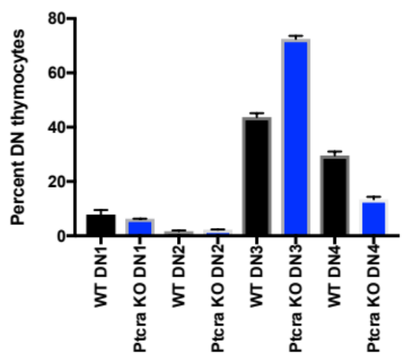
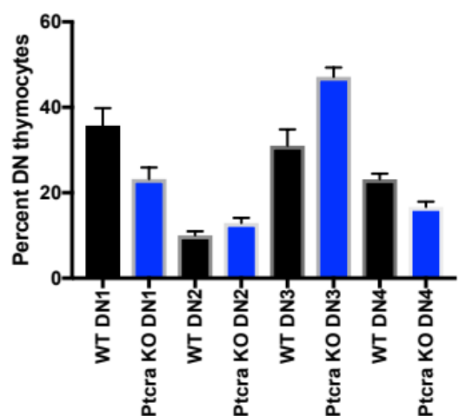
A
B
Young thymus
WT
Ptcra KO
Newborn
Old thymus
Old
CD4
CD8
Supplementary Fig. 3: Thymic hypoplasia phenotype of Ptcra KO is ameliorated with age. (A) Representative immunophenotypes of thymi derived from young (~1 week old) and adult (~6 months old) WT and Ptcra KO mice. (B) Immunophenotyping of the DN compartment of young and old WT and Ptcra KO thymuses. The developmental arrest of Ptcra KO thymocytes at DN3 is less pronounced by adulthood; the inability to complete the DN to DP transition is almost completely reversed.

Slide 4
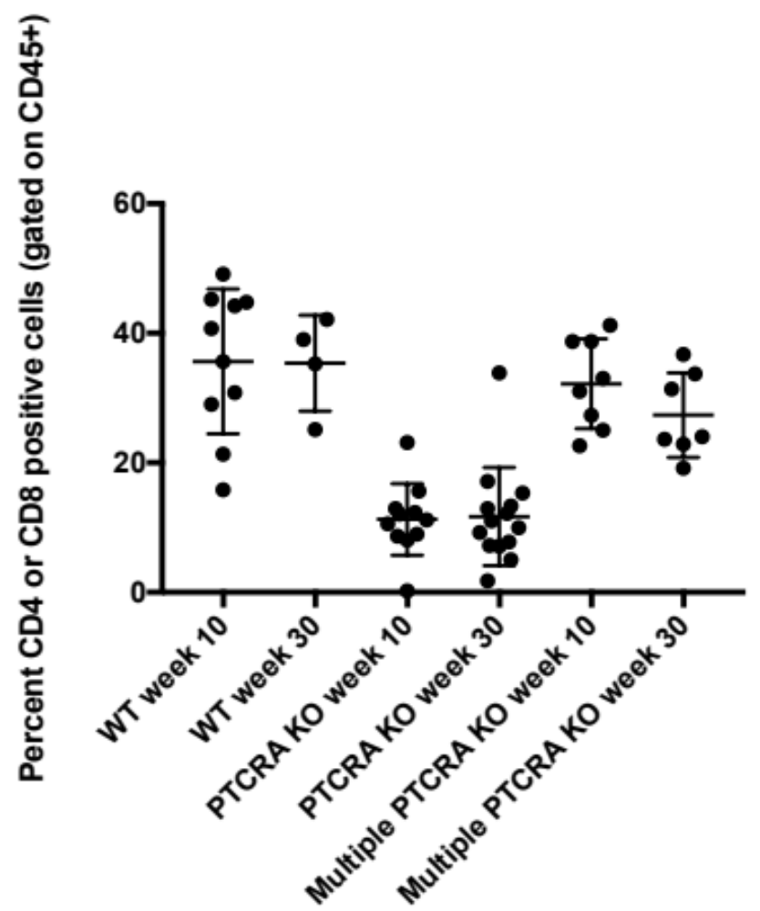
Supplementary Fig. 4: Ptcra KO thymi are capable of T-cell production following transplantation. Peripheral T-cell frequency was monitored by flow cytometry during the course of thymic transplantation studies. Values for 1 WT thymus , 2 Ptcra KO thymi and multiple (4 or 8) Ptcra KO are plotted.

Slide 5
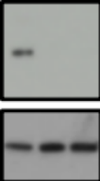
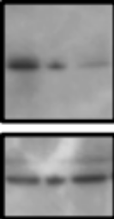
SupT1
HPB-ALL
KO2
KO2
KO1
KO1
C
C
pTα
pTα
Tubulin
Tubulin
Supplementary Fig. 5: Western blots confirming efficient knock-out of PTCRA in human T-ALL cell lines

Slide 6
A
Normalized to mode
Parental fibroblasts
Fibroblasts + PTCRA + TCRb
Ptcra
Supplementary Figure 6: Validation of 2F5 mAb clone for human Ptcra. Murine fibroblast cells we co-transfected with plasmids encoding human PTCRA and a rearranged Tcrb gene. PTCRA cell surface expression was assessed by flow cytometry using the 2F5 mAb targeting Ptcra, following the manufacturer’s protocol.

