Slide 1
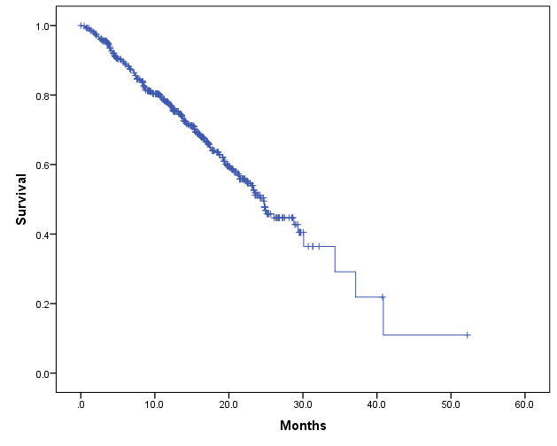
Supplementary Fig. 1
Kaplan-Meier curve for the overall survival in metastatic castration-resistant prostate cancer patients treated with abiraterone and/or enzalutamide
Median OS: 24.7 months
95%CI: 22.5-27.0

