Slide 1
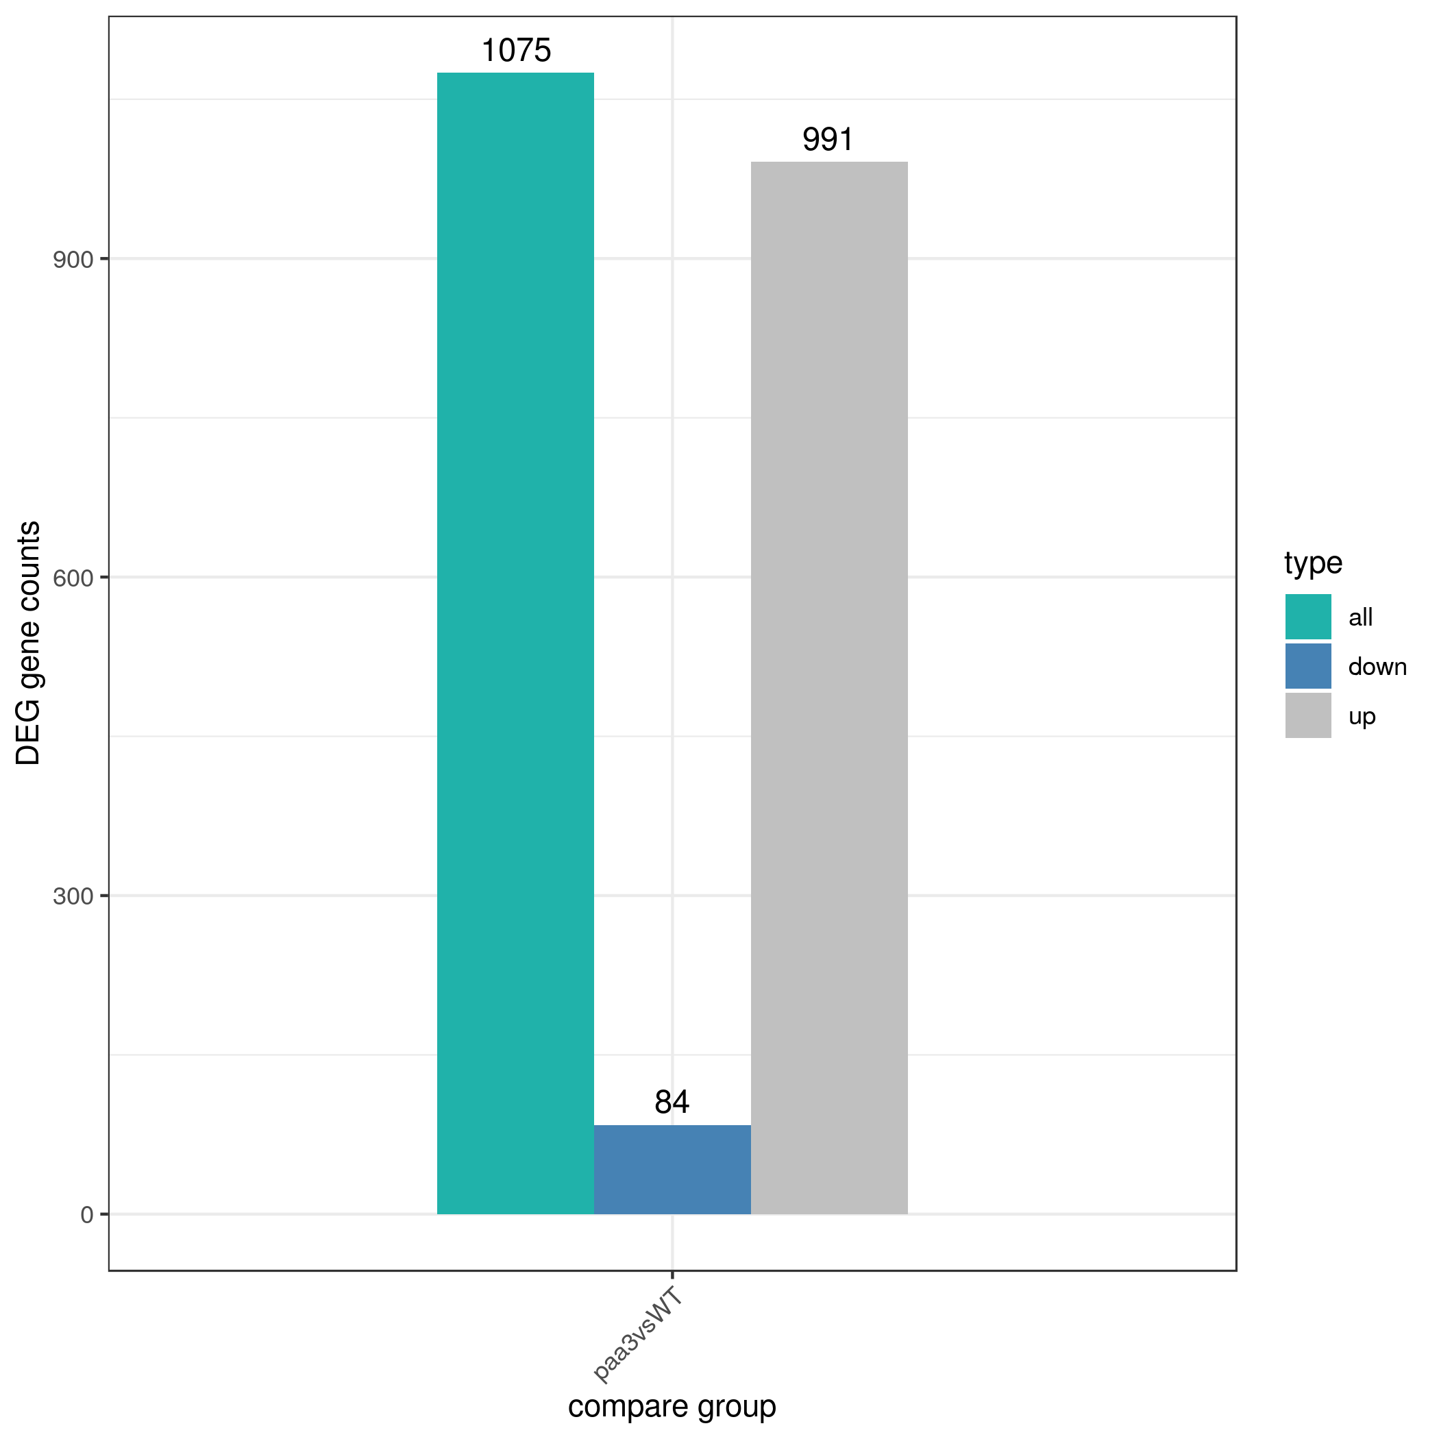
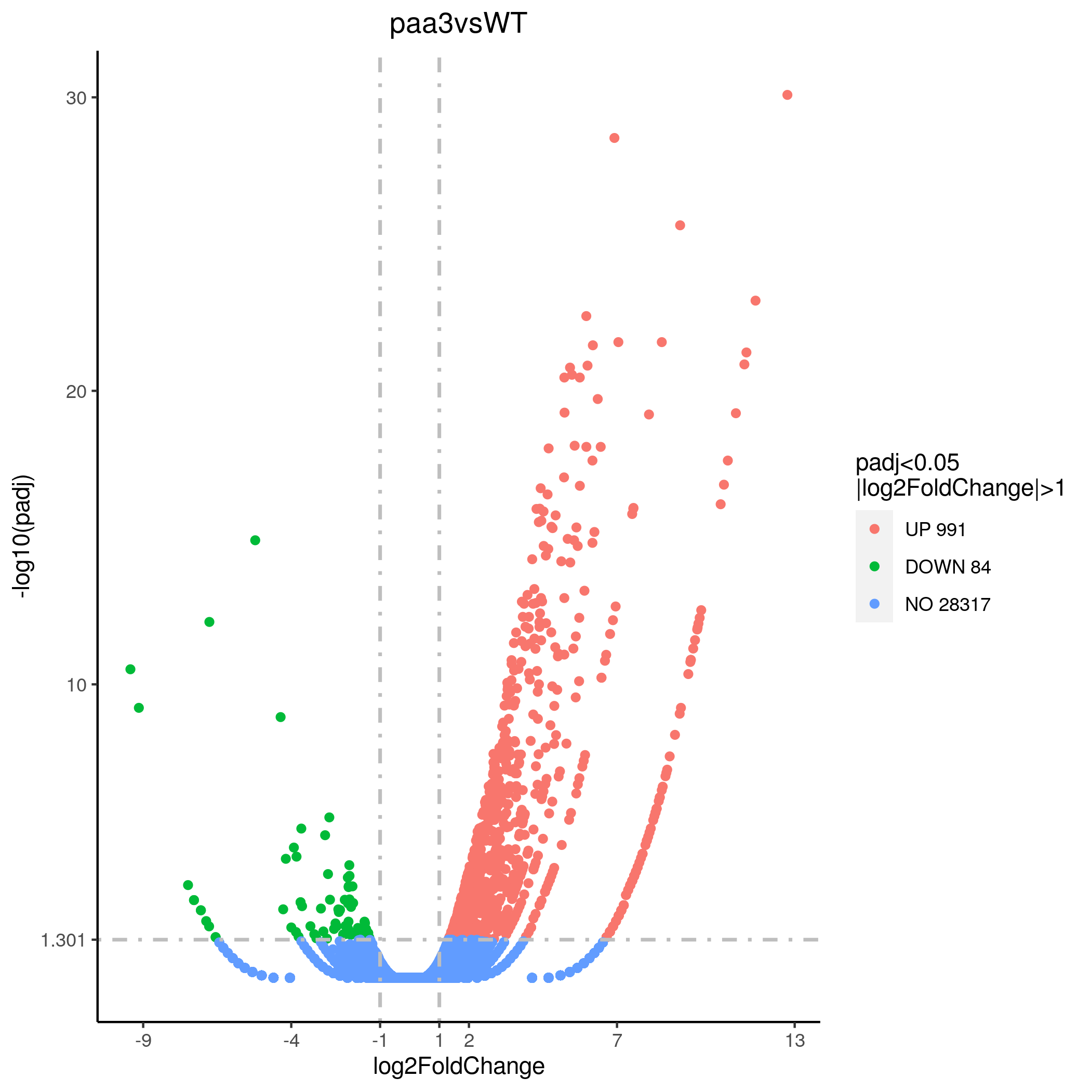
Supplemental Figure 1
a
b
Supplemental Figure 1, transcriptome analysis of paa3
a, Showed that there were 1075 differential genes in WT and paa3 samples, among which 991 genes were up-regulated and 84 genes were down-regulated. b The volcano figure showed an overall overview, including 28,317 genes with no change in expression, 991 up-regulated genes and 84 down-regulated genes.

