Slide 1
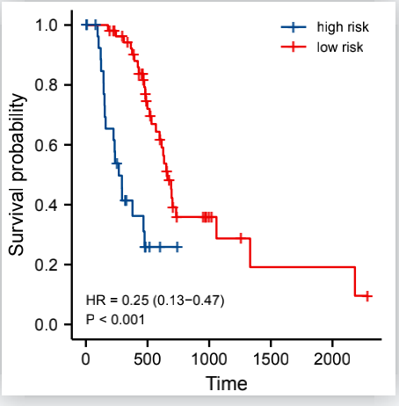
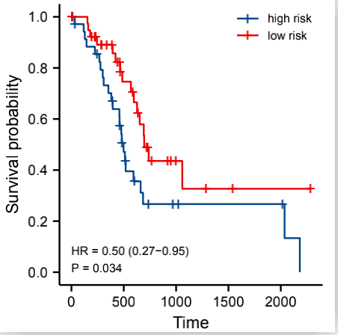
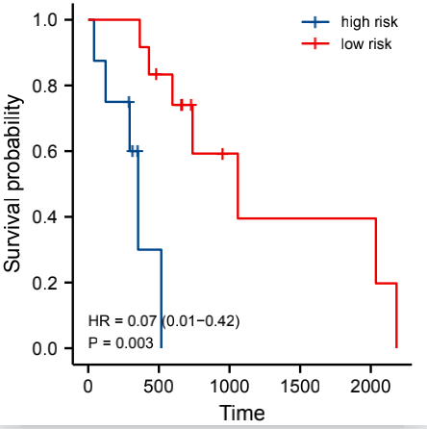
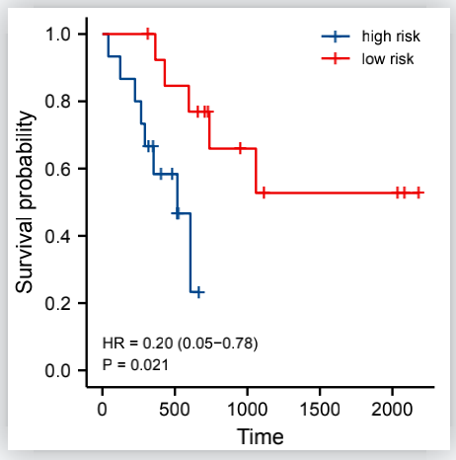
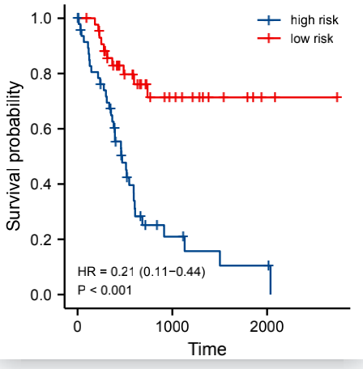
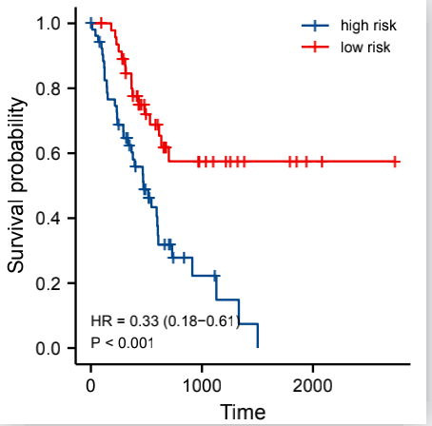
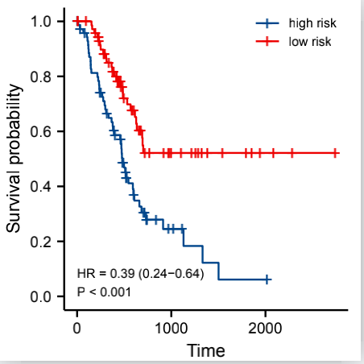
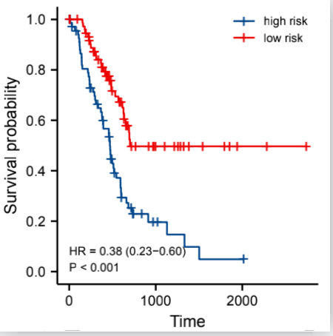
a
b
c
d
age≤65
female
stage I
T 1+2
e
f
g
h
age>65
male
stage II
T 3+4
Supplementary Figure 3 Prognostic value in clinicopathological stratification. a＆e Prognostic value of the prognostic model based on hub genes in age. b＆f Prognostic value of the prognostic model based on hub genes in gender. c＆g Prognostic value of the prognostic model based on hub genes in pathological stage.d＆h Prognostic value of the prognostic model based on hub genes in T stage.

