Slide 1
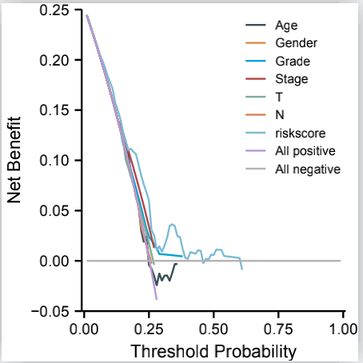
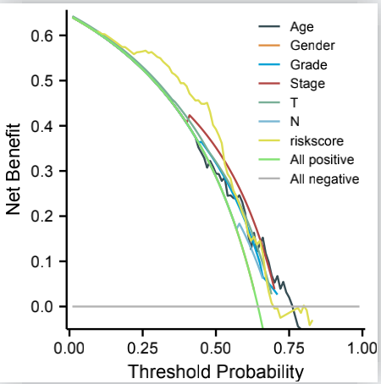
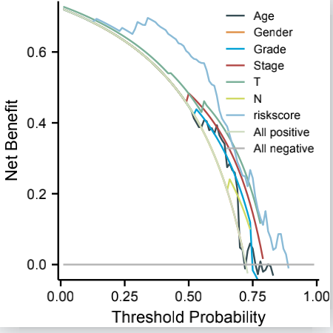
a
b
c
Supplementary Figure 4 Comparative analysis of diagnostic efﬁciency between the riskscore and clinicopathological characteristics. a-c DCA of the risk score and clinicopathological characteristics at 1/3/5 year.

