Slide 1
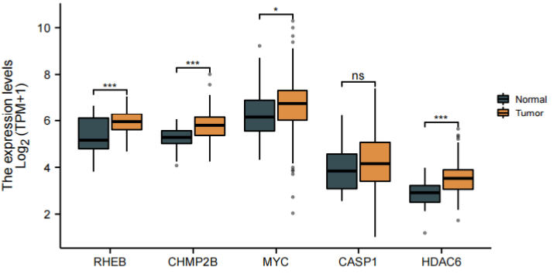
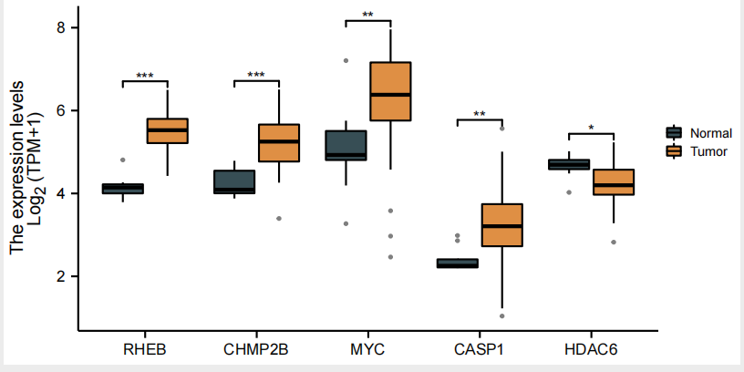
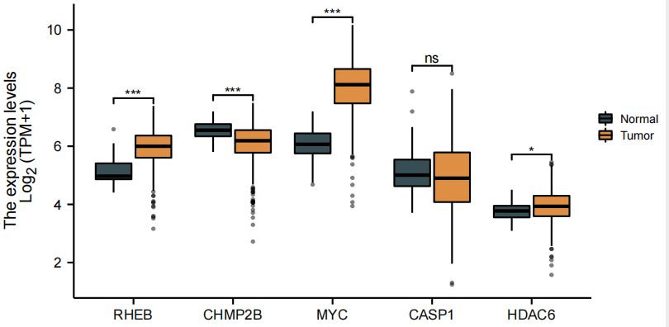
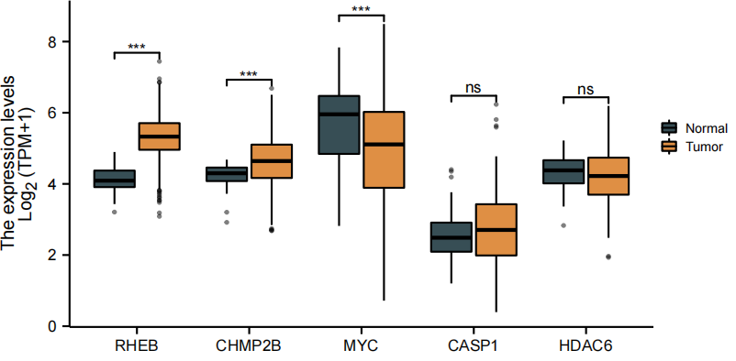
a
b
c
d
Supplementary Figure 1 Validation of hub genes expression. a Genes expressions in TCGA-STAD.b Genes expressions in TCGA-CHOL.c Genes expressions in TCGA-COAD.d Genes expressions in TCGA-LIHC.(The normal group is depicted in gray, the tumor group is depicted in orange. *p < 0.05, **p < 0.01, ***p < 0.001.)

