Slide 1
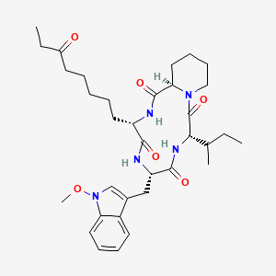
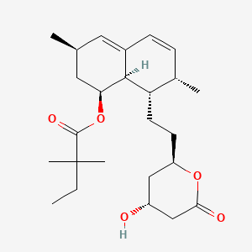
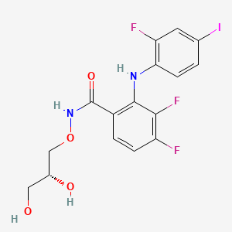
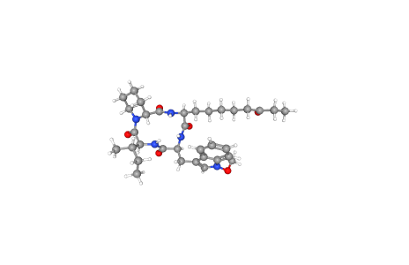
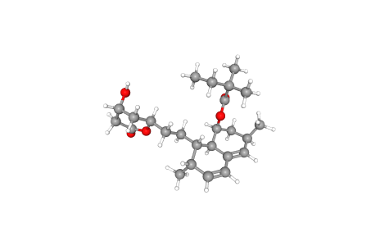
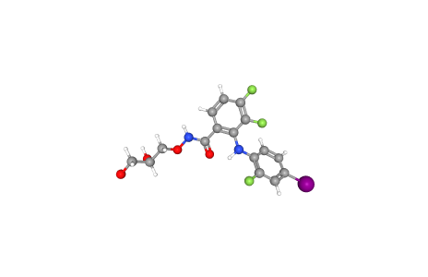
a
b
c
e
f
d
Supplementary Figure 5 Exploring the mechanism of action of hub genes.a-f Structures of the screened small-molecule compounds. hub genes were uploaded to the L1000FWD website to screen for potential small-molecule compounds. The top three compounds were visualized using the PubChem website.( a,d 2D and 3D structures of apicidin. b,e 2D and 3D structures of simvastatin. c,f 2D and 3D structures of PD-0325901.)

