Slide 1
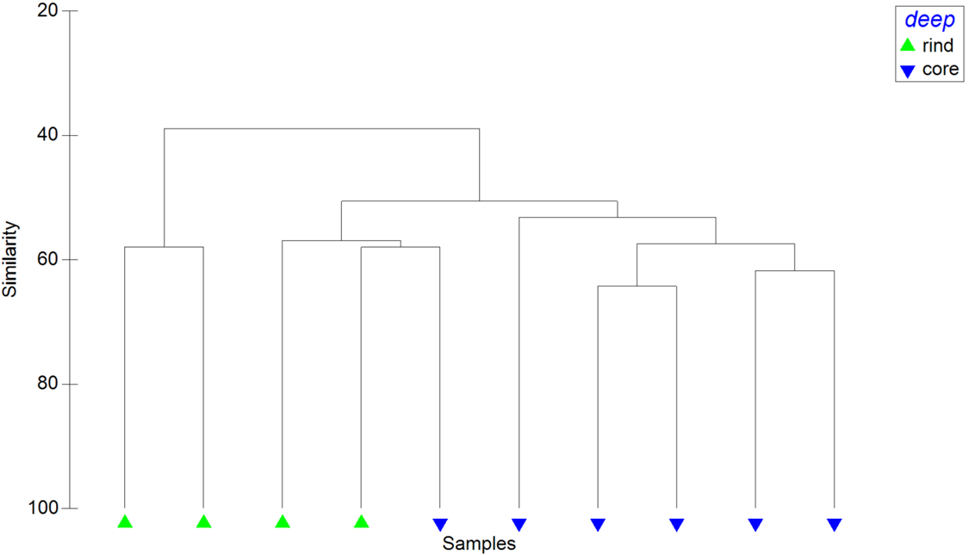
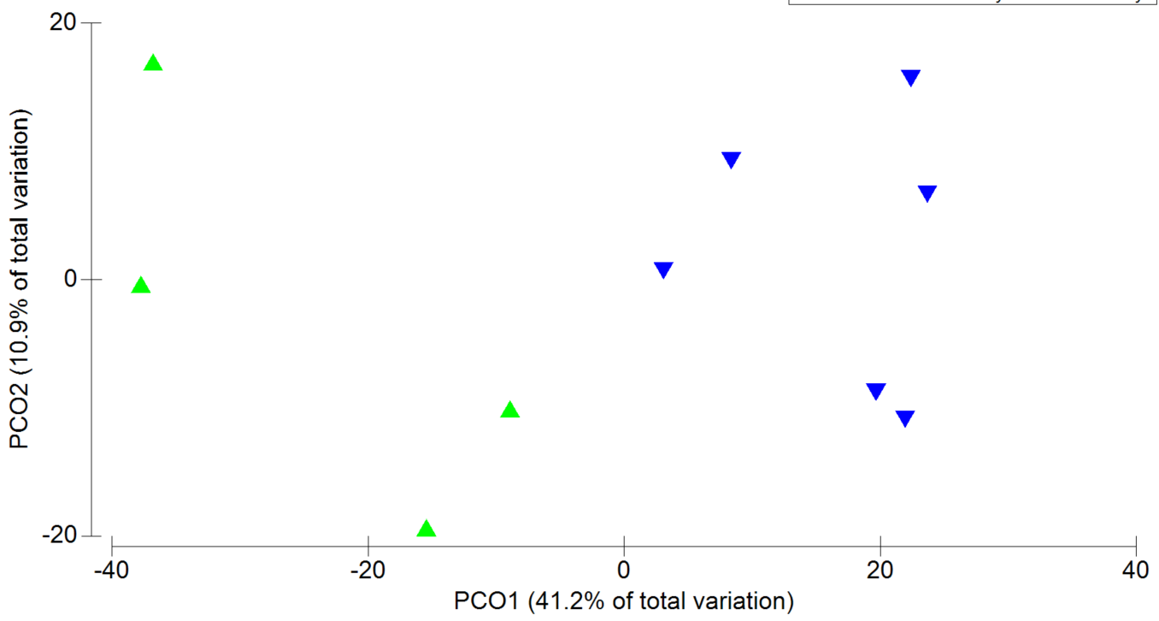
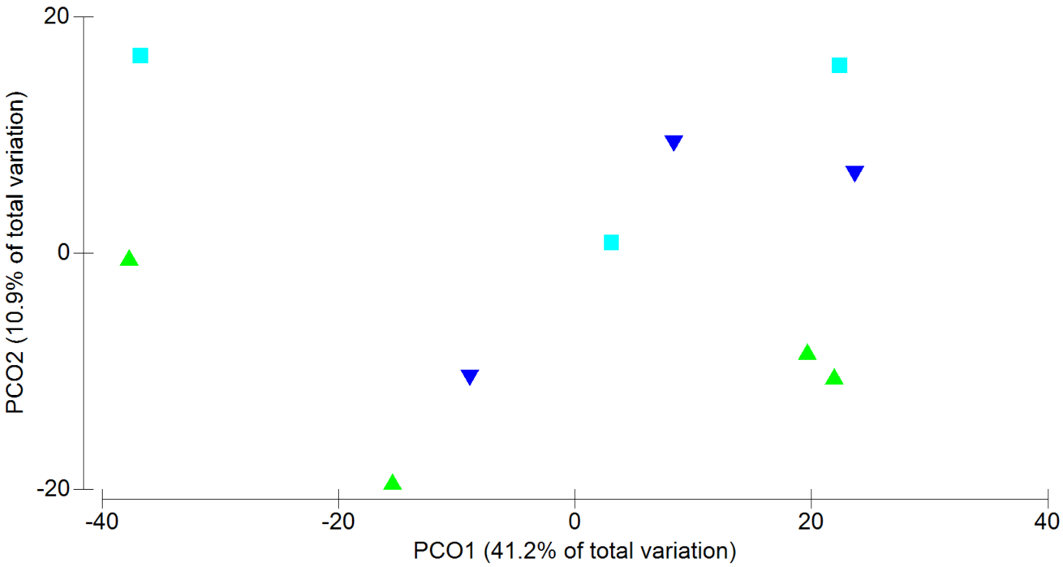
A
B
C
Notes:
Additional File 7. Functional statistics of the identified proteins. Identified proteins are functionally categorized into GO. Cumulative abundance of each GO class is employed for the statistical evaluation of the microbial communities on a functional view. The sole rind versus core comparison scored a statistically significant difference (p< 0,01). A- panel visualizes the samples hierarchical clustering. B-panel depicts the dataset on a PCO plot. Panel C represent the same scattering of the dataset by labelling the samples according to the ripening timepoints (p>0,05).

Slide 2
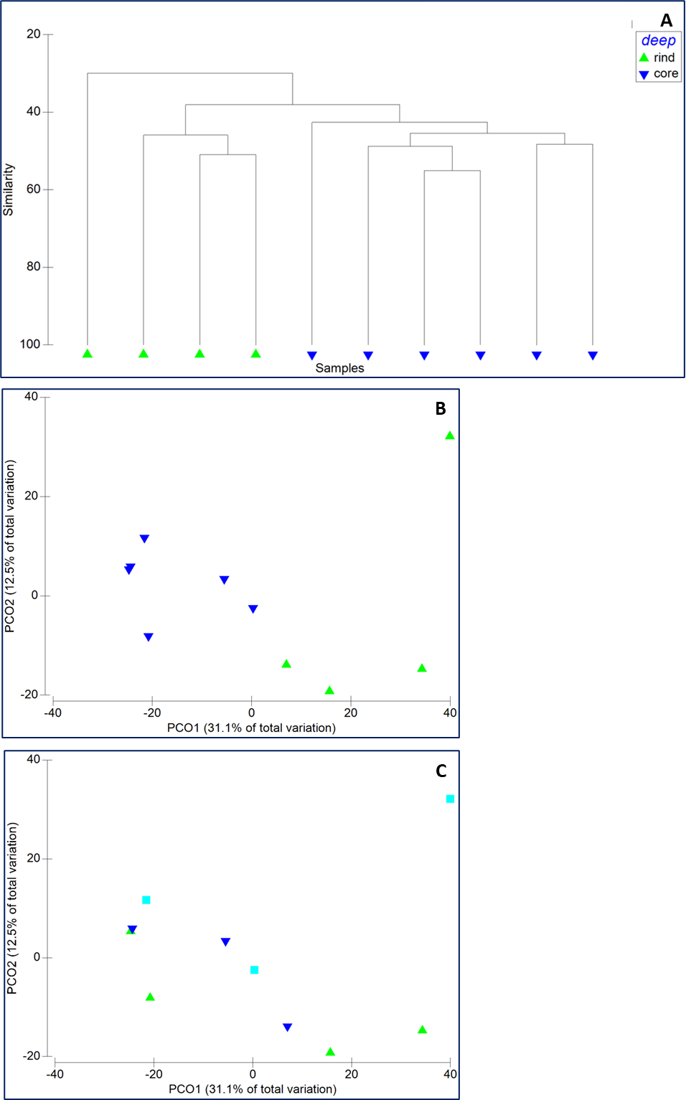
Notes:
Additional File 7. Functional statistics of the identified proteins. Identified proteins are functionally categorized into GO_biological processes. Cumulative abundance of each functional class is employed for the statistical evaluation of the microbial communities on a functional view. The sole rind versus core comparison scored a statistically significant difference (p< 0,01). A- panel visualizes the samples hierarchical clustering. B-panel depicts the dataset on a PCO plot. Panel C represent the same scattering of the dataset by labelling the samples according to the ripening timepoints (p>0,05).

Slide 3
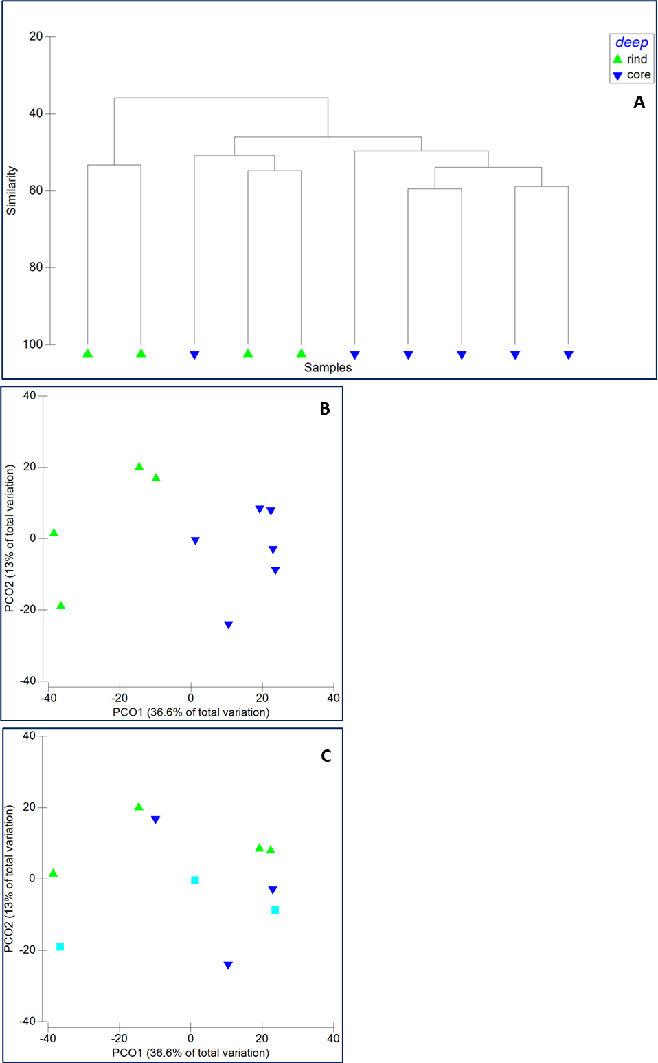
Notes:
Additional File 7. Functional statistics of the identified proteins. Identified proteins are functionally categorized into GO_molecular functions. Cumulative abundance of each functional class is employed for the statistical evaluation of the microbial communities on a functional view. The sole rind versus core comparison scored a statistically significant difference (p< 0,01). A- panel visualizes the samples hierarchical clustering. B-panel depicts the dataset on a PCO plot. Panel C represent the same scattering of the dataset by labelling the samples according to the ripening timepoints (p>0,05).

Slide 4
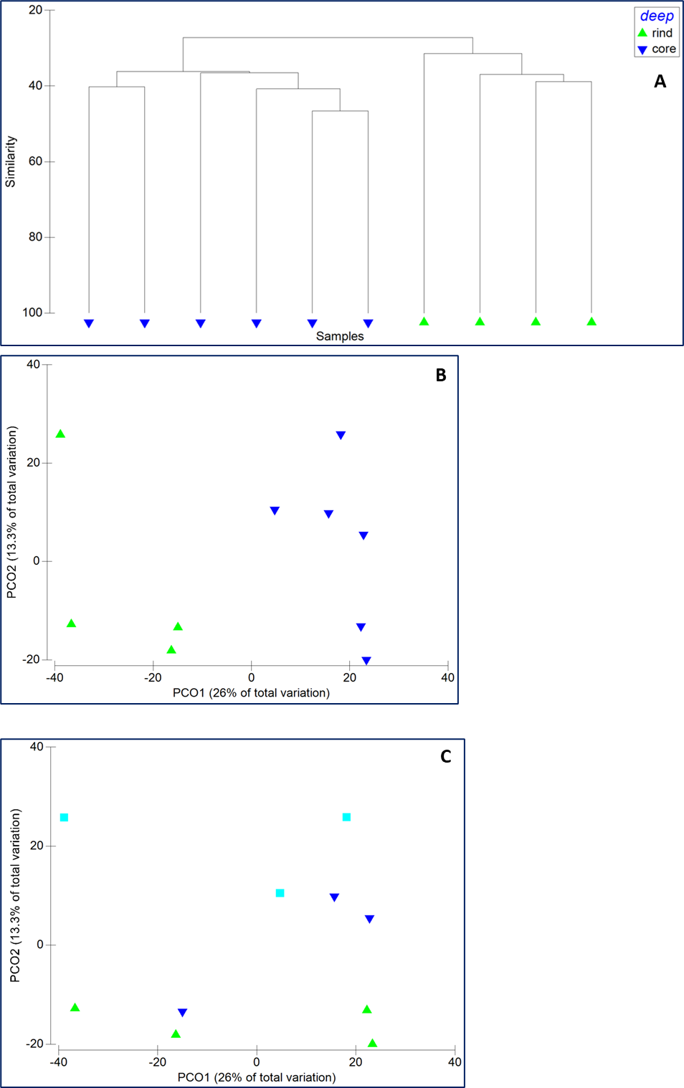
Notes:
Additional File 7. Functional statistics of the identified proteins. Identified proteins are functionally categorized into PFAM categories. Cumulative abundance of each functional class is employed for the statistical evaluation of the microbial communities on a functional view. The sole rind versus core comparison scored a statistically significant difference (p< 0,01). A- panel visualizes the samples hierarchical clustering. B-panel depicts the dataset on a PCO plot. Panel C represent the same scattering of the dataset by labelling the samples according to the ripening timepoints (p>0,05).

Slide 5
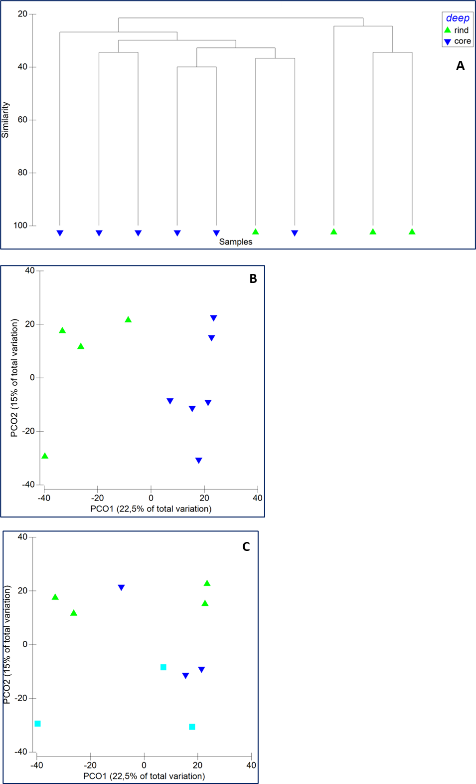
Notes:
Additional File 7. Functional statistics of the identified proteins. Identified proteins are functionally categorized into TIGRFAM categories. Cumulative abundance of each functional class is employed for the statistical evaluation of the microbial communities on a functional view. The sole rind versus core comparison scored a statistically significant difference (p< 0,01). A- panel visualizes the samples hierarchical clustering. B-panel depicts the dataset on a PCO plot. Panel C represent the same scattering of the dataset by labelling the samples according to the ripening timepoints (p>0,05).

