Slide 1
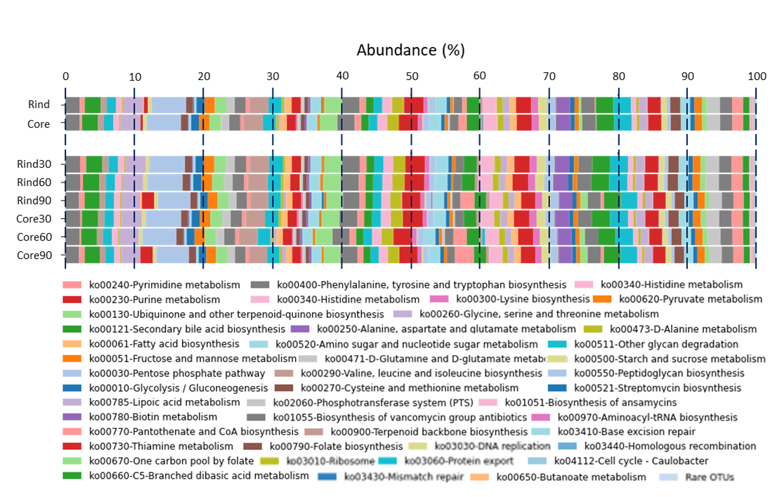
Notes:
Additional File 2. Metabolic potential of the micrbial communities. The functional potential of the metabolic community is predited via PICRUST analysis of the microbiota harbured on the rind and core (upper stacks) and in the micrbiota of the rind and core at hte ripening timepoints of 30,60 and 90 days (lower stacks).

