Slide 1
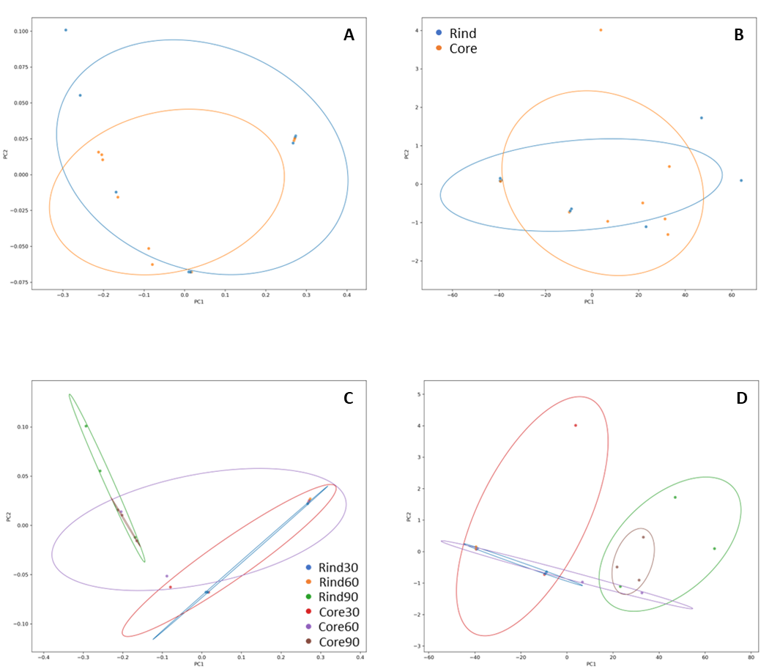
Notes:
Additional File 3. Functional dataset visualization.
PCO plot are relative to the samples stratified according to cheese wheel depths (A-B panels) and cheese wheel and ripening timepoints (C-D panels). Dataset are organizeded into matrices according to Bray-Curtis (A and C panels) and Euclidean distances (B and D panels).

