Slide 1
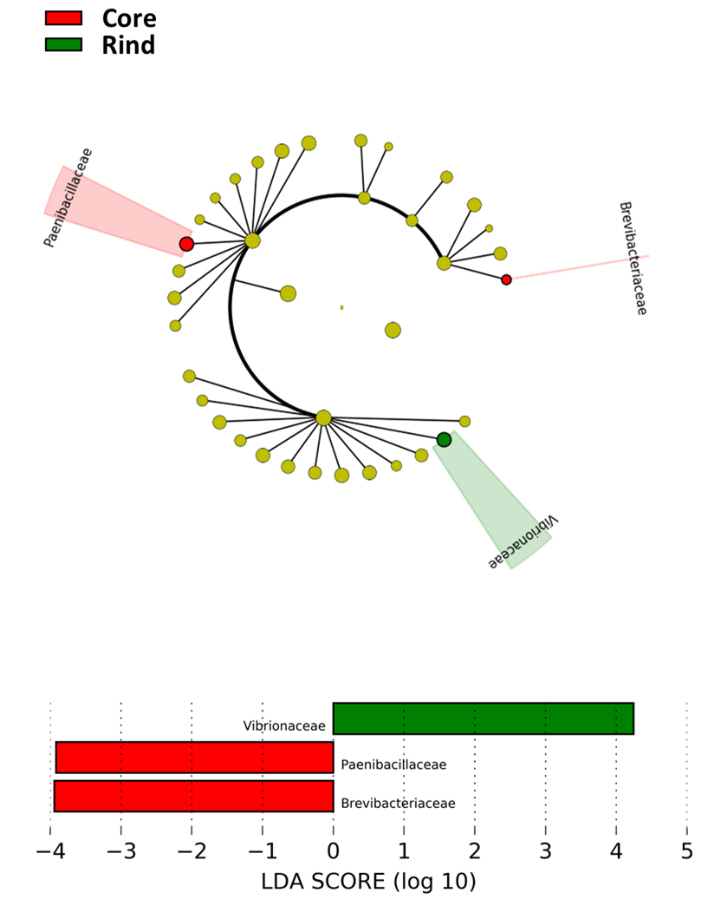
Notes:
Additional File 5. Linear Discriminant Analysis among the bacterial families of rind and core. The cladogram summarizes the LDA analysis of the identified proteins grouped for the bacterial families they belong to and sorted on a cheese wheel depth basis. Log10 LDA score depicted in the bar-chart below indicated the bacterial families significantly overrepresented in the Core and Rind microbial consortia as of the LDA analysis.

