Slide 1
Supplemental File
Single-Time-Point Dosimetry Using Model Selection and Non-Linear Mixed-Effects Modelling
Deni Hardiansyah^{1,2*}, Ade Riana¹, Ambros J. Beer³, Gerhard Glatting^{3,4}
¹Medical Physics and Biophysics, Physics Department, Faculty of Mathematics and Natural Sciences, Universitas Indonesia, Depok, Indonesia
²Research Collaboration Center for Theranostic Radiopharmaceuticals, Bandung, Indonesia
³Department of Nuclear Medicine, Ulm University, Ulm, Germany
⁴Medical Radiation Physics, Department of Nuclear Medicine, Ulm University, Ulm, Germany

Slide 2
Fig. S1
Fig. S1. Time-activity data and all-time-points (ATP) fit curves obtained using functions $f_{3a}$, $f_{3b}$, $f_{3c}$, and $f_{3d}$.

Slide 3
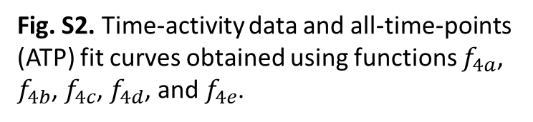
Fig. S2
Fig. S2. Time-activity data and all-time-points (ATP) fit curves obtained using functions $f_{4a}$, $f_{4b}$, $f_{4c}$, $f_{4d}$, and $f_{4e}$.

Slide 4
Fig. S3
Fig. S3. Time-activity data and all-time-points (ATP) fit curves obtained using functions $f_{5a}$and $f_{5b}$.

Slide 5
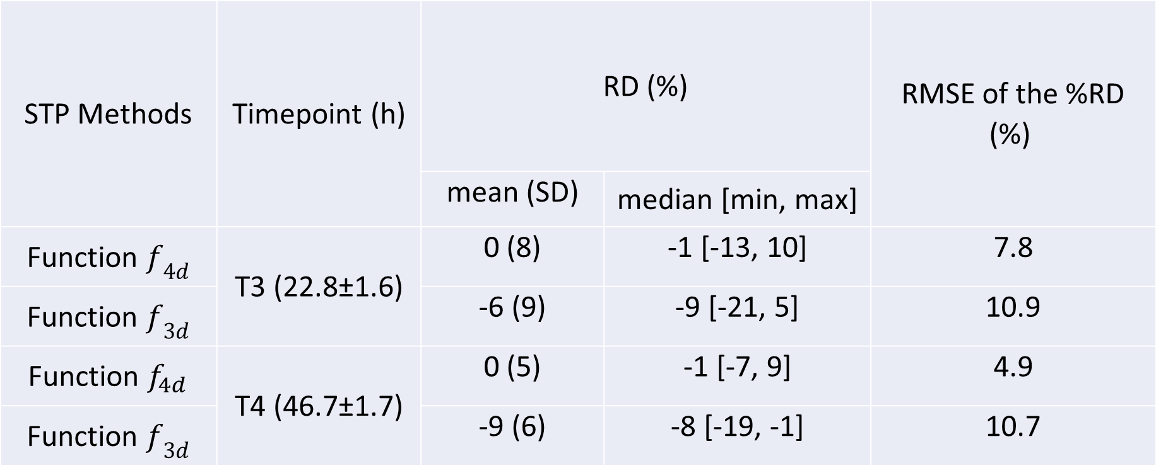
Tab. S1. RDs and RMSEs of TIAs obtained using a single time point fitting, and the best function of MS-NLME (f_{4d}) and the 3-parameter function f_{3d} with the second-highest Akaike weight (Table 1) of the 3-parameter functions (also used in ref. [8]). The RMSE of the STP method with the MS-NLME best function has a better performance than the RMSE of the STP method with function f_{3d} by a factor of two, which shows the superiority of the MS-NLME approach over the non-model-selecting NLME approach.
STP Methods | Timepoint (h) | RD (%) |  | RMSE of the %RD (%)
 |  | mean (SD) | median [min, max]
Function $f_{4d}$ | T3 (22.8±1.6) | 0 (8) | -1 [-13, 10] | 7.8
Function $f_{3d}$ |  | -6 (9) | -9 [-21, 5] | 10.9
Function $f_{4d}$ | T4 (46.7±1.7) | 0 (5) | -1 [-7, 9] | 4.9
Function $f_{3d}$ |  | -9 (6) | -8 [-19, -1] | 10.7
RD … Relative deviation; RMSE … root mean square error; TIA … Time-integrated activity; MS … Model selection; NLME … Non-linear mixed-effects modelling; STP … single-time-point

