Slide 1
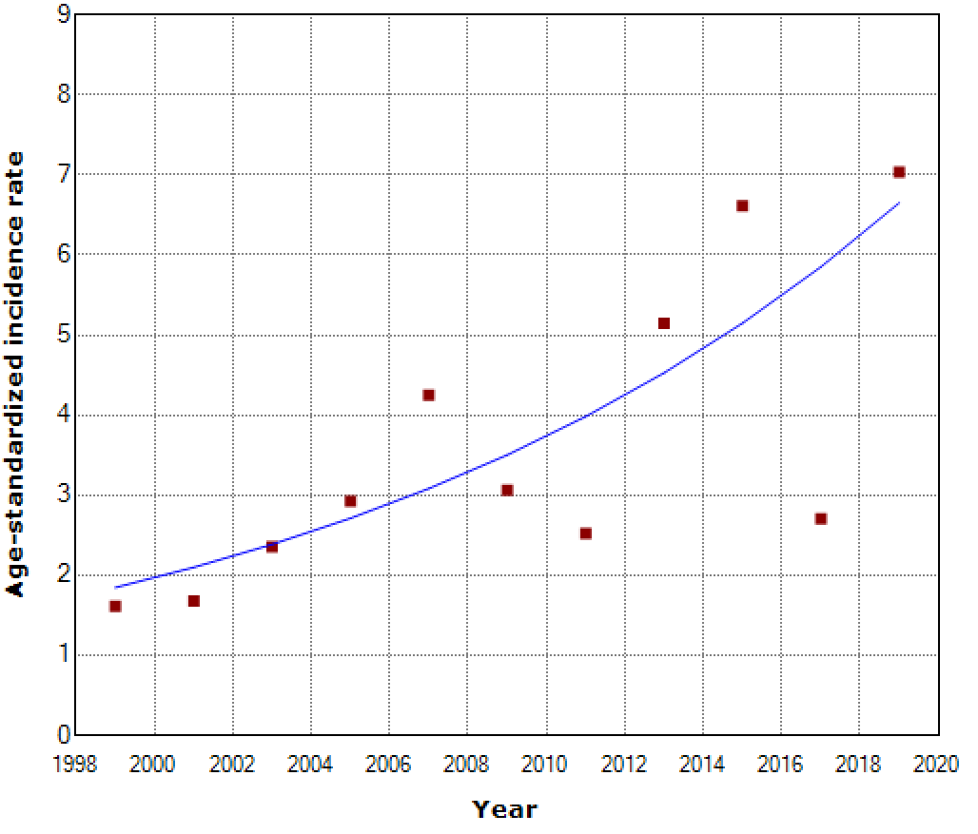
Supplementary Figure 1. (A)
Annual trend of age-standardized incidence rate of T1D for boys.
Age-stanaarized incidence rate / 100,000year
Notes:
男子 joinpoint0点

Slide 2
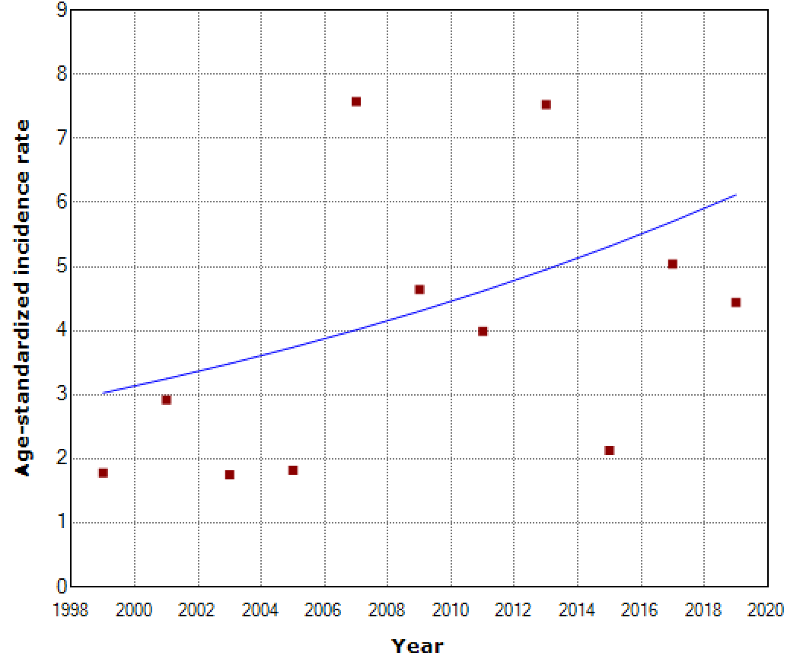
Supplementary Figure 1. (B)
Annual trend of age-standardized incidence rate of T1D for girls
Age-stanaarized incidence rate / 100,000year
Notes:
女子 joinpoint0点

Slide 3
Supplementary Figure 2. Comparison of numbers of newly onset type 1 diabetes with annual surveillance of Coxsackievirus in Oita Prefecture
Newly onset type 1 diabetes (N)
Coxsackievirus
(N)

Slide 4
Supplementary TABLE.
Annual increases in incidence rate over a 20-year period as estimated by mixed effects Poisson regression in subgroups defined by 4-year time period.
Subgroup |  | Annual increase(%) | (95% CI)
Period
 | 1999-2002 | 12.4 | (-55.6, 184.9)
 | 2003-2006 | 0.2 | (-41.9, 72.8)
 | 2007-2010 | -10.9 | (-62.8, 113.5)
 | 2011-2014 | 32.7 | (-19.0, 117.5)
 | 2015-2018 | -13.0 | (-74.5, 197.2)
 | 1999-2018† | 5.3* | (1.1, 9.8)
 | 1999-2021‡ | 4.7* | (1.7, 7.8)
† Evaluated time period (1999-2018) ‡ Overall time period including 2019-2021 * P <0.05

