Slide 1
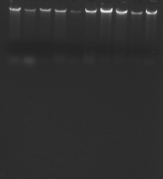
1 2 3 4 5 6 7 8 9 10
Fig. S1

Slide 2
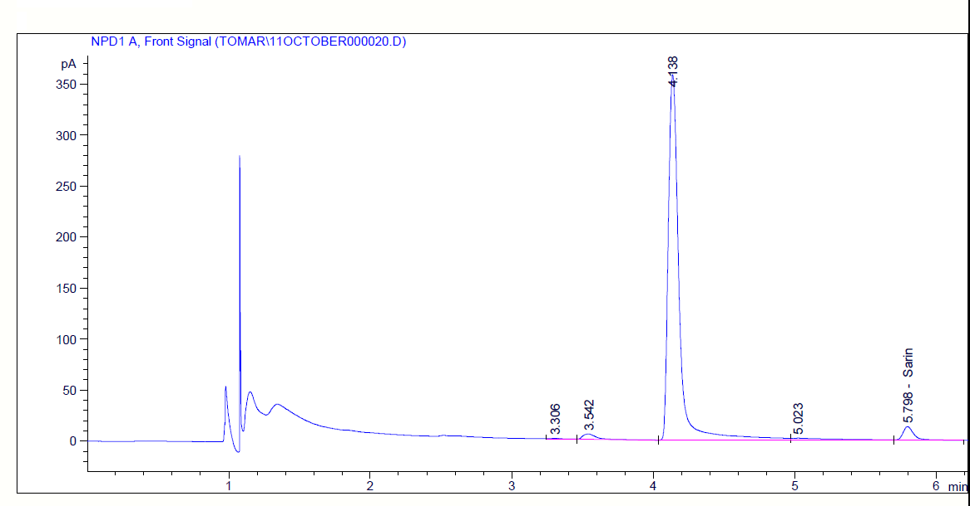
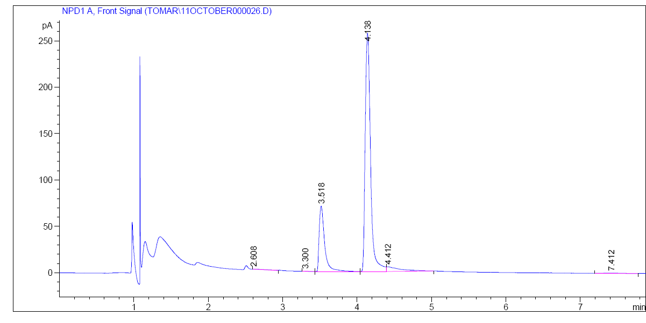
Fig.S2a
Fig.S2b

Slide 3
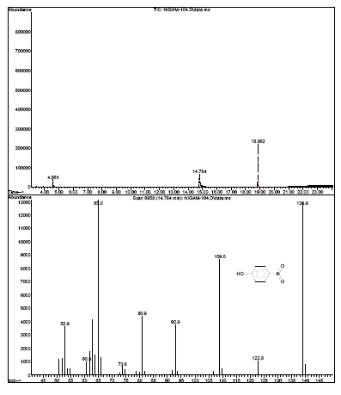
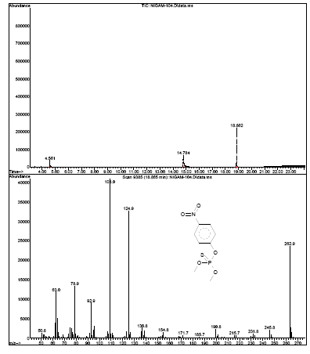
S Fig.3a
S Fig.3b

