Slide 1
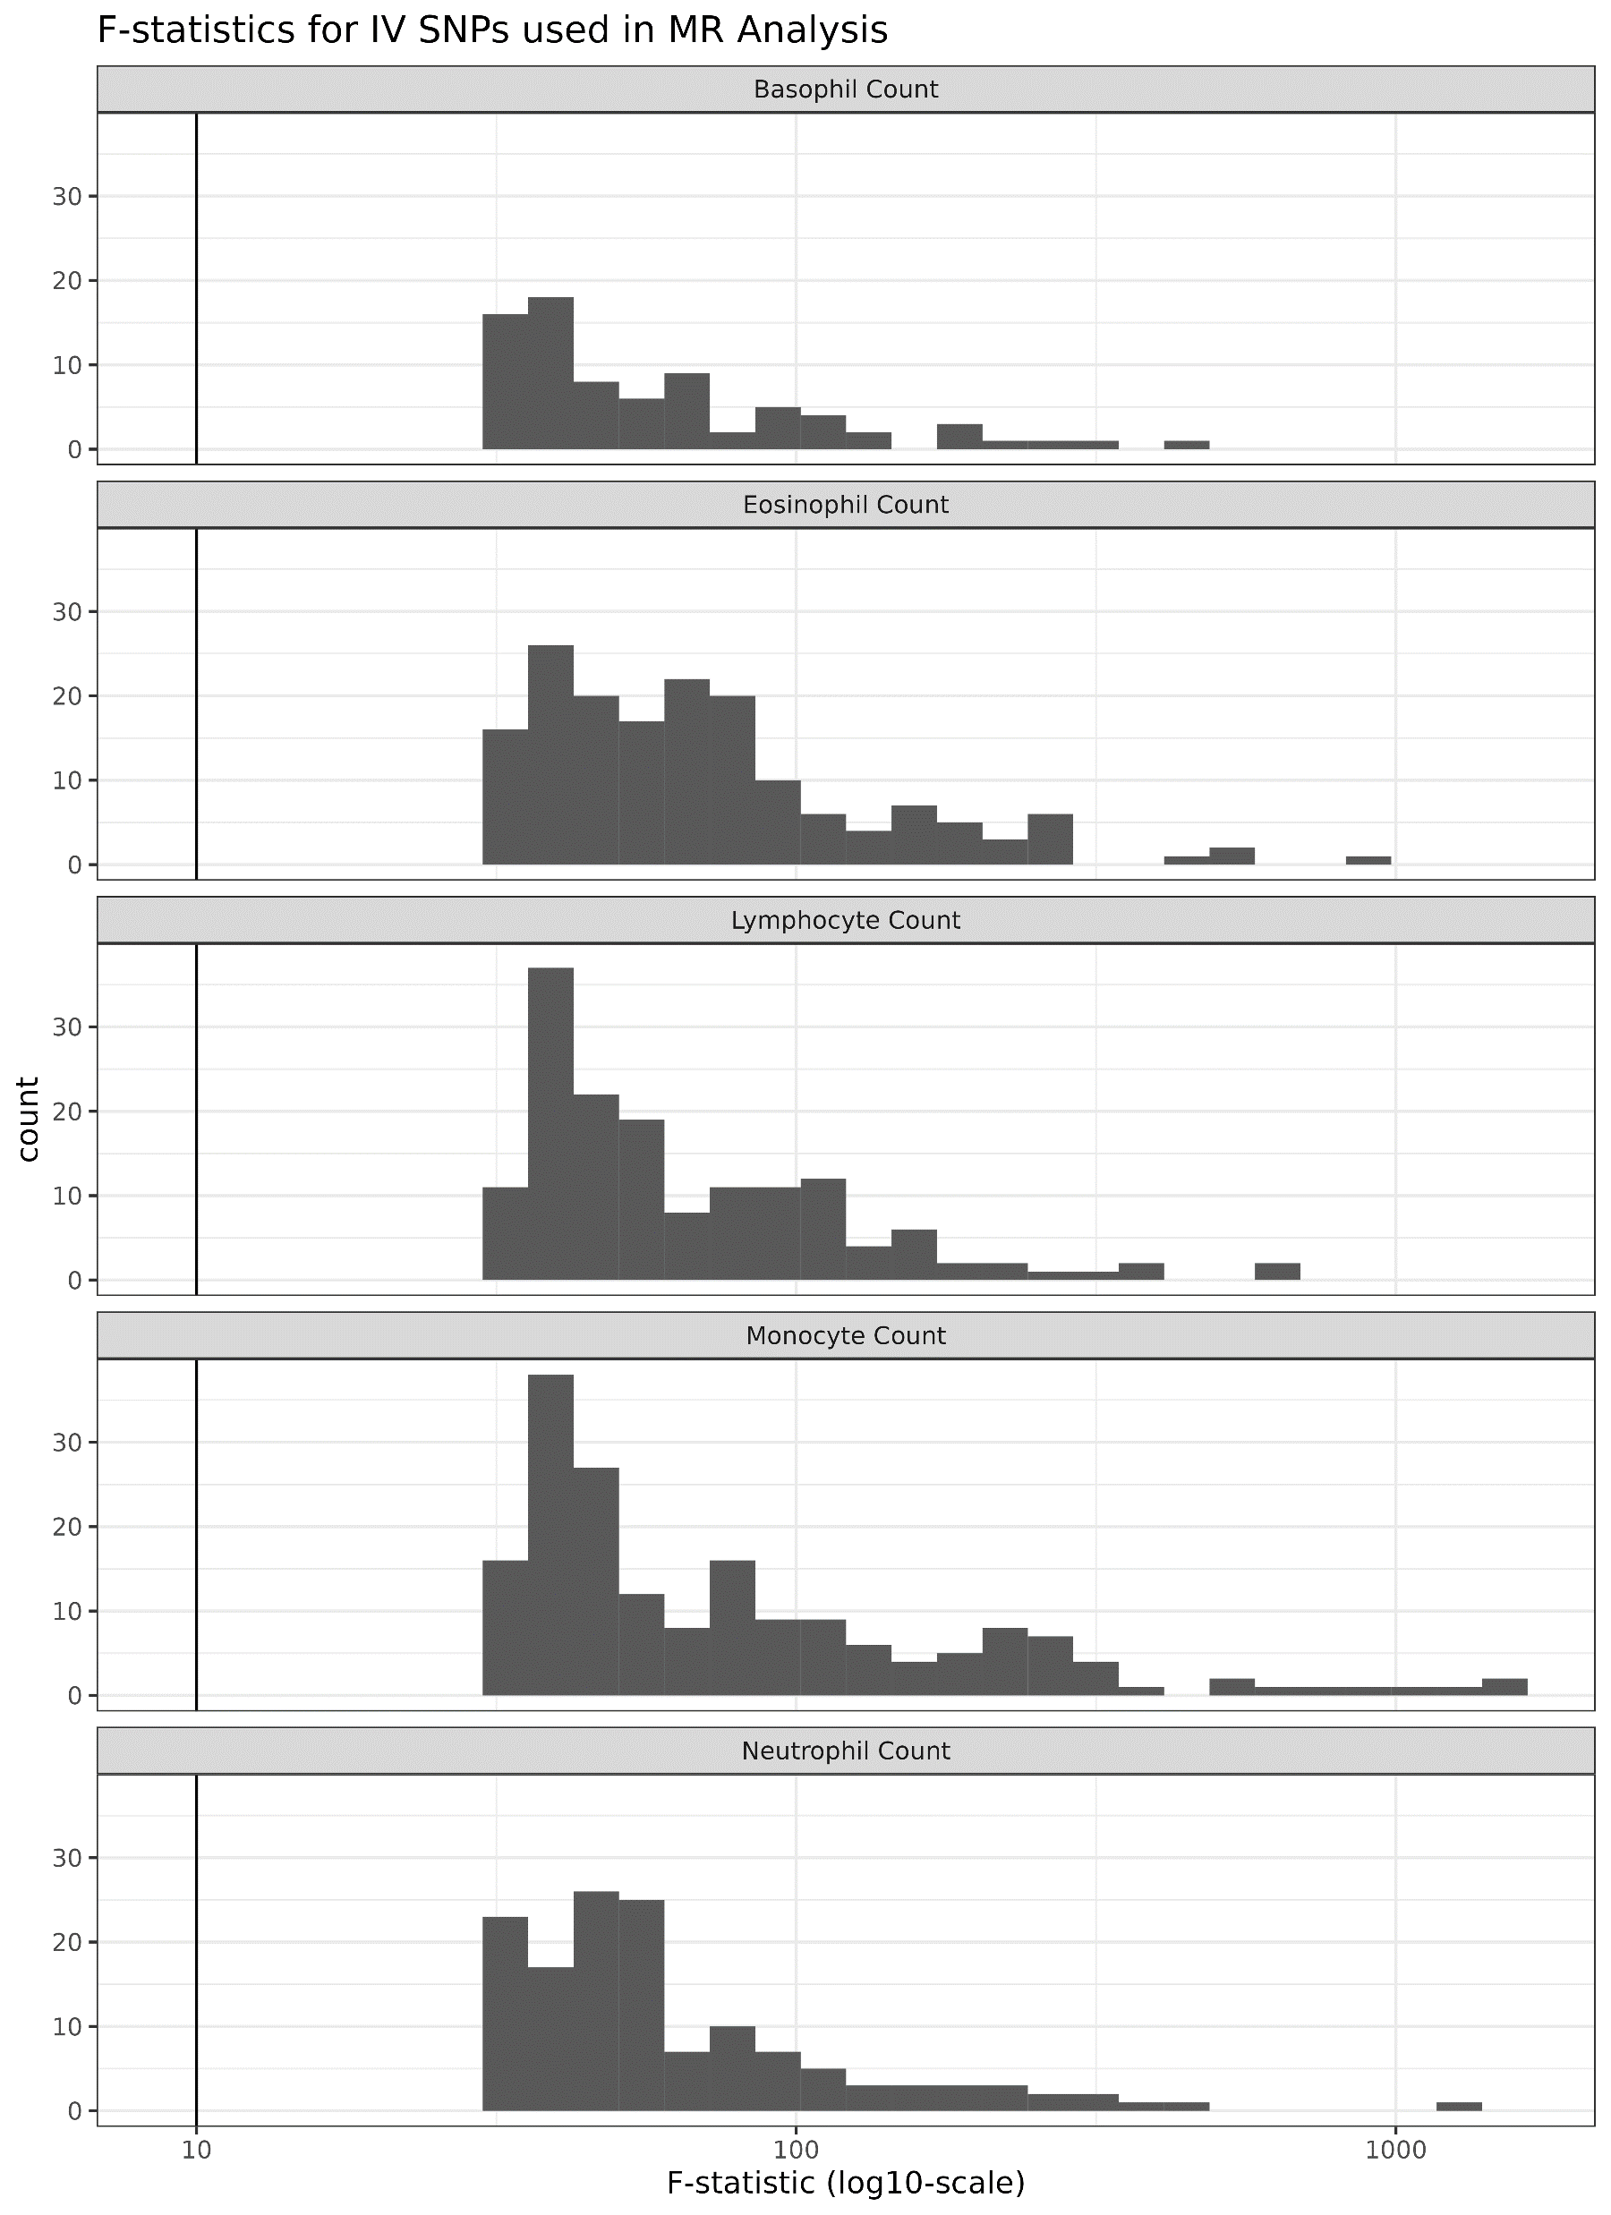
Supplemental Figure 1

Slide 2
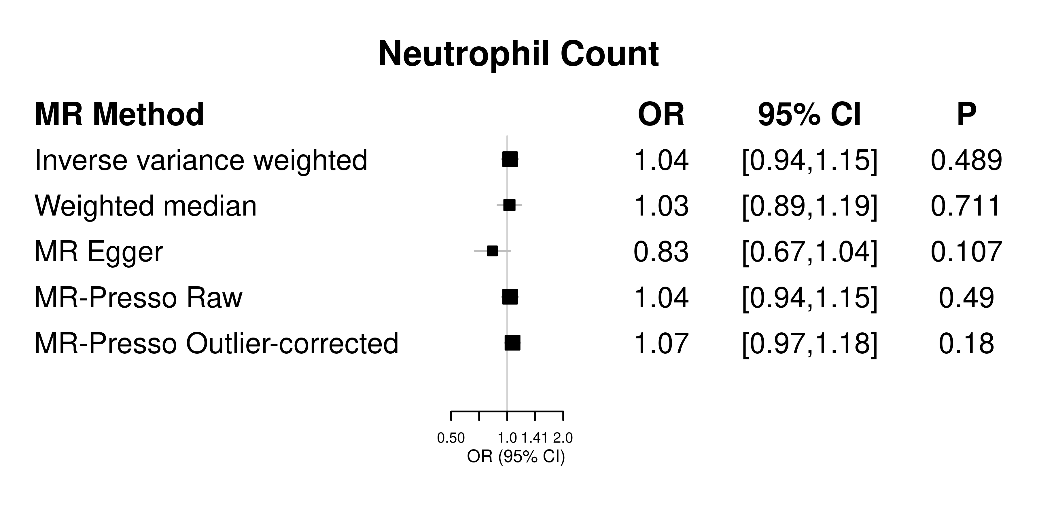
Supplemental Figure 2A: SNP effect on neutrophil count and CRS

Slide 3
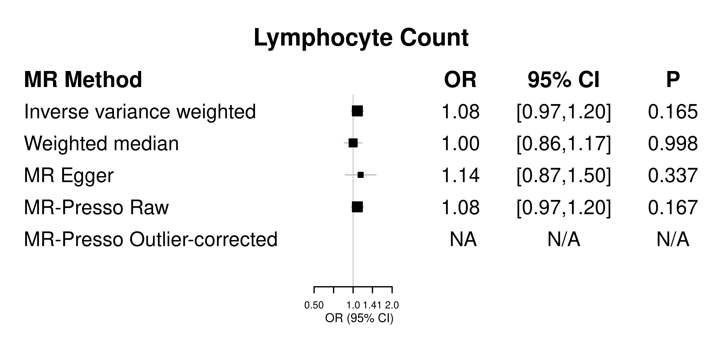
Supplemental Figure 2B: SNP effect on lymphocyte count and CRS

Slide 4
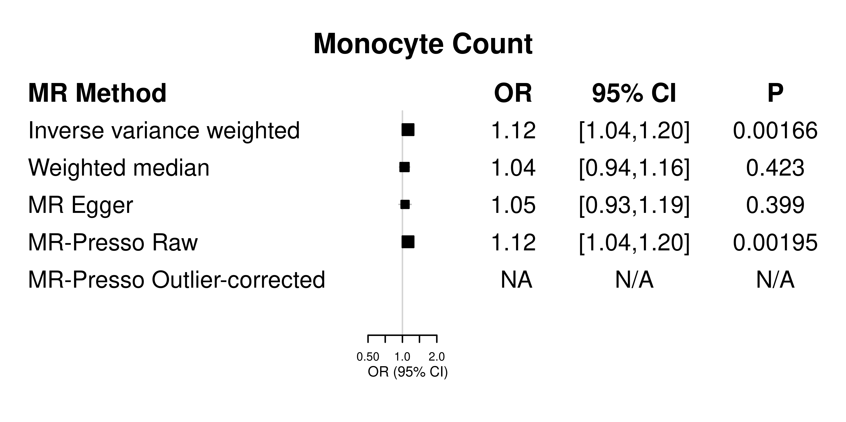
Supplemental Figure 2C: SNP effect on monocyte count and CRS

Slide 5
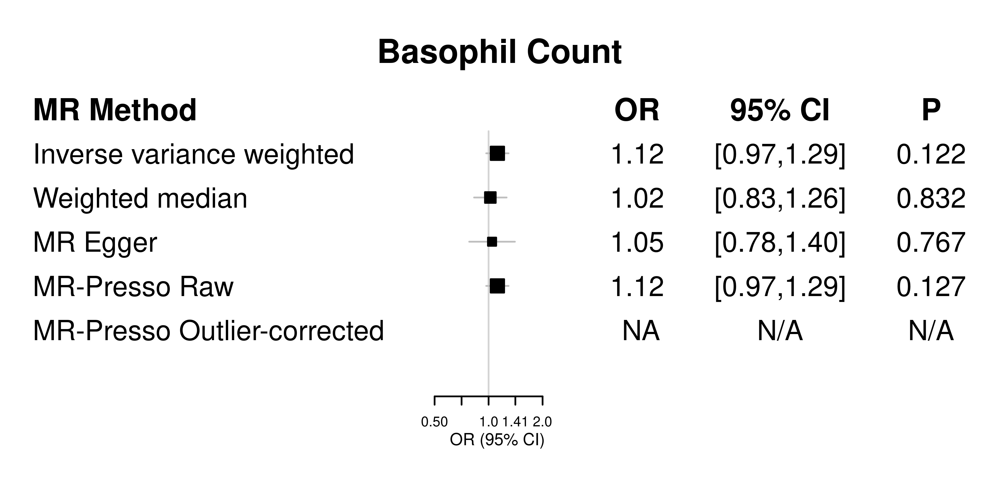
Supplemental Figure 2D: SNP effect on basophil count and CRS

Slide 6
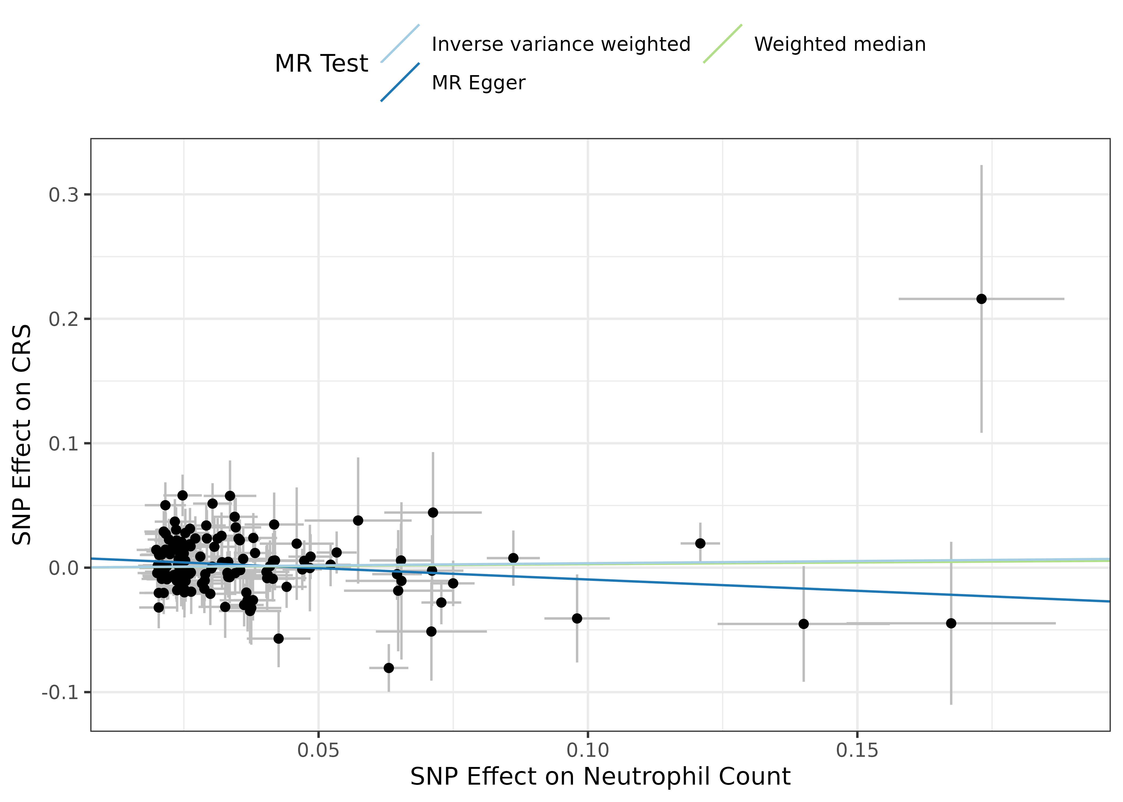
Supplemental Figure 3A: SNP effect on neutrophil count and CRS

Slide 7
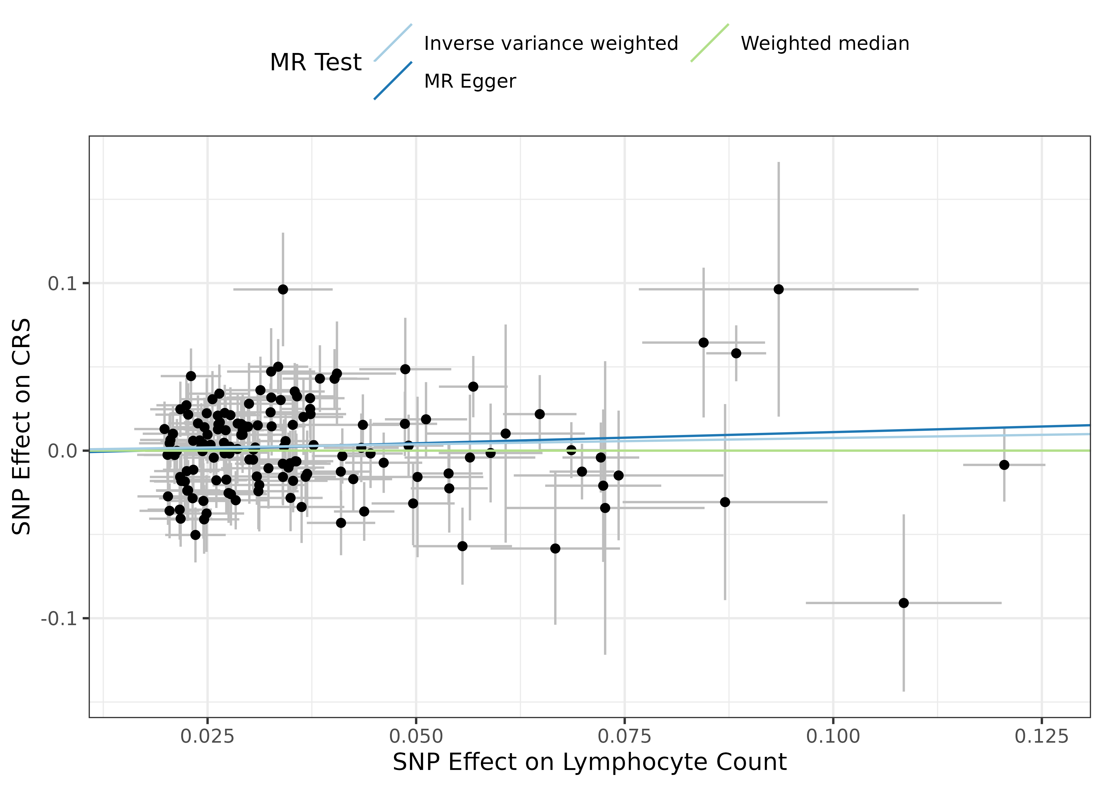
Supplemental Figure 3B: SNP effect on lymphocyte count and CRS

Slide 8
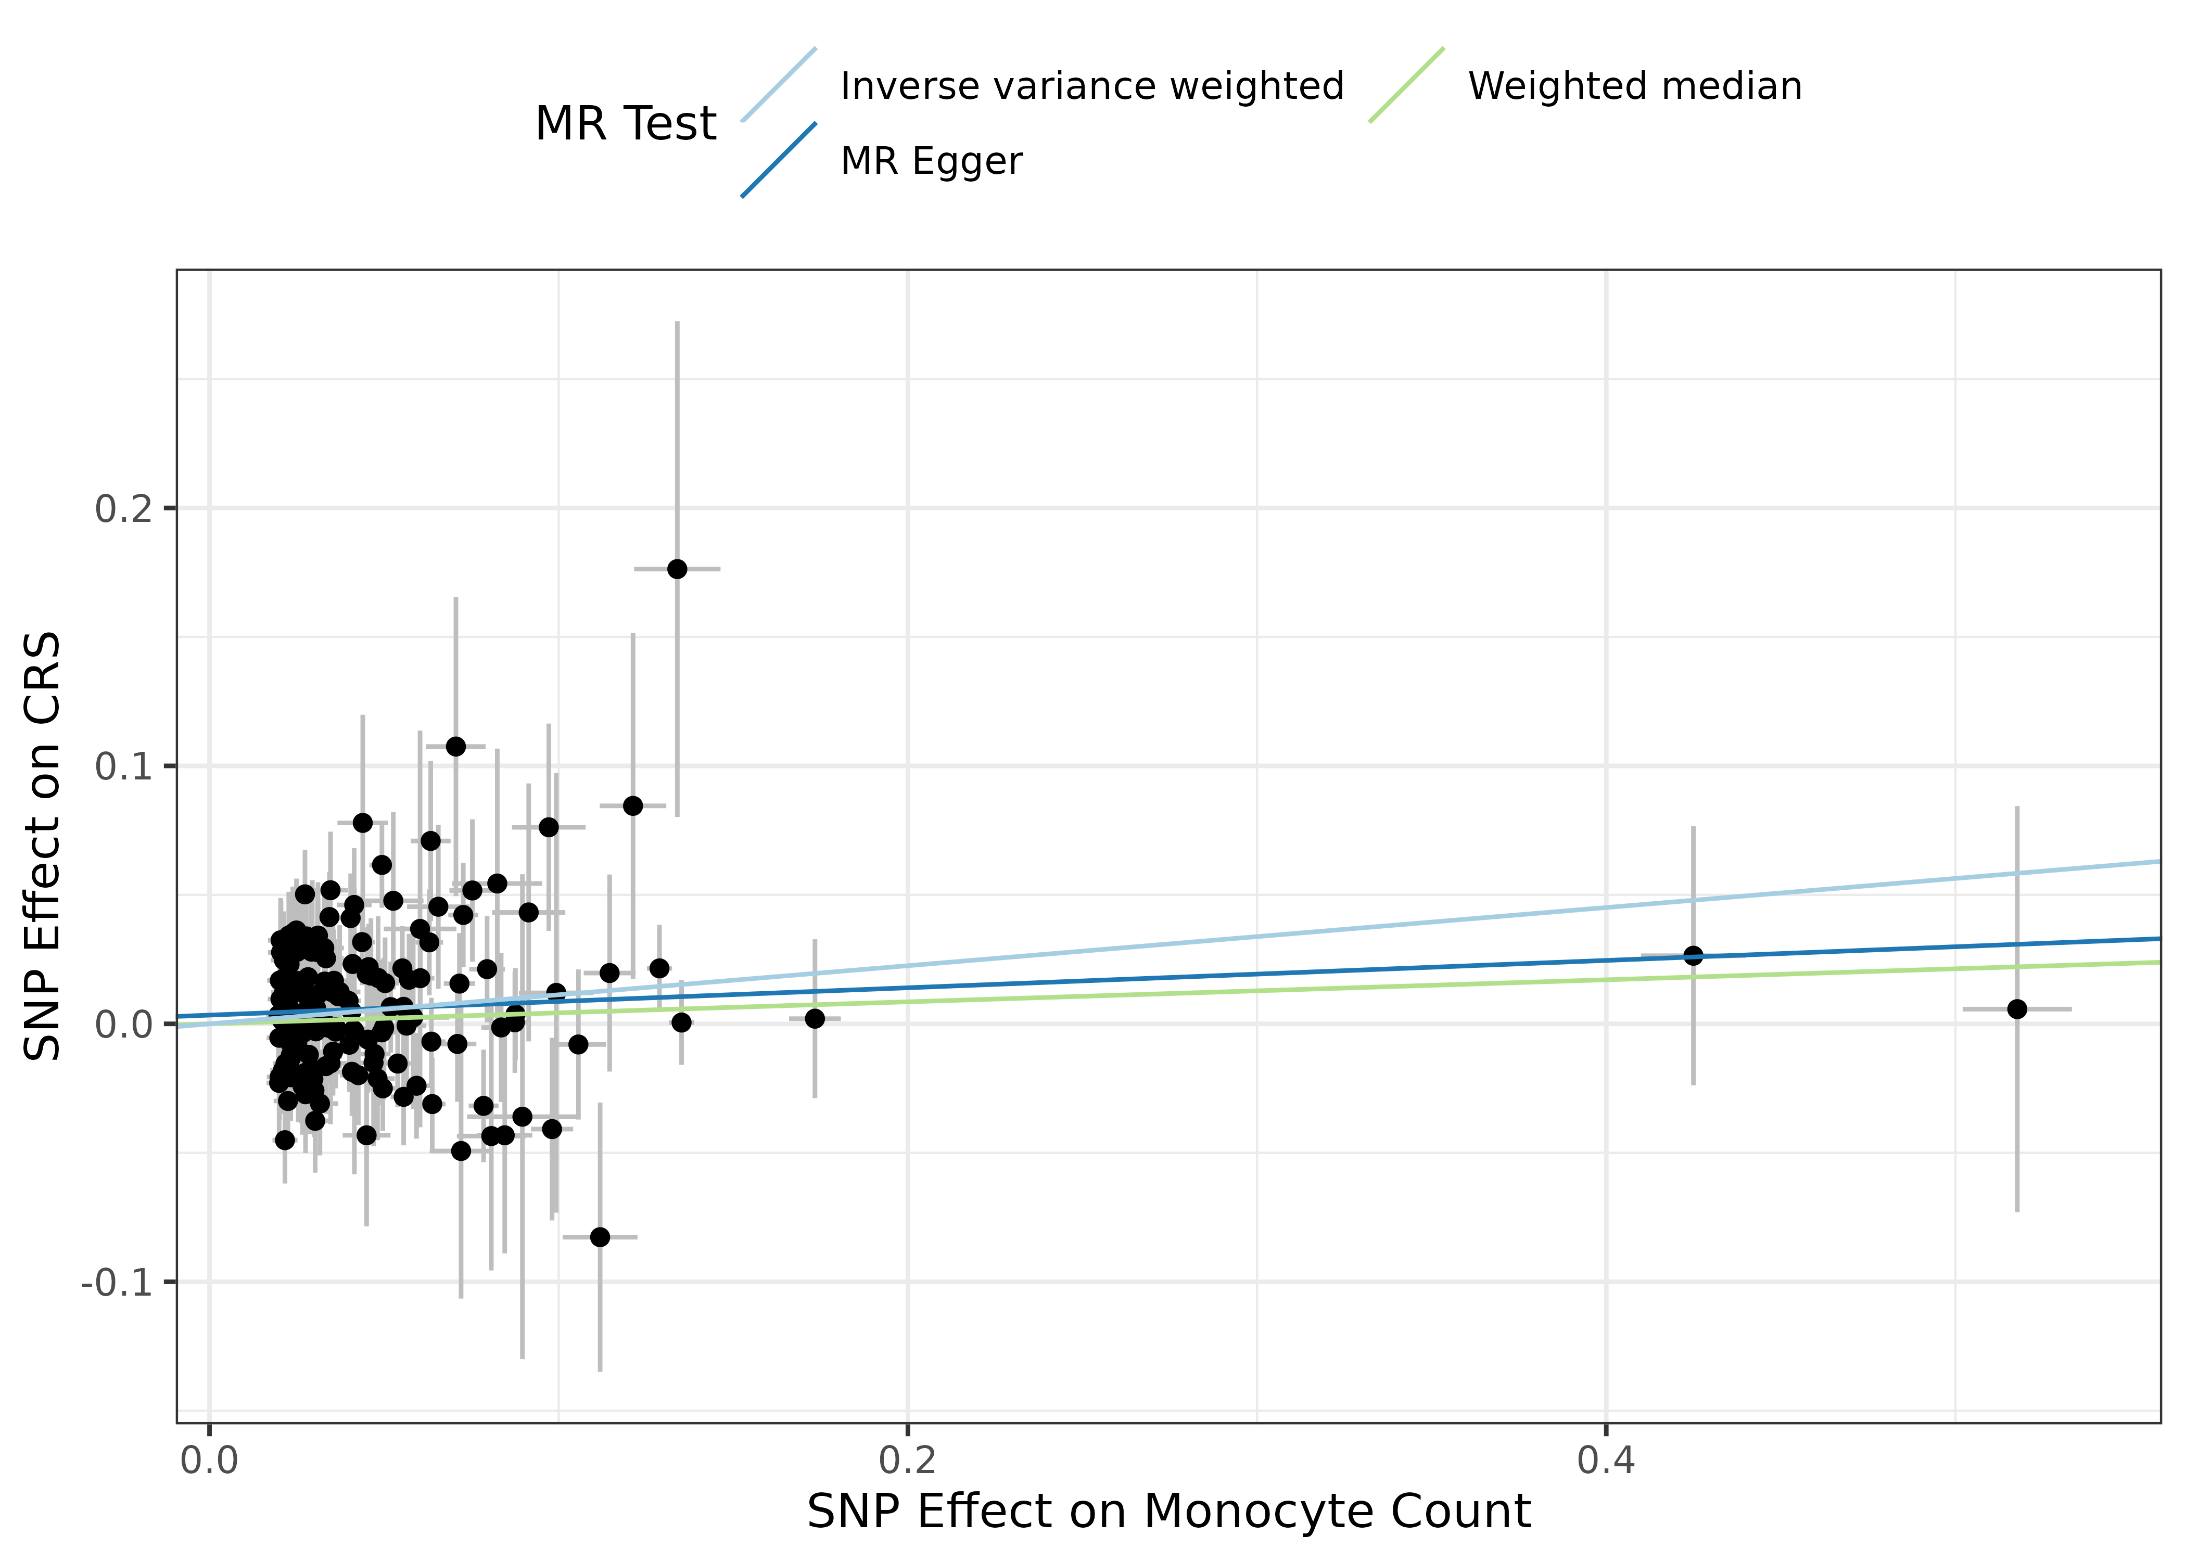
Supplemental Figure 3C: SNP effect on monocyte count and CRS

Slide 9
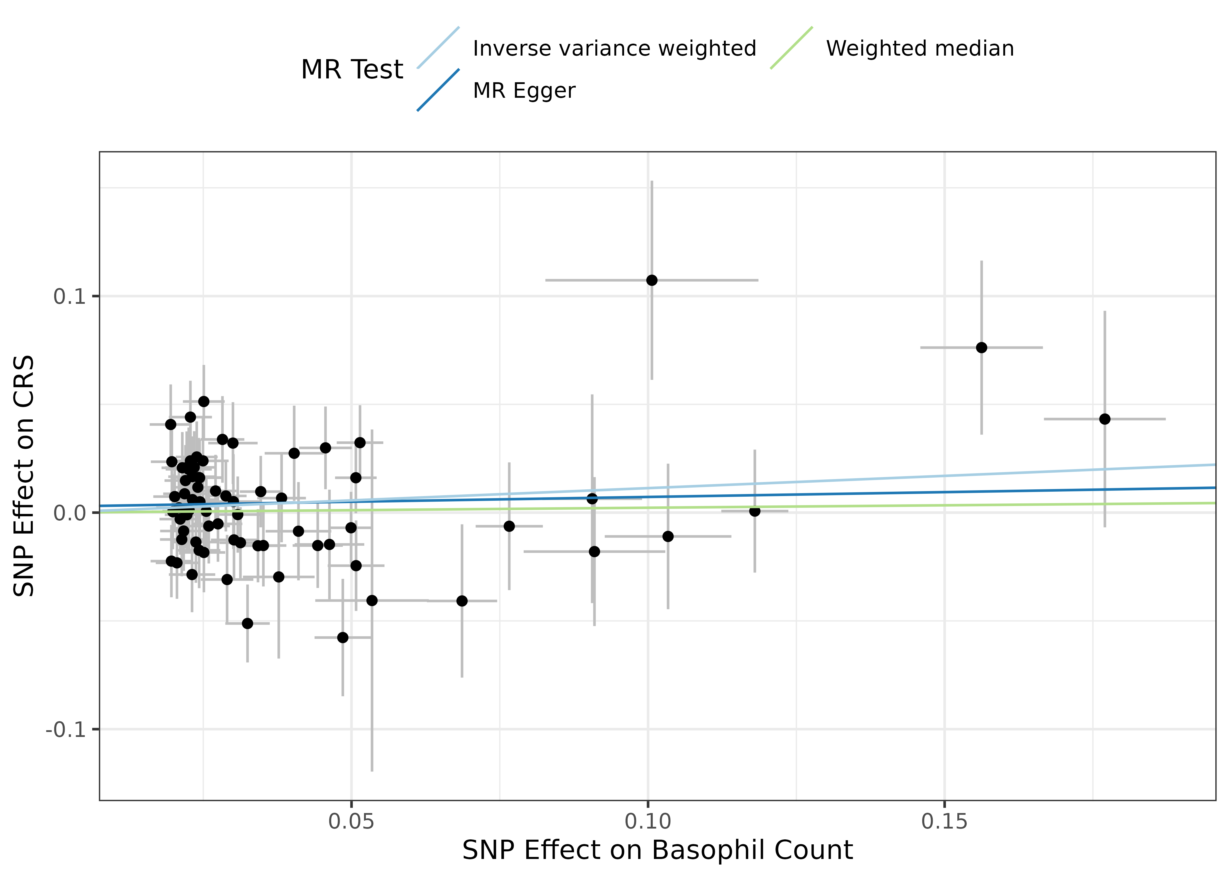
Supplemental Figure 3D: SNP effect on basophil count and CRS

Slide 10
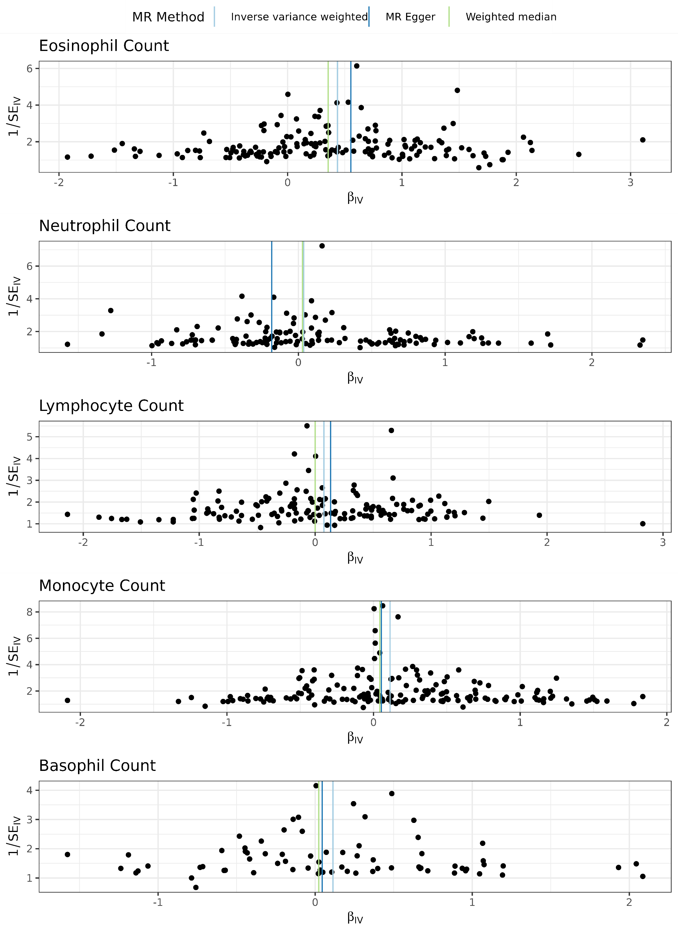
Supplemental Figure 4: Funnel plots for white blood cell types

