Slide 1
 | DH group n= 421 | GA group n= 825 | P value
Age | 78.00 [69.00,85.00] | 77.00 [68.00,84.00] | 0.005
Gender / male (%) | 254 (60.3) | 512 (62.1) | 0.595
Distance | 33.80 [21.10,49.00] | 7.00 [3.90,12.50] | <0.001
Vital signs (ambulance)
sBP | 159.00 [133.00,184.00] | 160.00 [140.00,182.00] | 0.128
RR | 20.00 [18.00,23.00] | 18.00 [18.00,20.00] | 0.498
HR | 82.00 [70.00,95.25] | 81.00 [70.00,93.00] | 0.913
Japan Coma Scale |  |  | <0.001
0-3 (%) | 204 (69.9) | 684 (86.4)
10-30 (%) | 48 (16.4) | 64 (8.1)
100-300 (%) | 40 (13.7) | 44 (5.6)
Time duration
onset to EMS | 37.00 [9.00,123.00] | 57.00 [14.00,235.00] | <0.001
EMS to HP arrival | 54.00 [45.00,65.00] | 34.00 [28.00,44.00] | <0.001
onset to HP arrival | 93.00 [67.00,180.00] | 98.00 [52.00,275.00] | 0.461
Treatment during transportation
tracheal intubation (%) | 9 (2.1) | 0 | <0.001
sedative drugs (%) | 7 (1.7) | 0 | 0.001
depressor drugs (%) | 35 (8.3) | 0 | <0.001
Vital signs (on admission)
sBp | 154.00 [136.00,174.00] | 159.00 [140.00,179.00] | 0.016
RR | 18.00 [16.00,22.00] | 18.00 [16.00,22.00] | 0.819
HR | 80.00 [69.00,93.00] | 80.00 [70.00,92.00] | 0.640
Glasgow Coma Scale | 14.00 [11.00,15.00] | 15.00 [13.00,15.00] | <0.001
NIHSS | 11.52 (9.84) | 8.76 (8.78) | <0.001
rt-PA (%) | 134 (31.8) | 193 (23.4) | 0.002
duration onset-rt-PA | 142.00[110.00,194.00] | 140.00[102.00,175.00] | 0.312
IVR (%) | 102 (24.2) | 134 (16.2) | 0.001
duration onset-IVR | 167.00[134.00,232.00] | 197.50[145.00,179.00] | 0.025
ICU admission (%) | 168 (40.8) | 273 (33.7) | 0.018
Hospital stay | 18.00 [11.00,28.00] | 16.00 [11.00,28.00] | 0.472
Mortality (%) | 31 (7.4) | 47 (5.7) | 0.288
CPC (%) |  |  | <0.001
1 | 154 (36.6) | 429 (52.0)
2 | 97 (23.0) | 126 (15.3)
3 | 130 (30.9) | 203 (24.6)
4 | 8 (1.9) | 22 (2.7)
5 | 32 (7.6) | 45 (5.5)
OPC (%) |  |  | 0.211
1 | 124 (29.5) | 289 (35.0)
2 | 104 (24.7) | 191 (23.2)
3 | 153 (36.3) | 276 (33.5)
4 | 8 (1.9) | 22 (2.7)
5 | 32 (7.6) | 47 (5.7)
Table 1
(full size)

Slide 2
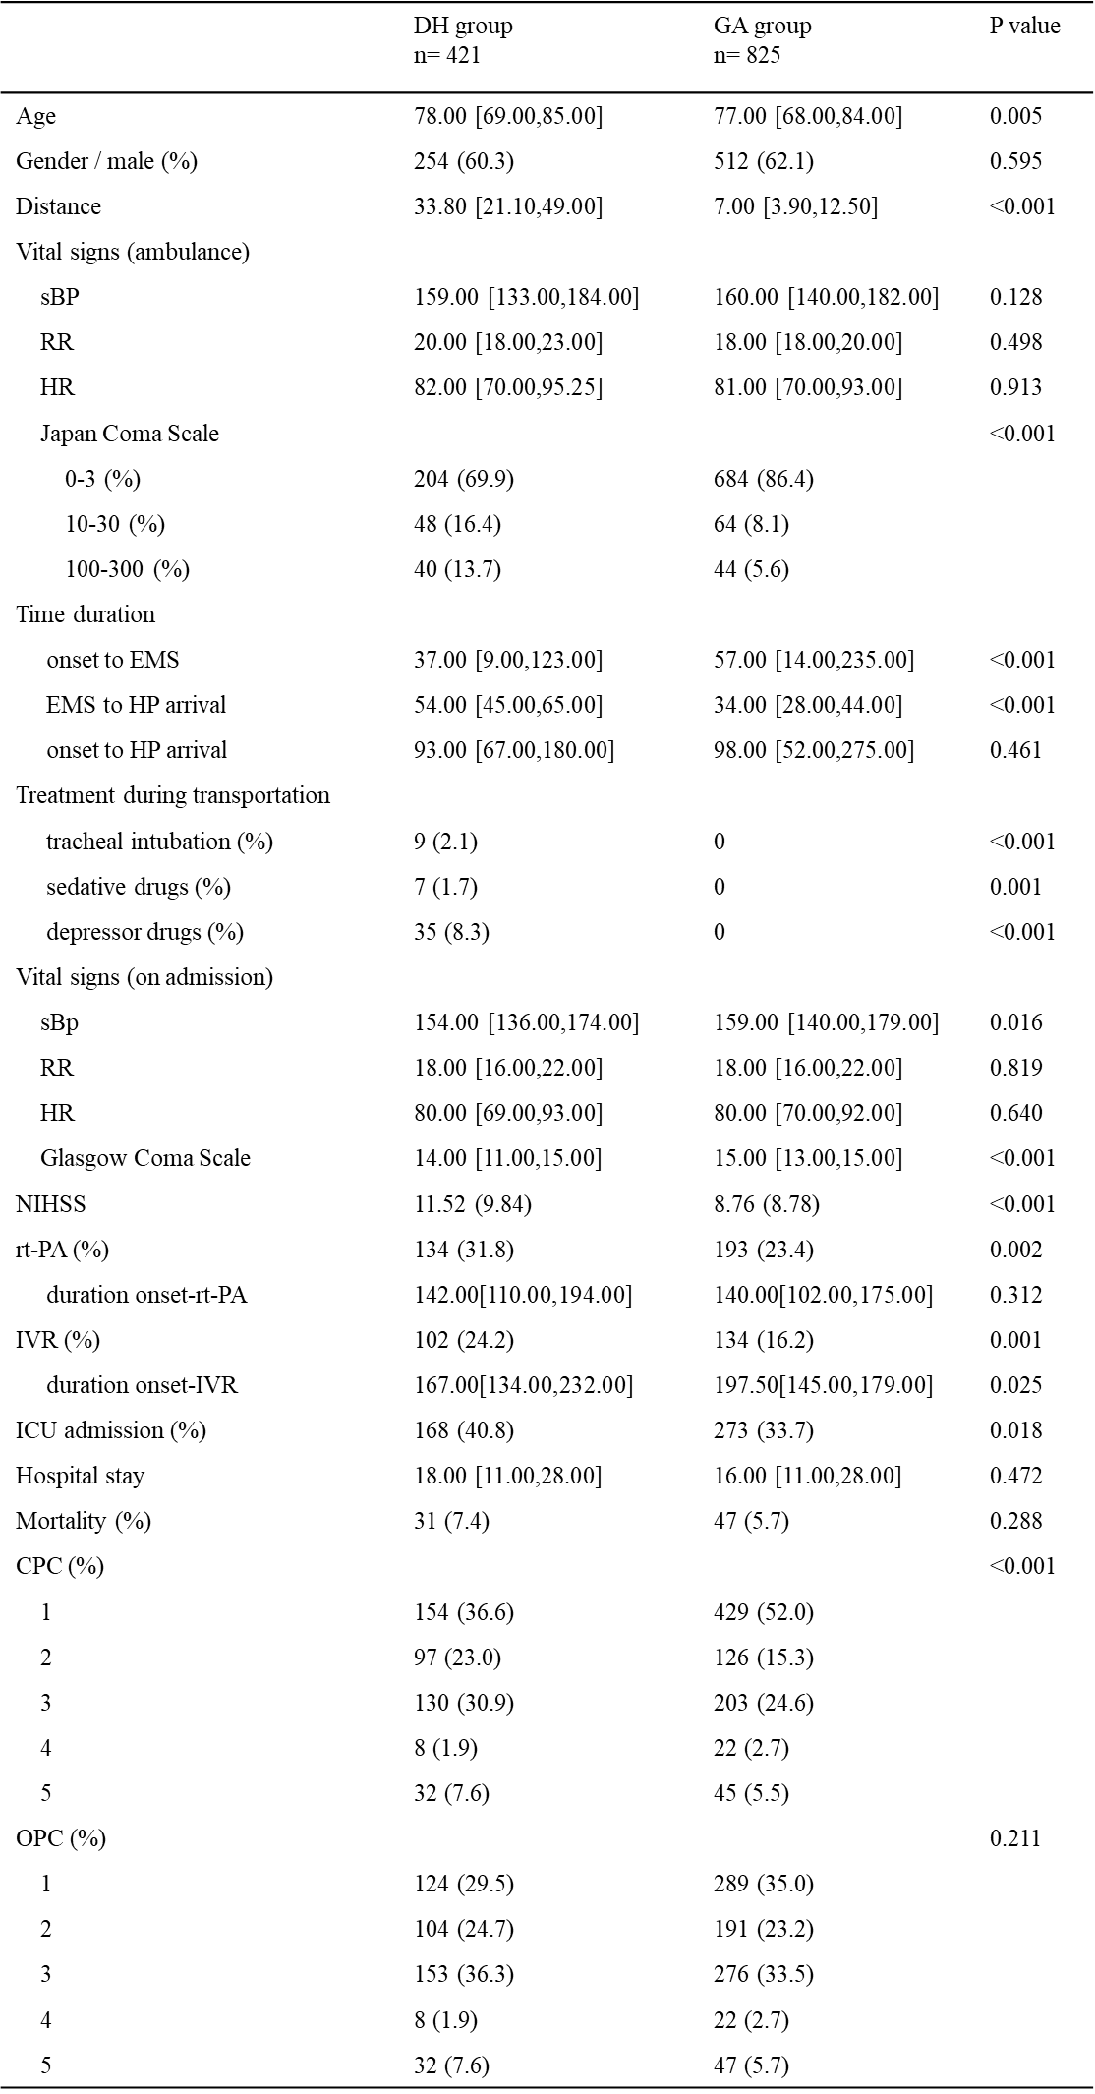
Table 1

Slide 3
Table 2
variables | Odds ratio | 95%CI |  | P value
variables | Odds ratio | lower | upper | P value
Transport by DH | 1.38 | 0.89 | 2.12 | 0.15
Age | 0.95 | 0.94 | 0.97 | 0.00
Male | 1.08 | 0.78 | 1.49 | 0.63
sBP on admission | 1.00 | 1.00 | 1.01 | 0.77
GCS on admission | 1.09 | 1.02 | 1.17 | 0.02
Duration from onset to EMS call | 1.00 | 1.00 | 1.00 | 0.74
NIHSS | 0.91 | 0.89 | 0.94 | 0.00
rt-PA | 1.18 | 0.84 | 1.66 | 0.35
IVR | 1.57 | 1.04 | 2.37 | 0.03
distance | 0.99 | 0.98 | 1.00 | 0.05

Slide 4
Table 3
 |  | 95%CI
variables | Odds ratio | lower | upper | P value
Transport by DH | 2.33 | 1.28 | 4.24 | 0.01
Age | 0.96 | 0.94 | 0.97 | 0.00
Male | 1.20 | 0.87 | 1.65 | 0.27
sBP on admission | 1.00 | 0.99 | 1.00 | 0.59
GCS on admission | 1.09 | 1.00 | 1.19 | 0.06
Duration from onset to EMS call | 1.00 | 1.00 | 1.00 | 0.65
NIHSS | 0.89 | 0.87 | 0.92 | 0.00
rt-PA | 1.27 | 0.90 | 1.80 | 0.18
IVR | 1.65 | 1.07 | 2.54 | 0.02
distance | 1.01 | 0.99 | 1.02 | 0.54

Slide 5
Table 4
 |  | 95%CI
variables | Odds ratio | lower | upper | P value
Transport by DH | 0.71 | 0.29 | 1.74 | 0.46
Age | 1.02 | 0.99 | 1.05 | 0.25
Male | 1.03 | 0.53 | 1.99 | 0.93
sBP on admission | 1.01 | 1.00 | 1.02 | 0.27
GCS on admission | 0.88 | 0.77 | 1.01 | 0.06
Duration from onset to EMS call | 1.00 | 1.00 | 1.00 | 0.70
NIHSS | 1.10 | 1.06 | 1.14 | 0.00
rt-PA | 0.38 | 0.18 | 0.77 | 0.01
IVR | 1.45 | 0.72 | 2.91 | 0.30
distance | 1.00 | 0.98 | 1.02 | 0.85

Slide 6
Table 5
 |  | 95%CI
variables | Odds ratio | lower | upper | P value
Transport by DH | 2.19 | 1.12 | 4.27 | 0.02
Age | 0.95 | 0.93 | 0.98 | 0.00
Male | 1.23 | 0.73 | 2.06 | 0.43
sBP on admission | 1.00 | 0.99 | 1.01 | 0.46
GCS on admission | 1.16 | 1.04 | 1.31 | 0.01
Duration from onset to EMS call | 1.00 | 1.00 | 1.00 | 0.98
NIHSS | 0.96 | 0.92 | 1.01 | 0.14
rt-PA | 2.41 | 1.46 | 3.99 | 0.00
IVR | 1.49 | 0.90 | 2.45 | 0.12
distance | 0.99 | 0.98 | 1.00 | 0.15

Slide 7
Table 6
 |  | 95%CI
variables | Odds ratio | lower | upper | P value
Transport by DH | 2.62 | 1.27 | 5.42 | 0.01
Age | 0.94 | 0.92 | 0.97 | 0.00
Male | 1.13 | 0.64 | 2.00 | 0.67
sBP on admission | 1.00 | 0.99 | 1.01 | 0.61
GCS on admission | 1.16 | 1.02 | 1.32 | 0.02
Duration from onset to EMS call | 1.00 | 1.00 | 1.00 | 0.94
NIHSS | 0.94 | 0.89 | 0.99 | 0.03
rt-PA | 2.38 | 1.38 | 4.10 | 0.00
IVR | 1.82 | 1.06 | 3.13 | 0.03
distance | 0.98 | 0.97 | 1.00 | 0.05

