Slide 1
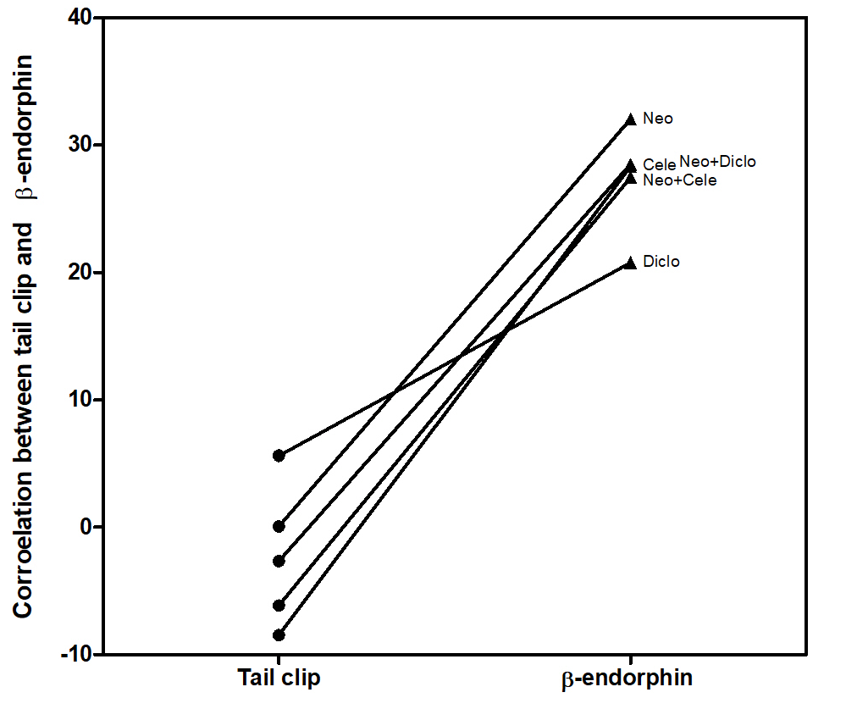

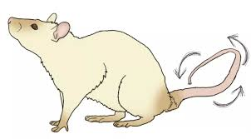

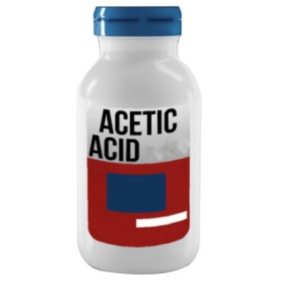
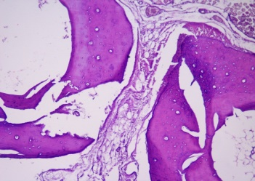
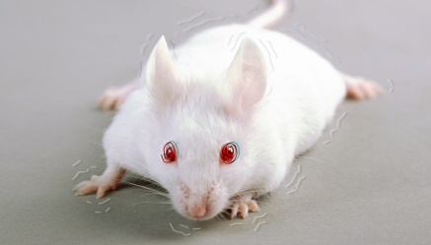
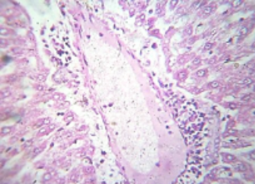
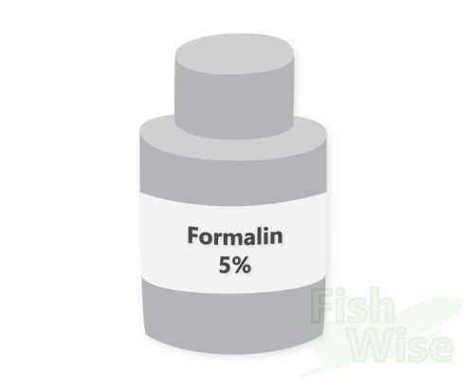

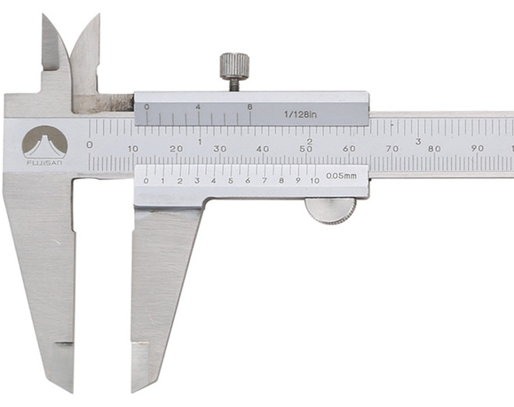
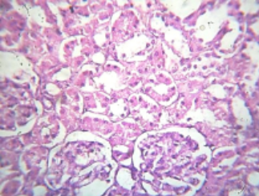
After
15,
30,
45,
60
min
Serum β-endorphin level after 60 min
Analgesia
Hind paw
Inhibition of abdominal cramps
Liver
Acute 24 hours
Neostegmine with/ without diclofenac or celecoxib
Sub-chronic
5 days
Inflammation
Kidney
Serum TNF-ɑ, HS-CRP, NF-кB, Cox activity, AST, ALT, creatinine, urea

