Slide 1
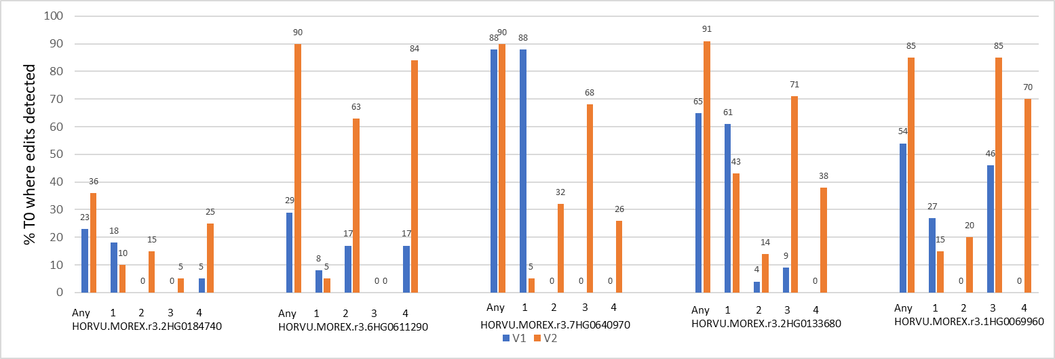
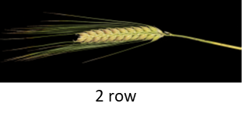
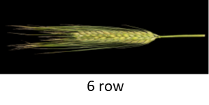
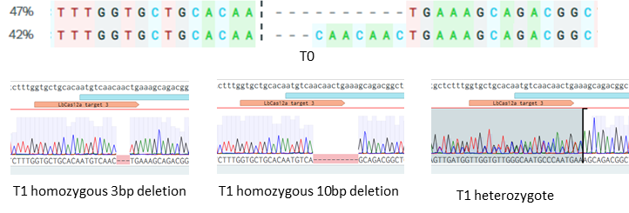
S1
S2
S3
S4
T-E9
Cas12a
P-AtUbi 10
At
U626
HH
DR
Guide
HDV
t

Slide 2
S1. Comparison of V1 and V2 guide architectures: Five barley genes targeted (Gene identifiers given), each with ttHsCas12a and 4 guides, either in a V1 or V2 array. Blue bars = percentage of T0 V1 lines containing targeted mutations. Orange bars = percentage of T0 V2 lines containing targeted mutations. X axis = guide order in array. Any = percentage of T0 lines containing mutations at one or more of the four guide target sites.
S2. Left: Wild type 2 row Golden promise. Right: Golden promise T0 plant mutated in HORVU.MOREX.r3.2HG0184740 showing 6 row phenotype.
S3. In one T0 barley line targeting HORVU.MOREX.r3.1HG0069960, 47% of alleles contained a 10bp deletion and 42% contained a 3bp deletion. Mutations were faithfully inherited in T1 progeny.
S4. Brassica oleracea construct architectures: P-AtUbi=Arabidopsis thaliana ubiquitin 10 promoter; Cas12a=LbCas12a CDS; T-E9 = Pisum sativum rbcS E9 terminator. AtU626 = Arabidopsis thaliana U626 promoter; DR = direct repeat of crRNA; HH/HDV=ribozymes; t=poly-T terminator.

