Slide 1
Supplementary Information
Simultaneous loading of PCR-based multiple fragments on mouse artificial chromosome vectors in DT40 cell for gene delivery
Kyotaro Yamazaki, Kyosuke Matsuo, Akane Okada, Narumi Uno, Teruhiko Suzuki, Satoshi Abe, Shusei Hamamichi, Nanami Kishima, Shota Togai, Kazuma Tomizuka, Yasuhiro Kazuki

Slide 2

Yamazaki et al. Supplementary Figure S1
a
10MAC2
b
Positive control
PX458.1a-
MAC10CR1
700 bp -
Cel-I
+
-
+
-
...GACCCAACCCCTTATCAAGAGATCTGGTA...
500 bp -
sgRNA
PAM
400 bp -
300 bp -
200 bp -
c
HR1
Fcy::Fur
nLA
CAG;EGFP
PGK;BS^{r}
TetR
nRA
d
e
HR1-BS
nLA
701-bp
nRA
936-bp
Electroporation
PX458.1a-MAC10CR1
10MAC2
nLA
nRA
nLA
nRA
sgRNA+Cas9
Pr.18/19
Pr.26/27
Supplementary Figure 1. Evaluation of sgRNA efficiency and CRISPR-Cas9 mediated KI efficiency in DT40 cells.
a, Diagrammatic representation of the 10MAC2 sequence and designed sgRNA recognition sequence. b, Analysis of sgRNA efficiency. For gel source data, refer to Supplementary Fig. 4. c, Schematic representation of HDR-KI with and without CRISPR-Cas9 mediated DSB. Arrows indicate the position of PCR primers used for analysis. Dashed lines and gray shadings indicate homology arm position and length. EGFP expression of DT40-10MAC2 cells containing recombined PCR-based HDR donors. d, The BS-resistant and EGFP-positive clone number after BS selection. e, Confirmation of precise simHDR by PCR analysis and the positive clone number.

Slide 3
Yamazaki et al. Supplementary Figure S2
Condition No. | DNA quantity (µg) | Voltage (V) | EGFP positive cells
1 | 0 | 275 | 0%
2 | 5 | 275 | 21%
3 | 10 | 275 | 29%
4 | 15 | 275 | 19%
5 | 20 | 275 | 11%
6 | 10 | 175 | 20%
7 | 10 | 225 | 38%
8 | 10 | 200 | 8%
Supplementary Figure 2. Optimization of electroporation conditions.
To optimize the electroporation conditions for DT40-10MAC2 cells, pCX-EGFP was transfected and EGFP-positive rate was evaluated. The DNA quantities were compared for 5, 10, 15, and 20 µg. The voltages at poring pulse were compared for 175, 100, 225, and 275 V.

Slide 4
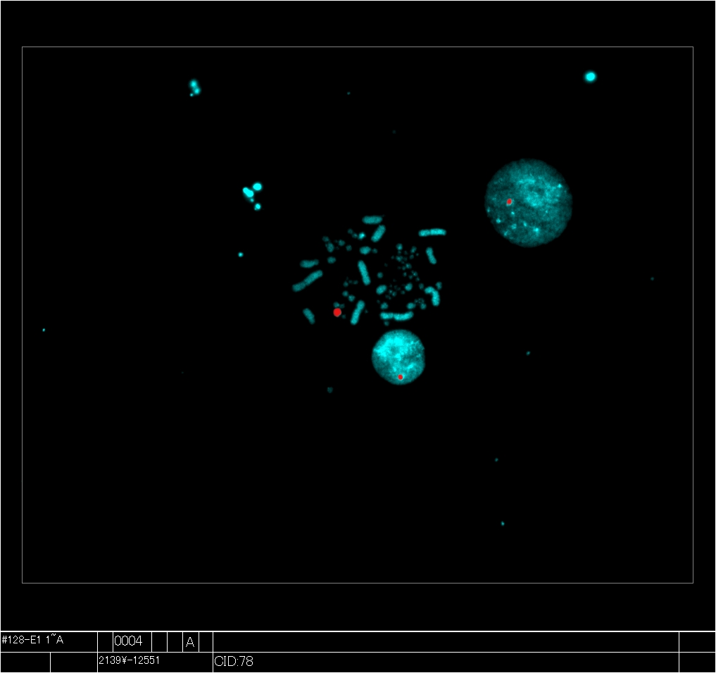
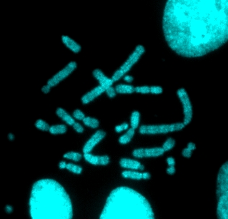
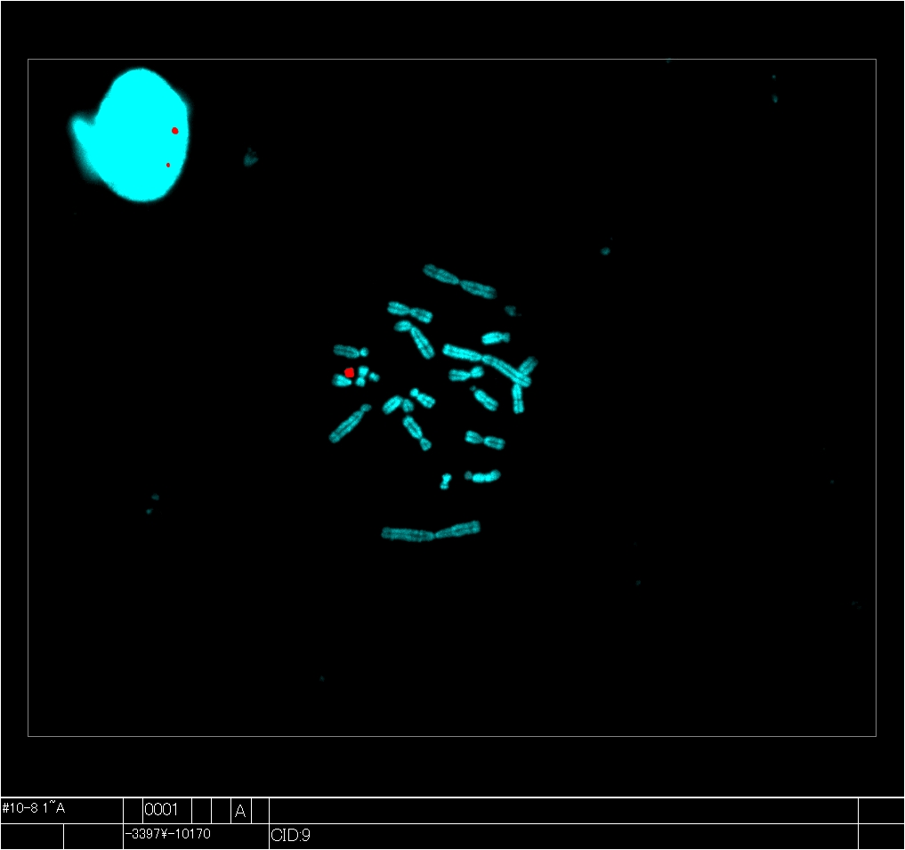
Yamazaki et al. Supplementary Figure S3
a
DT40 cells
Centrifugation
&
denucleation
CHO cells
Micronuclei formation
PEG fusion
10MAC2-HR3
CHO cells
10MAC2-HR3
b
BF
EGFP
CHO-10MAC2-HR3
c
DT40-10MAC2-HR3
CHO(Hprt^{-/-})
CHO-10MAC2-HR3
Mouse Cot-I (10MAC2): Rhodamine
Mouse Cot-I (10MAC2): Rhodamine
Mouse Cot-I (10MAC2): Rhodamine
Supplementary Figure 3. Schematic depiction of MMCT and analysis of gene function loaded by the simHDR.
a, Schematic depiction of MMCT for transferring 10MAC2-HR3-BSs from DT40 to CHO cells. First, colcemid treatment induced micronuclei formation. Second, micronucleated cells were denucleated by centrifugation to obtain microcells. Finally, microcells were fused with recipient CHO cells by polyethylene glycol, and CHO clones expressing EGFP were obtained. b, Images of CHO cells carrying the 10NAC2-HR3-BSs. GFP expression indicates the presence of the 10NAC2-HR3-BSs. BF, bright field. Scale bar: 100 µm. c, Representative image of metaphase FISH analysis with mouse Cot-I (red) detecting the 10MAC2. Arrowhead indicates the 10MAC2 and the inset shows an enlarged image thereof. Scale bar: 10 μm.

Slide 5
Yamazaki et al. Supplementary Figure S4
Lane |  | Cel-I | bp
 |  |  | Homo |  | Hetero
1 | Marker
2 | Kit positive control | + | 633 | 415
3 | Kit positive control | - |  | 218
4 | DT40-10MAC2 | + | 638 | 409
5 | DT40-10MAC2 | - |  | 229
6
1
2
3
4
5
6
Supplementary Figure 4. Uncropped images of electrophoresis.
Uncropped image of electrophoresis is presented, and the dotted square indicates the figure used in Supplementary Fig. 1b.

Slide 6
Yamazaki et al. Supplementary Figure S5
Lane |  | bp
1
2
3 | Marker
4 | HR1 | 8711
5 | HR2-1 | 4776
6 | HR2-2 | 4435
7
8
1
2
3
4
5
6
7
8
Lane |  | bp
1 | Marker
2 | HR3-1 | 3085
3 | HR3-2 | 2313
4 | HR4-3 | 1921
5 | HR4-4 | 3014
6
1
2
3
4
5
6
Supplementary Figure 5. Uncropped images of electrophoresis.
Uncropped images of electrophoresis are presented, and the dotted square indicates the figure used in Fig. 2b.

Slide 7
Yamazaki et al. Supplementary Figure S6
1
2
3
4
5
6
7
8
Lane |  | bp
1 | Marker
2 | HR2-1.G600 | 3085
3 | HR2-2.G600 | 6262
4 | HR2-2.G300 | 5926
5 | HR2-2.G60 | 5686
6 | HR2-1.G600.L60 | 2436
7 | HR2-2.G600.R60 | 5386
8 | HR2-2.G60.R60 | 4810
Supplementary Figure 6. Uncropped images of electrophoresis.
Uncropped image of electrophoresis is presented, and the dotted square indicates the figure used in Fig. 3b.

Slide 8
Yamazaki et al. Supplementary Figure S7
1
2
3
4
5
6
7
8
Lane |  | bp
1
2
3 | 5’EGFP | 3085
4 | 3’EGFP-BS | 2306
5 | HLA-A | 9977
6
7 | Marker
8
Supplementary Figure 7. Uncropped images of electrophoresis.
Uncropped image of electrophoresis is presented, and the dotted square indicates the figure used in Fig. 4b.

Slide 9
Yamazaki et al. Supplementary Figure S8
Lane |  | bp | Target | RT
1 | Marker
2 | DT40-10MAC2-HLA-A | 197 | HLA-A | +
3 | DT40-10MAC2 | 197 | HLA-A | +
4
5
6 | DT40-10MAC2-HLA-A | 113 | GAPDH | +
7 | DT40-10MAC2 | 113 | GAPDH | +
8
9
10 | DT40-10MAC2-HLA-A | 113 | GAPDH | -
11 | DT40-10MAC2 | 113 | GAPDH | -
12
13
1
2
3
4
5
6
7
8
9
10
11
12
13
Supplementary Figure 8. Uncropped images of electrophoresis.
Uncropped image of electrophoresis is presented, and the dotted square indicates the figure used in Fig. 4e.

Slide 10
Yamazaki et al. Supplementary Figure S9
Left: DT40-10MAC2 total cell protein (20 µL)
Right: DT40-10MAC2-HLA-A total cell protein (20 µL)
1st Ab: anti-HLA-A (Rabbit)
2nd Ab: anti-Rabbit (Goat)
Substrate: SuperSignal West Femto Maximum Sensitivity Substrate
Exposure: 30 s (Standard)
Left: DT40-10MAC2-HLA-A total cell protein (2 µL)
Right: DT40-10MAC2 total cell protein (2 µL)
1st Ab: anti-α-Tubulin (Rabbit)
2nd Ab: anti-Rabbit (Goat)
Substrate: Pierce ECL Western Blotting Substrate
Exposure: 480 s (Standard)
Supplementary Figure 9. Uncropped images of western blotting.
Uncropped image of western blotting is presented, and the dotted square indicates the figure used in Fig. 4f.

Slide 11
Yamazaki et al. Supplementary Table S1
Supplementary Table 1. Electroporation conditions related in Fig. 2 and Table 2.
 | PX458 | HR1 | HR2-1 | HR2-2 | HR3-1 | HR3-2 | HR4-3 | HR4-4 | Total
HR1-BS | 5,000 | 5,000 |  |  |  |  |  |  | 10,000
HR2-BSs | 5,000 |  | 2,750 | 2,550 |  |  |  |  | 10,300
HR3-BSs | 5,000 |  |  | 2,550 | 1,770 | 1,330 |  |  | 10,650
HR4-BSs | 5,000 |  |  |  | 1,770 | 1,330 | 1,100 | 1,730 | 10,930
 |  |  |  |  |  |  |  |  | (ng)
 | Poring pulse | Transfer pulse
Voltage | 225 | 20
Pulse length | 1 | 50
Pulse interval | 50 | 50
Number of pulses | 2 | 5
Decay rate | 10 | 40
Polarity | + | +/-

Slide 12
Yamazaki et al. Supplementary Table S2
Supplementary Table 2. Electroporation conditions related in Fig. 3 and Table 3.
 | PX458 | HR2-1 .G600 | HR2-2 .G600 | HR2-2 .G300 | HR2-2 .G60 | HR2-1 .G600.L60 | HR2-2 .G600.R60 | HR2-2 .G60.R60 | Total
HR-G600 | 5,000 | 1,770 | 3,600 |  |  |  |  |  | 10,370
HR-G300 | 5,000 | 1,770 |  | 3,400 |  |  |  |  | 10,170
HR-G60 | 5,000 | 1,770 |  |  | 3,260 |  |  |  | 10,030
HR-LR60 | 5,000 |  |  |  |  | 1,400 | 3,100 |  | 9,500
HR-LRG60 | 5,000 |  |  |  |  | 1,400 |  | 2,760 | 9,160
 |  |  |  |  |  |  |  |  | (ng)
 | Poring pulse | Transfer pulse
Voltage | 225 | 20
Pulse length | 1 | 50
Pulse interval | 50 | 50
Number of pulses | 2 | 5
Decay rate | 10 | 40
Polarity | + | +/-

Slide 13
Yamazaki et al. Supplementary Table S3
Supplementary Table 3. Electroporation conditions related in Fig. 4.
PX458 | HLA-A | 5'EGFP | 3'EGFP-BS | Total
5,000 | 15,000 | 5,800 | 5,600 | 31,400
 |  |  |  | (ng)
 | Poring pulse | Transfer pulse
Voltage | 225 | 20
Pulse length | 1 | 50
Pulse interval | 50 | 50
Number of pulses | 2 | 5
Decay rate | 10 | 40
Polarity | + | +/-
Electroporation were performed under conditions optimized for transfection efficiency of PCR HDR donors, 10-kb HLA-A, 3-kb 5’EGFP, and 2.3-kb 3’EGFP-BS.

