Slide 1
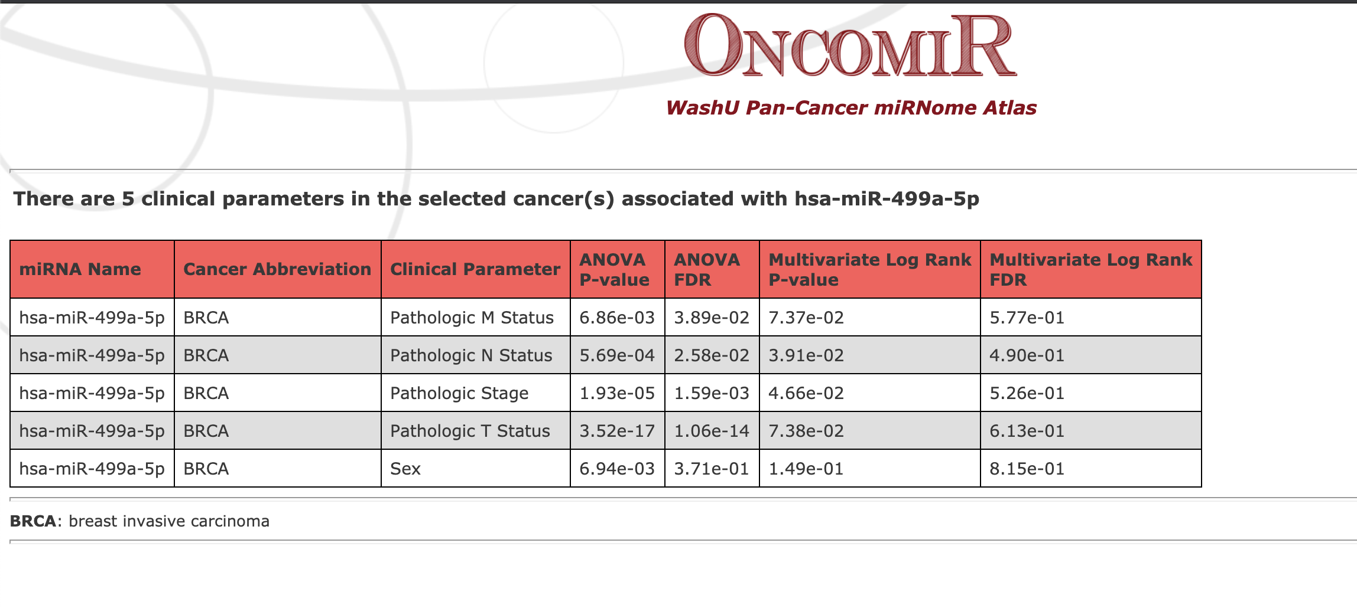
Supplementary figure 1
Supplementary figure 1. The association between clinical parameters and miR-499a-5p expression in breast cancer
http://www.oncomir.org/cgi-bin/dbSearch.cgi

Slide 2
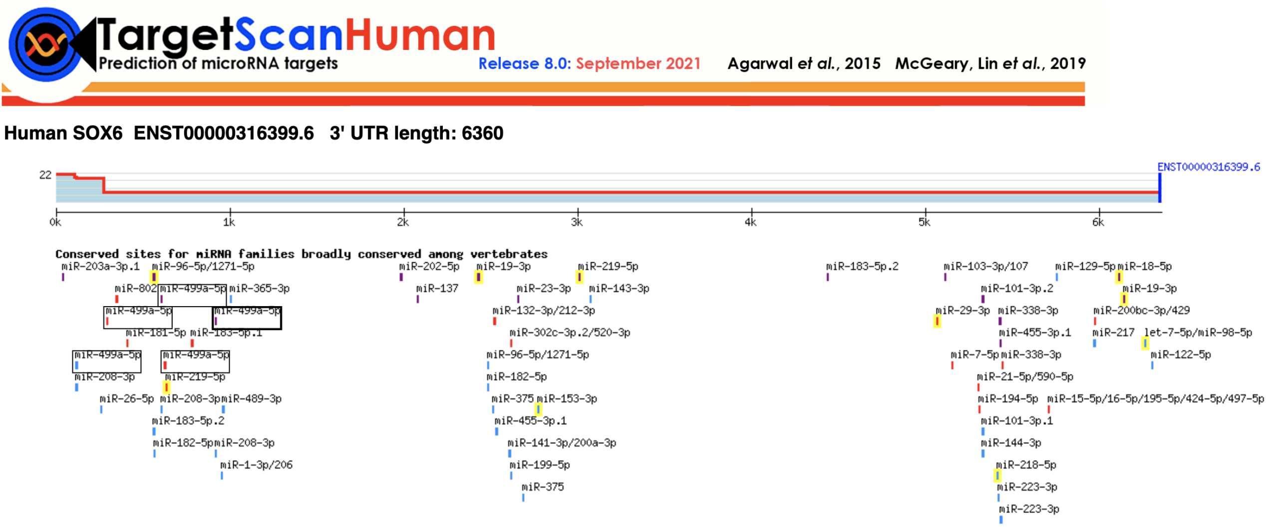
Supplementary figure 2
Supplementary figure 2. SOX6 is potential target of miR-499a-5p predicted by TargetScan platform

