Slide 1
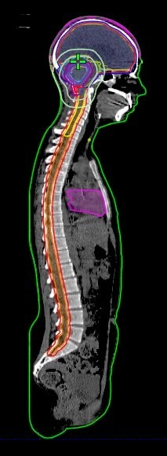
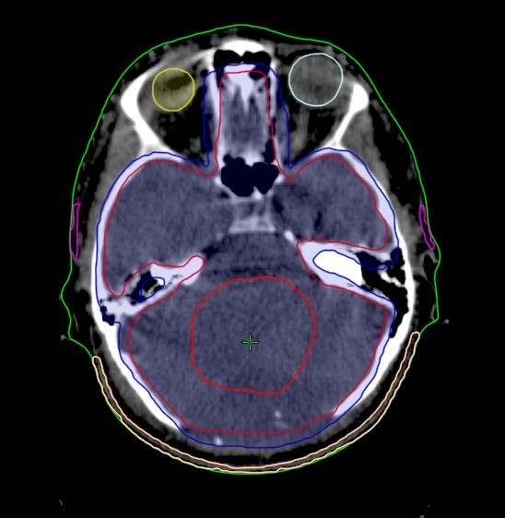
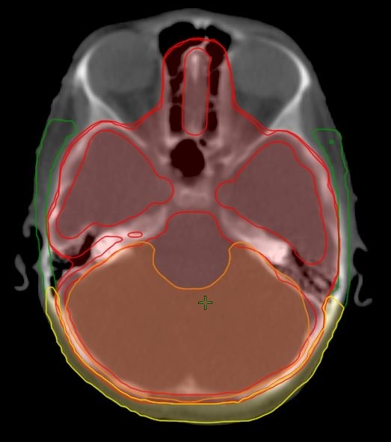
A
B
C
Figure 1. Craniospinal-irradiation treatment plan.
Original CSI plan
Original whole-cranial (blue) and tumor bed boost in the PCF (red), CTV radiotherapy plan;
Original whole-cranial (red) and W-PCF boost (orange), CTV radiotherapy plan.

