Slide 1
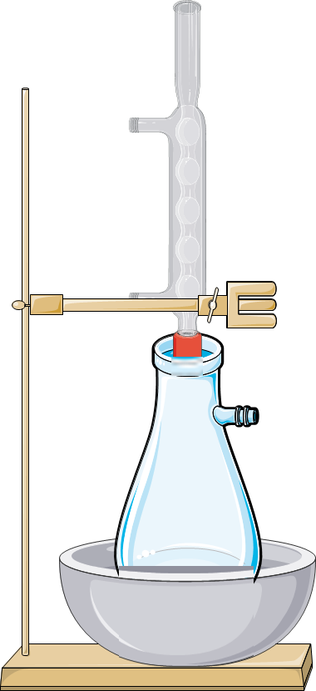
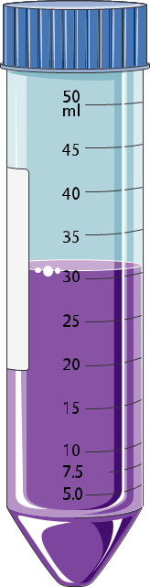





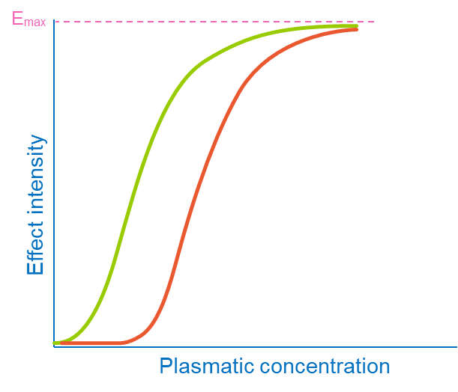
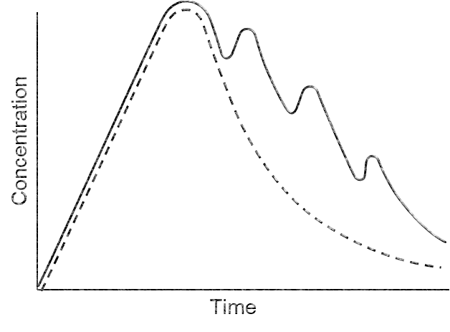
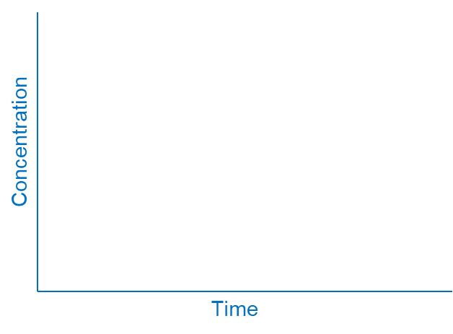
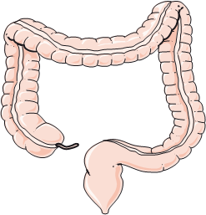
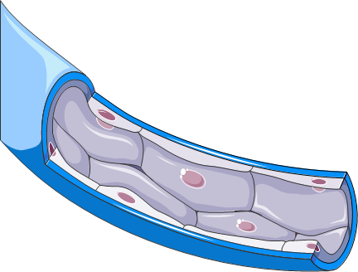


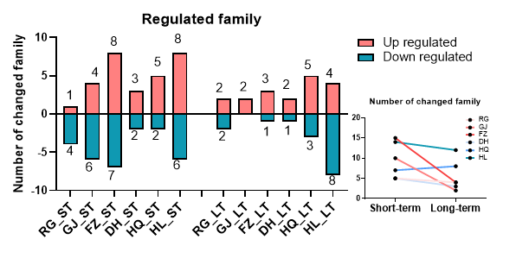
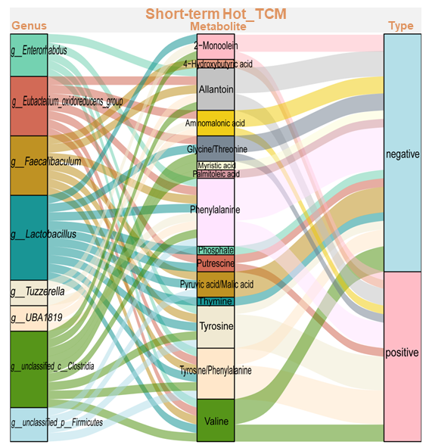
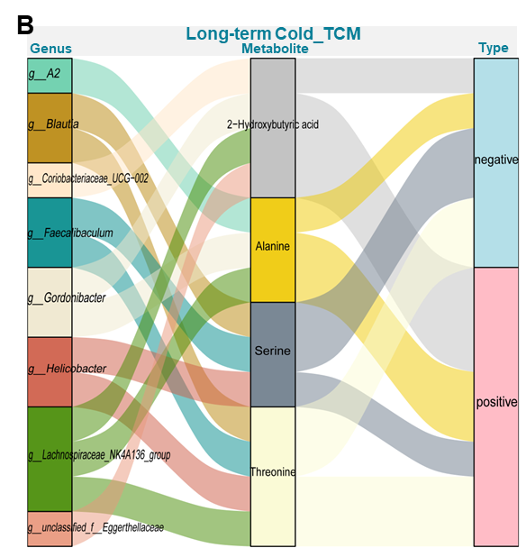
Graphic Abstract
Plant extract & analysis
Animal Intervention
Hot TCM
Short-term intervention
RG
GJ
FZ
Day 7
HOT
Control
Hot_TCM
Cold_TCM
Cross talk
Cold TCM
DH
HQ
HL
COLD
Day 35
Long-term intervention
Microbiota sequencing
Serum metabolomic analysis
Correlation analysis
Microbiome structure, abundance and function
Metabolites, class and function
Bacteria were significantly associated with metabolites

