Slide 1
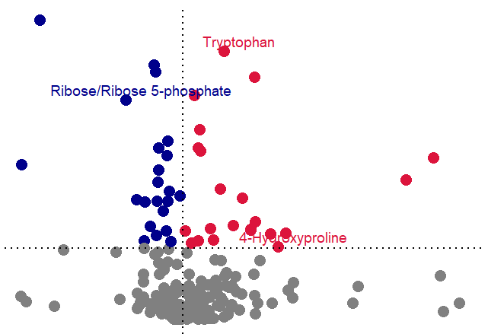
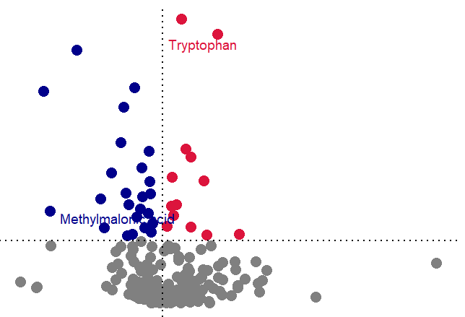
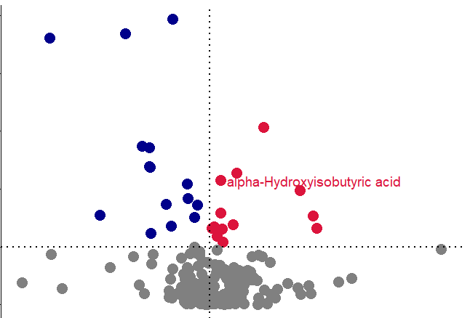
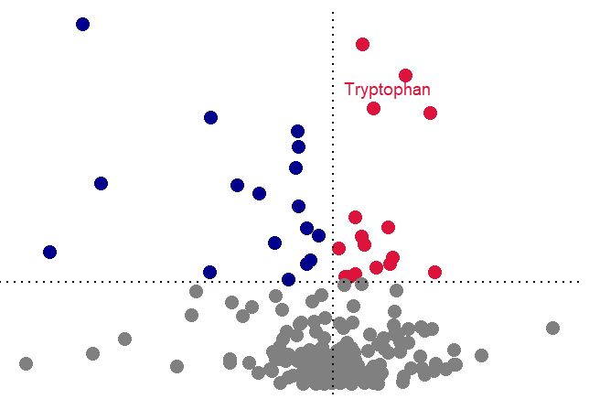
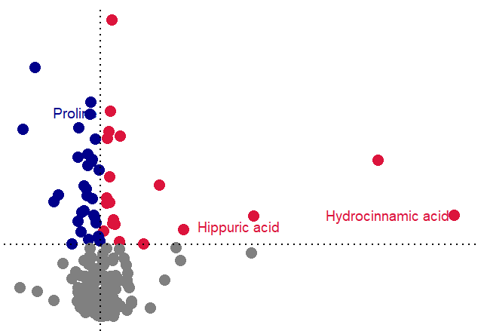
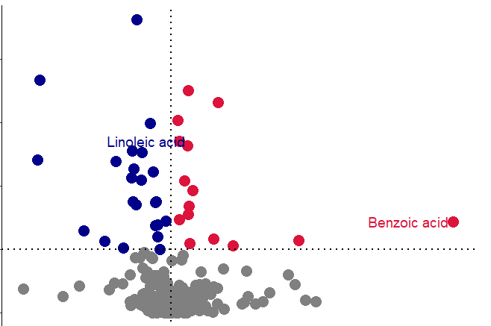
A
4
RG_LT
GJ_LT
5
FZ_LT
UP
4
4
Down
3
Nonsignificant
3
3
2
VIP
VIP
VIP
2
2
1
1
1
0
1
2
0
1
2
0
0.5
1
1.5
2
Fold Change
Fold Change
Fold Change
3
DH_LT
4
HQ_LT
4
HL_LT
2
3
3
VIP
2
VIP
1
VIP
2
1
1
0
0.5
1
1.5
0
1
2
3
4
5
0
0.5
1.0
1.5
2.0
2.5
B
Fold Change
Fold Change
Fold Change
C
RG_LT vs. Con_LT
Venn diagram between Shared metabolites
DH_LT vs. Con_LT
RG_LT vs. Con_LT
Venn diagram between Shared pathway
DH_LT vs. Con_LT
9
4
7
5
5
16
1
0
5
1
1
3
15
9
12
9
4
5
3
5
1
3
1
1
11
29
21
8
17
16
6
8
2
2
GJ_LT vs. Con_LT
FZ_LT vs. Con_LT
HQ_LT vs. Con_LT
HL_LT vs. Con_LT
GJ_LT vs. Con_LT
FZ_LT vs. Con_LT
HQ_LT vs. Con_LT
HL_LT vs. Con_LT
D

