Slide 1
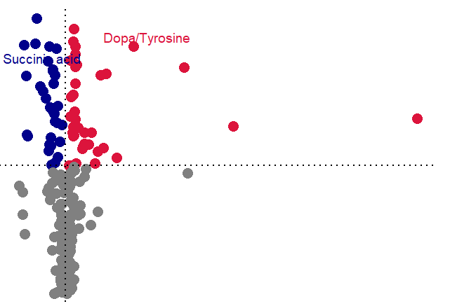
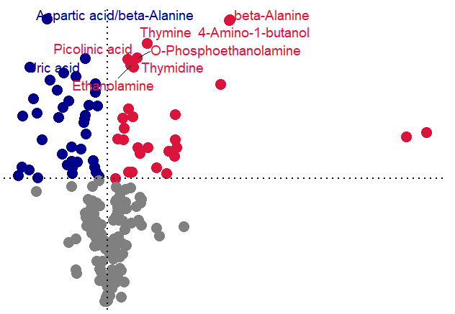
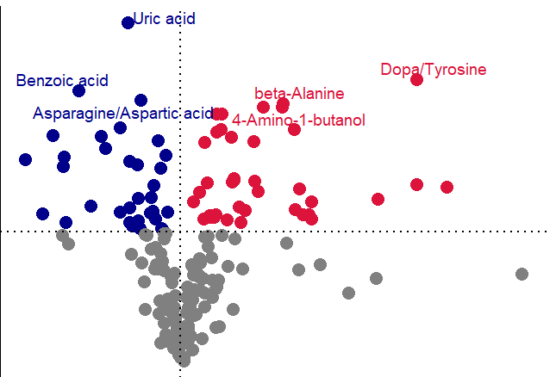
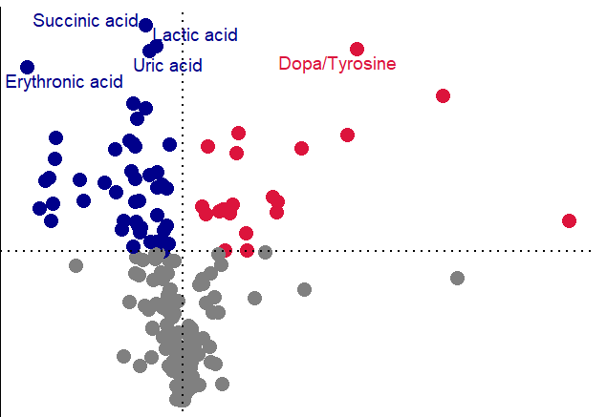
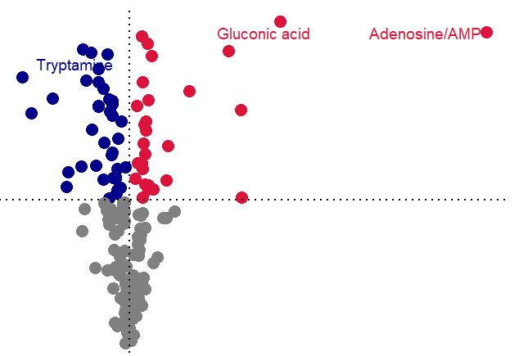
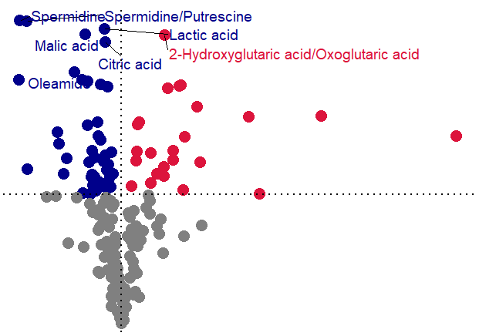
A
GJ_ST
FZ_ST
2.0
RG_ST
2.0
2.0
1.5
1.5
VIP
VIP
1.0
VIP
1.0
1.0
0.5
UP
0.5
Down
0.0
0.0
1
2
4
Nonsignificant
0.0
0.5
1.0
1.5
2.0
2.5
Fold Change
6
1
2
3
Fold Change
2.5
Fold Change
HL_ST
2.0
DH_ST
2.0
HQ_ST
2.0
1.5
1.5
1.5
VIP
VIP
VIP
1.0
1.0
1.0
0.5
0.5
0.5
0.0
1
2
0.0
1
2
3
4
0.0
1
2
3
Fold Change
Fold Change
Fold Change
B
C

