Slide 1

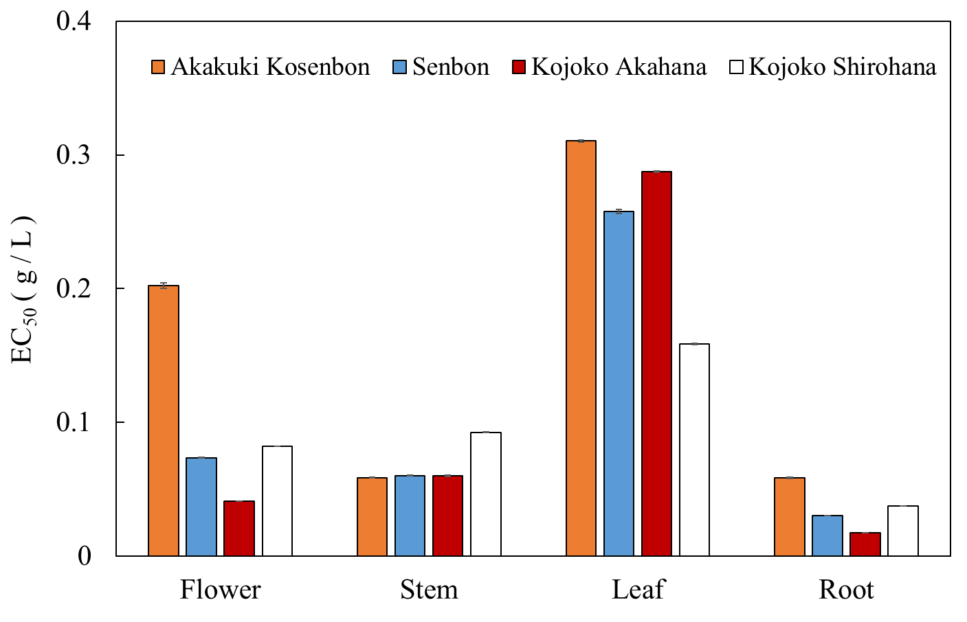
Senbon Kojoko Akahana
Microwave treatment
Tadeai (Japanese indigo plants)
Kojoko Shirohana Akakuki Koseibon

