Slide 1
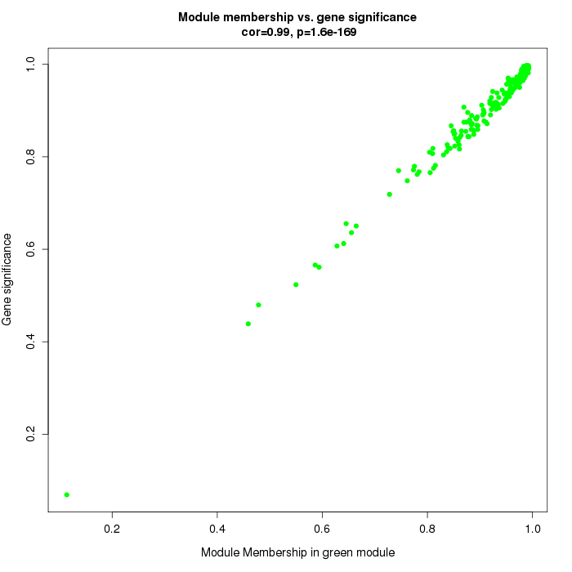
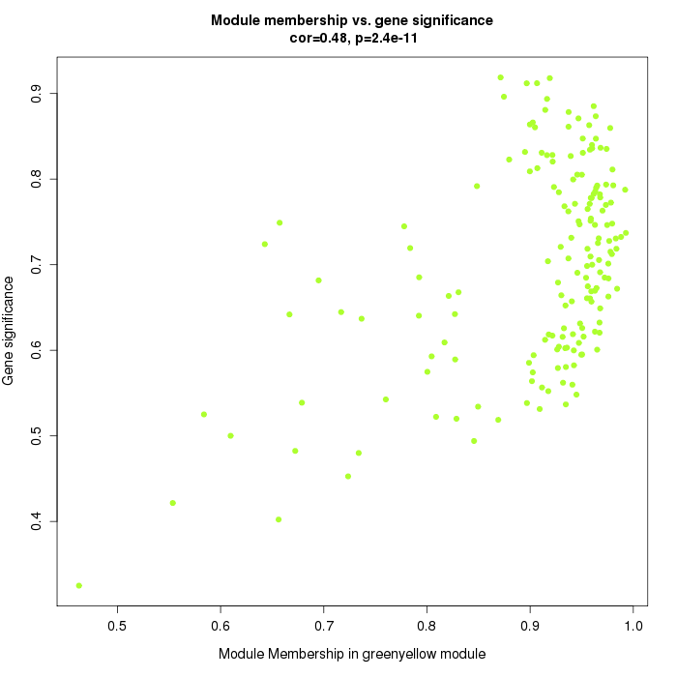
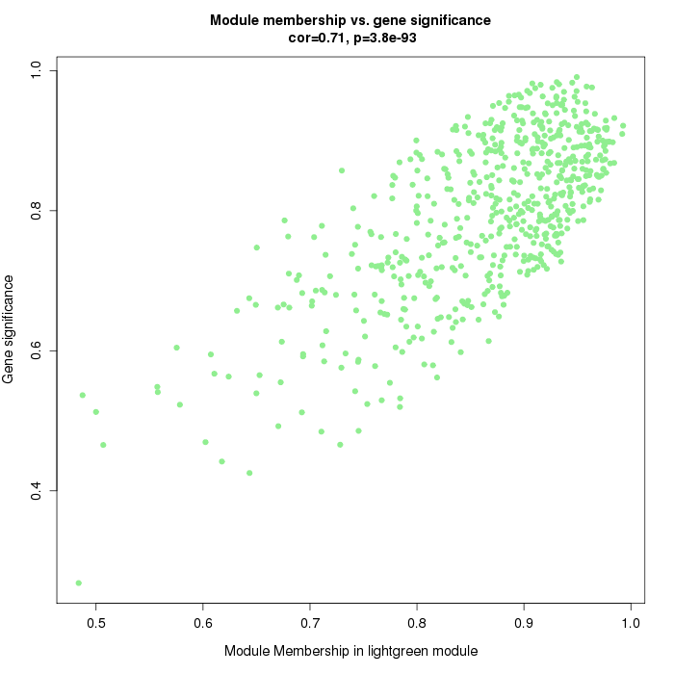
A
B
ME green
ME greenyellow
C
ME lightgreen
Additional file 10: Figure S2. Scatterplots of gene significance (GS) vs. module membership (MM). The plots show the correlation between GS and MM in the three modules that best correlate with the different tissues analyzed illustrating that gene highly significantly associated with a trait are often also the most important (central) elements of modules associated with the trait. (A) MEgreen; (B) MEgreenyellow; (C) MElightgreen

