Slide 1
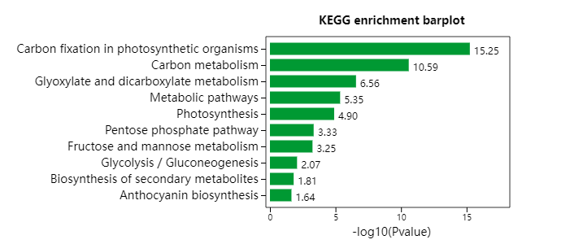
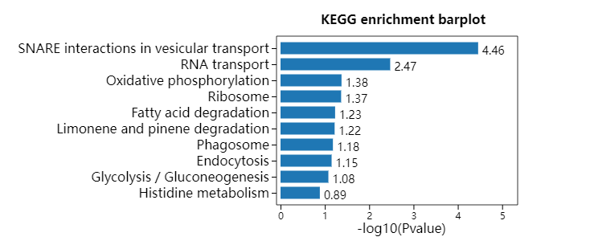
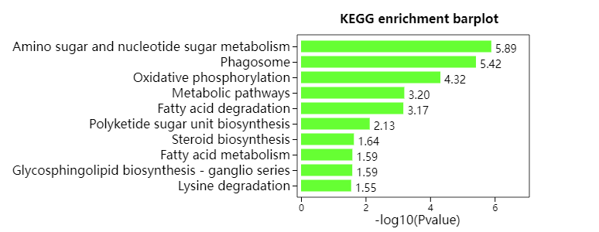
A
MEgreen
B
MEgreenyellow
C
MElighgreen
Additional file 13: Figure S3. KEGG enrichment analysis of four representative modules of WGCNA. KEGG results of gene co-expression network candidate genes in (A) MEgreen module. (B) MEgreenyellow module; (C) MElightgreen module;

