Slide 1
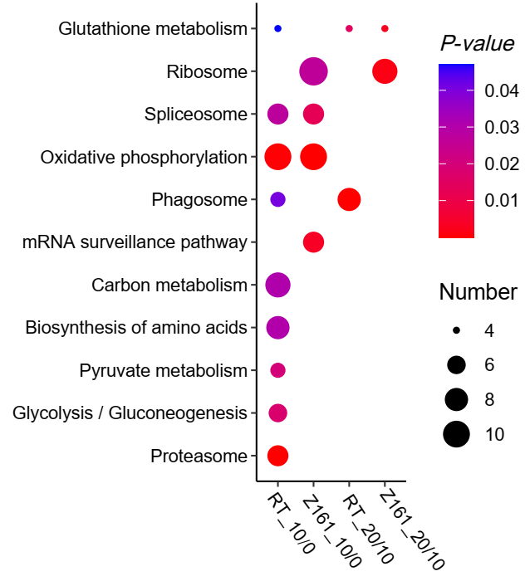
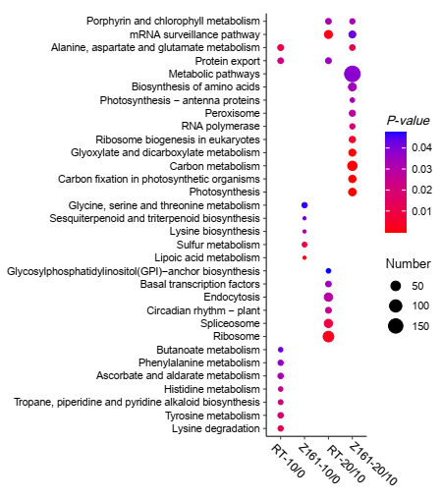
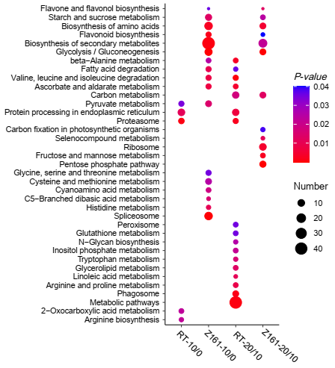
A
B
C
Additional file 5: Figure S1. Enrichment analysis of KEGG metabolic pathway of other three protein and gene expression patterns. (A) the opposite expression trend of protein and gene. (B) the only differentially expressed gene sets. (C) the only protein differentially expressed gene set.

