Slide 1
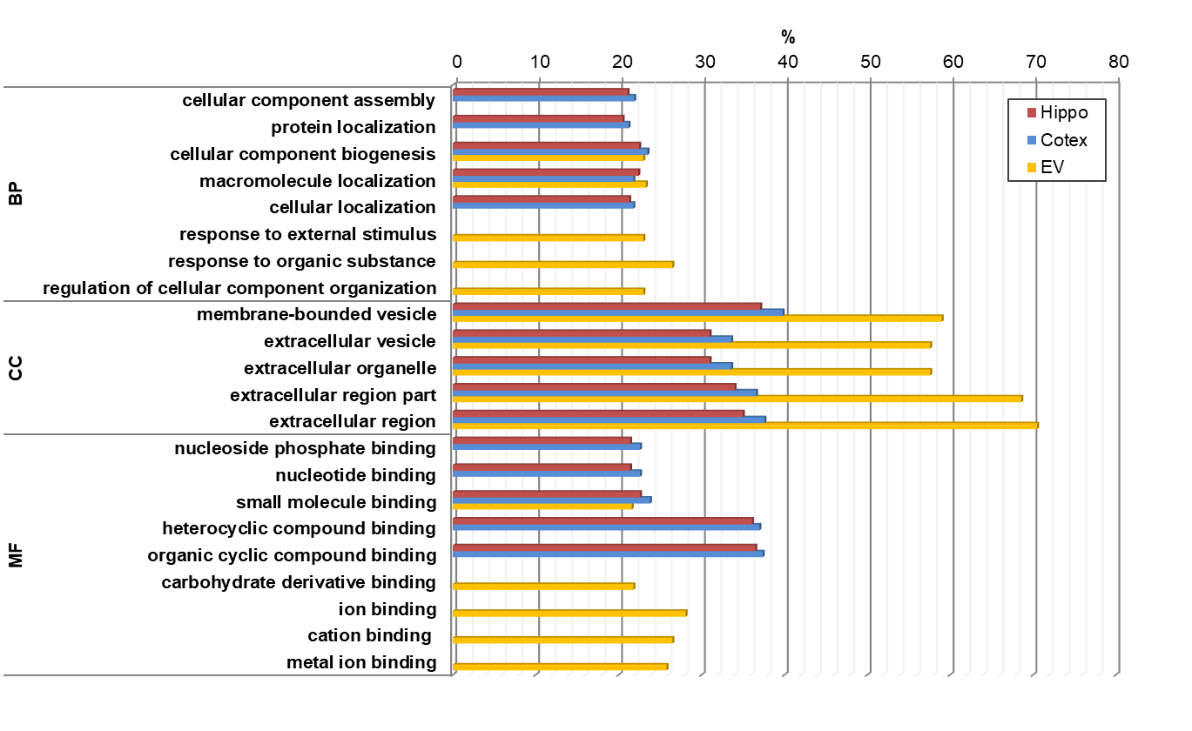
Figure S1. Functional annotation of the proteomic comparison between 3-month and 6-month of 5xFAD mice

Slide 2
Figure S2. Western blots for the extracellular vesicle markers using blood EVs of stage-divided human AD patients
Relative densitometric level
(Fold of Normal)
Relative densitometric level
(Fold of Normal)
Relative densitometric level
(Fold of Normal)

Slide 3
Figure S3. Western blots for the selected biomarker candidates using blood EVs of stage-divided human AD patients
Relative densitometric level
(Fold of Normal)
Relative densitometric level
(Fold of Normal)
Relative densitometric level
(Fold of Normal)
Relative densitometric level
(Fold of Normal)
Relative densitometric level
(Fold of Normal)
Relative densitometric level
(Fold of Normal)
Relative densitometric level
(Fold of Normal)
Relative densitometric level
(Fold of Normal)
Relative densitometric level
(Fold of Normal)

