Slide 1
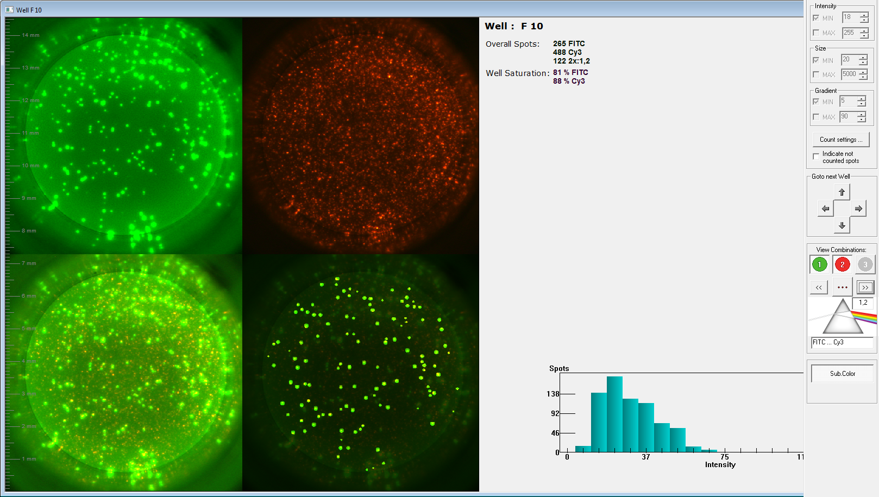
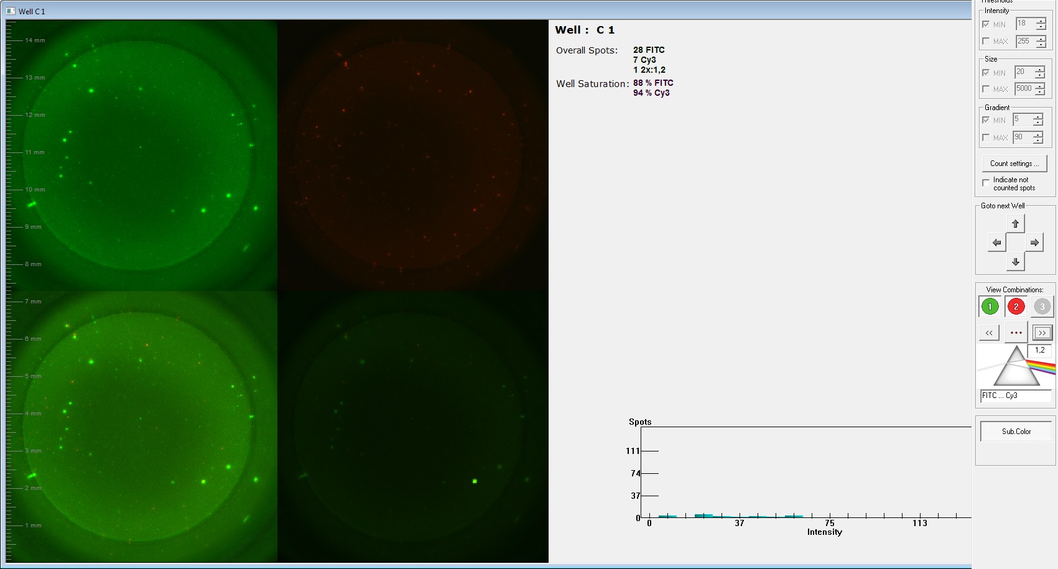
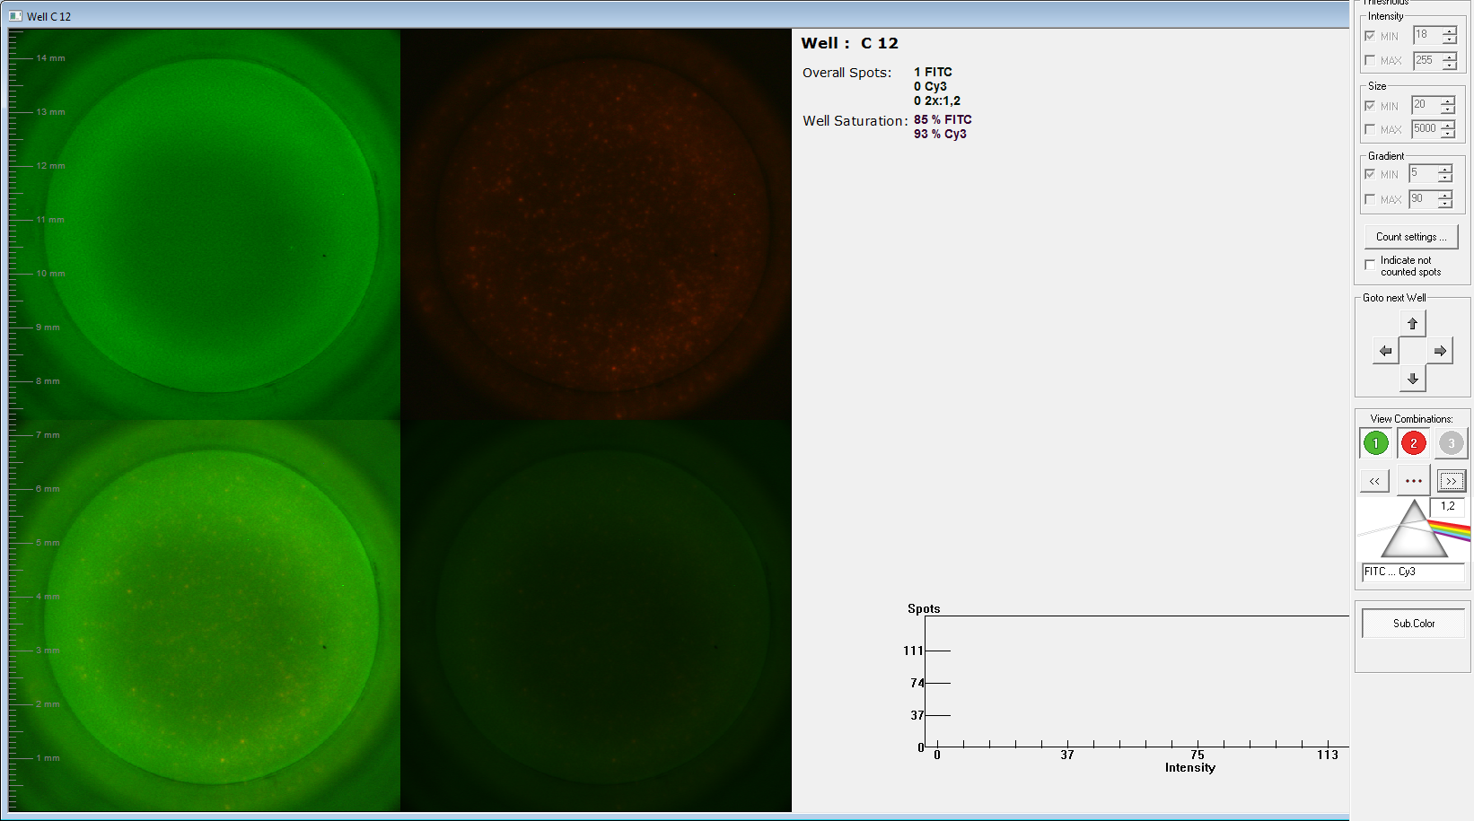
Supplementary figure 1. Typical results of IFN- γ /TNF-α dual release fluorospot assay
 | IFN-γ single release assay | TNF-α single release assay | Dual release assay | IFN-γ/TNF-α dual spot
Active TB
Not active TB with LTBI
Not active TB without LTBI

