Slide 1
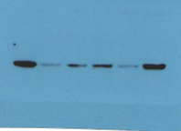

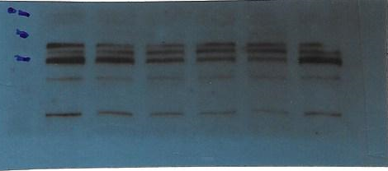
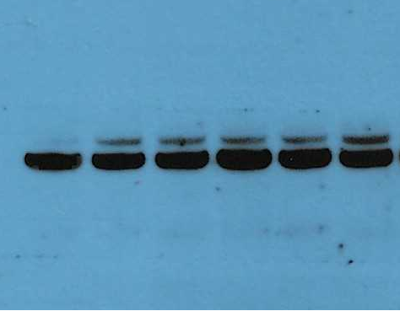
Unedited images for Figure 1 (Response to Reviewers)
eIF5A hypusine (18 kDa) for Fig 1B
35 kDa
25 kDa
20 kDa
15 kDa
10 kDa
25 kDa
Total eIF5A (18 kDa) for Fig 1B
20 kDa
15 kDa
10 kDa
β-actin (42 kDa) for Fig 1B
SIK2 (130 kDa) for Fig 1B
180 kDa
75 kDa
140 kDa
130 kDa
60 kDa
100 kDa
75 kDa
45 kDa
42 kDa
60 kDa
35 kDa
25 kDa
20 kDa

Slide 2
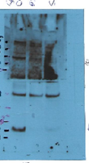
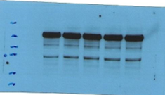

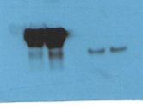
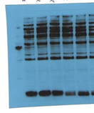
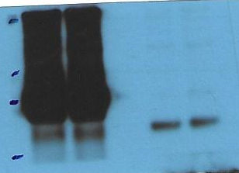
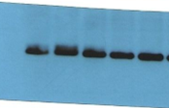
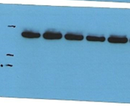
Unedited images for Figure 2 (Response to Reviewers)
SIK2 (130 kDa) / p4E-BP1 (Ser 65) (21 kDa) for Fig 2B
Flag-SIK2 (130 kDa) for Fig 2C
180 kDa
SIK2 (130 kDa) for Fig 2A
180 kDa
140 kDa
140 kDa
130 kDa
180 kDa
130 kDa
140 kDa
100 kDa
100 kDa
130 kDa
75 kDa
100 kDa
60 kDa
p4E-BP1 (Ser 65) (21 kDa) for Fig 2A
75 kDa
45 kDa
60 kDa
45 kDa
45 kDa
35 kDa
35 kDa
180 kDa
p4E-BP1 (Ser 65) (21 kDa) for Fig 2C
25 kDa
140 kDa
25 kDa
20 kDa
130 kDa
20 kDa
15 kDa
100 kDa
15 kDa
10 kDa
75 kDa
10 kDa
60 kDa
45 kDa
Total 4E-BP1 (21 kDa) for Fig 2A (1st)
35 kDa
25 kDa
45 kDa
20 kDa
35 kDa
45 kDa
Total 4E-BP1 (21 kDa) for Fig 2C
25 kDa
35 kDa
20 kDa
β-actin(42 kDa) for Fig 2B
25 kDa
15 kDa
15 kDa
180 kDa
10 kDa
140 kDa
130 kDa
β-actin (42 kDa) for Fig 2C
100 kDa
75 kDa
45 kDa
60 kDa
35 kDa
45 kDa
25 kDa
35 kDa
15 kDa
25 kDa
10 kDa
20 kDa

Slide 3
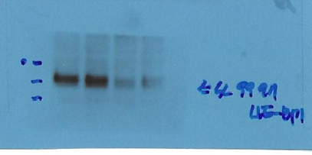
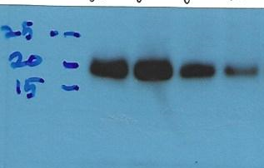
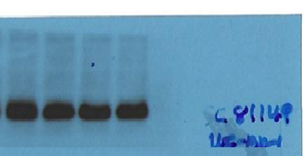
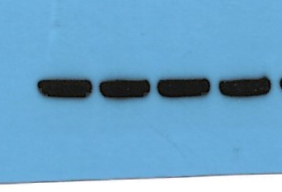
Unedited images for Figure 2 (Response to Reviewers)
p4E-BP1 (Ser 65) (21 kDa) for Fig 2D
p4E-BP1 (Ser 65) (21 kDa) for Fig 2D
45 kDa
35 kDa
25 kDa
15 kDa
10 kDa
Total 4E-BP1 (21 kDa) for Fig 2D
45 kDa
35 kDa
25 kDa
15 kDa
10 kDa
β-actin (42 kDa) for Fig 2D
60 kDa
45 kDa
35 kDa
25 kDa
20 kDa

