Slide 1
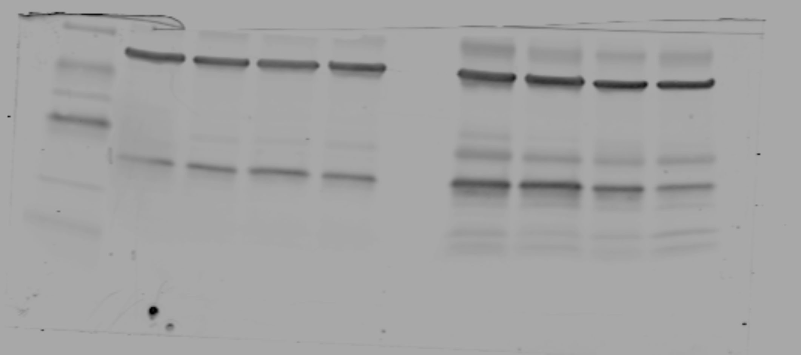
Figure 2 E: Unedited Western Blot for reviewers only
50
38
30
βactin
25
15
H-ferritin
8
8-week-old
20-week-old
After transfer to Nitrocellulose membrane, the blot was below 50 kDa and probed with
H-ferritin: Molecular Weight: 21 kDa, Rabbit Monoclonal (EPR18878), ab183781, Abcam, https://www.abcam.com/ferritin-heavy-chain-antibody-epr18878-ab183781.html
Βactin: Molecular Weight: 42 kDa, Mouse Monoclonal, (mAbcam 8226): ab8226
Ladder : Licor Chameleon Duo, 92860000 https://www.licor.com/bio/reagents/chameleon-duo-pre-stained-protein-ladder

Slide 2
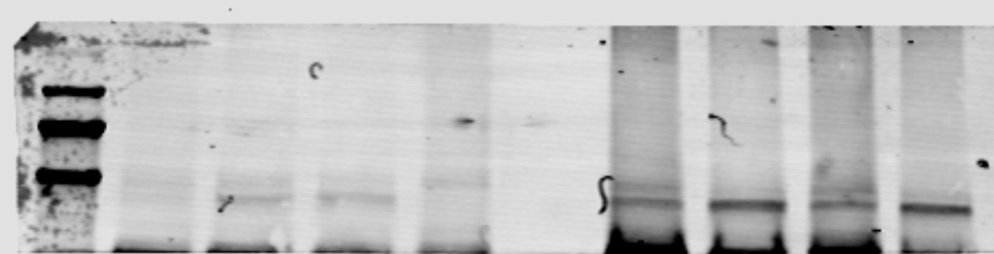
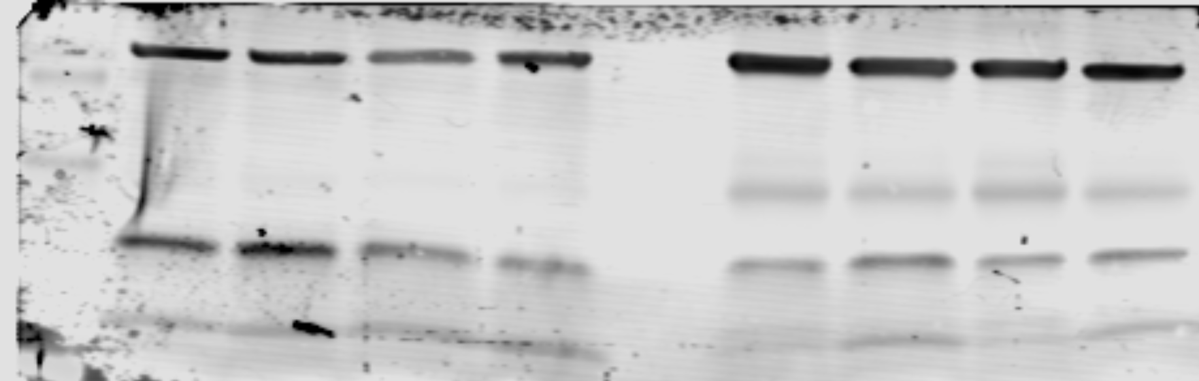
Figure 4 C-D : Unedited Western Blot for reviewers only
260
160
125
90
ACSL4
70
38
βactin
30
25
15
GPX4
8
8-week-old
20-week-old
After transfer to Nitrocellulose membrane, the blot was cut at 50 kDa and probed with
ACSL4: Molecular Weight: Predicted 75 kDa, Observed at close to 90 kDa (as indicated by Santa Cruz) Mouse Monoclonal, (A-5): sc-271800, Santa Cruz Biotechnology. https://datasheets.scbt.com/sc-271800.pdf
GPX4: Molecular Weight: 17 kDa, Rabbit Monoclonal, (EPNCIR144): ab125066, Abcam. https://www.abcam.com/glutathione-peroxidase-4-antibody-epncir144-ab125066.html
Βactin: Molecular Weight: 42 kDa, Mouse Monoclonal, (mAbcam 8226): ab8226
Ladder : Licor Chameleon Duo, 92860000. https://www.licor.com/bio/reagents/chameleon-duo-pre-stained-protein-ladder

Slide 3
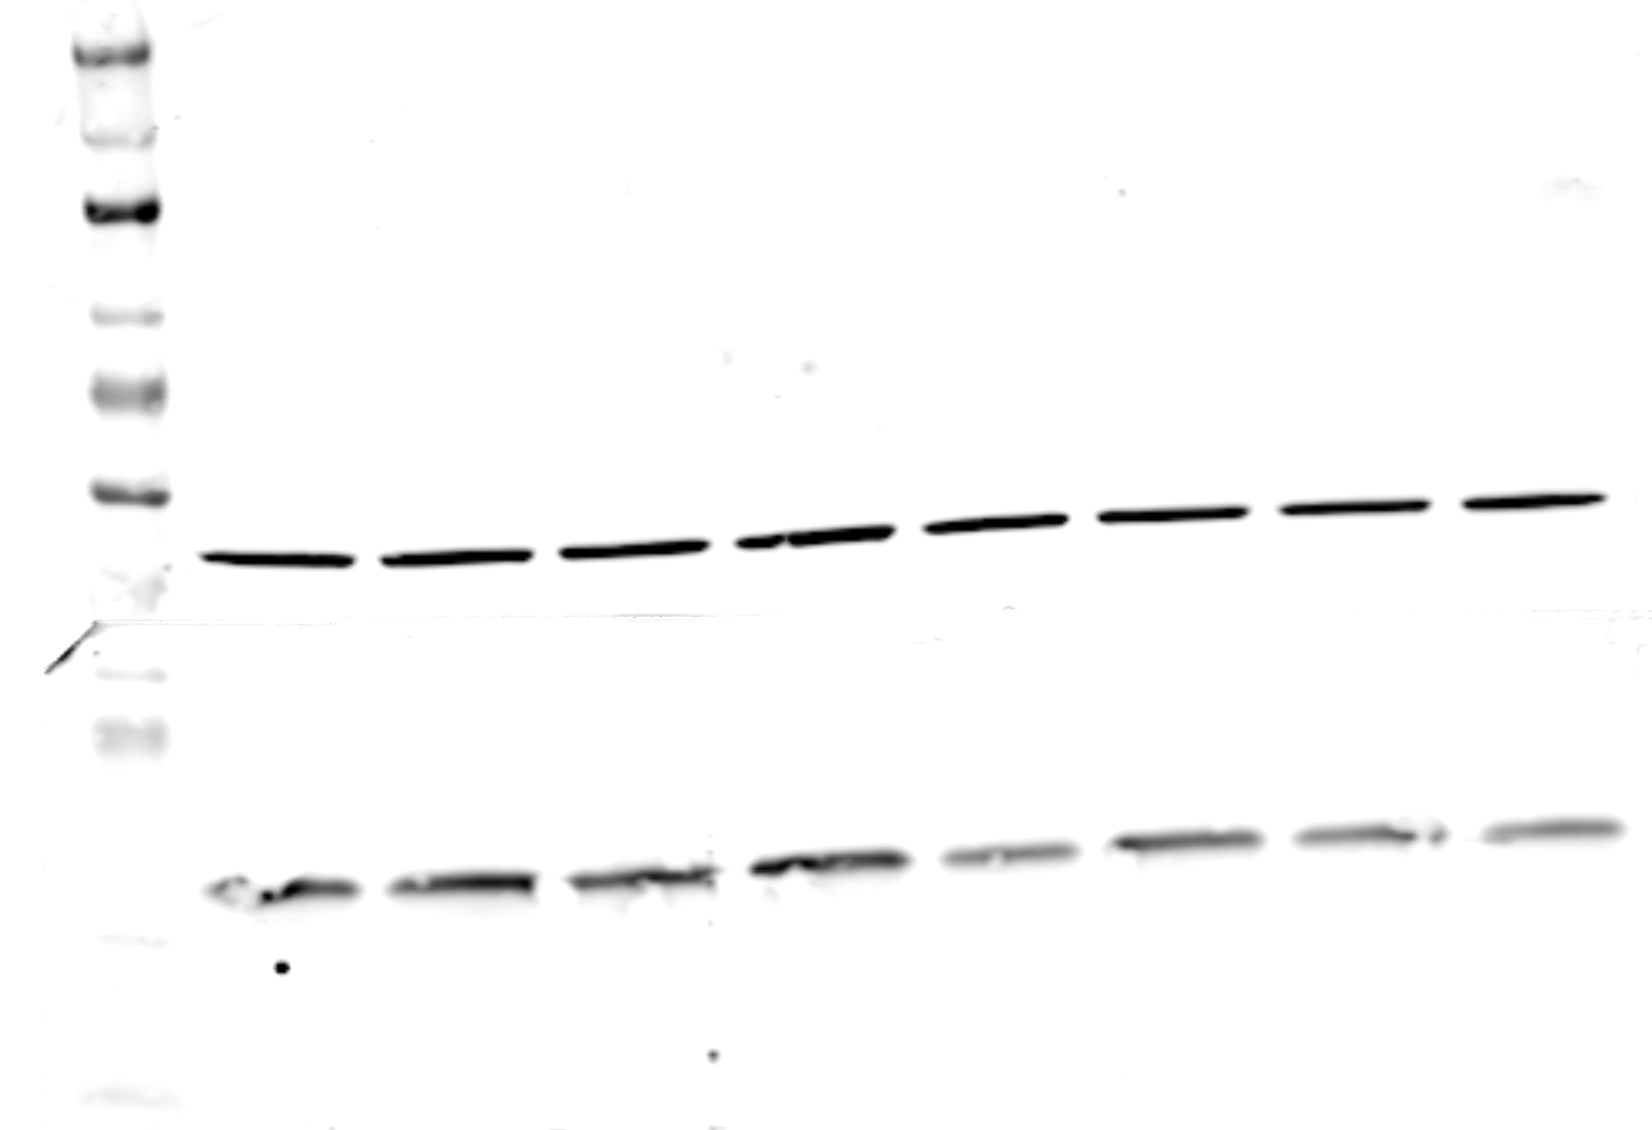
Supplemental Figure 4c : Unedited Western Blot for reviewers only
260
160
125
90
70
50
βactin
38
30
25
GPX4
15
8
4-week-old male
16-week-old male
After transfer to Nitrocellulose membrane, the blot was probed with
GPX4: Molecular Weight: 17 kDa, Rabbit Monoclonal, (EPNCIR144): ab125066, Abcam, https://www.abcam.com/glutathione-peroxidase-4-antibody-epncir144-ab125066.html
Βactin: Molecular Weight: 42 kDa, Mouse Monoclonal, (mAbcam 8226): ab8226
Ladder : Licor Chameleon Duo, 928-60000, https://www.licor.com/bio/reagents/chameleon-duo-pre-stained-protein-ladder

Slide 4
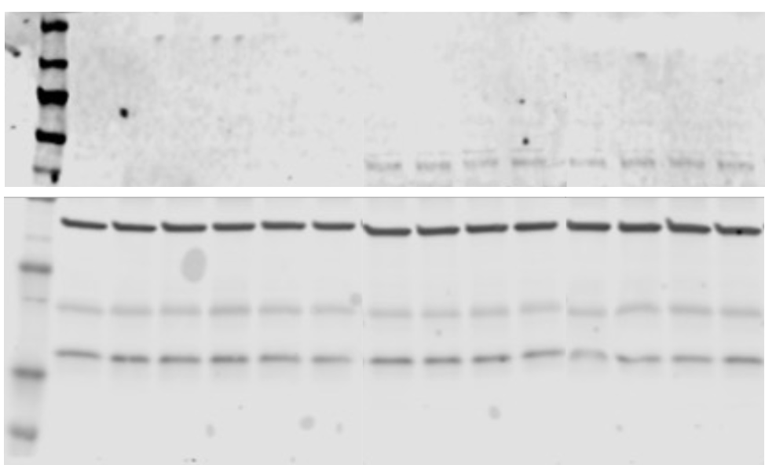
Figure 5G : Unedited Western Blot for reviewers only
260
160
125
90
70
ACSL4
50
38
βactin
30
25
15
GPX4
8
After transfer to Nitrocellulose membrane, the blot was cut at 50 kDa and probed with
ACSL4: Molecular Weight: Predicted 75 kDa, Observed at close to 90 kDa (as indicated by Santa Cruz) Mouse Monoclonal, (A-5): sc-271800, Santa Cruz Biotechnology. https://datasheets.scbt.com/sc-271800.pdf
GPX4: Molecular Weight: 17 kDa, Rabbit Monoclonal, (EPNCIR144): ab125066, Abcam. https://www.abcam.com/glutathione-peroxidase-4-antibody-epncir144-ab125066.html
Βactin: Molecular Weight: 42 kDa, Mouse Monoclonal, (mAbcam 8226): ab8226
Ladder : Licor Chameleon Duo, 92860000. https://www.licor.com/bio/reagents/chameleon-duo-pre-stained-protein-ladder

Slide 5
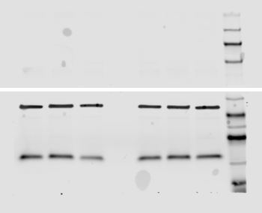
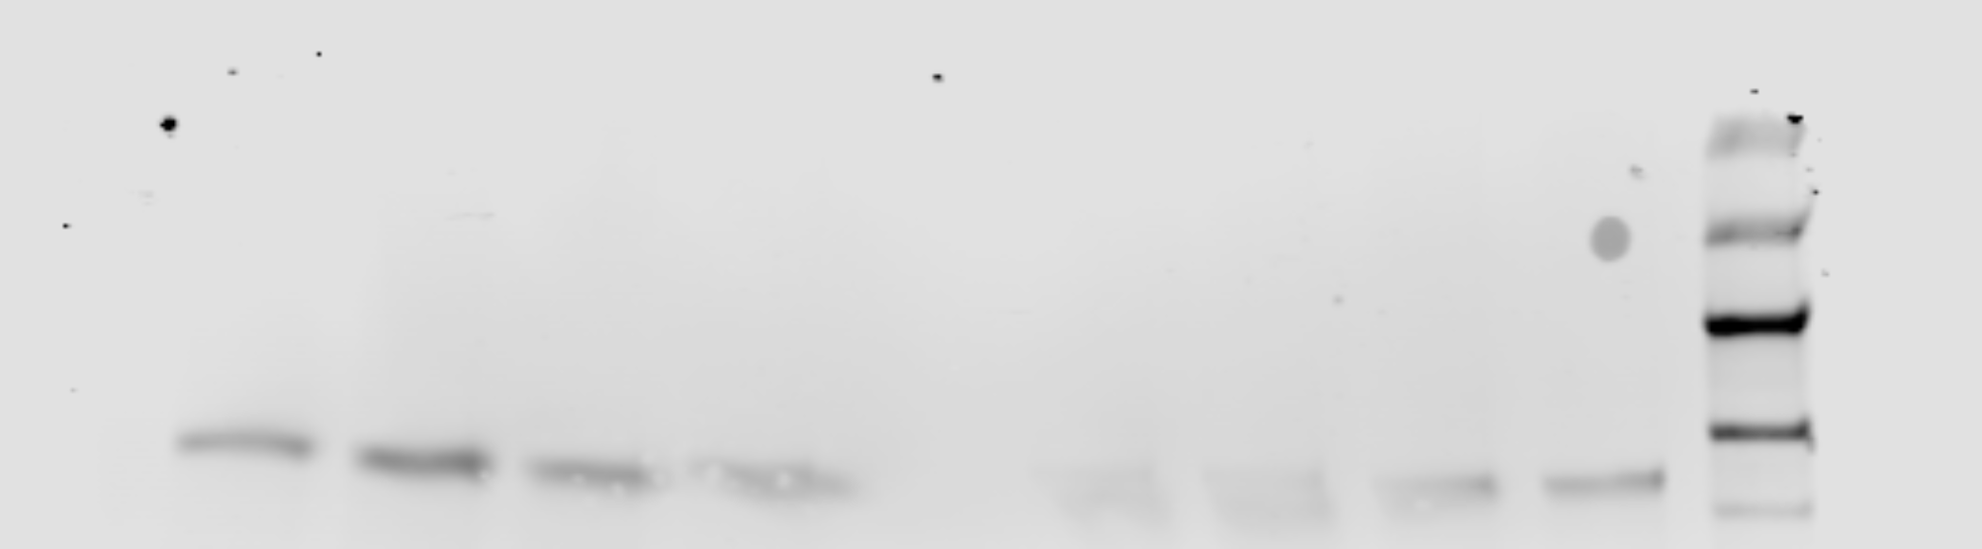
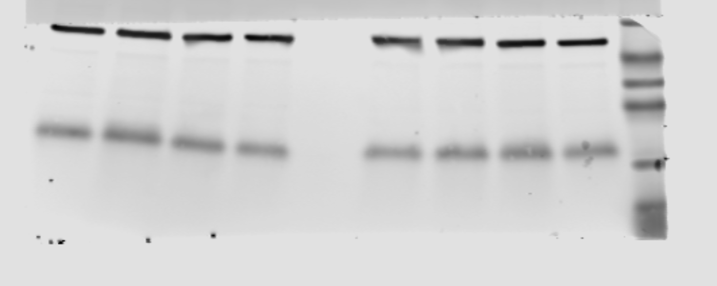
Figure 6D & 6E : Unedited Western Blot for reviewers only
Fe only
Albumin treated HK2 cells
260
160
260
125
160
90
125
70
ACSL4
90
ACSL4
50
70
βactin
50
βactin
38
38
30
30
25
25
GPX4
GPX4
15
15
8
8
Scramble
+ Fe
FtH1 KD
+ Fe
Scramble
+ Albumin
FtH1 KD
+ Albumin
After transfer to Nitrocellulose membrane, the blot was cut at 50 kDa and probed with
ACSL4: Molecular Weight: Predicted 75 kDa, Observed at close to 90 kDa (as indicated by Santa Cruz) Mouse Monoclonal, (A-5): sc-271800, Santa Cruz Biotechnology. https://datasheets.scbt.com/sc-271800.pdf
GPX4: Molecular Weight: 17 kDa, Rabbit Monoclonal, (EPNCIR144): ab125066, Abcam. https://www.abcam.com/glutathione-peroxidase-4-antibody-epncir144-ab125066.html
Βactin: Molecular Weight: 42 kDa, Mouse Monoclonal, (mAbcam 8226): ab8226
Ladder : Licor Chameleon Duo, 92860000. https://www.licor.com/bio/reagents/chameleon-duo-pre-stained-protein-ladder

Slide 6
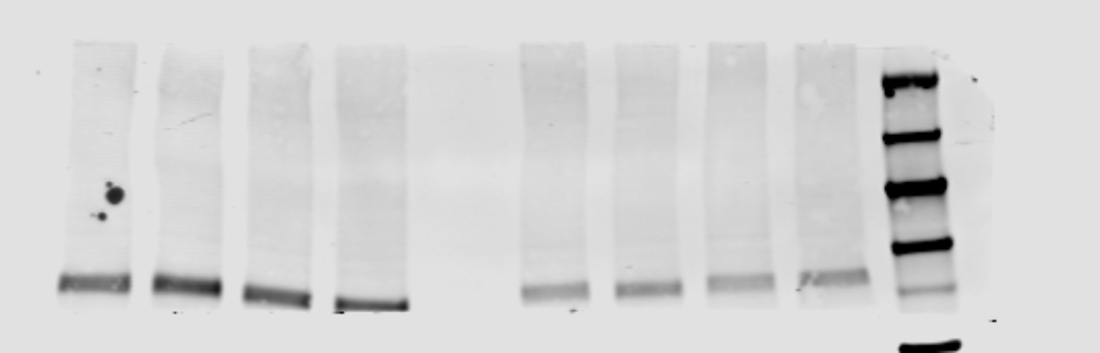
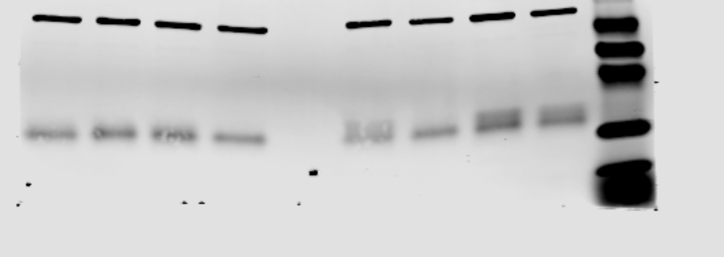
Figure 6G : Unedited Western Blot for reviewers only
Fe + Albumin
260
160
125
90
70
ACSL4
50
38
βactin
30
25
15
GPX4
8
Scramble
Fe + Albumin
FtH1 KD
Fe + Albumin
After transfer to Nitrocellulose membrane, the blot was cut at 50 kDa and probed with
ACSL4: Molecular Weight: Predicted 75 kDa, Observed at close to 90 kDa (as indicated by Santa Cruz) Mouse Monoclonal, (A-5): sc-271800, Santa Cruz Biotechnology. https://datasheets.scbt.com/sc-271800.pdf
GPX4: Molecular Weight: 17 kDa, Rabbit Monoclonal, (EPNCIR144): ab125066, Abcam. https://www.abcam.com/glutathione-peroxidase-4-antibody-epncir144-ab125066.html
Βactin: Molecular Weight: 42 kDa, Mouse Monoclonal, (mAbcam 8226): ab8226
Ladder : Licor Chameleon Duo, 92860000. https://www.licor.com/bio/reagents/chameleon-duo-pre-stained-protein-ladder

