Slide 1
Supplementary Figures

Slide 2
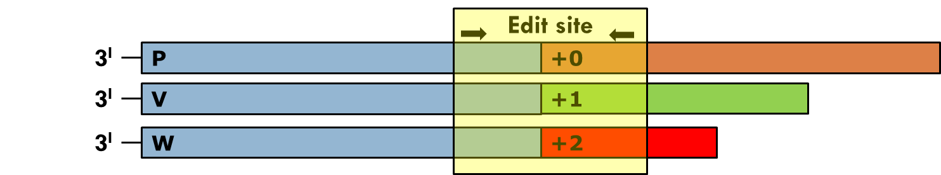
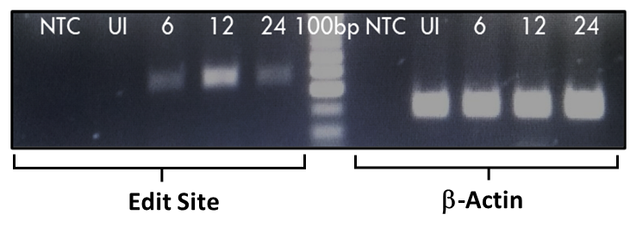
(a)
(b)
Supplementary Figure No. 1: Differential expression of P gene products in NDV strain Komarov infected cells.
Cartoon depicting the P, V and W products of P gene and the regions adjacent to the edit site used for amplicon sequencing
The c-DNA, prepared using oligo(dT) primers from the total RNA derived from NDV strain Komarov infected DF-1 cells, were amplified using primers on either side of the P gene “editing site”. The amplicons thus generated were run on agarose gel, subjected to gel extraction and analysed by sequencing.

Slide 3
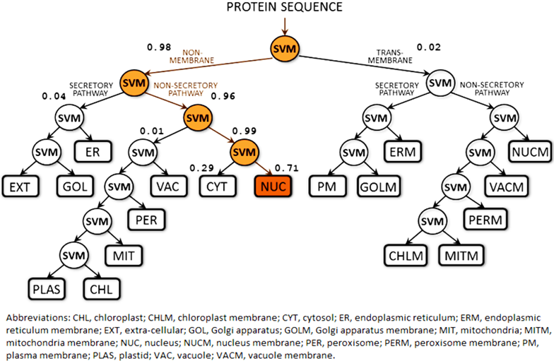
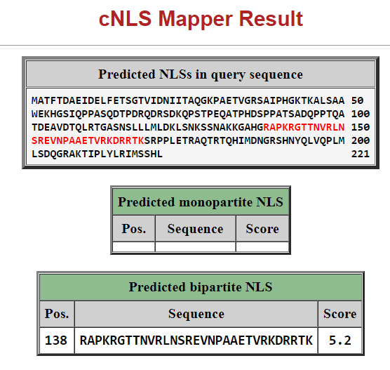
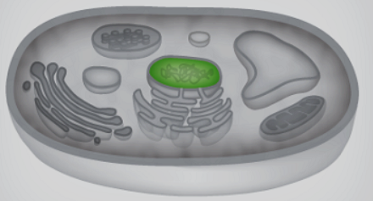
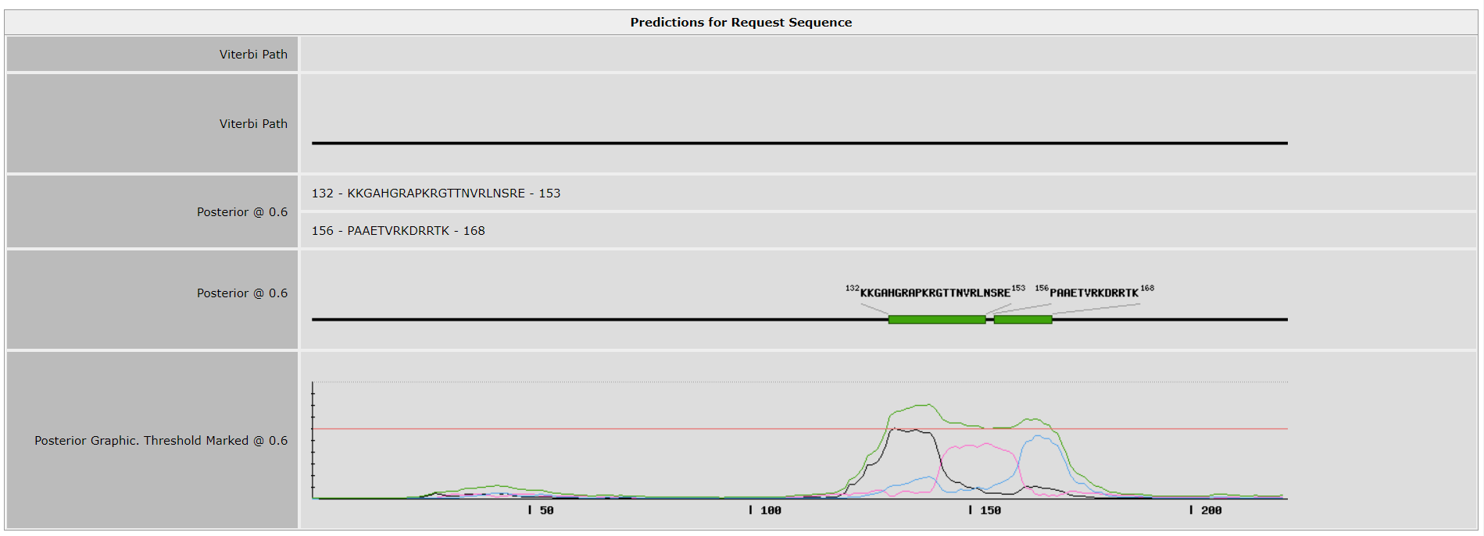
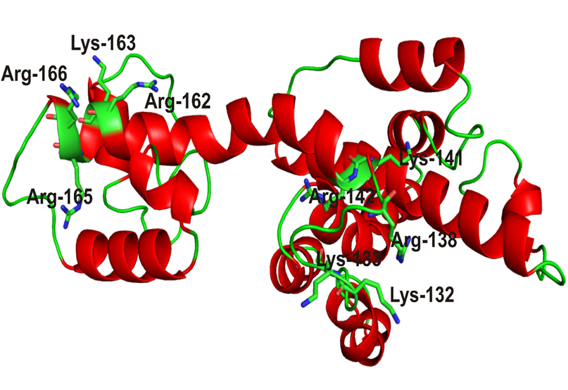
(a)
Score | Expected Accuracy | Localization class | Gene Ontology Terms
60 | 93% | Nucleus | Nucleus GO:0005634;
Supplementary Figure 2. In silico analysis of subcellular localization of W protein of NDV strain Komarov.
(b)
(c)
(d)

Slide 4
Supplementary Figure No. 2: In silico analysis of subcellular localization of W protein of NDV strain Komarov. (a) Prediction of localization of W protein of NDV strain Komarov in eukaryotic cells by LocTree3 and visualization of the decisions leading to the prediction. (b) cNLS Mapper prediction of the NLS of W protein of NDV strain Komarov (in red). (c) NLStradamus prediction of the bipartite NLS of W protein of NDV strain Komarov (in green squares). (d) Homology model of W protein of NDV strain Komarov produced by computer program MODELLER showing the basic amino acids (lysine and arginine) in the predicted NLS region are represented as sticks in the outer portion of W protein of NDV strain Komarov.

Slide 5
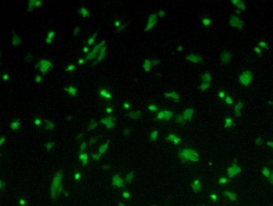
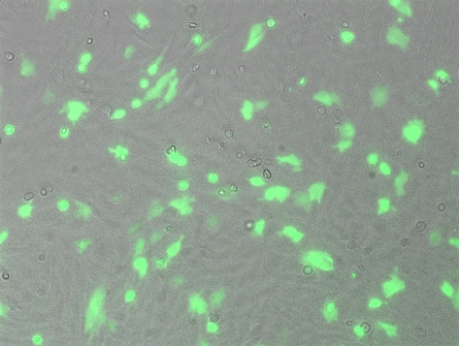
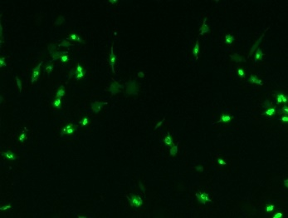
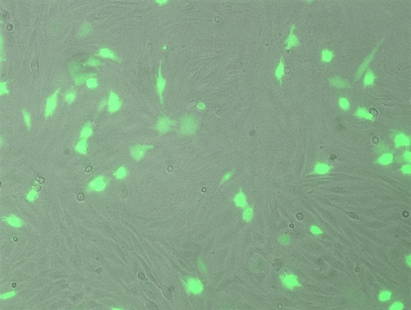
(a)
(b)
Supplementary Figure No. 3: Transfection efficiency of (a)Wild type W (W-EYFP) and (b) cytoplasmic mutant W (Wµ-EYFP) in DF1 cells prior to infection

