Slide 1
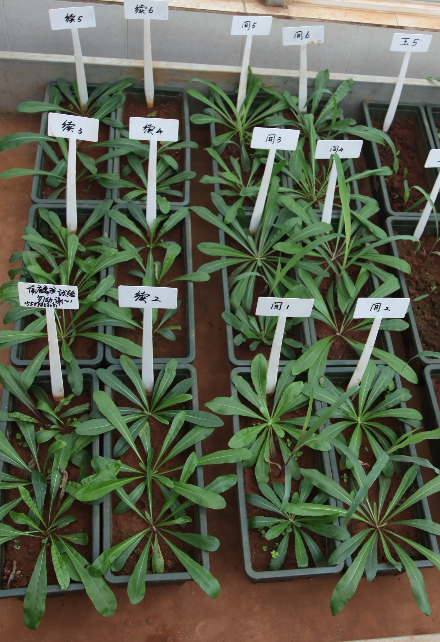
A
B
10cm
MS
IS
Supplementary figure S1

Slide 2
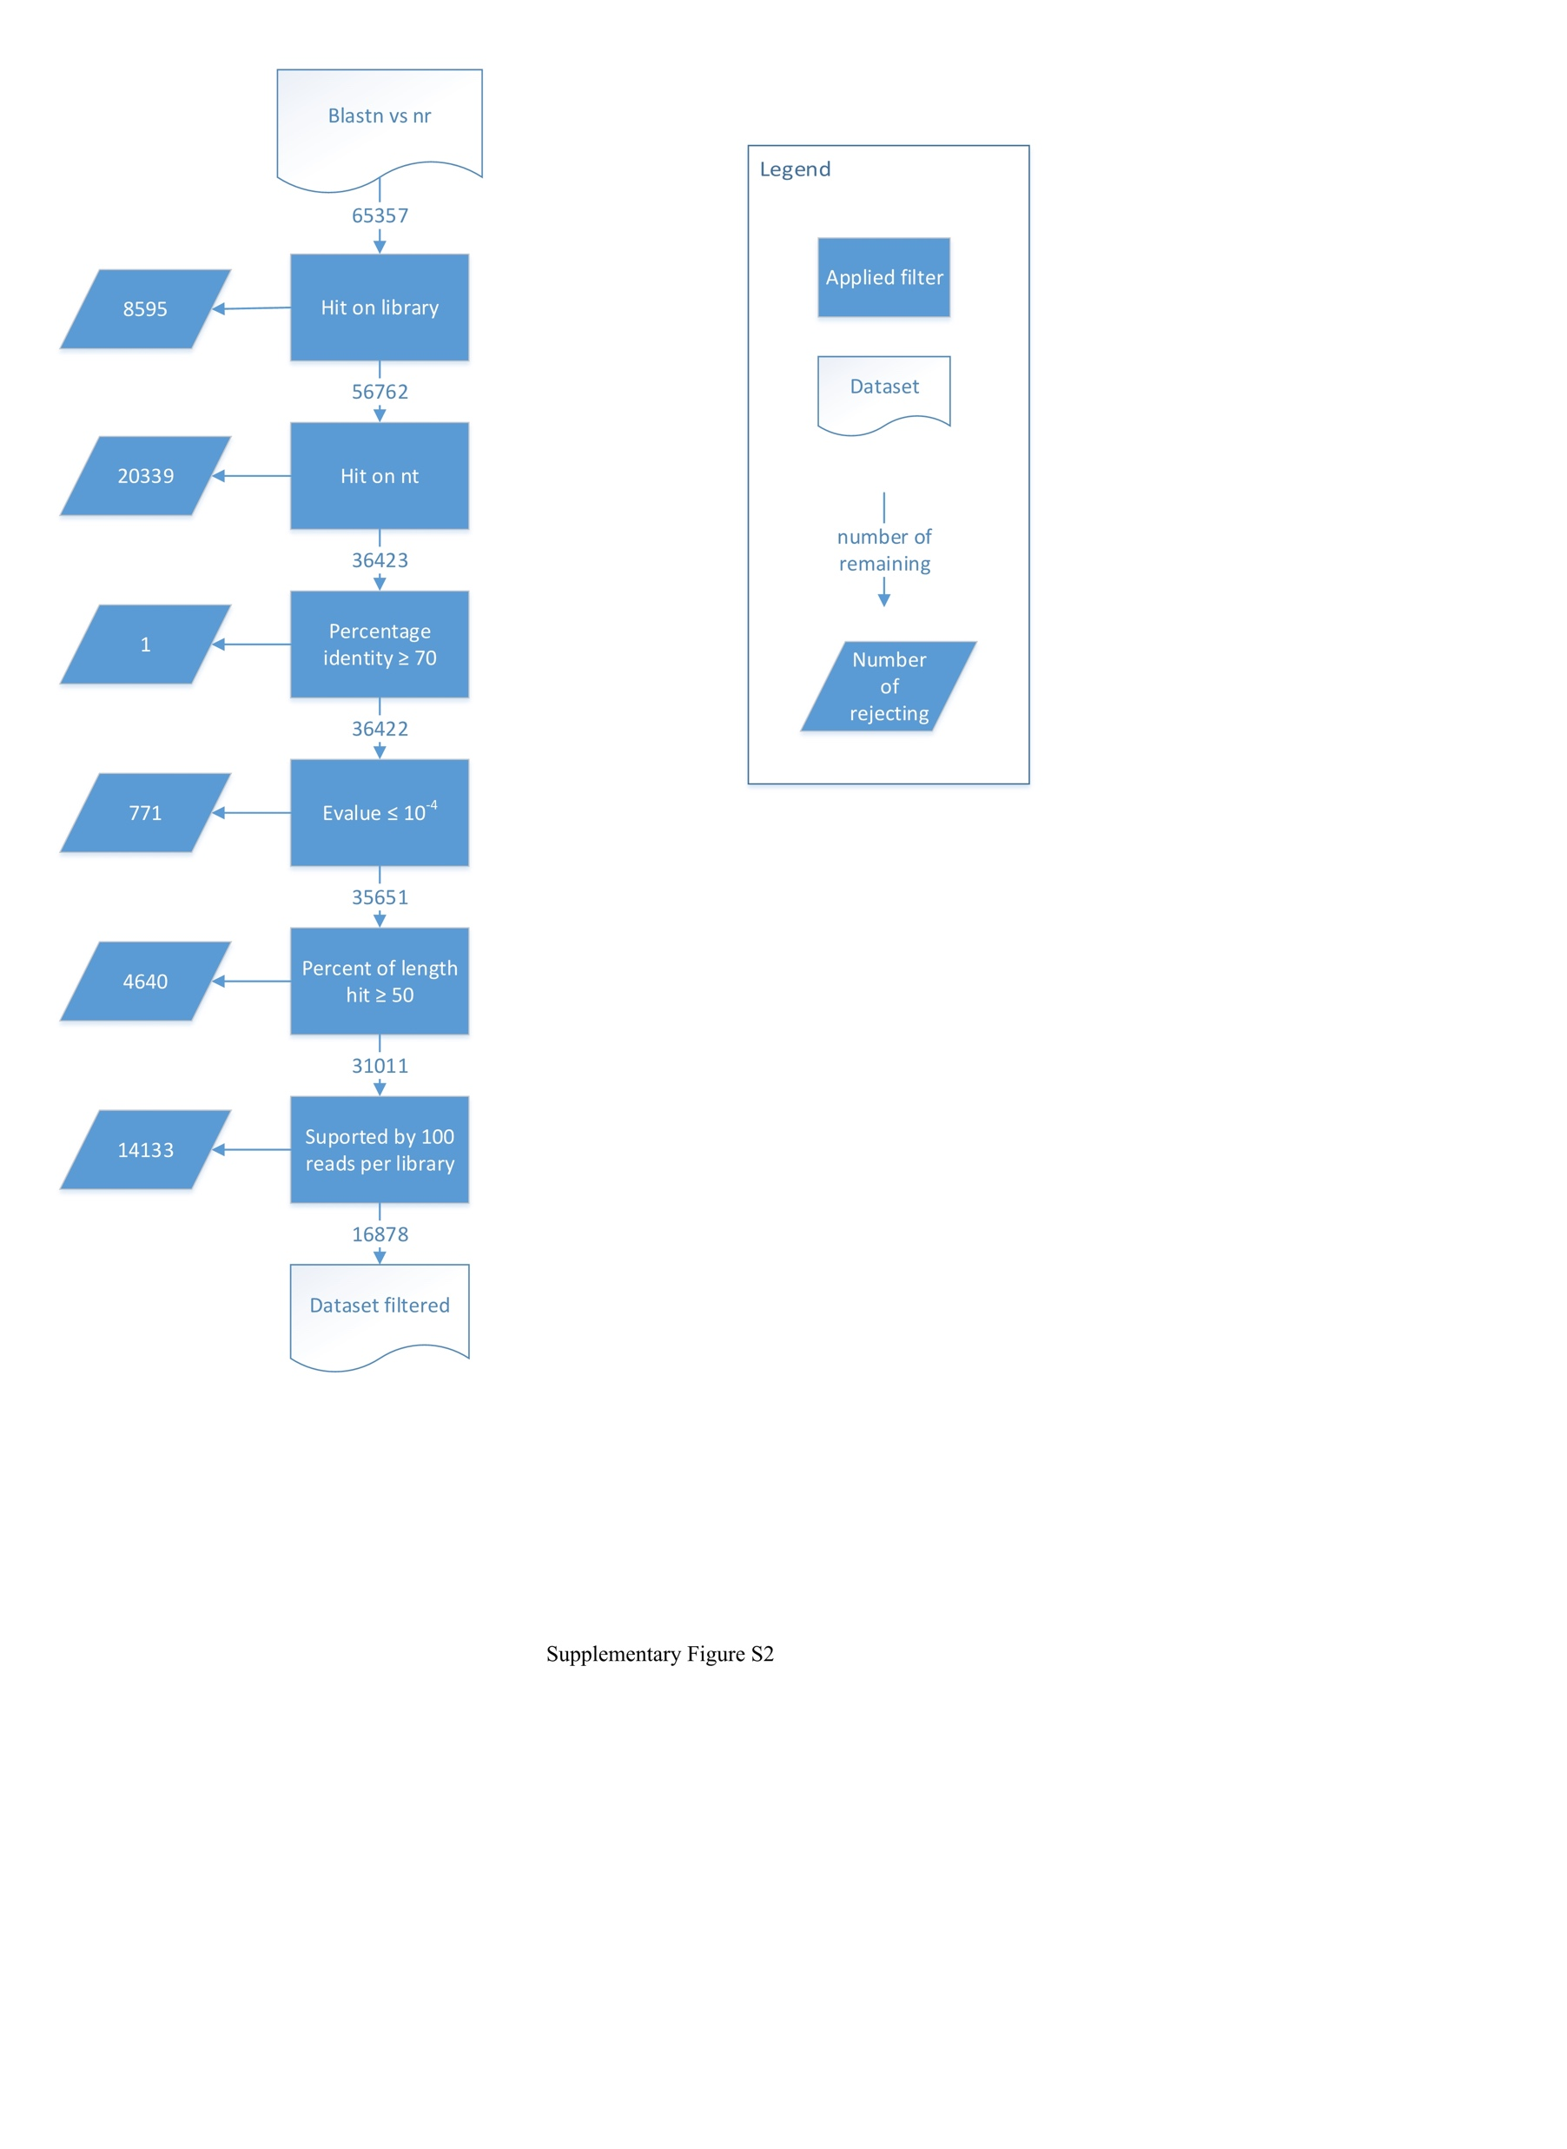

Slide 3
Supplementary Figure S3

Slide 4
Supplementary Figure S3

